Slide 1
Detecting natural selection from genomic data
(part 1)
Matteo Fumagalli
August 25th 2017

Slide 2
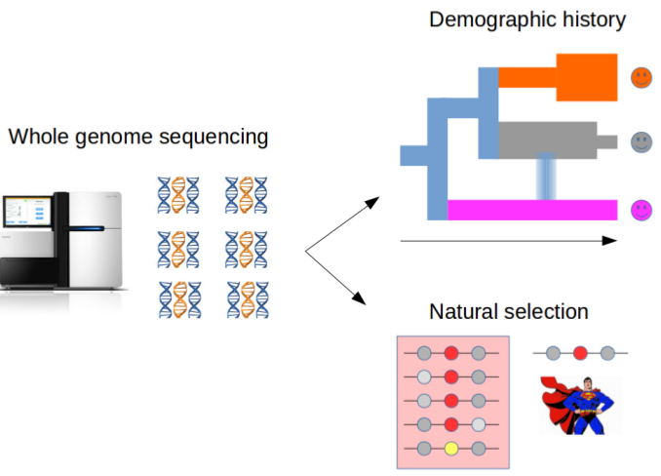
Bioinformatics for Adaptation
Notes:
I am a computational biologist interested in developing methods for the analysis of DNA data for population genetic purposes, both for reconstructing the species demography and for detecting signatures of natural selection.

Slide 3
Outline
Brief introduction to natural selection
Inferring selection at the intra-species level
  Genetic differentiation
  Haplotype variation
  Model-based approaches
  Testing for significance
Inferring selection at the inter-species level
Detecting selection from low-depth sequencing data
Experimental design
Notes:
Broad overview on adaptation to environments

Slide 4
Natural selection
Heritable traits that increase the fitness of the become more common.
Mutations arise randomly and evolve according to their effect on the fitness of the carrier
Neutrality
1
(slow) Fixation
Frequency in the population
Polymorphism
0
t=T
(slow?) Removal
t=present
Time
Notes:
Yes, but lines are built up step by step
So a strategy to understand molecular basis of adaptation is to look for sign of selection

Slide 5

Natural selection
Heritable traits that increase the fitness of the become more common.
Mutations arise randomly and evolve according to their effect on the fitness of the carrier
Negative selection
1
Frequency in the population
0
t=T
(quick) Removal
t=present
Time
Notes:
Yes, but lines are built up step by step
So a strategy to understand molecular basis of adaptation is to look for sign of selection

Slide 6

Natural selection
Heritable traits that increase the fitness of the become more common.
Mutations arise randomly and evolve according to their effect on the fitness of the carrier
Positive selection
t=Selective pressure
1
(quick) Fixation
Frequency in the population
0
t=T
t=present
Time
Notes:
Yes, but lines are built up step by step
So a strategy to understand molecular basis of adaptation is to look for sign of selection

Slide 7

Natural selection
Heritable traits that increase the fitness of the become more common.
Mutations arise randomly and evolve according to their effect on the fitness of the carrier
Balancing selection
t=Selective pressure
1
Frequency in the population
Balanced
polymorphism
0
t=T
t=present
Time
Notes:
Yes, but lines are built up step by step
So a strategy to understand molecular basis of adaptation is to look for sign of selection

Slide 8
Natural selection
Heritable traits that increase the fitness of the become more common.
Mutations arise randomly and evolve according to their effect on the fitness of the carrier
Sites targeted by natural selection are likely to harbour functionality
Natural selection
t=Selective pressure
1
(quick) Fixation
Frequency in the population
Balanced
polymorphism
Polymorphism
0
t=T
(quick) Removal
t=present
Time
Notes:
Yes, but lines are built up step by step
So a strategy to understand molecular basis of adaptation is to look for sign of selection

Slide 9
Outline
Brief introduction to natural selection
Modes of selection
Inferring selection at the intra-species level
  Genetic differentiation
  Haplotype variation
  Model-based approaches
  Testing for significance
Inferring selection at the inter-species level
Detecting selection from low-depth sequencing data
Notes:
Broad overview on adaptation to environments

Slide 10

Methods to infer selection
within-species:
Micro-evolutionary events between populations, local adaptation
Notes:
And here first show (nielse 2005) the molecular effect of natural selection, then say methods

Slide 11
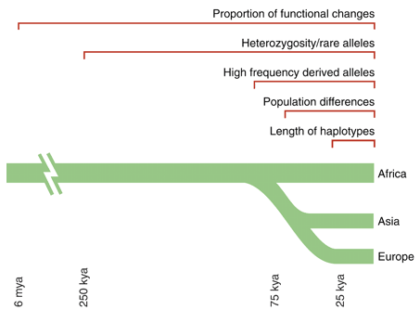
Methods to infer recent selection
Sabeti et al. 2006 Science

Slide 12
Methods to infer recent selection
Sabeti et al. 2006 Science

Slide 13
Allele frequency differentiation
Time
Present time

Slide 14
Allele frequency differentiation
Time
Separation
Environmental change
Present time

Slide 15
Allele frequency differentiation
Time
Separation
Environmental change
Onset of beneficial
mutation
Present time

Slide 16
Allele frequency differentiation
Time
Separation
Environmental change
Onset of beneficial
mutation
Present time

Slide 17
Allele frequency differentiation
Time
Separation
Environmental change
Onset of beneficial
mutation
Present time
Notes:
How can we quantify this?

Slide 18
F_{ST}
Common measure for quantifying population subdivision.
H_{B}: between populations
H_{W}: average within populations
if H_{W}=0 then F_{ST}=1
if H_{B}=0 then F_{ST}=0
F_{ST} = H_{B} / (H_{W} + H_{B})

Slide 19
Haplotype-based F_{ST}
F_{ST} based on haplotype differentiation between populations
F_{ST} = 1 – (H_{W} / H_{B})
A
B
C
Within populations
Between populations
What is the variation within populations?
e.g. A vs B
The differ by 1 site
D
E
F
As defined by Eq. 3 in Hudson, Slatkin and Maddison 1992
Notes:
Here develop our own estimator based on haplo differences

Slide 20
Haplotype-based F_{ST}
F_{ST} = 1 – (H_{W} / H_{B})
A
B
C
Within populations
Between populations
What is the variation within populations?
A | B
A | C
B | C
Mean=?
D
E
F
D | E
D | F
E | F
Mean=?
H_{W} is the average within-populations: ?
Notes:
Here develop our own estimator based on haplo differences

Slide 21
Haplotype-based F_{ST}
F_{ST} = 1 – (H_{W} / H_{B})
A
B
C
Within populations
Between populations
What is the variation within populations?
A | B | 1
A | C | 2
B | C | 1
Mean=4/3
D
E
F
D | E | 0
D | F | 0
E | F | 0
Mean=0/3
H_{W} is the average within-populations: (4/3+0/3)/2=2/3
Notes:
Here develop our own estimator based on haplo differences

Slide 22
Haplotype-based F_{ST}
F_{ST} = 1 – (H_{W} / H_{B})
Within populations
Between populations
A
B
C
What is the variation between populations?
A | D | 0
A | E | 0
A | F | 0
B | D | 1
B | E | 1
B | F | 1
C | D | 2
C | E | 2
C | F | 2
D
E
F
Mean=9/9
H_{B} is the average between-populations: 9/9=1
Notes:
Here develop our own estimator based on haplo differences

Slide 23
Haplotype-based F_{ST}
F_{ST} based on haplotype differentiation between populations
A
B
C
F_{ST} = 1 – (H_{W} / H_{B}) = 1 – ((2/3)/1) = 1/3 ~ 0.33
D
E
F
Notes:
Here develop our own estimator based on haplo differences

Slide 24
Allele frequency differentiation
From standing variation
Difference in
allele frequency
Time

Slide 25
Allele frequency differentiation
With migration
Difference in
allele frequency
Time

Slide 26
Allele frequency differentiation
With recent divergence
Difference in
allele frequency
Time

Slide 27


Population genetic differentiation
T
C
F_{ST}(T-C)

Slide 28
Population genetic differentiation
T
C
T(T-A)
T(C-A)
A
F_{ST}(T-C)~T(T-A-C)

Slide 29
Population genetic differentiation
F_{ST}(T-C)~T(T-A-C)
?
T
C
T(T-A)
T(C-A)
C
T
T(T-A)
T(C-A)
A
A

Slide 30

Population genetic differentiation
T
C
T(T-A)
A
T(C-A)
T(E-A)
E

Slide 31
Population genetic differentiation
T
C
T(T-A)
A
T(C-A)
T(T-A-C)=-log(1-F_{ST}(T-C))
T(E-A)
E
T(T-A)?

Slide 32
Methods to infer selection
Sabeti et al. 2006 Science

Slide 33
Positive selection: effect on haplotypes
t<T_{sel}
Notes:
Under neutrality, each haplotype will accumulate it own mutations

Slide 34
Positive selection: effect on haplotypes
t<T_{sel}
t=T_{sel}
Notes:
Under neutrality, each haplotype will accumulate it own mutations

Slide 35
Positive selection: effect on haplotypes
t<T_{sel}
t=T_{sel}
t>T_{sel}
Notes:
Under neutrality, each haplotype will accumulate it own mutations

Slide 36


Positive selection: effect on haplotypes
t<T_{sel}
t=T_{sel}
t>T_{sel}
t>>T_{sel}
Selective sweep
Genetic hitch-hiking
Adaptation
Notes:
Selective sweep: the beneficial allele is driven to fixation
Partial sweep: when the beneficial allele hasn’t reached fixation yet.

Slide 37
Positive selection
t<T_{sel}
…
t>>T_{sel}
?
Notes:
Reduced number of polymorphisms, but need to derive some indexes of nucleotide diversity taking into account the sample size for instance

Slide 38
Positive selection
t<T_{sel}
…
t>>T_{sel}
- Reduction of polymorphisms levels
(e.g. from 7 to 5 SNPs)
Notes:
Reduced number of polymorphisms, but need to derive some indexes of nucleotide diversity taking into account the sample size for instance

Slide 39
Positive selection
t<T_{sel}
…
t>>T_{sel}
- Reduction of polymorphisms levels
(e.g. from 7 to 5 SNPs)
Nucleotide diversity index: Watterson’s Theta
with K SNPs and n chromosomes
Notes:
Under neutrality, each haplotype will accumulate it own mutations

Slide 40
Positive selection
t<T_{sel}
…
t>>T_{sel}
Reduction of polymorphisms levels (Theta)
?
Notes:
Not only the number of SNPs but their frequency as well

Slide 41
Positive selection
t<T_{sel}
…
t>>T_{sel}
Reduction of polymorphisms levels (Theta)
Excess of low-frequency variants
Nucleotide diversity index: average pairwise nucleotide differences (Pi)
with k_{i,j} equal to the number of nucleotide differences between sequences i and j
Notes:
Not only the number of SNPs but their frequency as well

Slide 42
Positive selection
t<T_{sel}
…
t>>T_{sel}
Reduction of polymorphisms levels (Theta)
Excess of low-frequency variants (Pi)
Under neutrality, Theta and Pi are expected to be the same.
Tajima’s D measures their difference.
D<0 is suggestive of an excess of low-frequency variants
Notes:
Not only the number of SNPs but their frequency as well

Slide 43
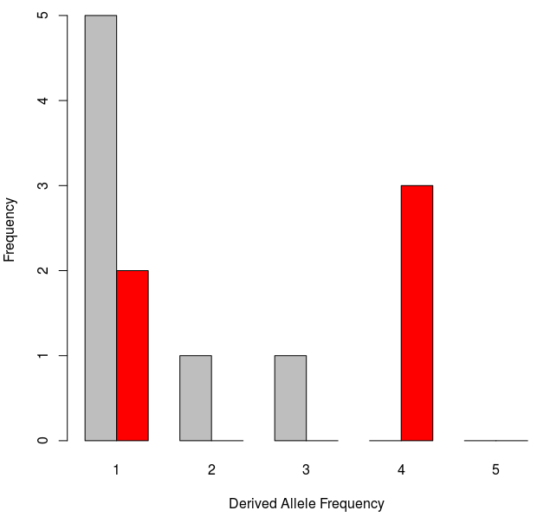
The Site Frequency Spectrum
t<T_{sel}
…
t>>T_{sel}
Notes:
Show the site frequency spectrum here for these cases

Slide 44
The Site Frequency Spectrum
t<T_{sel}
…
t>>T_{sel}
Tajima’s D?
~0.33=1/3
= 10, the number of comparisons you need to make
Notes:
Show the site frequency spectrum here for these cases

Slide 45
The importance of being…
The Site Frequency Spectrum
t<T_{sel}
…
t>>T_{sel}
K=5
a_{n}=1/1 + 1/2 + 1/3 + 1/4=(12+6+4+3)/12=25/12
Theta=5/(25/12)=12/5
Pi=(5+5+5+5+0+0+0+0+0+0)/10=20/10=2
sd(D)=1/3
D=(2-12/5)/(1/3)=((10-12)/5)*3=-6/5=-1.2
D<0
Notes:
Show the site frequency spectrum here for these cases

Slide 46
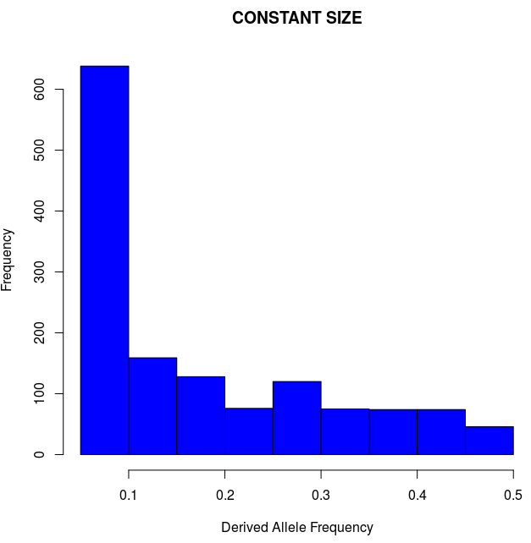
Demography matters?
n=20; L=500kbp; no selection
K=1,390
Theta=392
Pi=390
D=-0.016
Minor Allele Frequency
Notes:
Here run some simulations assuming expansion (Africans?)… and show tajima’s D negative.
Draw together some conclusions on the effect of pop size expansion?
Then introduce 2 ways of correcting for this, empirical and simulations
Then show what D>0 means? Balancing selection and introduce it.

Slide 47
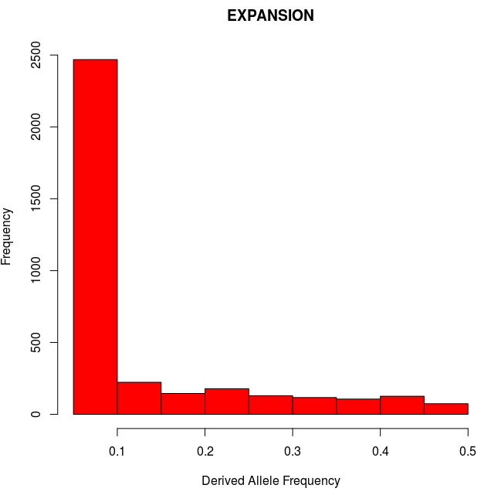
Demography matters?
n=20; L=500kbp; no selection
n=20; L=500kbp; no selection
K=1,390
Theta=392
Pi=390
D=-0.016
K=3,566
Theta=1,005
Pi=732
D=-1.14
Minor Allele Frequency
Minor Allele Frequency
Notes:
Here run some simulations assuming expansion (Africans?)… and show tajima’s D negative.
Draw together some conclusions on the effect of pop size expansion?
Then introduce 2 ways of correcting for this, empirical and simulations
Then show what D>0 means? Balancing selection and introduce it.

Slide 48
Demography matters!
n=20; L=500kbp; no selection
n=20; L=500kbp; no selection
K=1,390
Theta=392
Pi=390
D=-0.016
K=3,566
Theta=1,005
Pi=732
D=-1.14
Minor Allele Frequency
Minor Allele Frequency
Notes:
Here run some simulations assuming expansion (Africans?)… and show tajima’s D negative.
Draw together some conclusions on the effect of pop size expansion?
Then introduce 2 ways of correcting for this, empirical and simulations
Then show what D>0 means? Balancing selection and introduce it.

Slide 49
Demography matters!
n=20; L=500kbp; no selection
n=20; L=500kbp; no selection
K=1,390
Theta=392
Pi=390
D=-0.016
K=3,566
Theta=1,005
Pi=732
D=-1.14
Minor Allele Frequency
Minor Allele Frequency
Excess of segregating sites
Excess of low-frequency variants
SFS-derived summary statistics may fail to distinguish between the effects of demography and selection
Notes:
Here run some simulations assuming expansion (Africans?)… and show tajima’s D negative.
Draw together some conclusions on the effect of pop size expansion?
Then introduce 2 ways of correcting for this, empirical and simulations
Then show what D>0 means? Balancing selection and introduce it.

Slide 50
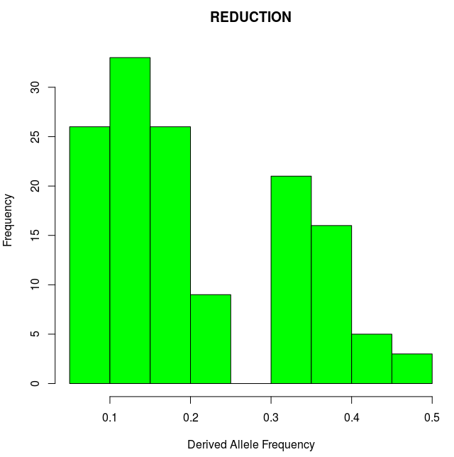
Demography matters?
n=20; L=500kbp; no selection
n=20; L=500kbp; no selection
K=1,390
Theta=392
Pi=390
D=-0.016
K=139
Theta=39
Pi=47
D=0.83
Minor Allele Frequency
Minor Allele Frequency
Notes:
Here run some simulations assuming expansion (Africans?)… and show tajima’s D negative.
Draw together some conclusions on the effect of pop size expansion?
Then introduce 2 ways of correcting for this, empirical and simulations
Then show what D>0 means? Balancing selection and introduce it.

Slide 51
Demography matters!
n=20; L=500kbp; no selection
n=20; L=500kbp; no selection
K=1,390
Theta=392
Pi=390
D=-0.016
K=139
Theta=39
Pi=47
D=0.83
Minor Allele Frequency
Minor Allele Frequency
Notes:
Here run some simulations assuming expansion (Africans?)… and show tajima’s D negative.
Draw together some conclusions on the effect of pop size expansion?
Then introduce 2 ways of correcting for this, empirical and simulations
Then show what D>0 means? Balancing selection and introduce it.

Slide 52
Demography matters!
n=20; L=500kbp; no selection
n=20; L=500kbp; no selection
K=1,390
Theta=392
Pi=390
D=-0.016
K=139
Theta=39
Pi=47
D=0.83
Minor Allele Frequency
Minor Allele Frequency
Depletion of segregating sites
Excess of intermediate-frequency variants
SFS-derived summary statistics may fail to distinguish between the effects of demography and selection
?
Notes:
Here run some simulations assuming expansion (Africans?)… and show tajima’s D negative.
Draw together some conclusions on the effect of pop size expansion?
Then introduce 2 ways of correcting for this, empirical and simulations
Then show what D>0 means? Balancing selection and introduce it.

Slide 53
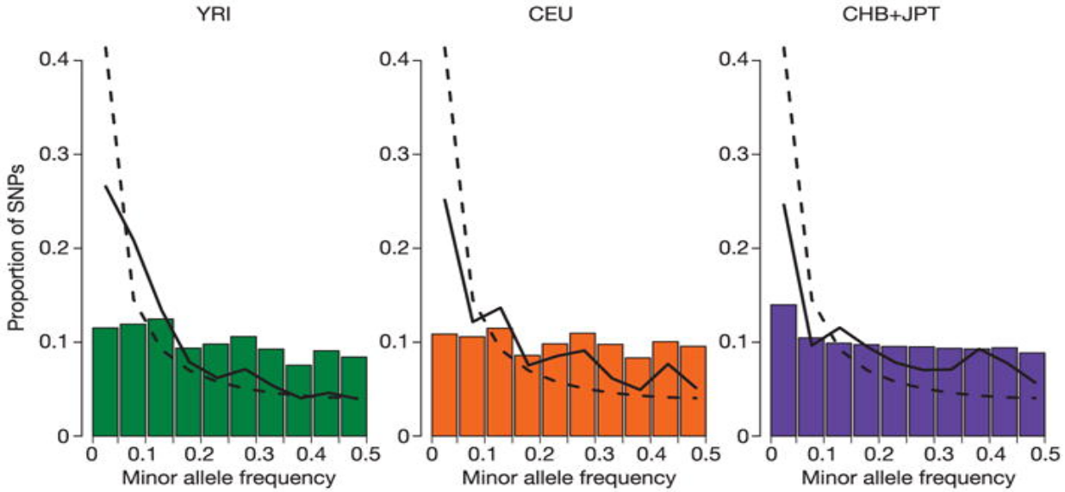
Experimental design matters?
The effect of ascertainment bias
Deficiency of low-frequency variants
HapMap Consortium. Nature 2005
Notes:
Another bias that may mimic balancing selection (mention also ancient pop structure)

Slide 54
How to take neutral confounding factors into account?
Under constant population size:
Tajima’s D
2
.
.
.
.
.
.
.
.
.
.
.
.
.
.
.
E[D]~0
0
-2
Genome / Chromosome
Notes:
Here run some simulations assuming expansion (Africans?)… and show tajima’s D negative.
Draw together some conclusions on the effect of pop size expansion?
Then introduce 2 ways of correcting for this, empirical and simulations
Then show what D>0 means? Balancing selection and introduce it.

Slide 55
How to take neutral confounding factors into account?
Under expanding population size:
Tajima’s D
2
0
.
.
.
.
.
.
.
.
.
.
.
.
.
.
.
E[D]<0
-2
Genome / Chromosome
Notes:
Here run some simulations assuming expansion (Africans?)… and show tajima’s D negative.
Draw together some conclusions on the effect of pop size expansion?
Then introduce 2 ways of correcting for this, empirical and simulations
Then show what D>0 means? Balancing selection and introduce it.

Slide 56
How to take neutral confounding factors into account?
Under expanding population size and positive selection:
Tajima’s D
2
0
.
.
.
.
.
.
.
.
.
.
.
.
.
.
E[D]<0
.
-2
Genome / Chromosome
Demography affects all loci equally, while selection changes local patterns
Notes:
Here run some simulations assuming expansion (Africans?)… and show tajima’s D negative.
Draw together some conclusions on the effect of pop size expansion?
Then introduce 2 ways of correcting for this, empirical and simulations
Then show what D>0 means? Balancing selection and introduce it.

Slide 57
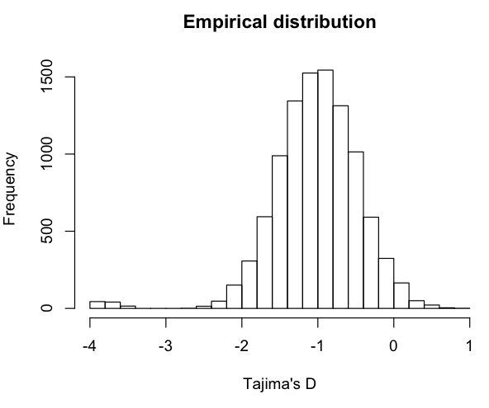
Outlier approach
Tajima’s D
2
0
.
.
.
.
.
.
.
.
.
.
.
.
.
.
E[D]<0
.
-2
Genome / Chromosome
Assign empirical p-values
(ranked percentiles)
Notes:
Here run some simulations assuming expansion (Africans?)… and show tajima’s D negative.
Draw together some conclusions on the effect of pop size expansion?
Then introduce 2 ways of correcting for this, empirical and simulations
Then show what D>0 means? Balancing selection and introduce it.

Slide 58
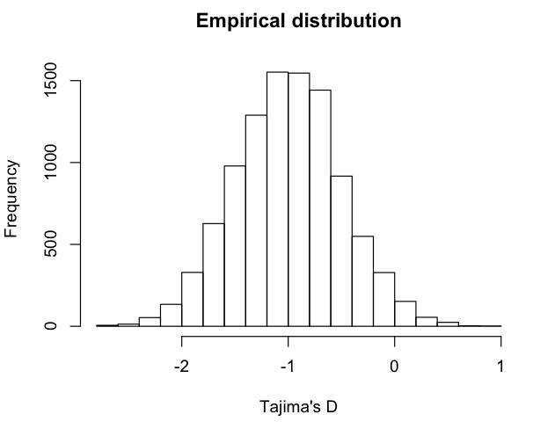
Outlier approach
Tajima’s D
2
0
.
.
.
.
.
.
.
.
.
.
.
.
.
.
E[D]<0
.
-2
Genome / Chromosome
?
Assign empirical p-values
(ranked percentiles)
Notes:
Gene ontology or pathway enrichment analyses, you will always get some outliers
An alternative is to use a demographic model

Slide 59
How to take neutral confounding factors into account?
Under expanding population size and positive selection:
Tajima’s D
2
But we know what’s driving the expected distribution
0
E[D]<0
.
-2
Genome / Chromosome
Demography affects all loci equally, while selection changes local patterns
What should we do if we don’t have genome-wide data?
Notes:
Here run some simulations assuming expansion (Africans?)… and show tajima’s D negative.
Draw together some conclusions on the effect of pop size expansion?
Then introduce 2 ways of correcting for this, empirical and simulations
Then show what D>0 means? Balancing selection and introduce it.

Slide 60
Simulations-based approach
Tajima’s D
2
0
E[D]<0
.
-2
Genome / Chromosome
Known demographic model
N0
T
N1
N1
Notes:
Here run some simulations assuming expansion (Africans?)… and show tajima’s D negative.
Draw together some conclusions on the effect of pop size expansion?
Then introduce 2 ways of correcting for this, empirical and simulations
Then show what D>0 means? Balancing selection and introduce it.

Slide 61
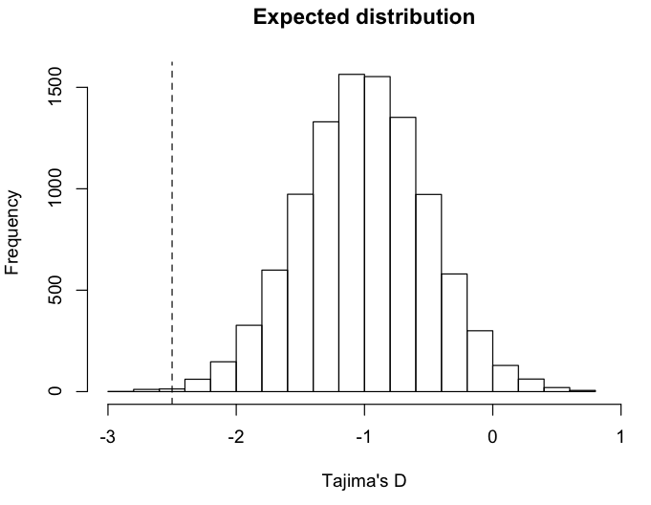
Simulations-based approach
Tajima’s D
2
0
E[D]<0
.
-2
Assign p-values
(based on ranked percentile of observed value)
Genome / Chromosome
Known demographic model
N0
T
N1
N1
Notes:
Here run some simulations assuming expansion (Africans?)… and show tajima’s D negative.
Draw together some conclusions on the effect of pop size expansion?
Then introduce 2 ways of correcting for this, empirical and simulations
Then show what D>0 means? Balancing selection and introduce it.

Slide 62
Positive selection
t<T_{sel}
…
t>>T_{sel}
Reduction of polymorphisms levels (Theta)
Excess of low-frequency variants (Pi, Tajima’s D, SFS)
?
Notes:
Not only the number of SNPs but their frequency as well
LD-based approaches:
identifying variants under partial or incomplete selective sweep
EHH from a core allele to a specified distance
EHH decreases with distance by the action of recombination

Slide 63
Positive selection
t<T_{sel}
…
t>>T_{sel}
Reduction of polymorphisms levels (Theta)
Excess of low-frequency variants (Pi, Tajima’s D, SFS)
Extended haplotype homozygosity / Extended LD
Notes:
How can we quantify such extension of haplotype homozygosity?

Slide 64
Extended Haplotype Homozygosity
t>>T_{sel}
…
t>>>T_{sel}
…
Notes:
In practise it is more complicated due to mutation….

Slide 65
Extended Haplotype Homozygosity
t>>T_{sel}
…
t>>>T_{sel}
…
t>>>T_{sel}
Notes:
…and recombination.
For instance, if just looking at Theta W we might get the same value as for neutrality (6 SNPs)

Slide 66
Extended Haplotype Homozygosity
1
1
1
1
1
0
Core haplotype is 1
(Biallelic: 0 is ancestral, 1 is derived allele)
Core SNP
Notes:
…and recombination.
For instance, if just looking at Theta W we might get the same value as for neutrality (6 SNPs)

Slide 67
Extended Haplotype Homozygosity
1
1
1
1
1
0
Core haplotype is 1
(Biallelic: 0 is ancestral, 1 is derived allele)
Until marker x_{i}
(starting from x₀)
Notes:
…and recombination.
For instance, if just looking at Theta W we might get the same value as for neutrality (6 SNPs)

Slide 68
Extended Haplotype Homozygosity
1
1
1
1
1
0
Core haplotype is 1
(Biallelic: 0 is ancestral, 1 is derived allele)
Sum across all unique haplotypes carrying the core SNP
Notes:
…and recombination.
For instance, if just looking at Theta W we might get the same value as for neutrality (6 SNPs)

Slide 69
Extended Haplotype Homozygosity
1
1
1
1
1
0
Core haplotype is 1
(Biallelic: 0 is ancestral, 1 is derived allele)
n_{h} is haplotype frequency of h
n_{h} is haplotype frequency of the core SNP
Sum across all unique haplotypes carrying the core SNP
Notes:
…and recombination.
For instance, if just looking at Theta W we might get the same value as for neutrality (6 SNPs)

Slide 70
Extended Haplotype Homozygosity
1
1
1
1
1
0
Core haplotype is 1
(Biallelic: 0 is ancestral, 1 is derived allele)
n_{h} is haplotype frequency of h
n_{h} is haplotype frequency of the core SNP
Sum across all unique haplotypes carrying the core SNP
Notes:
…and recombination.
For instance, if just looking at Theta W we might get the same value as for neutrality (6 SNPs)

Slide 71
Extended Haplotype Homozygosity
1
1
1
1
1
0
Core haplotype is 1
(Biallelic: 0 is ancestral, 1 is derived allele)
n_{h} is haplotype frequency of h
n_{c} is haplotype frequency of the core SNP
Sum across all unique haplotypes carrying the core SNP
Notes:
…and recombination.
For instance, if just looking at Theta W we might get the same value as for neutrality (6 SNPs)

Slide 72
Extended Haplotype Homozygosity
1
1
1
1
1
1
1
1
1
0
0
0
x=0
x=+1
1
0
How many unique haplotypes carrying the core SNP?
What is their frequency?
Notes:
…and recombination.
For instance, if just looking at Theta W we might get the same value as for neutrality (6 SNPs)

Slide 73
Extended Haplotype Homozygosity
1
1
1
1
1
1
1
1
1
0
0
0
x=0
x=+1
1
0
Notes:
…and recombination.
For instance, if just looking at Theta W we might get the same value as for neutrality (6 SNPs)

Slide 74
Extended Haplotype Homozygosity
1
1
1
1
1
1
1
1
1
1
1
1
1
0
0
0
0
0
x=0
x=+1
x=+2
1
0
Notes:
…and recombination.
For instance, if just looking at Theta W we might get the same value as for neutrality (6 SNPs)

Slide 75
Extended Haplotype Homozygosity
1
1
1
1
1
1
1
1
1
1
1
1
1
0
0
0
0
0
x=0
x=+1
x=+2
1
0
Notes:
…and recombination.
For instance, if just looking at Theta W we might get the same value as for neutrality (6 SNPs)

Slide 76
Extended Haplotype Homozygosity
1
1
1
1
1
1
1
0
1
1
1
0
1
1
1
1
1
0
0
0
0
0
0
0
x=0
x=+1
x=+2
x=+3
1
0
How many unique haplotypes carrying the core SNP?
What is their frequency?
Notes:
…and recombination.
For instance, if just looking at Theta W we might get the same value as for neutrality (6 SNPs)

Slide 77
Extended Haplotype Homozygosity
1
1
1
1
1
1
1
0
1
1
1
0
1
1
1
1
1
0
0
0
0
0
0
0
x=0
x=+1
x=+2
x=+3
1
0
How many unique haplotypes carrying the core SNP?
What is their frequency?
1111 with freq=2
1110 with freq=2
1000 with freq=1
Notes:
…and recombination.
For instance, if just looking at Theta W we might get the same value as for neutrality (6 SNPs)

Slide 78
Extended Haplotype Homozygosity
1
1
1
1
1
1
1
0
1
1
1
0
1
1
1
1
1
0
0
0
0
0
0
0
x=0
x=+1
x=+2
x=+3
1
0
How many unique haplotypes carrying the core SNP?
What is their frequency?
1111 with freq=2
1110 with freq=2
1000 with freq=1
Notes:
…and recombination.
For instance, if just looking at Theta W we might get the same value as for neutrality (6 SNPs)

Slide 79
Extended Haplotype Homozygosity
1
1
1
1
1
1
0
0
1
1
1
0
0
1
1
1
1
0
1
1
1
1
1
1
1
0
1
0
0
0
0
1
0
0
0
0
x=-2
x=-1
x=0
x=+1
x=+2
x=+3
n | n choose 2
1 | 0
2 | 1
3 | 3
4 | 6
5 | 10
6 | 15
1
0
Comment on differences (if any) between EHH(x=+2) and EHH(x=-2).
Notes:
…and recombination.
For instance, if just looking at Theta W we might get the same value as for neutrality (6 SNPs)

Slide 80
Extended Haplotype Homozygosity
1
1
1
1
1
1
0
0
1
1
1
0
0
1
1
1
1
0
1
1
1
1
1
1
1
0
1
0
0
0
0
1
0
0
0
0
x=-2
x=-1
x=0
x=+1
x=+2
x=+3
n | n choose 2
1 | 0
2 | 1
3 | 3
4 | 6
5 | 10
6 | 15
1
0
+ (1 choose 2)
Comment on differences (if any) between EHH(x=+2) and EHH(x=-2)?
Notes:
Rather than actual values of EHH, the decay (against physical of genetic map) is the important feature

Slide 81
Integrated Haplotype Score
1
1
1
1
1
1
0
0
1
1
1
0
0
1
1
1
1
0
1
1
1
1
1
1
1
0
1
0
0
0
0
1
0
0
0
0
x=-2
x=-1
x=0
x=+1
x=+2
x=+3
1
For the derived allele
0
cM
1
For the ancestral allele
0
cM
Notes:
Rather than actual values of EHH, the decay (against physical of genetic map) is the important feature

Slide 82
Integrated Haplotype Score
1
1
1
1
1
1
0
0
1
1
1
0
0
1
1
1
1
0
1
1
1
1
1
1
1
0
1
0
0
0
0
1
0
0
0
0
x=-2
x=-1
x=0
x=+1
x=+2
x=+3
1
iHH₁
Integrated haplotype homozygosity (iHH)
0
cM
1
iHH₀
0
cM
Notes:
Rather than actual values of EHH, the decay (against physical of genetic map) is the important feature
iHS compares the area under the curve defined by EHH for the derived and ancestral variants as one travels further in genetic distance from the core region
cross-population extended haplotype homozygosity (XP-EHH) compares haplotype lengths between populations.

Slide 83
Integrated Haplotype Score
1
1
1
1
1
1
0
0
1
1
1
0
0
1
1
1
1
0
1
1
1
1
1
1
1
0
1
0
0
0
0
1
0
0
0
0
x=-2
x=-1
x=0
x=+1
x=+2
x=+3
1
iHH₁
Integrated haplotype homozygosity (iHH)
0
cM
1
iHH₀
0
cM
Integrated haplotype score:
iHs = ln(iHH₁/iHH₀)
Genome-wide normalization in frequency bins
(to mean=0 and sd=1)
Notes:
Rather than actual values of EHH, the decay (against physical of genetic map) is the important feature

Slide 84
Cross-population
Extended Haplotype Homozygosity
1
1
1
1
1
1
0
0
1
1
1
0
0
1
1
1
1
0
1
1
1
1
1
1
1
0
1
0
0
0
0
1
0
0
0
0
x=-2
x=-1
x=0
x=+1
x=+2
x=+3
1
iHH_{A}
Integrated haplotype homozygosity (iHH)
for populations A and B
0
cM
1
iHH_{B}
0
cM
Integrated haplotype score:
XP-EHH = ln(iHH_{A}/iHH_{B})
Genome-wide normalization in frequency bins
(to mean=0 and sd=1)
Notes:
Rather than actual values of EHH, the decay (against physical of genetic map) is the important feature

Slide 85
Outline
Brief introduction to natural selection
Modes of selection
Inferring selection at the intra-species level
  Genetic differentiation
  Haplotype variation
  Model-based approaches
  Testing for significance
Inferring selection at the inter-species level
Detecting selection from low-depth sequencing data

Slide 86


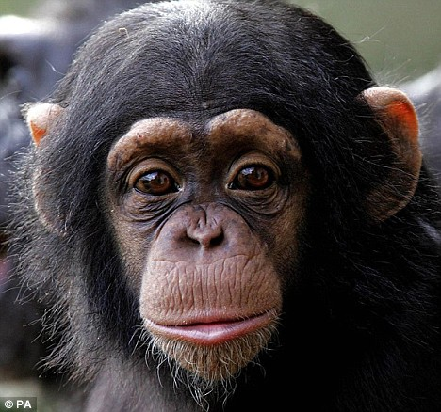
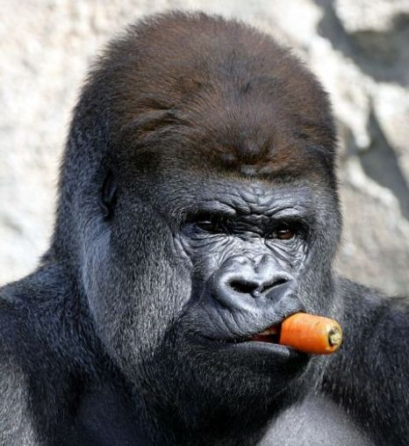
Inter-species variation
Inter-species
Intra-species
events in the deep past, macro-evolutionary trends, selection between species
Notes:
These changes typically occur at a longer time-scale.
Why is there the need of using different tools to detect selection at the inter-species level?
Let’s see a case study to understand why we need different methods in this case.

Slide 87
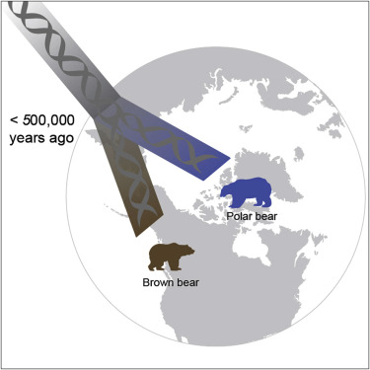
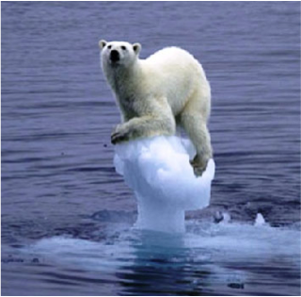
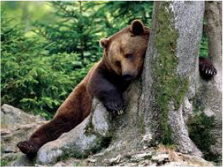
Polar bears vs. Brown bears
Question: what are the genetic signatures of polar bears’ adaptation to the Arctic environment?
Notes:
Why should we care about polar bears? Polar bears are an iconic species in evolutionary biology. Despite their relatively recent divergence from brown bears, they completely differ in their physiology, ecology and behavior suggesting a rapid evolutionary adaptation.
What is the first thing to do? Go there and collect samples.

Slide 88
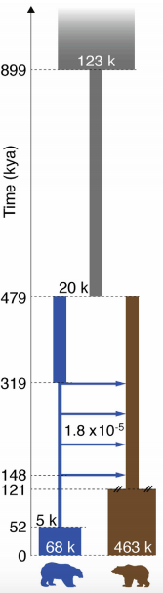
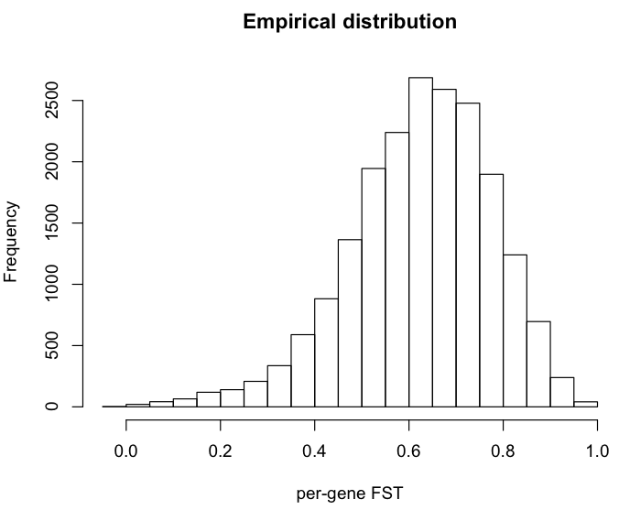
Expected genetic differentiation
Notes:
Under this demographic model the expected distribution of the FST values is this one.
As you can see, this distribution is very skewed towards high values.

Slide 89
Expected genetic differentiation
P(FST>0.7)=0.33
Notes:
For instance high values of FST, like 0.7 would be largely expected by simply neutral evolution with this model.

Slide 90
Expected genetic differentiation
P(FST>0.8)=0.11
Notes:
For instance high values of FST, like 0.8 would be largely expected by simply neutral evolution with this model.
And indeed the empirical distribution of FST in genes in this data set reflects this observation.
Many genes have very high FST. So by using only FST (so allele frequency differentiation) we cannot completely rule out whether selection or drift was responsible for driving this differentiation (and fixation).
We therefore need to implement a different text.

Slide 91
Inferring inter-species selection
Inter-species
Fixed substitutions
Polymorphisms
Intra-species
Notes:
Polymorphism levels depends on local mutation rates: under neutral evolution, the amount of within- and between-species diversity is expected to be similar across all loci in the genome.

Slide 92
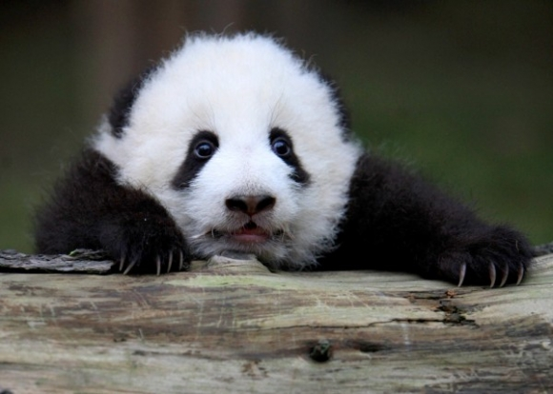
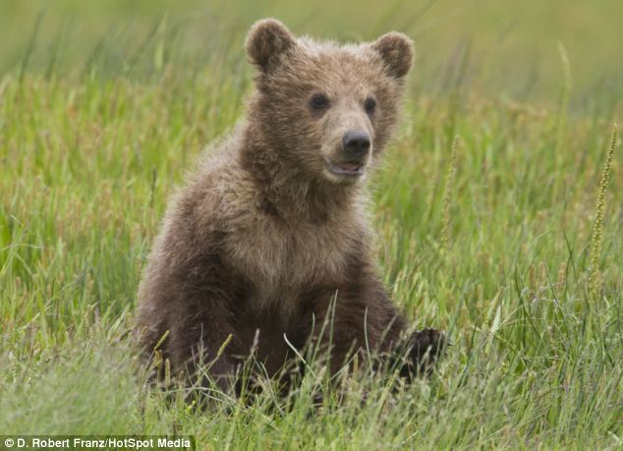
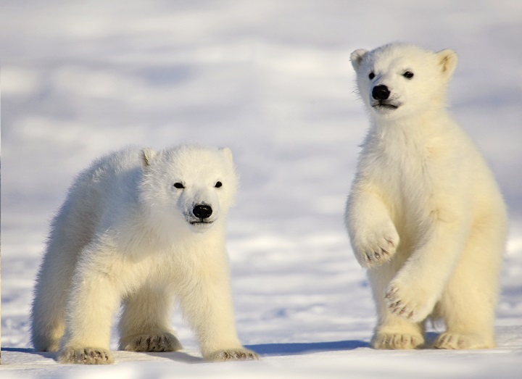
Polymorphisms and divergence
As both depend on mutation rates, and levels are expected to be proportional.

Slide 93
Polymorphisms and divergence
Under neutrality
(control locus or genome-wide)
≈
?

Slide 94
Polymorphisms and divergence
Under neutrality
(control locus or genome-wide)
≈
??? selection
>

Slide 95
Polymorphisms and divergence
Under neutrality
(control locus or genome-wide)
≈
Positive selection
(or negative selection)
>

Slide 96
Polymorphisms and divergence
Under neutrality
(control locus or genome-wide)
≈
?

Slide 97
Polymorphisms and divergence
Under neutrality
(control locus or genome-wide)
≈
<

Slide 98
Polymorphisms and divergence
Under neutrality
(control locus or genome-wide)
≈
??? selection
<

Slide 99
Polymorphisms and divergence
Under neutrality
(control locus or genome-wide)
≈
Balancing selection
(or relaxation of functional constraints)
<

Slide 100
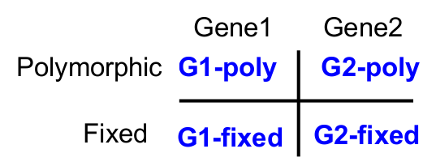
HKA test
Hudson-Kreitman-Aguadè (HKA, Hudson et al. 1987) test
Contingency table 2x2: chi-square test
Under investigation
Control / Neutrally evolving

Slide 101
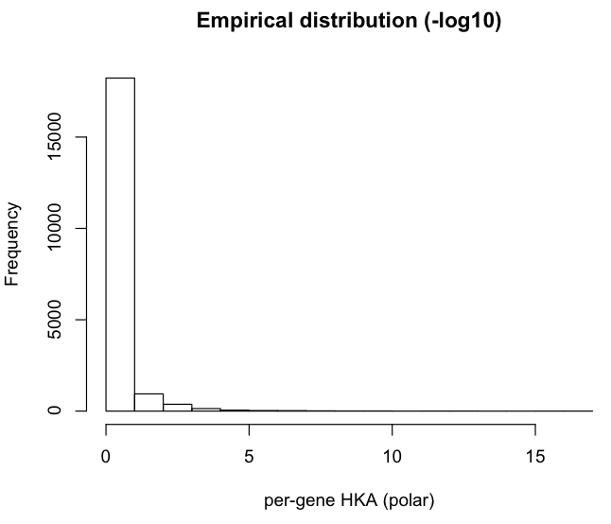
HKA test
Genes where divergence-to-polymorphisms ration was greater in brown bears

Slide 102
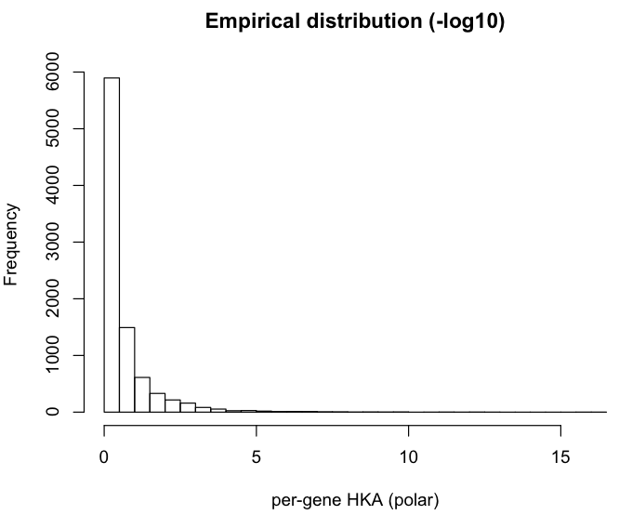
HKA test
Long tail

Slide 103
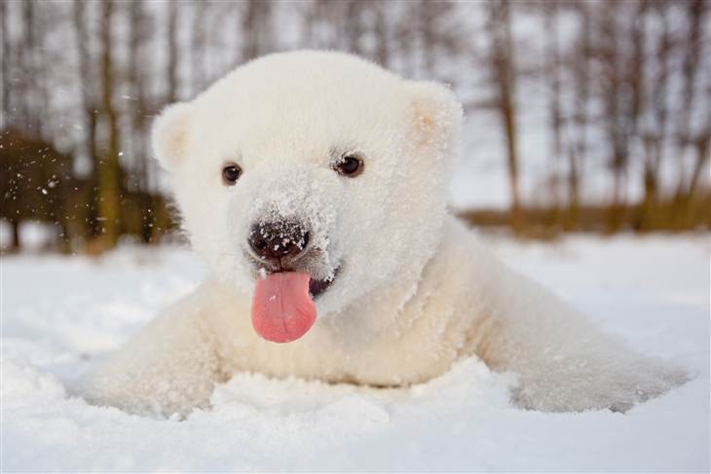
Coding polymorphisms
Substitutions in the coding regions may alter (non-synonymous) or not (synonymous) the protein sequence:
ATC CAA …
I Q
ATA GAA …
I K
ATG CAG …
M Q
Ancestral sequence
Species 1
Species 2
Non-synonymous
Synonymous
Notes:
Synonymous rate as baseline, considered as neutral evolving

Slide 104
dN/ds
Comparison between rate of nonsynonymous substitutions and rate of synonymous substitutions (also called K_{a}/K_{s} or ω)
Non-synonymous
Synonymous
Positive selection
(novel proteins)
K_{a}/K > 1
Negative selection
(against deleterious mutations
K_{a}/K <1
Notes:
Synonymous rate as baseline

Slide 105
Coding polymorphisms and divergence
Compare the amount of variation within a species to the divergence between species at non-synonymous and synonymous variants.
Non-synonymous
Synonymous
Substitutions
Polymorphisms
Notes:
Synonymous rate as baseline

Slide 106
MK (McDonald–Kreitman) test
Non-synonymous
Synonymous
Substitutions
Polymorphisms
Non-synonymous
Synonymous
Divergence
Polymorphisms
Notes:
Synonymous rate as baseline

Slide 107
MK (McDonald–Kreitman) test
Non-synonymous
Synonymous
Substitutions
Polymorphisms
Non-synonymous
Synonymous
Divergence
dN/dS between species
Polymorphisms
Notes:
Synonymous rate as baseline

Slide 108
MK (McDonald–Kreitman) test
Non-synonymous
Synonymous
Substitutions
Polymorphisms
Non-synonymous
Synonymous
Divergence
Polymorphisms
dN/dS withinspecies
Notes:
Synonymous rate as baseline

Slide 109
MK (McDonald–Kreitman) test
Non-synonymous
Synonymous
Substitutions
Polymorphisms
Non-synonymous
Synonymous
Divergence
2x2 contingency table
Polymorphisms
Notes:
Under neutrality, these rates should be equal.
If the between-species ratio exceeds the within-species ratio indicates positive selection between species (a larger within-species value suggests balancing selection or excess or weakly deleterious variants).

Slide 110
Summary
Methods to detect signatures of selection are grouped based on:
time of selection
summary statistics used
Assessing statistical significance through empirical or expected distributions
Investigating complex models of selection and adaptation

