Slide 1
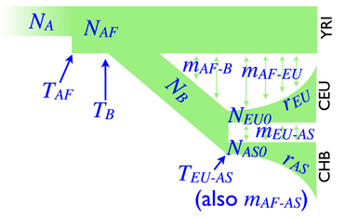
x N
N_{e}
μ
ρ
Length
Sample size
observed
N summary statistics
+

