Slide 1
Selection (part 2)

Slide 2

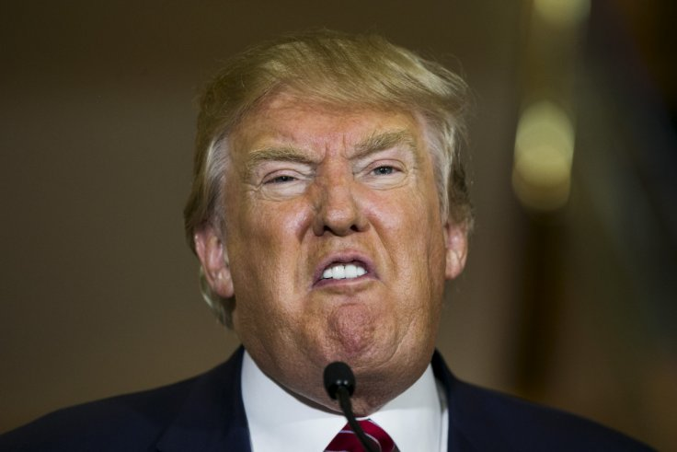
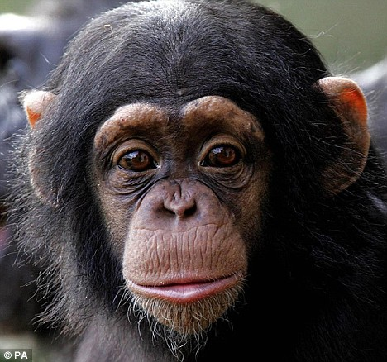
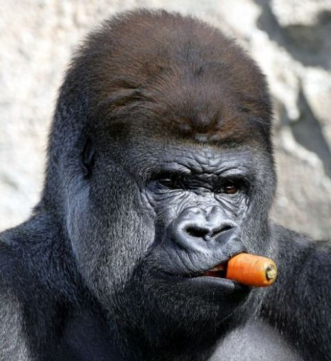
Inter-species variation
Inter-species
Intra-species
events in the deep past, macro-evolutionary trends, selection between species
Notes:
These changes typically occur at a longer time-scale.
Why is there the need of using different tools to detect selection at the inter-species level?
Let’s see a case study to understand why we need different methods in this case.

Slide 3
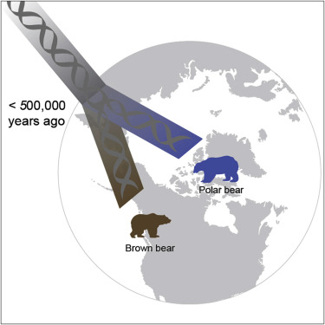
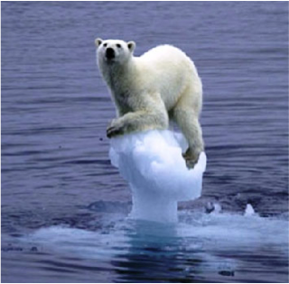
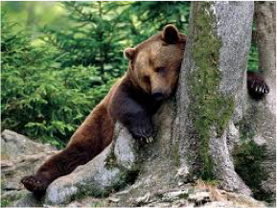
Polar bears vs. Brown bears
Question: what are the genetic signatures of polar bears’ adaptation to the Arctic environment?
Notes:
Why should we care about polar bears? Polar bears are an iconic species in evolutionary biology. Despite their relatively recent divergence from brown bears, they completely differ in their physiology, ecology and behavior suggesting a rapid evolutionary adaptation.
What is the first thing to do? Go there and collect samples.

Slide 4
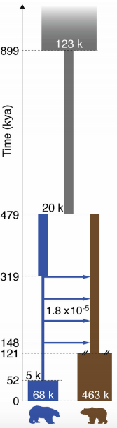
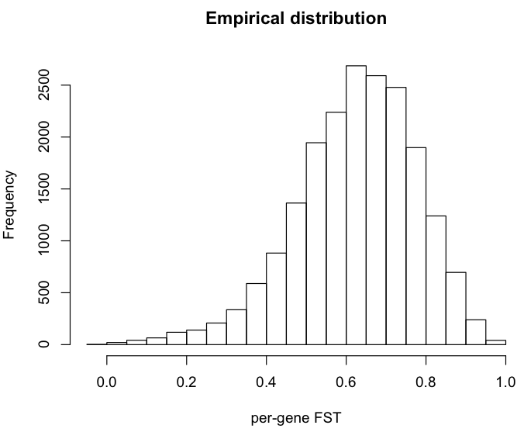
Expected genetic differentiation
Notes:
Under this demographic model the expected distribution of the FST values is this one.
As you can see, this distribution is very skewed towards high values.

Slide 5
Expected genetic differentiation
P(FST>0.7)=0.33
Notes:
For instance high values of FST, like 0.7 would be largely expected by simply neutral evolution with this model.

Slide 6
Expected genetic differentiation
P(FST>0.8)=0.11
Notes:
For instance high values of FST, like 0.8 would be largely expected by simply neutral evolution with this model.
And indeed the empirical distribution of FST in genes in this data set reflects this observation.
Many genes have very high FST. So by using only FST (so allele frequency differentiation) we cannot completely rule out whether selection or drift was responsible for driving this differentiation (and fixation).
We therefore need to implement a different text.

Slide 7
Inferring inter-species selection
Inter-species
Fixed substitutions
Polymorphisms
Intra-species
Notes:
Polymorphism levels depends on local mutation rates: under neutral evolution, the amount of within- and between-species diversity is expected to be similar across all loci in the genome.

Slide 8
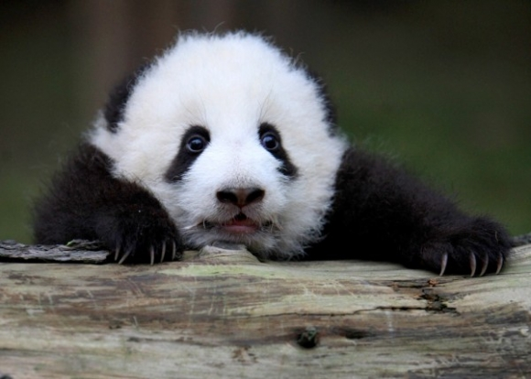
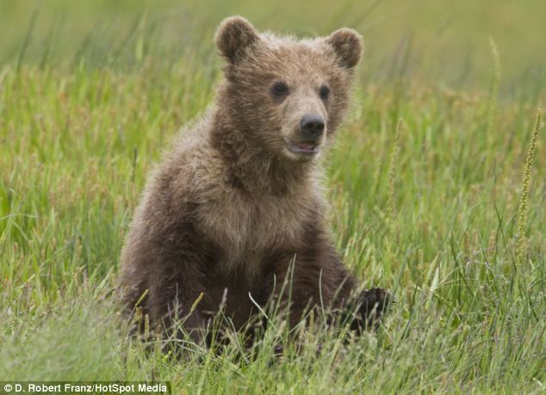
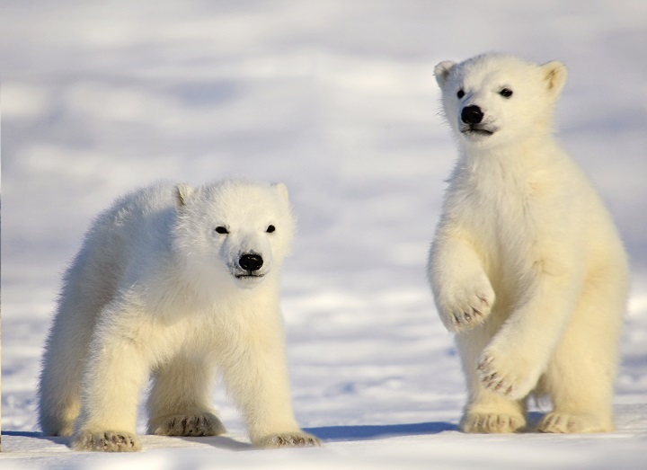
Polymorphisms and divergence
As both depend on mutation rates, and levels are expected to be proportional.

Slide 9
Polymorphisms and divergence
Under neutrality
(control locus or genome-wide)
≈
?

Slide 10
Polymorphisms and divergence
Under neutrality
(control locus or genome-wide)
≈
??? selection
>

Slide 11
Polymorphisms and divergence
Under neutrality
(control locus or genome-wide)
≈
Positive selection
(or negative selection)
>

Slide 12
Polymorphisms and divergence
Under neutrality
(control locus or genome-wide)
≈
?

Slide 13
Polymorphisms and divergence
Under neutrality
(control locus or genome-wide)
≈
<

Slide 14
Polymorphisms and divergence
Under neutrality
(control locus or genome-wide)
≈
??? selection
<

Slide 15
Polymorphisms and divergence
Under neutrality
(control locus or genome-wide)
≈
Balancing selection
(or relaxation of functional constraints)
<

Slide 16
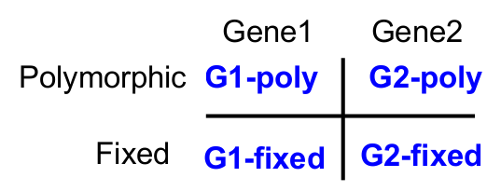
HKA test
Hudson-Kreitman-Aguadè (HKA, Hudson et al. 1987) test
Contingency table 2x2: chi-square test
Under investigation
Control / Neutrally evolving

Slide 17
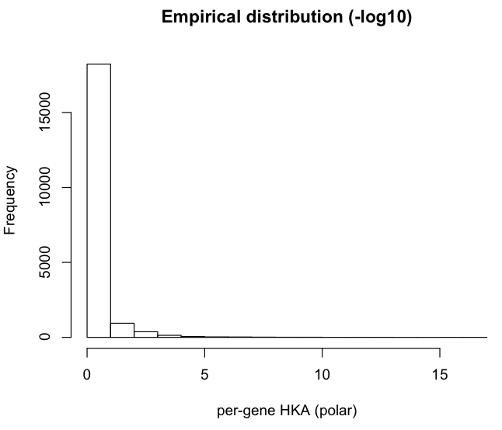
HKA test
Genes where divergence-to-polymorphisms ration was greater in brown bears

Slide 18
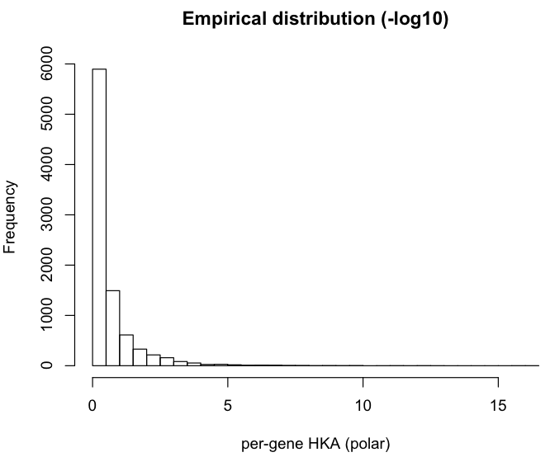
HKA test
Long tail

Slide 19
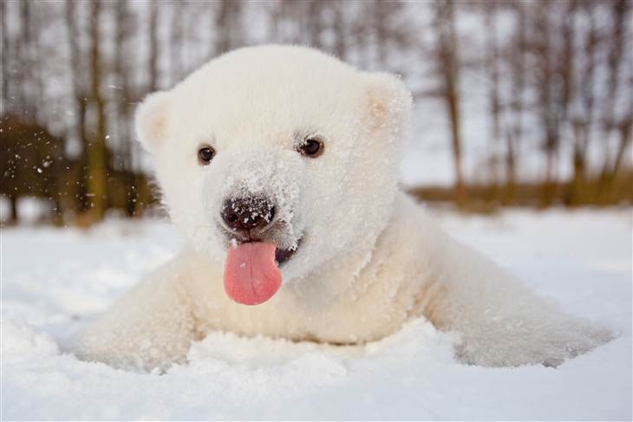
Coding polymorphisms
Substitutions in the coding regions may alter (non-synonymous) or not (synonymous) the protein sequence:
ATC CAA …
I Q
ATA GAA …
I K
ATG CAG …
M Q
Ancestral sequence
Species 1
Species 2
Non-synonymous
Synonymous
Notes:
Synonymous rate as baseline, considered as neutral evolving

Slide 20
dN/ds
Comparison between rate of nonsynonymous substitutions and rate of synonymous substitutions (also called K_{a}/K_{s} or ω)
Non-synonymous
Synonymous
Positive selection
(novel proteins)
K_{a}/K > 1
Negative selection
(against deleterious mutations
K_{a}/K <1
Notes:
Synonymous rate as baseline

Slide 21
Coding polymorphisms and divergence
Compare the amount of variation within a species to the divergence between species at non-synonymous and synonymous variants.
Non-synonymous
Synonymous
Substitutions
Polymorphisms
Notes:
Synonymous rate as baseline

Slide 22
MK (McDonald–Kreitman) test
Non-synonymous
Synonymous
Substitutions
Polymorphisms
Non-synonymous
Synonymous
Divergence
Polymorphisms
Notes:
Synonymous rate as baseline

Slide 23
MK (McDonald–Kreitman) test
Non-synonymous
Synonymous
Substitutions
Polymorphisms
Non-synonymous
Synonymous
Divergence
dN/dS between species
Polymorphisms
Notes:
Synonymous rate as baseline

Slide 24
MK (McDonald–Kreitman) test
Non-synonymous
Synonymous
Substitutions
Polymorphisms
Non-synonymous
Synonymous
Divergence
Polymorphisms
dN/dS withinspecies
Notes:
Synonymous rate as baseline

Slide 25
MK (McDonald–Kreitman) test
Non-synonymous
Synonymous
Substitutions
Polymorphisms
Non-synonymous
Synonymous
Divergence
2x2 contingency table
Polymorphisms
Notes:
Under neutrality, these rates should be equal.
If the between-species ratio exceeds the within-species ratio indicates positive selection between species (a larger within-species value suggests balancing selection or excess or weakly deleterious variants).

