Slide 1
Inference of natural selection from NGD data
Matteo Fumagalli
September, 14th 2017

Slide 2
Outline
Brief introduction to natural selection
Inferring selection at the intra-species level using summary statistics
PRACTICAL: detecting selection from low-depth NGS data
The effect of demography on selection scans
PRACTICAL: quantifying selection using ABC
(Experimental design)
Notes:
Broad overview on adaptation to environments

Slide 3
Natural selection
Heritable traits that increase the fitness of the become more common.
Mutations arise randomly and evolve according to their effect on the fitness of the carrier
Neutrality
1
(slow) Fixation
Frequency in the population
Polymorphism
0
t=T
(slow?) Removal
t=present
Time
Notes:
Yes, but lines are built up step by step
So a strategy to understand molecular basis of adaptation is to look for sign of selection

Slide 4

Natural selection
Heritable traits that increase the fitness of the become more common.
Mutations arise randomly and evolve according to their effect on the fitness of the carrier
Negative selection
1
Frequency in the population
0
t=T
(quick) Removal
t=present
Time
Notes:
Yes, but lines are built up step by step
So a strategy to understand molecular basis of adaptation is to look for sign of selection

Slide 5

Natural selection
Heritable traits that increase the fitness of the become more common.
Mutations arise randomly and evolve according to their effect on the fitness of the carrier
Positive selection
t=Selective pressure
1
(quick) Fixation
Frequency in the population
0
t=T
t=present
Time
Notes:
Yes, but lines are built up step by step
So a strategy to understand molecular basis of adaptation is to look for sign of selection

Slide 6

Natural selection
Heritable traits that increase the fitness of the become more common.
Mutations arise randomly and evolve according to their effect on the fitness of the carrier
Balancing selection
t=Selective pressure
1
Frequency in the population
Balanced
polymorphism
0
t=T
t=present
Time
Notes:
Yes, but lines are built up step by step
So a strategy to understand molecular basis of adaptation is to look for sign of selection

Slide 7
Natural selection
Heritable traits that increase the fitness of the become more common.
Mutations arise randomly and evolve according to their effect on the fitness of the carrier
Sites targeted by natural selection are likely to harbour functionality
Natural selection
t=Selective pressure
1
(quick) Fixation
Frequency in the population
Balanced
polymorphism
Polymorphism
0
t=T
(quick) Removal
t=present
Time
Notes:
Yes, but lines are built up step by step
So a strategy to understand molecular basis of adaptation is to look for sign of selection

Slide 8

Methods to infer selection
within-species:
Micro-evolutionary events between populations, local adaptation
Notes:
And here first show (nielse 2005) the molecular effect of natural selection, then say methods

Slide 9
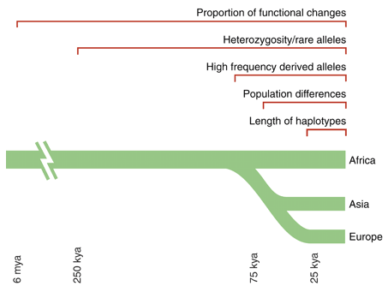
Methods to infer recent selection
Sabeti et al. 2006 Science

Slide 10
Methods to infer recent selection
Sabeti et al. 2006 Science

Slide 11
Allele frequency differentiation
Time
Present time

Slide 12
Allele frequency differentiation
Time
Separation
Environmental change
Present time

Slide 13
Allele frequency differentiation
Time
Separation
Environmental change
Onset of beneficial
mutation
Present time

Slide 14
Allele frequency differentiation
Time
Separation
Environmental change
Onset of beneficial
mutation
Present time

Slide 15
Allele frequency differentiation
Time
Separation
Environmental change
Onset of beneficial
mutation
Present time
Notes:
How can we quantify this?

Slide 16
F_{ST}
Common measure for quantifying population subdivision.
H_{B}: between populations
H_{W}: average within populations
if H_{B}>>H_{W} then F_{ST}~1
if H_{B}=0 then F_{ST}=0
F_{ST} = H_{B} / (H_{W} + H_{B})

Slide 17
Haplotype-based F_{ST}
F_{ST} based on haplotype differentiation between populations
F_{ST} = 1 – (H_{W} / H_{B})
A
B
C
Within populations
Between populations
What is the variation within populations?
e.g. A vs B
The differ by 1 site
D
E
F
As defined by Eq. 3 in Hudson, Slatkin and Maddison 1992
Notes:
Here develop our own estimator based on haplo differences

Slide 18
Allele frequency differentiation
From standing variation
Difference in
allele frequency
Time

Slide 19
Allele frequency differentiation
With migration
Difference in
allele frequency
Time

Slide 20
Allele frequency differentiation
With recent divergence
Difference in
allele frequency
Time

Slide 21


Population genetic differentiation
T
C
F_{ST}(T-C)

Slide 22
Population genetic differentiation
T
C
T(T-A)
T(C-A)
A
F_{ST}(T-C)~T(T-A-C)

Slide 23
Population genetic differentiation
F_{ST}(T-C)~T(T-A-C)
?
T
C
T(T-A)
T(C-A)
C
T
T(T-A)
T(C-A)
A
A

Slide 24
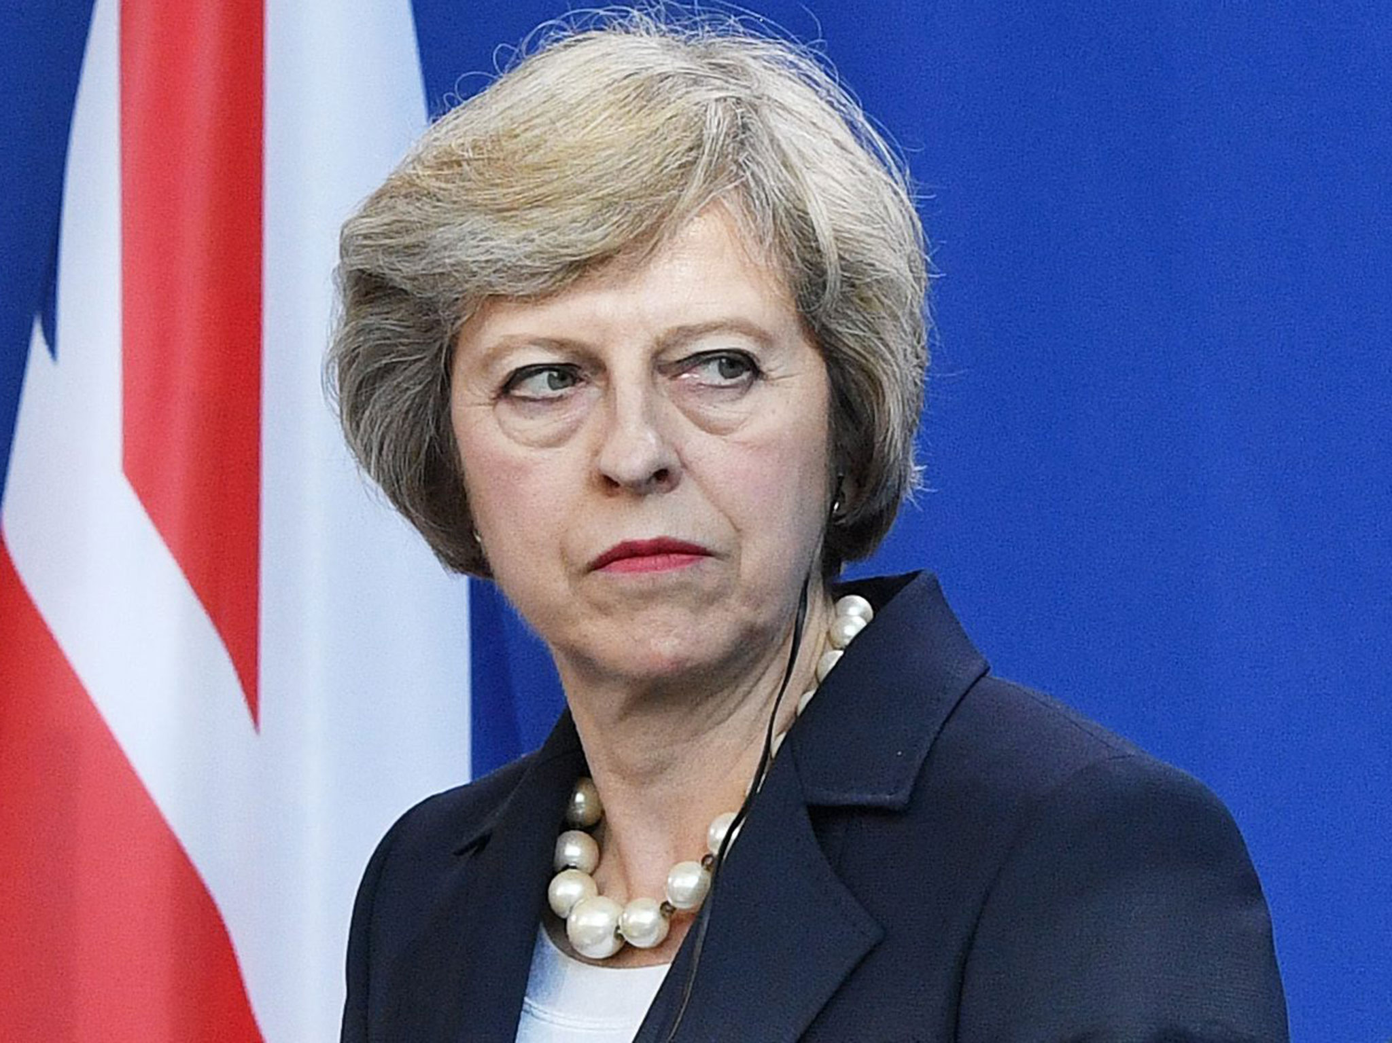
Population genetic differentiation
T
C
T(T-A)
A
T(C-A)
T(E-A)
E

Slide 25
Population genetic differentiation
T(T-A-C)=-log(1-F_{ST}(T-C))
T
T(T-C)
C
T(T-A)?
A
T(C-E)
T(T-E)
T_{(T-A)}= ...
E

Slide 26
Population genetic differentiation
T(T-A-C)=-log(1-F_{ST}(T-C))
T
T(T-C)
C
T(T-A)?
A
T(C-E)
T(T-E)
T_{(T-A)}=( T_{(T-E)}+T_{(T-C)}-T_{(C-E)} )/2
E

Slide 27
Methods to infer selection
Sabeti et al. 2006 Science

Slide 28
Positive selection: effect on haplotypes
t<T_{sel}
Notes:
Under neutrality, each haplotype will accumulate it own mutations

Slide 29
Positive selection: effect on haplotypes
t<T_{sel}
t=T_{sel}
Notes:
Under neutrality, each haplotype will accumulate it own mutations

Slide 30
Positive selection: effect on haplotypes
t<T_{sel}
t=T_{sel}
t>T_{sel}
Notes:
Under neutrality, each haplotype will accumulate it own mutations

Slide 31


Positive selection: effect on haplotypes
t<T_{sel}
t=T_{sel}
t>T_{sel}
t>>T_{sel}
Selective sweep
Genetic hitch-hiking
Adaptation
Notes:
Selective sweep: the beneficial allele is driven to fixation
Partial sweep: when the beneficial allele hasn’t reached fixation yet.

Slide 32
Positive selection
t<T_{sel}
…
t>>T_{sel}
?
Notes:
Reduced number of polymorphisms, but need to derive some indexes of nucleotide diversity taking into account the sample size for instance

Slide 33
Positive selection
t<T_{sel}
…
t>>T_{sel}
- Reduction of polymorphisms levels
(e.g. from 7 to 5 SNPs)
Notes:
Reduced number of polymorphisms, but need to derive some indexes of nucleotide diversity taking into account the sample size for instance

Slide 34
Positive selection
t<T_{sel}
…
t>>T_{sel}
- Reduction of polymorphisms levels
(e.g. from 7 to 5 SNPs)
Nucleotide diversity index: Watterson’s Theta
with K SNPs and n chromosomes
Notes:
Under neutrality, each haplotype will accumulate it own mutations

Slide 35
Positive selection
t<T_{sel}
…
t>>T_{sel}
Reduction of polymorphisms levels (Theta)
?
Notes:
Not only the number of SNPs but their frequency as well

Slide 36
Positive selection
t<T_{sel}
…
t>>T_{sel}
Reduction of polymorphisms levels (Theta)
Excess of low-frequency variants
Nucleotide diversity index: average pairwise nucleotide differences (Pi)
with k_{i,j} equal to the number of nucleotide differences between sequences i and j
Notes:
Not only the number of SNPs but their frequency as well

Slide 37
Positive selection
t<T_{sel}
…
t>>T_{sel}
Reduction of polymorphisms levels (Theta)
Excess of low-frequency variants (Pi)
Under neutrality, Theta and Pi are expected to be the same.
Tajima’s D measures their difference.
D<0 is suggestive of an excess of low-frequency variants
Notes:
Not only the number of SNPs but their frequency as well

Slide 38
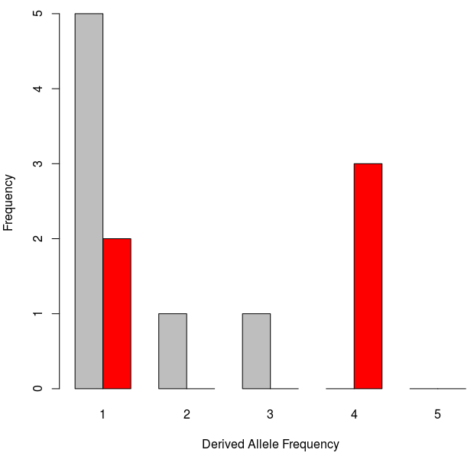
The Site Frequency Spectrum
t<T_{sel}
…
t>>T_{sel}
Notes:
Show the site frequency spectrum here for these cases

Slide 39
The Site Frequency Spectrum
t<T_{sel}
…
t>>T_{sel}
Tajima’s D?
~0.33=1/3
= 10, the number of comparisons you need to make
Notes:
Show the site frequency spectrum here for these cases

Slide 40
The Site Frequency Spectrum
t<T_{sel}
…
t>>T_{sel}
K=5
a_{n}=1/1 + 1/2 + 1/3 + 1/4=(12+6+4+3)/12=25/12
Theta=5/(25/12)=12/5
Pi=(5+5+5+5+0+0+0+0+0+0)/10=20/10=2
sd(D)=1/3
D=(2-12/5)/(1/3)=((10-12)/5)*3=-6/5=-1.2
D<0
Notes:
Show the site frequency spectrum here for these cases

Slide 41
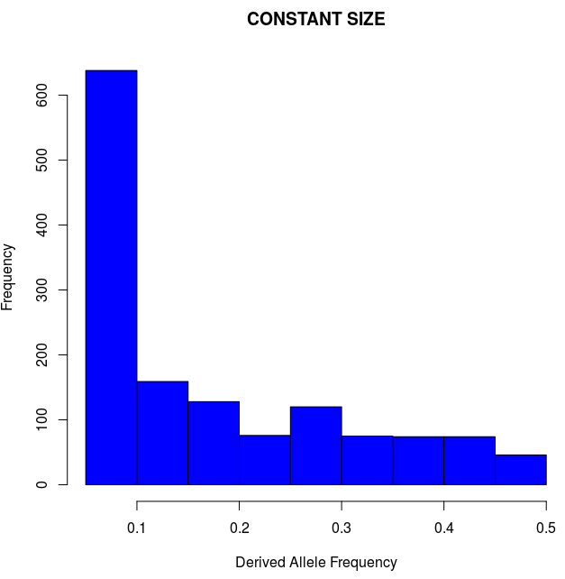
Demography matters?
n=20; L=500kbp; no selection
K=1,390
Theta=392
Pi=390
D=-0.016
Minor Allele Frequency
Notes:
Here run some simulations assuming expansion (Africans?)… and show tajima’s D negative.
Draw together some conclusions on the effect of pop size expansion?
Then introduce 2 ways of correcting for this, empirical and simulations
Then show what D>0 means? Balancing selection and introduce it.

Slide 42
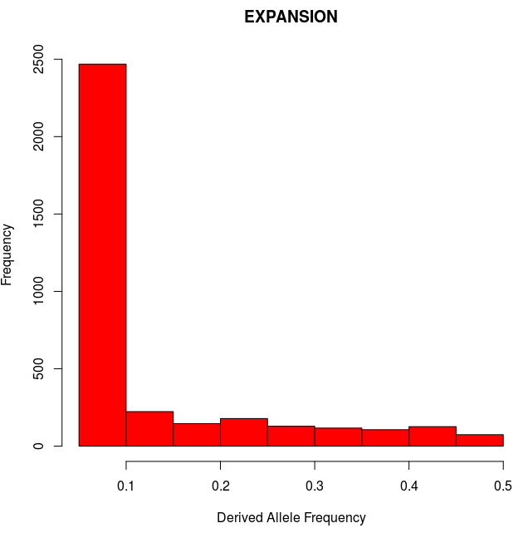
Demography matters?
n=20; L=500kbp; no selection
n=20; L=500kbp; no selection
K=1,390
Theta=392
Pi=390
D=-0.016
K=3,566
Theta=1,005
Pi=732
D=-1.14
Minor Allele Frequency
Minor Allele Frequency
Notes:
Here run some simulations assuming expansion (Africans?)… and show tajima’s D negative.
Draw together some conclusions on the effect of pop size expansion?
Then introduce 2 ways of correcting for this, empirical and simulations
Then show what D>0 means? Balancing selection and introduce it.

Slide 43
Demography matters!
n=20; L=500kbp; no selection
n=20; L=500kbp; no selection
K=1,390
Theta=392
Pi=390
D=-0.016
K=3,566
Theta=1,005
Pi=732
D=-1.14
Minor Allele Frequency
Minor Allele Frequency
Notes:
Here run some simulations assuming expansion (Africans?)… and show tajima’s D negative.
Draw together some conclusions on the effect of pop size expansion?
Then introduce 2 ways of correcting for this, empirical and simulations
Then show what D>0 means? Balancing selection and introduce it.

Slide 44
Demography matters!
n=20; L=500kbp; no selection
n=20; L=500kbp; no selection
K=1,390
Theta=392
Pi=390
D=-0.016
K=3,566
Theta=1,005
Pi=732
D=-1.14
Minor Allele Frequency
Minor Allele Frequency
Excess of segregating sites
Excess of low-frequency variants
SFS-derived summary statistics may fail to distinguish between the effects of demography and selection
Notes:
Here run some simulations assuming expansion (Africans?)… and show tajima’s D negative.
Draw together some conclusions on the effect of pop size expansion?
Then introduce 2 ways of correcting for this, empirical and simulations
Then show what D>0 means? Balancing selection and introduce it.

Slide 45
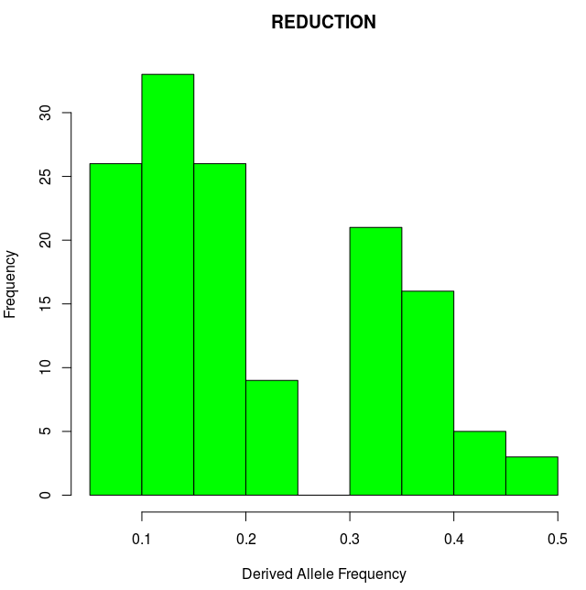
Demography matters?
n=20; L=500kbp; no selection
n=20; L=500kbp; no selection
K=1,390
Theta=392
Pi=390
D=-0.016
K=139
Theta=39
Pi=47
D=0.83
Minor Allele Frequency
Minor Allele Frequency
Notes:
Here run some simulations assuming expansion (Africans?)… and show tajima’s D negative.
Draw together some conclusions on the effect of pop size expansion?
Then introduce 2 ways of correcting for this, empirical and simulations
Then show what D>0 means? Balancing selection and introduce it.

Slide 46
Demography matters!
n=20; L=500kbp; no selection
n=20; L=500kbp; no selection
K=1,390
Theta=392
Pi=390
D=-0.016
K=139
Theta=39
Pi=47
D=0.83
Minor Allele Frequency
Minor Allele Frequency
Notes:
Here run some simulations assuming expansion (Africans?)… and show tajima’s D negative.
Draw together some conclusions on the effect of pop size expansion?
Then introduce 2 ways of correcting for this, empirical and simulations
Then show what D>0 means? Balancing selection and introduce it.

Slide 47
Demography matters!
n=20; L=500kbp; no selection
n=20; L=500kbp; no selection
K=1,390
Theta=392
Pi=390
D=-0.016
K=139
Theta=39
Pi=47
D=0.83
Minor Allele Frequency
Minor Allele Frequency
Depletion of segregating sites
Excess of intermediate-frequency variants
SFS-derived summary statistics may fail to distinguish between the effects of demography and selection
Notes:
Here run some simulations assuming expansion (Africans?)… and show tajima’s D negative.
Draw together some conclusions on the effect of pop size expansion?
Then introduce 2 ways of correcting for this, empirical and simulations
Then show what D>0 means? Balancing selection and introduce it.

Slide 48
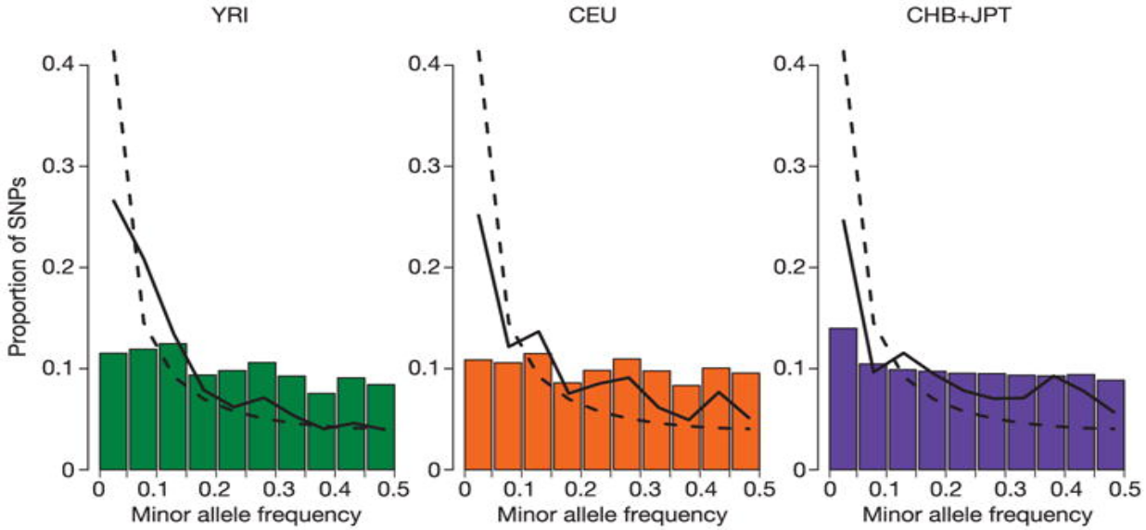
Experimental design matters!
The effect of ascertainment bias
Deficiency of low-frequency variants
HapMap Consortium. Nature 2005
Notes:
Another bias that may mimic balancing selection (mention also ancient pop structure)

Slide 49
How to take neutral confounding factors into account?
Under constant population size:
Tajima’s D
2
.
.
.
.
.
.
.
.
.
.
.
.
.
.
.
E[D]~0
0
-2
Genome / Chromosome
Notes:
Here run some simulations assuming expansion (Africans?)… and show tajima’s D negative.
Draw together some conclusions on the effect of pop size expansion?
Then introduce 2 ways of correcting for this, empirical and simulations
Then show what D>0 means? Balancing selection and introduce it.

Slide 50
How to take neutral confounding factors into account?
Under expanding population size:
Tajima’s D
2
0
.
.
.
.
.
.
.
.
.
.
.
.
.
.
.
E[D]<0
-2
Genome / Chromosome
Notes:
Here run some simulations assuming expansion (Africans?)… and show tajima’s D negative.
Draw together some conclusions on the effect of pop size expansion?
Then introduce 2 ways of correcting for this, empirical and simulations
Then show what D>0 means? Balancing selection and introduce it.

Slide 51
How to take neutral confounding factors into account?
Under expanding population size and positive selection:
Tajima’s D
2
0
.
.
.
.
.
.
.
.
.
.
.
.
.
.
E[D]<0
.
-2
Genome / Chromosome
Demography affects all loci equally, while selection changes local patterns
Notes:
Here run some simulations assuming expansion (Africans?)… and show tajima’s D negative.
Draw together some conclusions on the effect of pop size expansion?
Then introduce 2 ways of correcting for this, empirical and simulations
Then show what D>0 means? Balancing selection and introduce it.

Slide 52
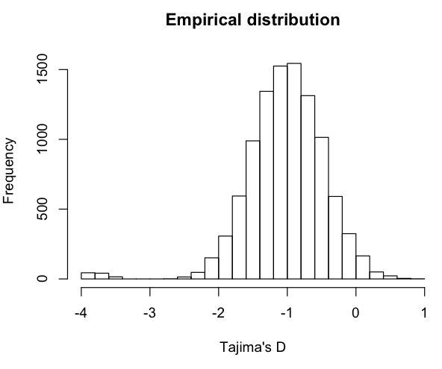
Outlier approach
Tajima’s D
2
0
.
.
.
.
.
.
.
.
.
.
.
.
.
.
E[D]<0
.
-2
Genome / Chromosome
Assign empirical p-values
(ranked percentiles)
Notes:
Here run some simulations assuming expansion (Africans?)… and show tajima’s D negative.
Draw together some conclusions on the effect of pop size expansion?
Then introduce 2 ways of correcting for this, empirical and simulations
Then show what D>0 means? Balancing selection and introduce it.

Slide 53
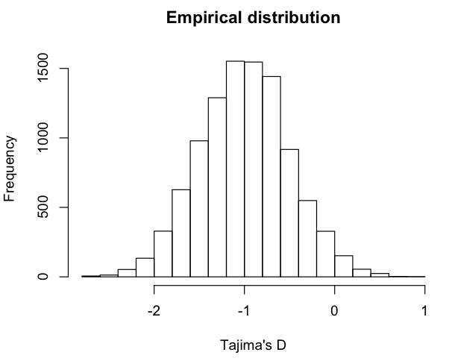
Outlier approach
Tajima’s D
2
0
.
.
.
.
.
.
.
.
.
.
.
.
.
.
E[D]<0
.
-2
Genome / Chromosome
?
Assign empirical p-values
(ranked percentiles)
Notes:
Gene ontology or pathway enrichment analyses, you will always get some outliers
An alternative is to use a demographic model

Slide 54
How to take neutral confounding factors into account?
Under expanding population size and positive selection:
Tajima’s D
2
But we know what’s driving the expected distribution
0
E[D]<0
.
-2
Genome / Chromosome
Demography affects all loci equally, while selection changes local patterns
What should we do if we don’t have genome-wide data?
Notes:
Here run some simulations assuming expansion (Africans?)… and show tajima’s D negative.
Draw together some conclusions on the effect of pop size expansion?
Then introduce 2 ways of correcting for this, empirical and simulations
Then show what D>0 means? Balancing selection and introduce it.

Slide 55
Simulations-based approach
Tajima’s D
2
0
E[D]<0
.
-2
Genome / Chromosome
Known demographic model
N0
T
N1
N1
Notes:
Here run some simulations assuming expansion (Africans?)… and show tajima’s D negative.
Draw together some conclusions on the effect of pop size expansion?
Then introduce 2 ways of correcting for this, empirical and simulations
Then show what D>0 means? Balancing selection and introduce it.

Slide 56
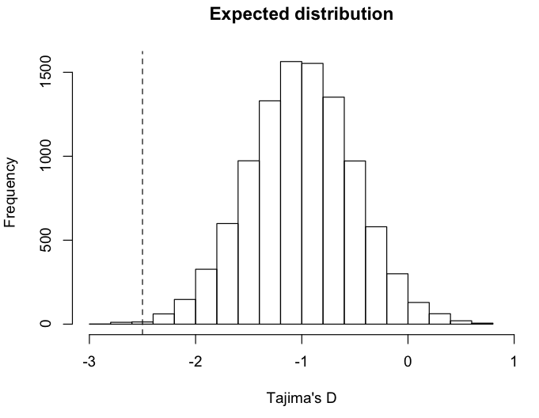
Simulations-based approach
Tajima’s D
2
0
E[D]<0
.
-2
Assign p-values
(based on ranked percentile of observed value)
Genome / Chromosome
Known demographic model
N0
T
N1
N1
Notes:
Here run some simulations assuming expansion (Africans?)… and show tajima’s D negative.
Draw together some conclusions on the effect of pop size expansion?
Then introduce 2 ways of correcting for this, empirical and simulations
Then show what D>0 means? Balancing selection and introduce it.

