Slide 1
Supplementary material

Slide 2
Positive selection
t<T_{sel}
…
t>>T_{sel}
?
Notes:
Reduced number of polymorphisms, but need to derive some indexes of nucleotide diversity taking into account the sample size for instance

Slide 3
Positive selection
t<T_{sel}
…
t>>T_{sel}
?
Notes:
Reduced number of polymorphisms, but need to derive some indexes of nucleotide diversity taking into account the sample size for instance

Slide 4
Extended Haplotype Homozygosity
t>>T_{sel}
…
t>>>T_{sel}
…
Notes:
In practise it is more complicated due to mutation….

Slide 5
Extended Haplotype Homozygosity
t>>T_{sel}
…
t>>>T_{sel}
…
Notes:
In practise it is more complicated due to mutation….

Slide 6
Extended Haplotype Homozygosity
t>>T_{sel}
…
t>>>T_{sel}
…
Notes:
In practise it is more complicated due to mutation….

Slide 7
Extended Haplotype Homozygosity
t>>T_{sel}
…
t>>>T_{sel}
…
Notes:
In practise it is more complicated due to mutation….

Slide 8
Extended Haplotype Homozygosity
t>>T_{sel}
…
t>>>T_{sel}
…
Notes:
In practise it is more complicated due to mutation….

Slide 9
Extended Haplotype Homozygosity
t>>T_{sel}
…
t>>>T_{sel}
…
Notes:
In practise it is more complicated due to mutation….

Slide 10
Extended Haplotype Homozygosity
t>>T_{sel}
…
t>>>T_{sel}
…
Notes:
In practise it is more complicated due to mutation….

Slide 11
Extended Haplotype Homozygosity
t>>T_{sel}
…
t>>>T_{sel}
…
Notes:
In practise it is more complicated due to mutation….

Slide 12
Extended Haplotype Homozygosity
t>>T_{sel}
…
t>>>T_{sel}
…
Notes:
In practise it is more complicated due to mutation….

Slide 13
Extended Haplotype Homozygosity
t>>T_{sel}
…
t>>>T_{sel}
…
Notes:
In practise it is more complicated due to mutation….

Slide 14
Extended Haplotype Homozygosity
t>>T_{sel}
…
t>>>T_{sel}
…
Notes:
In practise it is more complicated due to mutation….

Slide 15
Extended Haplotype Homozygosity
t>>T_{sel}
…
t>>>T_{sel}
…
Notes:
In practise it is more complicated due to mutation….

Slide 16
Extended Haplotype Homozygosity
t>>T_{sel}
…
t>>>T_{sel}
…
Notes:
In practise it is more complicated due to mutation….

Slide 17
Extended Haplotype Homozygosity
t>>T_{sel}
…
t>>>T_{sel}
…
Notes:
In practise it is more complicated due to mutation….

Slide 18
Extended Haplotype Homozygosity
t>>T_{sel}
…
t>>>T_{sel}
…
Notes:
In practise it is more complicated due to mutation….

Slide 19
Extended Haplotype Homozygosity
t>>T_{sel}
…
t>>>T_{sel}
…
Notes:
In practise it is more complicated due to mutation….

Slide 20
Extended Haplotype Homozygosity
t>>T_{sel}
…
t>>>T_{sel}
…
Notes:
In practise it is more complicated due to mutation….

Slide 21
Integrated Haplotype Score
1
1
1
1
1
1
0
0
1
1
1
0
0
1
1
1
1
0
1
1
1
1
1
1
1
0
1
0
0
0
0
1
0
0
0
0
x=-2
x=-1
x=0
x=+1
x=+2
x=+3
1
For the derived allele
0
cM
1
For the ancestral allele
0
cM
Notes:
Rather than actual values of EHH, the decay (against physical of genetic map) is the important feature

Slide 22
Integrated Haplotype Score
1
1
1
1
1
1
0
0
1
1
1
0
0
1
1
1
1
0
1
1
1
1
1
1
1
0
1
0
0
0
0
1
0
0
0
0
x=-2
x=-1
x=0
x=+1
x=+2
x=+3
1
For the derived allele
0
cM
1
For the ancestral allele
0
cM
Notes:
Rather than actual values of EHH, the decay (against physical of genetic map) is the important feature

Slide 23
Integrated Haplotype Score
1
1
1
1
1
1
0
0
1
1
1
0
0
1
1
1
1
0
1
1
1
1
1
1
1
0
1
0
0
0
0
1
0
0
0
0
x=-2
x=-1
x=0
x=+1
x=+2
x=+3
1
For the derived allele
0
cM
1
For the ancestral allele
0
cM
Notes:
Rather than actual values of EHH, the decay (against physical of genetic map) is the important feature

Slide 24
Cross-population
Extended Haplotype Homozygosity
1
1
1
1
1
1
0
0
1
1
1
0
0
1
1
1
1
0
1
1
1
1
1
1
1
0
1
0
0
0
0
1
0
0
0
0
x=-2
x=-1
x=0
x=+1
x=+2
x=+3
1
iHH_{A}
Integrated haplotype homozygosity (iHH)
for populations A and B
0
cM
1
iHH_{B}
0
cM
Integrated haplotype score:
XP-EHH = ln(iHH_{A}/iHH_{B})
Genome-wide normalization in frequency bins
(to mean=0 and sd=1)
Notes:
Rather than actual values of EHH, the decay (against physical of genetic map) is the important feature

Slide 25
Outline
Brief introduction to natural selection
Inferring selection at the intra-species level using summary statistics
PRACTICAL: detecting selection from low-depth NGS data
The effect of demography on selection scans
PRACTICAL: quantifying selection using ABC
(Experimental design)
Notes:
Broad overview on adaptation to environments

Slide 26


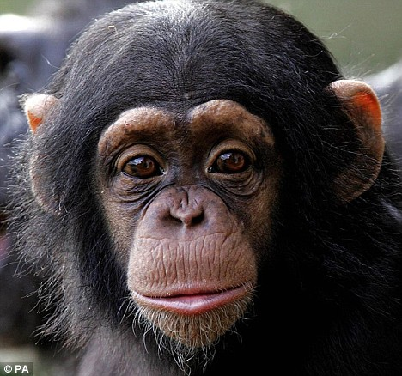
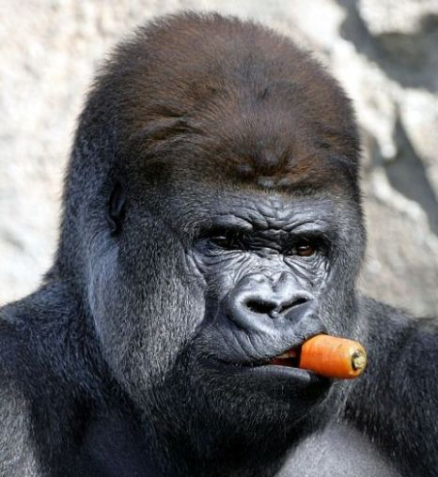
Inter-species variation
Inter-species
Intra-species
events in the deep past, macro-evolutionary trends, selection between species
Notes:
These changes typically occur at a longer time-scale.
Why is there the need of using different tools to detect selection at the inter-species level?
Let’s see a case study to understand why we need different methods in this case.

Slide 27
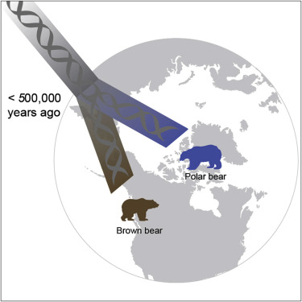
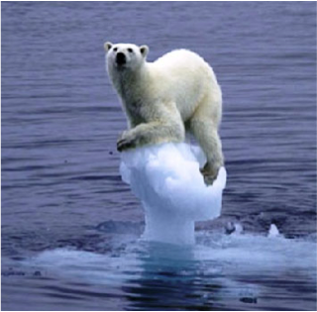
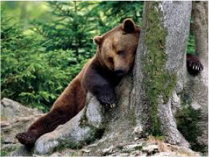
Polar bears vs. Brown bears
Question: what are the genetic signatures of polar bears’ adaptation to the Arctic environment?
Notes:
Why should we care about polar bears? Polar bears are an iconic species in evolutionary biology. Despite their relatively recent divergence from brown bears, they completely differ in their physiology, ecology and behavior suggesting a rapid evolutionary adaptation.
What is the first thing to do? Go there and collect samples.

Slide 28
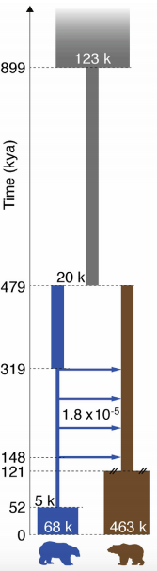
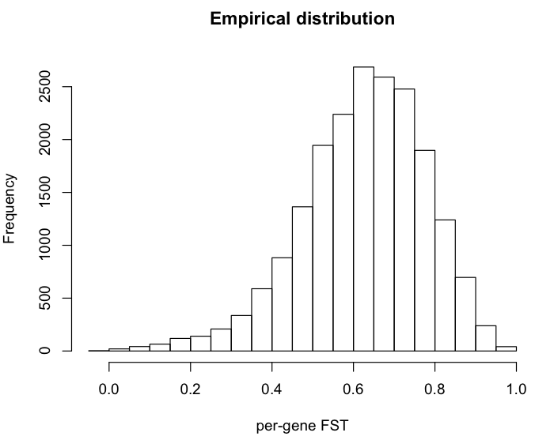
Expected genetic differentiation
Notes:
Under this demographic model the expected distribution of the FST values is this one.
As you can see, this distribution is very skewed towards high values.

Slide 29
Expected genetic differentiation
Notes:
Under this demographic model the expected distribution of the FST values is this one.
As you can see, this distribution is very skewed towards high values.

Slide 30
Expected genetic differentiation
Notes:
Under this demographic model the expected distribution of the FST values is this one.
As you can see, this distribution is very skewed towards high values.

Slide 31
Inferring inter-species selection
Inter-species
Fixed substitutions
Polymorphisms
Intra-species
Notes:
Polymorphism levels depends on local mutation rates: under neutral evolution, the amount of within- and between-species diversity is expected to be similar across all loci in the genome.

Slide 32
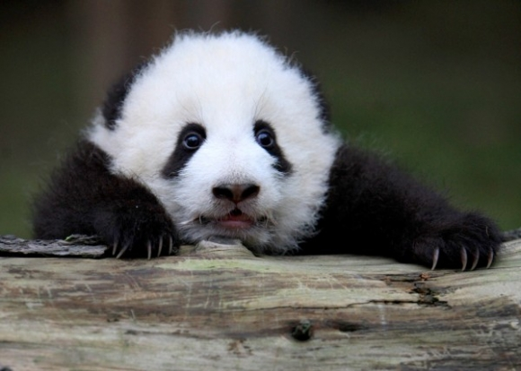
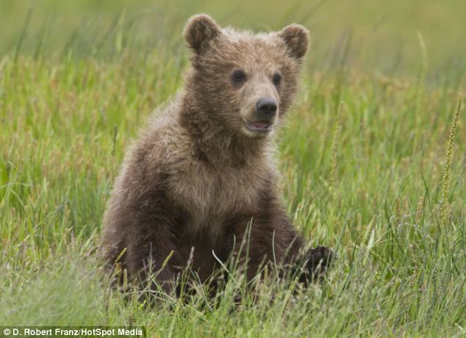
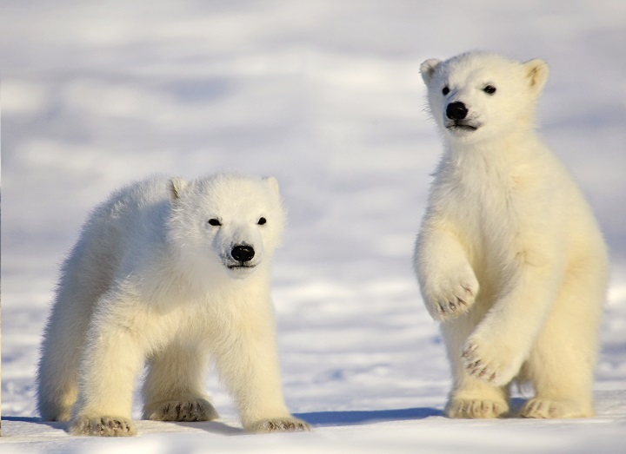
Polymorphisms and divergence
As both depend on mutation rates, and levels are expected to be proportional.

Slide 33
Polymorphisms and divergence
As both depend on mutation rates, and levels are expected to be proportional.

Slide 34
Polymorphisms and divergence
As both depend on mutation rates, and levels are expected to be proportional.

Slide 35
Polymorphisms and divergence
As both depend on mutation rates, and levels are expected to be proportional.

Slide 36
Polymorphisms and divergence
As both depend on mutation rates, and levels are expected to be proportional.

Slide 37
Polymorphisms and divergence
As both depend on mutation rates, and levels are expected to be proportional.

Slide 38
Polymorphisms and divergence
As both depend on mutation rates, and levels are expected to be proportional.

Slide 39
Polymorphisms and divergence
As both depend on mutation rates, and levels are expected to be proportional.

Slide 40
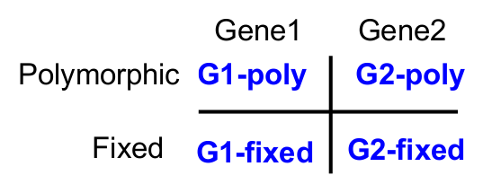
HKA test
Hudson-Kreitman-Aguadè (HKA, Hudson et al. 1987) test
Contingency table 2x2: chi-square test
Under investigation
Control / Neutrally evolving

Slide 41
HKA test
Hudson-Kreitman-Aguadè (HKA, Hudson et al. 1987) test
Contingency table 2x2: chi-square test
Under investigation
Control / Neutrally evolving

Slide 42
HKA test
Hudson-Kreitman-Aguadè (HKA, Hudson et al. 1987) test
Contingency table 2x2: chi-square test
Under investigation
Control / Neutrally evolving

Slide 43
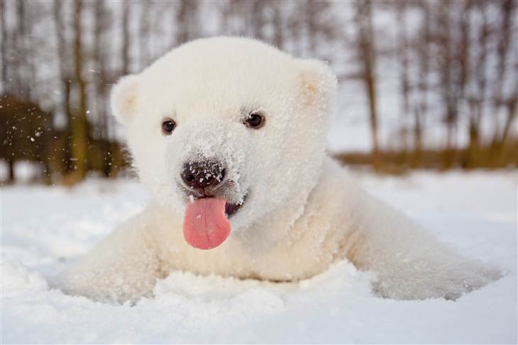
Coding polymorphisms
Substitutions in the coding regions may alter (non-synonymous) or not (synonymous) the protein sequence:
ATC CAA …
I Q
ATA GAA …
I K
ATG CAG …
M Q
Ancestral sequence
Species 1
Species 2
Non-synonymous
Synonymous
Notes:
Synonymous rate as baseline, considered as neutral evolving

Slide 44
dN/ds
Comparison between rate of nonsynonymous substitutions and rate of synonymous substitutions (also called K_{a}/K_{s} or ω)
Non-synonymous
Synonymous
Positive selection
(novel proteins)
K_{a}/K > 1
Negative selection
(against deleterious mutations
K_{a}/K <1
Notes:
Synonymous rate as baseline

Slide 45
Coding polymorphisms and divergence
Compare the amount of variation within a species to the divergence between species at non-synonymous and synonymous variants.
Non-synonymous
Synonymous
Substitutions
Polymorphisms
Notes:
Synonymous rate as baseline

Slide 46
MK (McDonald–Kreitman) test
Non-synonymous
Synonymous
Substitutions
Polymorphisms
Non-synonymous
Synonymous
Divergence
Polymorphisms
Notes:
Synonymous rate as baseline

Slide 47
MK (McDonald–Kreitman) test
Non-synonymous
Synonymous
Substitutions
Polymorphisms
Non-synonymous
Synonymous
Divergence
Polymorphisms
Notes:
Synonymous rate as baseline

Slide 48
MK (McDonald–Kreitman) test
Non-synonymous
Synonymous
Substitutions
Polymorphisms
Non-synonymous
Synonymous
Divergence
Polymorphisms
Notes:
Synonymous rate as baseline

Slide 49
MK (McDonald–Kreitman) test
Non-synonymous
Synonymous
Substitutions
Polymorphisms
Non-synonymous
Synonymous
Divergence
Polymorphisms
Notes:
Synonymous rate as baseline

Slide 50
Summary
Methods to detect signatures of selection are grouped based on:
time of selection
summary statistics used
Assessing statistical significance through empirical or expected distributions
Investigating complex models of selection and adaptation

