Slide 1
Ceng 356
Wiimote Project
Mateus Mendonça

Slide 2
Tools used
SDL
  Window and keyboard Events Management
OpenGL
  Graphics Rendering
Socket
  Linux Ethernet Communication
Wiiuse
  Wiimote Control Interface

Slide 3
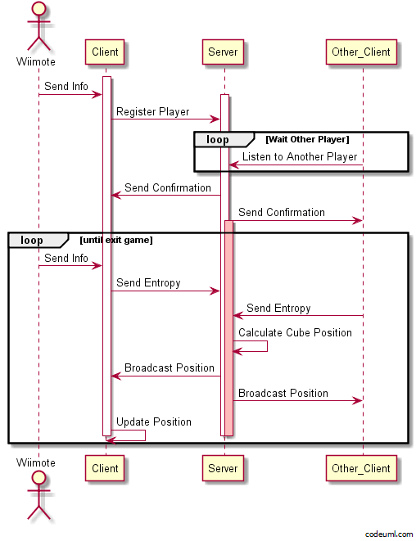
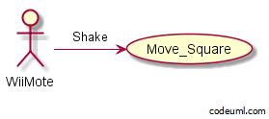
User Case/Event Sequence Diagram

Slide 4
References
Socket
  www.linuxhowtos.org/C_C++/socket.htm
Wiiuse
  http://www.macs.hw.ac.uk/~ruth/year4VEs/Labs/wiiuse.html
SDL and OpenGL
  http://lazyfoo.net/
UML
  http://www.codeuml.com/

