Slide 1
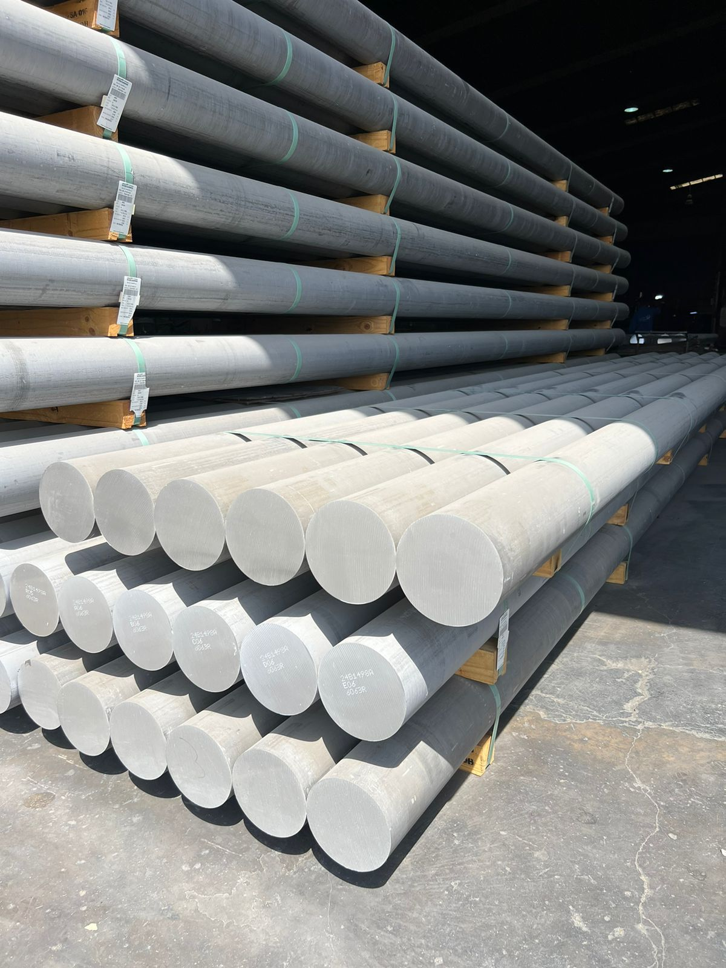
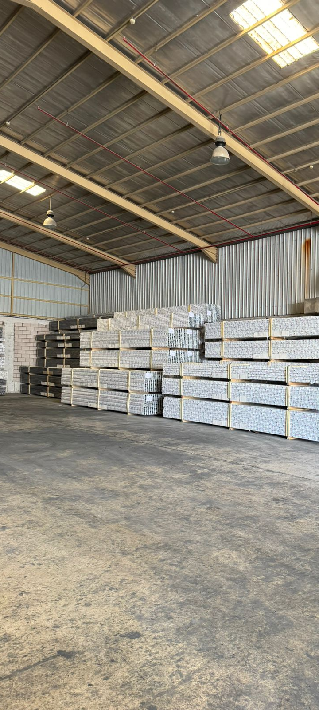
Aluminum Extrusion Factory
MADE BY:
Mohammed Al Yami

Slide 2
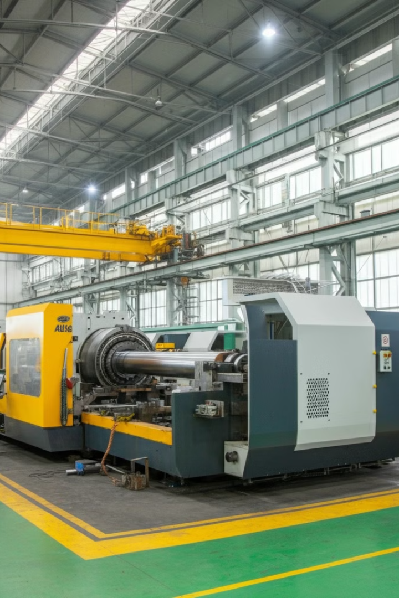
INTRODUCTION
An aluminum extrusion factory that transforms heated aluminum billets into customized shapes by forcing them through a die. This process produces high-quality components used in various industries, including construction and automotive manufacturing. The resulting products are valued for their strength, precision, and versatility.

Slide 3
Aluminum Extrusion Process Overview
Billet Storage and Crane Transfer
Heating
Extrusion
Cutting
Aging
Powder Coating
Billets are unloaded and moved by crane from storage to the heater, to the beginning of the production line.
Billets are heated to achieve the necessary malleability for extrusion.
Heated billets are pressed through dies to form profiles, then cooled to solidify and retain their shape.
Profiles are cut to specified lengths, ensuring they meet requirements for further processing.
Selected profiles undergo heat treatment to enhance strength and hardness.
Coating lines add aesthetic and protective finishes, improving corrosion resistance.

Slide 4
Methodology
The methodology aims to replicate the chosen factory’s operations as accurately as possible in a real-world setting. By utilizing Arena simulation software, we can explore, analyze, and enhance the system’s performance.
The steps were as follows:
1-Research: Conducted factory visits to observe operations and gather data.
Interviewed industry professionals to gain insights into the process.
Reviewed technical documentation on the extrusion process.
2-Data collection: Observed the production line from billet unloading to final coating.
3-Analysis: Analysed each step to evaluate efficiency and quality.
Focused on key stages: heating, extrusion, cooling, heat treatment, and coating.
Assessed equipment performance and material handling techniques.
Calculated additional performance data like throughput, bottleneck analysis, and yield rates to understand the overall effectiveness of the system.

Slide 5
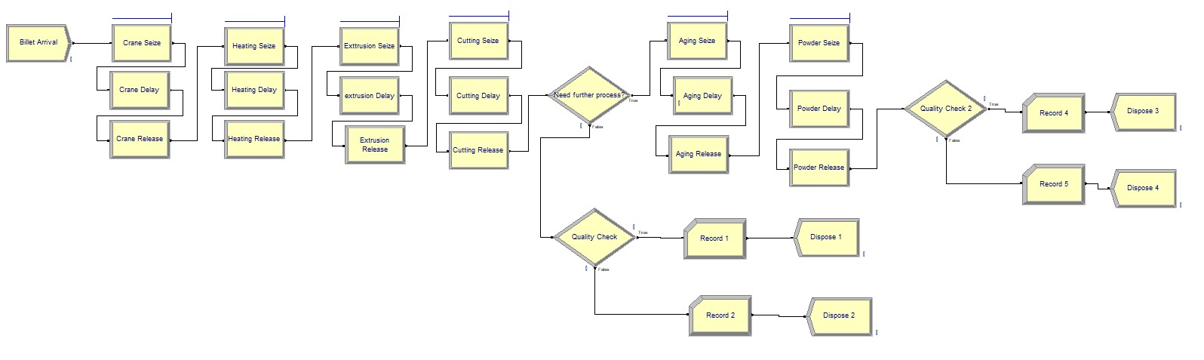
Current state
Insights
Quality check at the end of the production line, 25% – 27% defects
Crane transfer take 45 minutes for each billet
Aging oven take the longest process time of 210 minutes

Slide 6
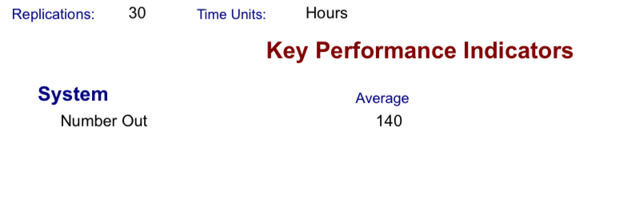
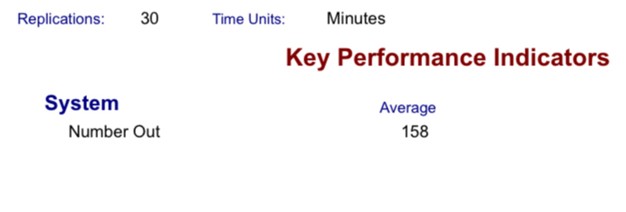
RESULTS
Before Improvement
After Improvement:
13% increase indicates that the changes made have successfully enhanced the system’s efficiency and lower the defects rate, leading to a higher production rate and better overall performance.

Slide 7
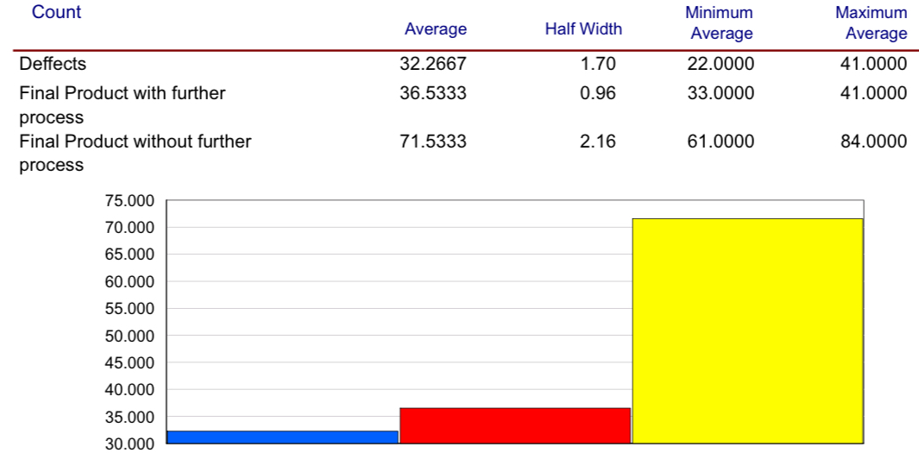
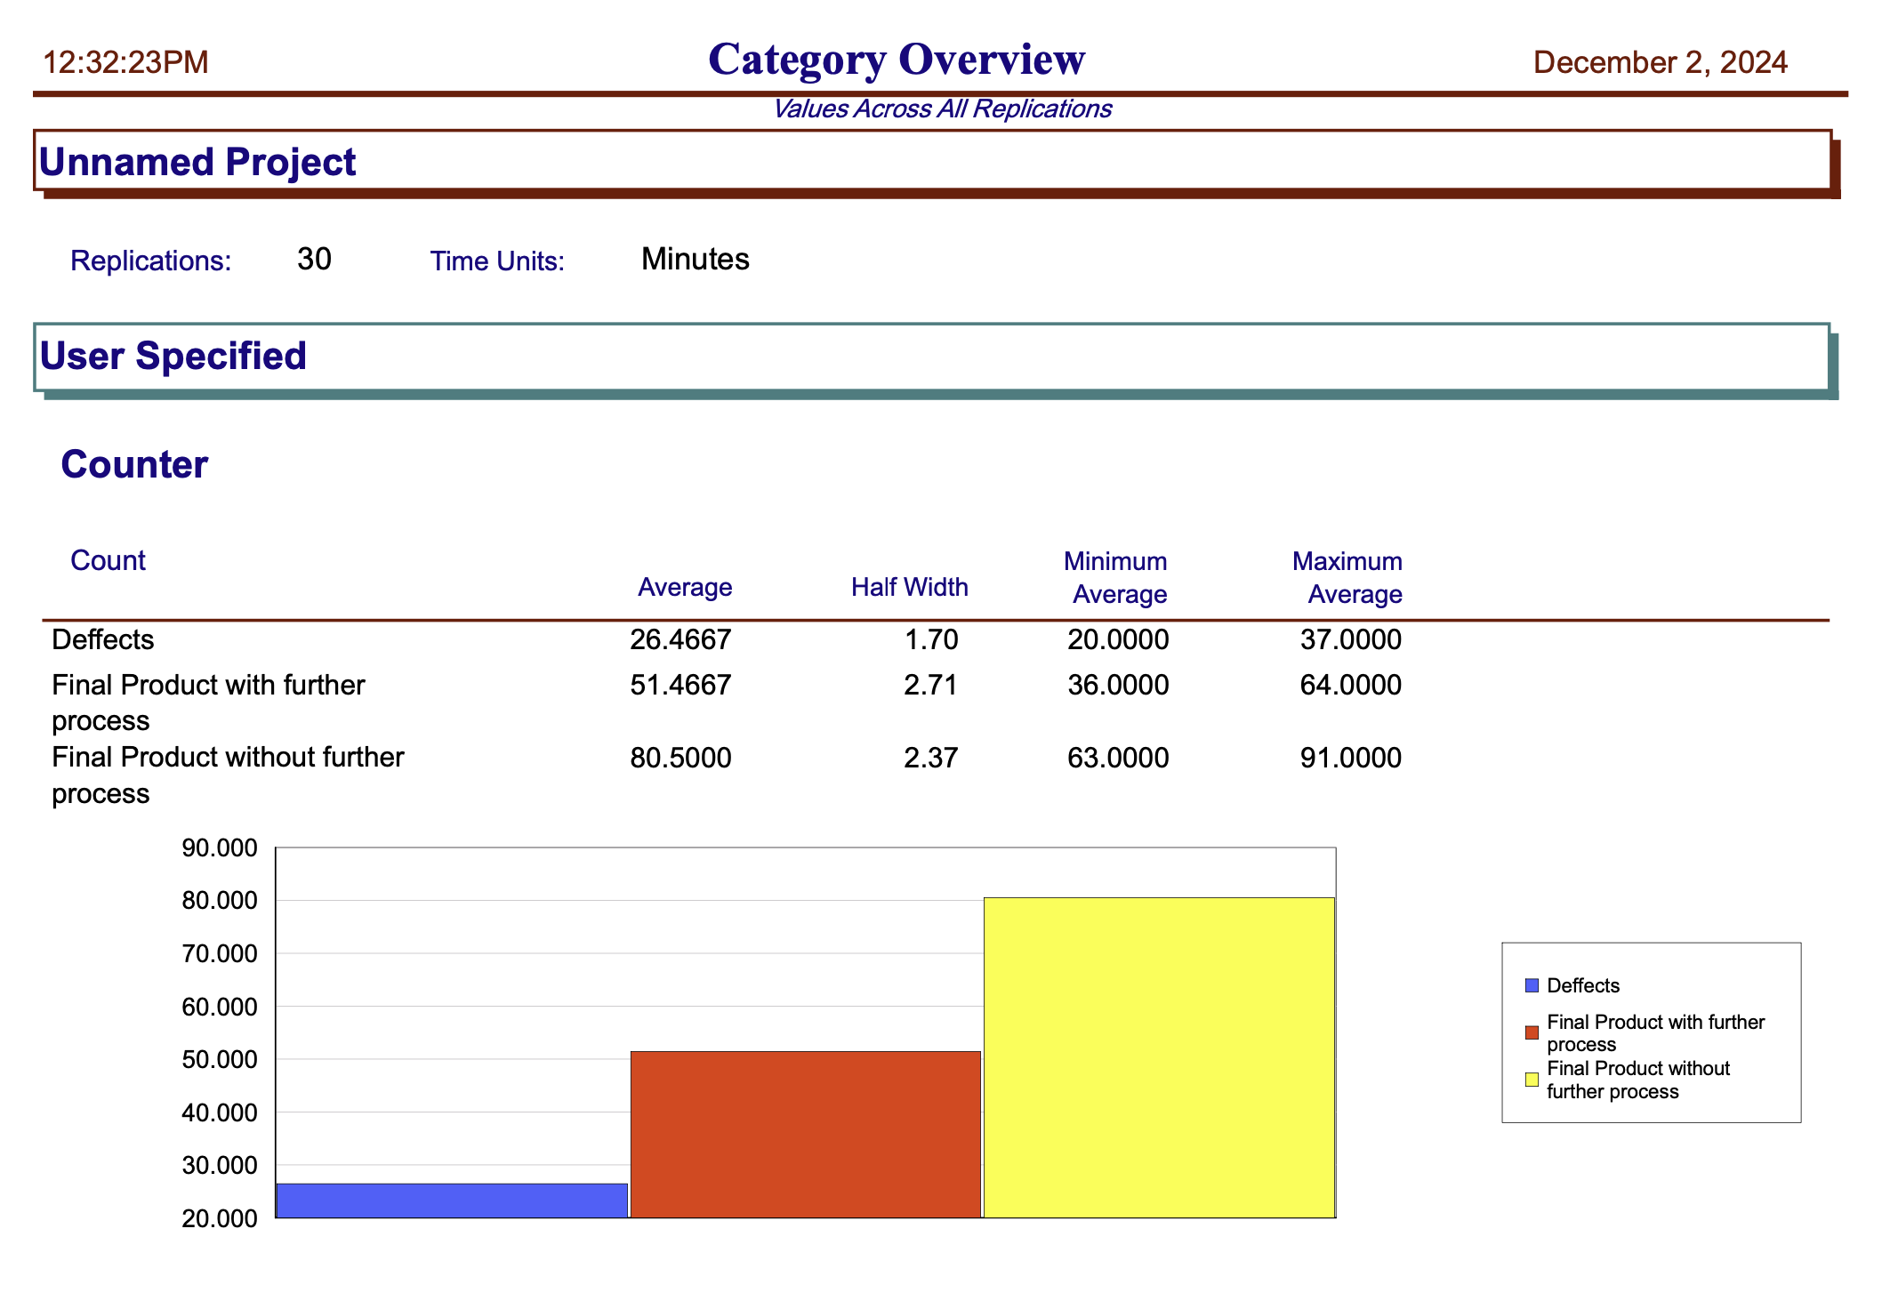
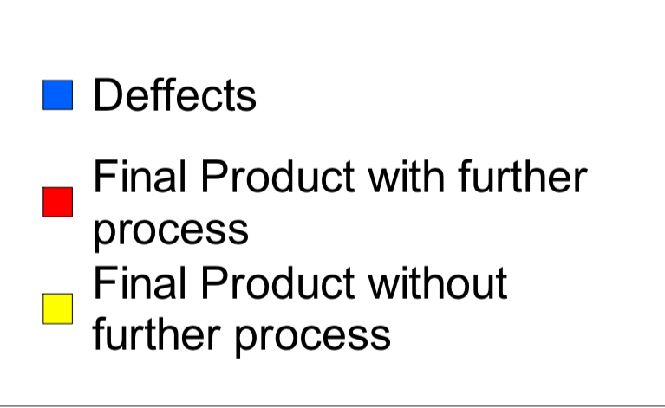
Before
After
This means that the improvements made to the system significantly reduced defects and increased production efficiency. Specifically:The reduction in defects from 23% to 16% shows that the quality of the raw materials or processes improved.
Red & yellow indicates that more high-quality products are being produced, both with and without additional processing steps.Overall, the improvements led to a more efficient and higher-quality production process.

Slide 8
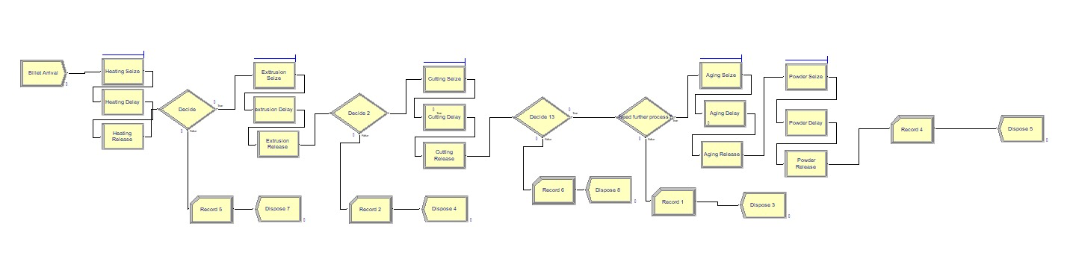
Improvement
How we improved the system?
Redesigned Layout: Separated entry and exit points for raw materials and finished products to reduce bottlenecks and enhance workflow.
Quality at Source: Integrated quality control measures early in the production process to detect and rectify defects promptly, reducing rework and waste.
Organizational Strategies: Applied 5S strategies to declutter workspaces, which significantly reduced defect rates, enhanced safety, and boosted overall production efficiency.

Slide 9

Challenges we have faced
1-Data Collection: Getting the right data from the factory was hard, but it was needed to make the model work properly.
2-Model Calibration: It was tricky to adjust the Arena model to match the factory. We had to compare the model with real data and fix it.
3-Finding Bottlenecks: It was hard to find where delays happened in the process, but we carefully looked at the material flow to find and fix them.

Slide 10
Conclusion
In conclusion, this project provided valuable insights into aluminum manufacturing processes. By simulating the extrusion process in Arena, we identified key areas for improvement, reduced defects, and increased production efficiency.
The improvements led to higher quality products and better overall output, both with and without further processing.
Ultimately, we were able to offer a viable solution to the challenges faced by aluminum factories, demonstrating the power of simulation in optimizing manufacturing operations.

