Slide 1
Portfolio optimization
Abdullah alsaleh ID 220110142
MOHAMMED ALYAMI ID 219110701

Slide 2
Markowitz MODEL
Harry Markowitz is awarded the Prize for having developed the theory of portfolio choice
IT IS CONVEINT WAY IN WHICH AN INVESTOR CAN ACTIVELY TRADE RISK AND RETURN

Slide 3
What is the problem
Develop an appropriate stock market investment portfolio based on historical stock market prices for companies Almarai Alhalawini and FirstMilles chosen over a period of days to maximize returns while minimizing risk.

Slide 4
1- decision variabel
Xm = fraction of partfolio to invenst in m
Xm → (0,1)
m-> ( 1,…c)

Slide 5
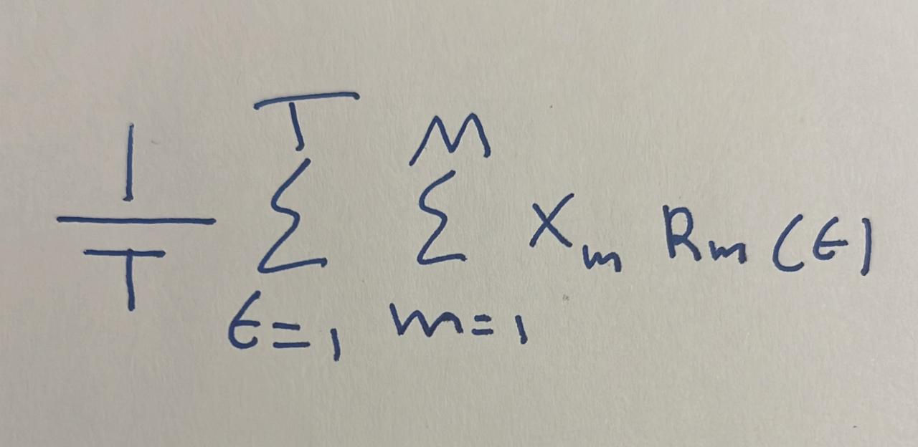
2- objective
🎯 Develop a stock investment portfolio using historical market data.
📈 Maximize expected returns while keeping portfolio risk below a set threshold.
🔍 Use quantitative models to simulate and evaluate portfolio performance.

Slide 6
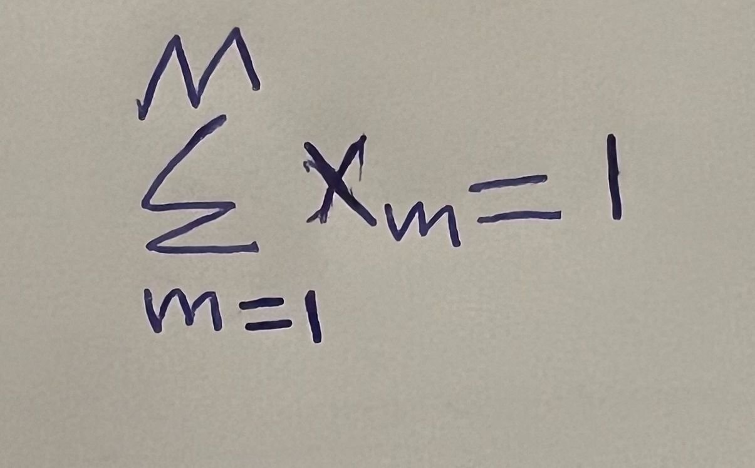
Constraints
1-
2- risk <= 0.4
3 Xm >= 0

Slide 7
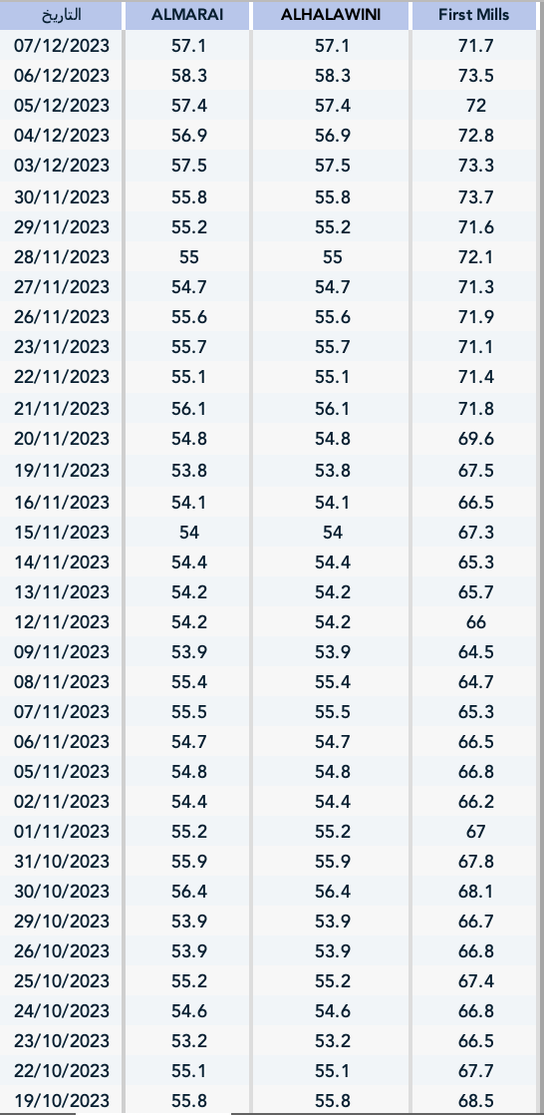
Solution steps
given data ( sample of historical stock market prices for companies Almarai
Alhalawini and FirstMilles )

Slide 8
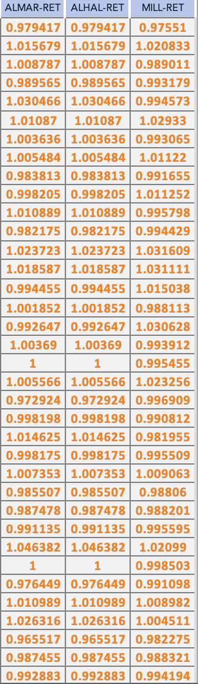
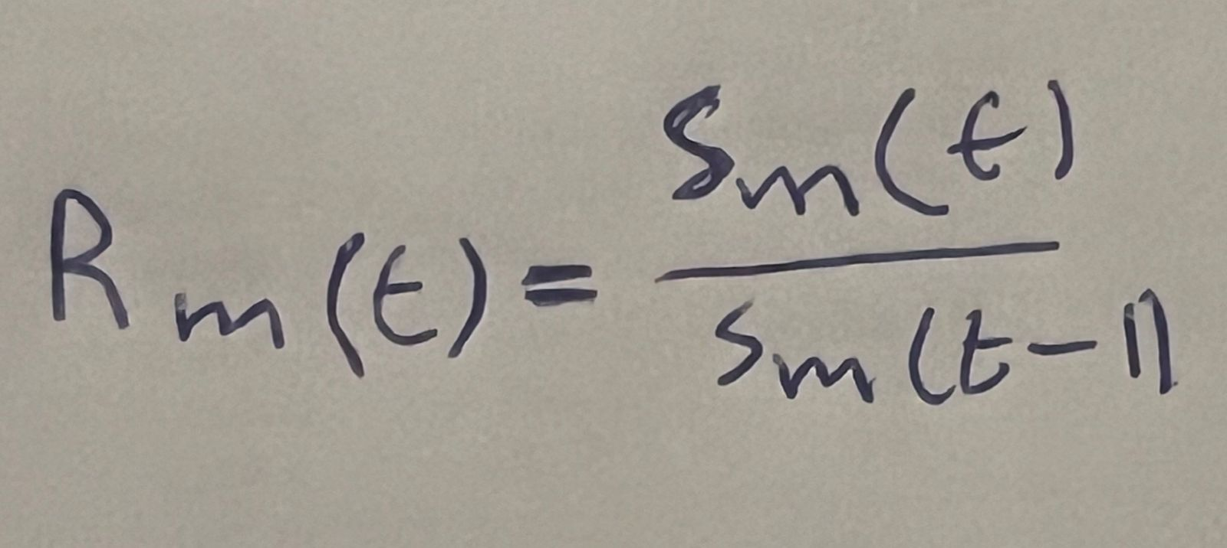
Excel steps
2- the return of each stock per day
Using the formula →

Slide 9

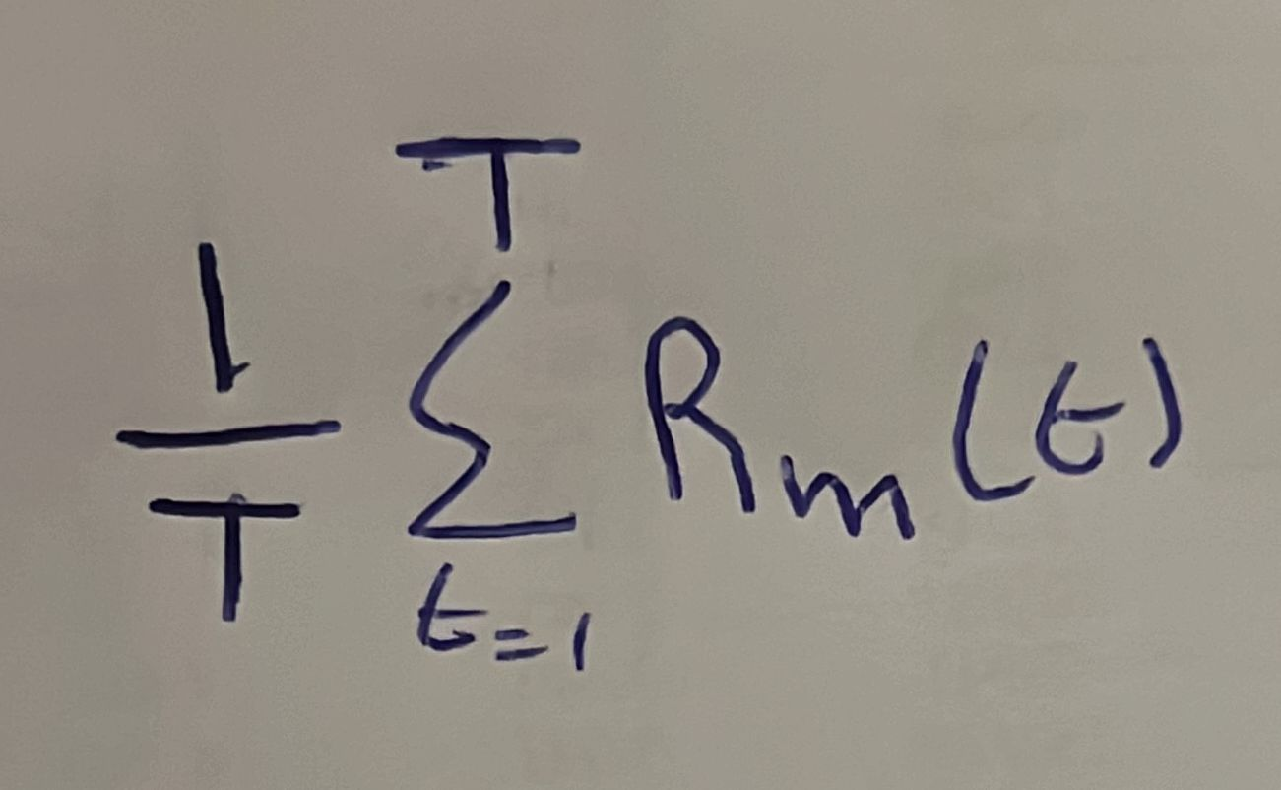
Excel steps
3- the avrage return from each company
Using this formula→

Slide 10
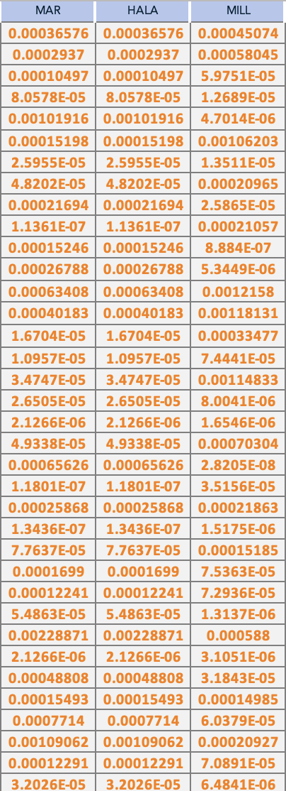
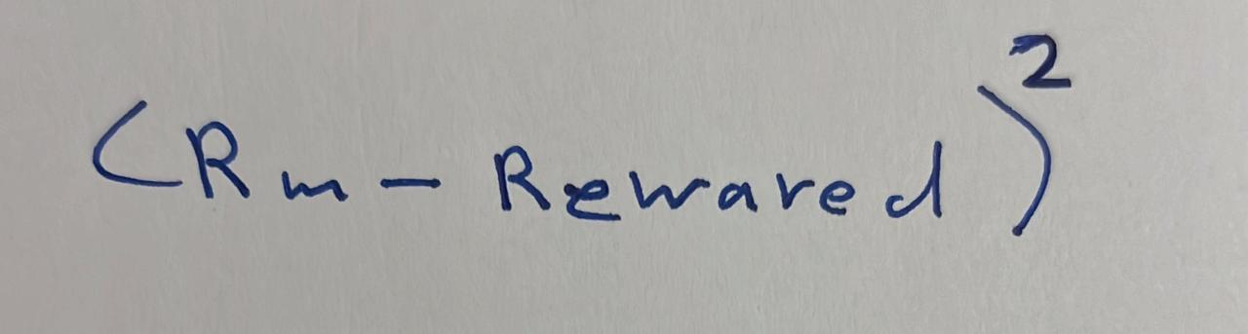
Excel steps
4- risk for each day from each company
Using the formula →

Slide 11
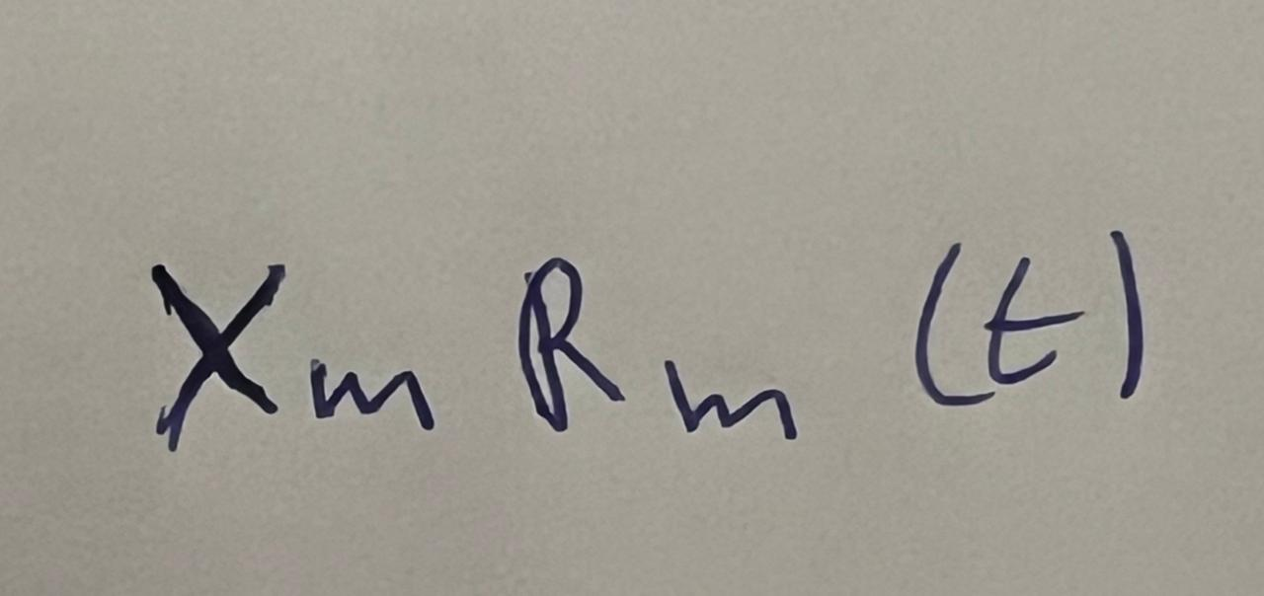
Exal steps
5- the retern of the stok ( per day)(after using the fraction portfolio)
Using the formula →

Slide 12
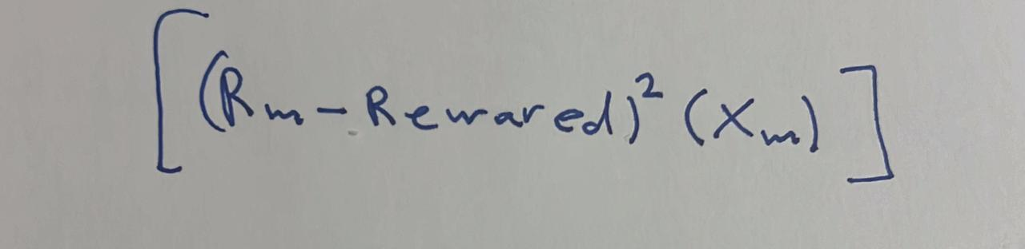
Exal steps
6 risk from investing the fraction of partfolio for each stok
Using the formula ->

Slide 13
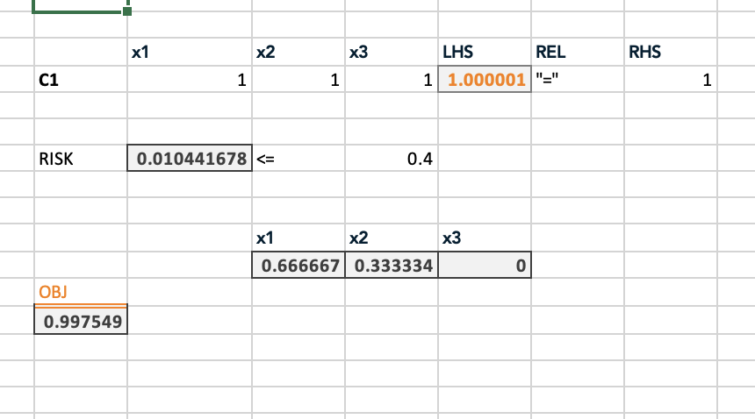
Exal steps
Final step using solver

