Slide 1
DRISHYAM
A DATA VISUALIZATION PROJECT
ON
GENDER EQUALITY IN ENTREPRENUERSHIP

Slide 2

PROJECT IDEA (GENDER EQUALITY)
Promoting equality for all employees should be a core focus for any business.
One should respect and protect the principles of fairness, dignity, diversity and respect for all workers.
Being a champion of workplace equality can be a significant sign to customers, industry, and prospective and existing employees that your business recognises the importance of providing equal opportunities.

Slide 3

PROJECT INTRODUCTION
Gender equality has been visualized in our project on the basis of –
Country that the person belongs to
Yearly basis
Type of work that one does

Slide 4

DATA DESCRIPTION
We have used the data provided by one of the featured 3rd party data providers, namely, CRUX Informatics.
This data is based upon gender equality in entrepreneurship.
Some of the attributes in the dataset include
Country name
Indicator (type of work)
Sex
Time (in year)

Slide 5

AWS Services used
AWS Data Exchange
Simple Storage Service (S3 bucket)
Glue
Athena
Quicksight

Slide 6

AWS DATA EXCHANGE
This is a service of Amazon which gives access to datasets provided by third-party data providers.
This data can further be used in other services of AWS using APIs.

Slide 7

AMAZON S3
It is a simple storage service which is present globally.
It stores data in the form of objects.
S3 can store data using buckets which have unique name.

Slide 8

AWS GLUE
It is a fully managed extract, transform, and load (ETL) service that makes it easy for users to analyse their data.
A Glue Crawler crawls through data lakes in S3 , finds the tables and the associated metadata.
The Glue Data Catalog stores the metadata of all the databases as well as their tables.

Slide 9

AwS Athena
A interactive serverless query service
Analysts do not need to stress about the underlying infrastructure.
Easily execute SQL queries on S3 data.

Slide 10

AWS quicksight
It is a business intelligence service for data visualization.
It lets you create interactive dashboards.
The dashboards can then be shared with anyone in an organization.

Slide 11
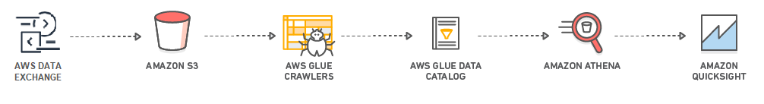
HOW IT WORKS

Slide 12
SOME SNAPS

Slide 13
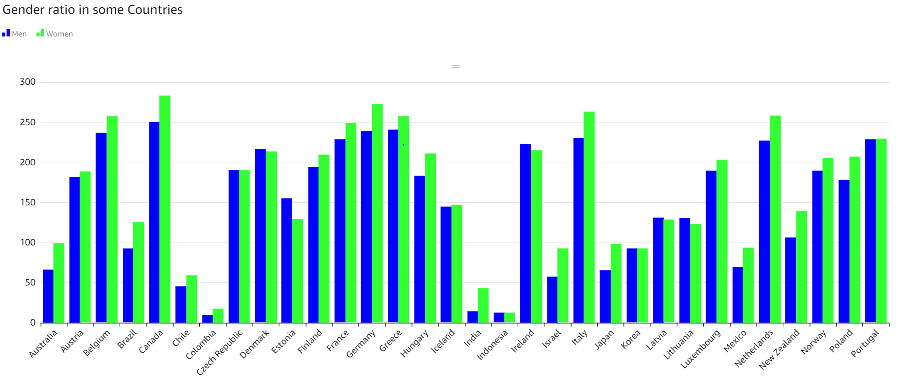

Slide 14
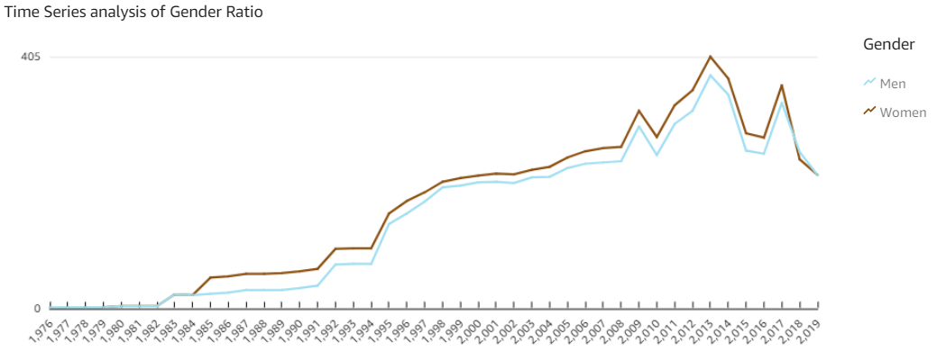

Slide 15
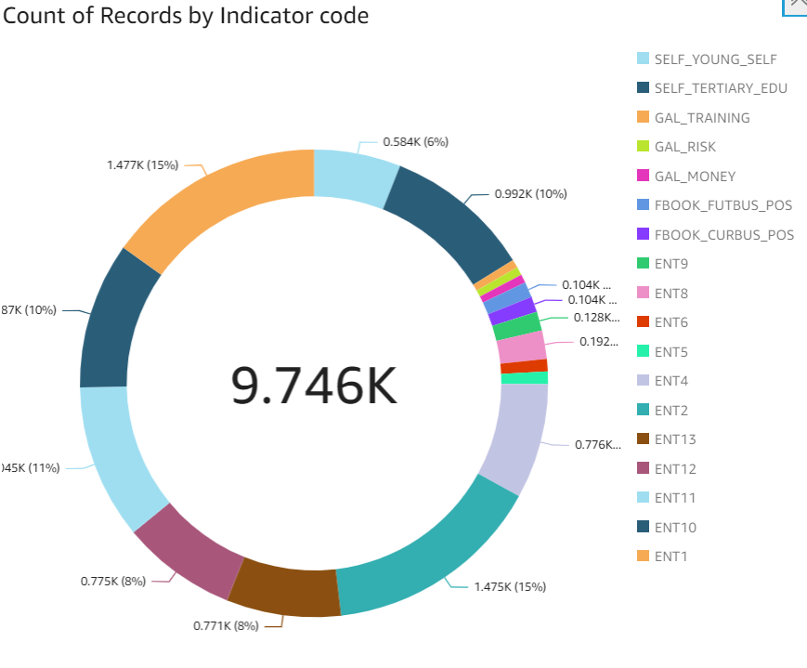


Slide 16

conclusion
From the dashboard, the following points can be interpreted
Since 1984, there has been a increase in the count of women entrepreneurs around the globe
In contrast to the general ideology, in entrepreneurship, women count is more as compared to the men count
There is an equality of working men as well as women in almost all the sectors as entrepreneurs.

Slide 17
THANK YOU
Mr. Firoj Siddique
Ms. Vibhuti Maheshwari

