Slide 1

Cryptography
Slides by miguel
22/11/2023
CTF Cafe

Slide 2
What is Crypto?
Encoding vs
Encryption
Maths!
Key Exchange, Symmetric, Asymmetric
Ciphers
Hashing
Data Representation

Slide 3

Encoding is NOT Encryption!
Encoding is a reversible process, involving changing data to a new format using a specific scheme. Encoding is often done to convert data to a usable format for a specific purpose, but not usually to protect data as it is trivial to reverse.
Encryption is also reversible – but can only be reversed by authorised users using a password or encryption key.
Hence, whilst encryption DOES involve encoding, it is only used to refer to data that has been securely encoded in this manner.

Slide 4
Some Key Terms
Plaintext — Data before encryption, often in the form of text in the context of CTFs.
Ciphertext — Data after encryption.
Brute force — Attacking cryptography by trying every possible password or key.
Cryptanalysis — Attacking cryptography by finding a weakness in an algorithm’s underlying maths.

Slide 5
Let’s start!

Slide 6
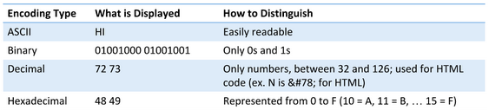
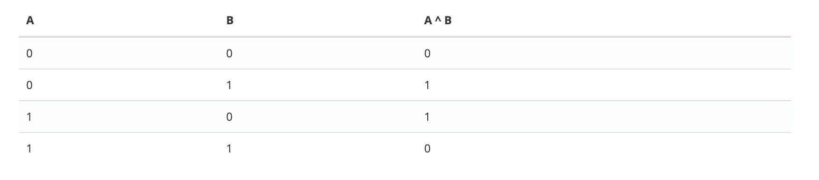
XOR – Single Byte and Multibyte

Slide 7
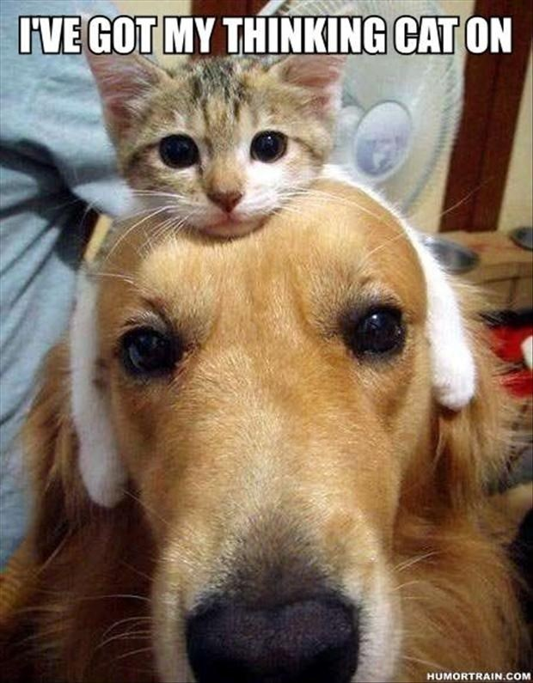
XOR – continued
Let’s do some decrypting together to demonstrate how things work in a CTF context:
Key: A, which is 41 in Hex.
We are given the ciphertext “boffe”, which is 62 6F 66 66 65 in Hex.
You should have got the answer “hello”!

Slide 8
Simple Ciphers
Ciphers are systems for encrypting or decrypting data. Some ciphers often count as encoding methods, but many aim to be solidly encrypted, ranging in complexity.
Caesar Cipher – the simplest kind of cipher. Shift each letter in the plaintext by a given number to the next letter in the alphabet. Also sometimes known by ROT13, meaning rotate by 13 places in the alphabet, and includes variants ROT1 to ROT25.
Substitution Cipher – similar in concept to Caesar, where each letter in plaintext is replaced by a different letter according to a given key. Caesar ciphers are technically a type of substitution cipher. Can often be cracked with frequency analysis, or a tool that I love called https://quipqiup.com/!

Slide 9
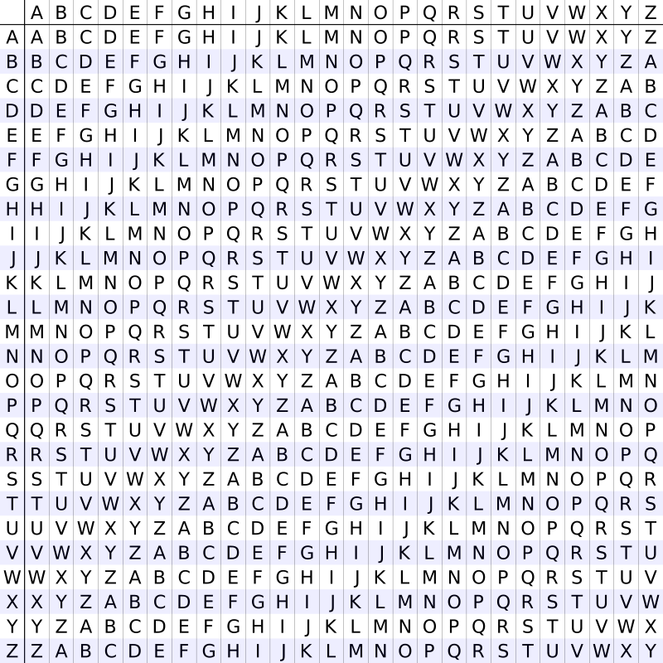
Harder Classical Ciphers…
Vigenere Cipher – still easily crackable with online tools, the Vigenere cipher is a Caesar cipher variant that uses a key. We pad out the key to the length of our plaintext, and then use each letter of the key as the row with our plaintext letter in the column within the table below, to find what letter to use in our ciphertext.
There are waaaay harder ciphers than Vigenere – this is really just the tip of the iceberg for classical cryptography!

Slide 10
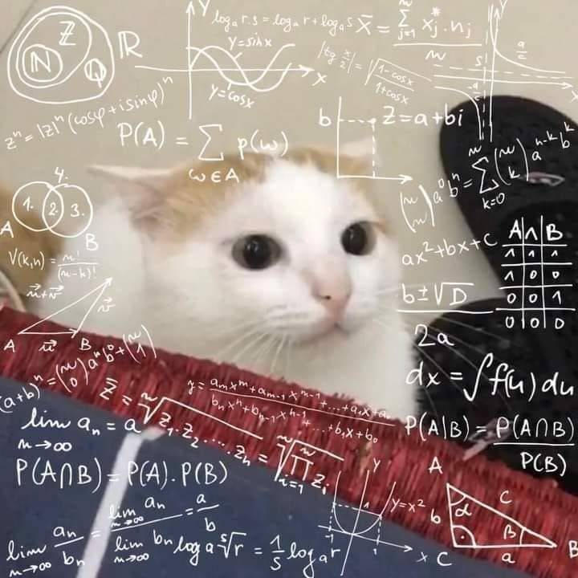
Hashing Functions
A hash function takes in an input of any size, and outputs a fixed-length summary, or “digest”, of that data.
A good hash function produces data that is hard to predict, and non-reversible – meaning you cannot get the input data from the output.
Hashing functions often utilise modular arithmetic!
Hence, theoretically, there are a set number of outputs for any hashing function. These can be placed in what we refer to as rainbow tables.

Slide 11

Hashing Functions – continued
In the context of CTFs, there are many hashing functions which have been proven insecure for various reasons.
“In March 2005, Xiaoyun Wang and Hongbo Yu of Shandong University in China published an article in which they described an algorithm that can find two different sequences of 128 bytes with the same MD5 hash.”
These attacks can even be used to create files with identical hashes!

Slide 12

Hashing Functions - Tools
Commands like md5sum or shasum can help find hashes of files or strings in the Terminal.
hashcat and John the Ripper are common tools used for attacking password hashes using rainbow tables.
There are many online tools for checking for known hashes. Don’t be afraid to try out new ones!

Slide 13
Oh no… maths…

Slide 14
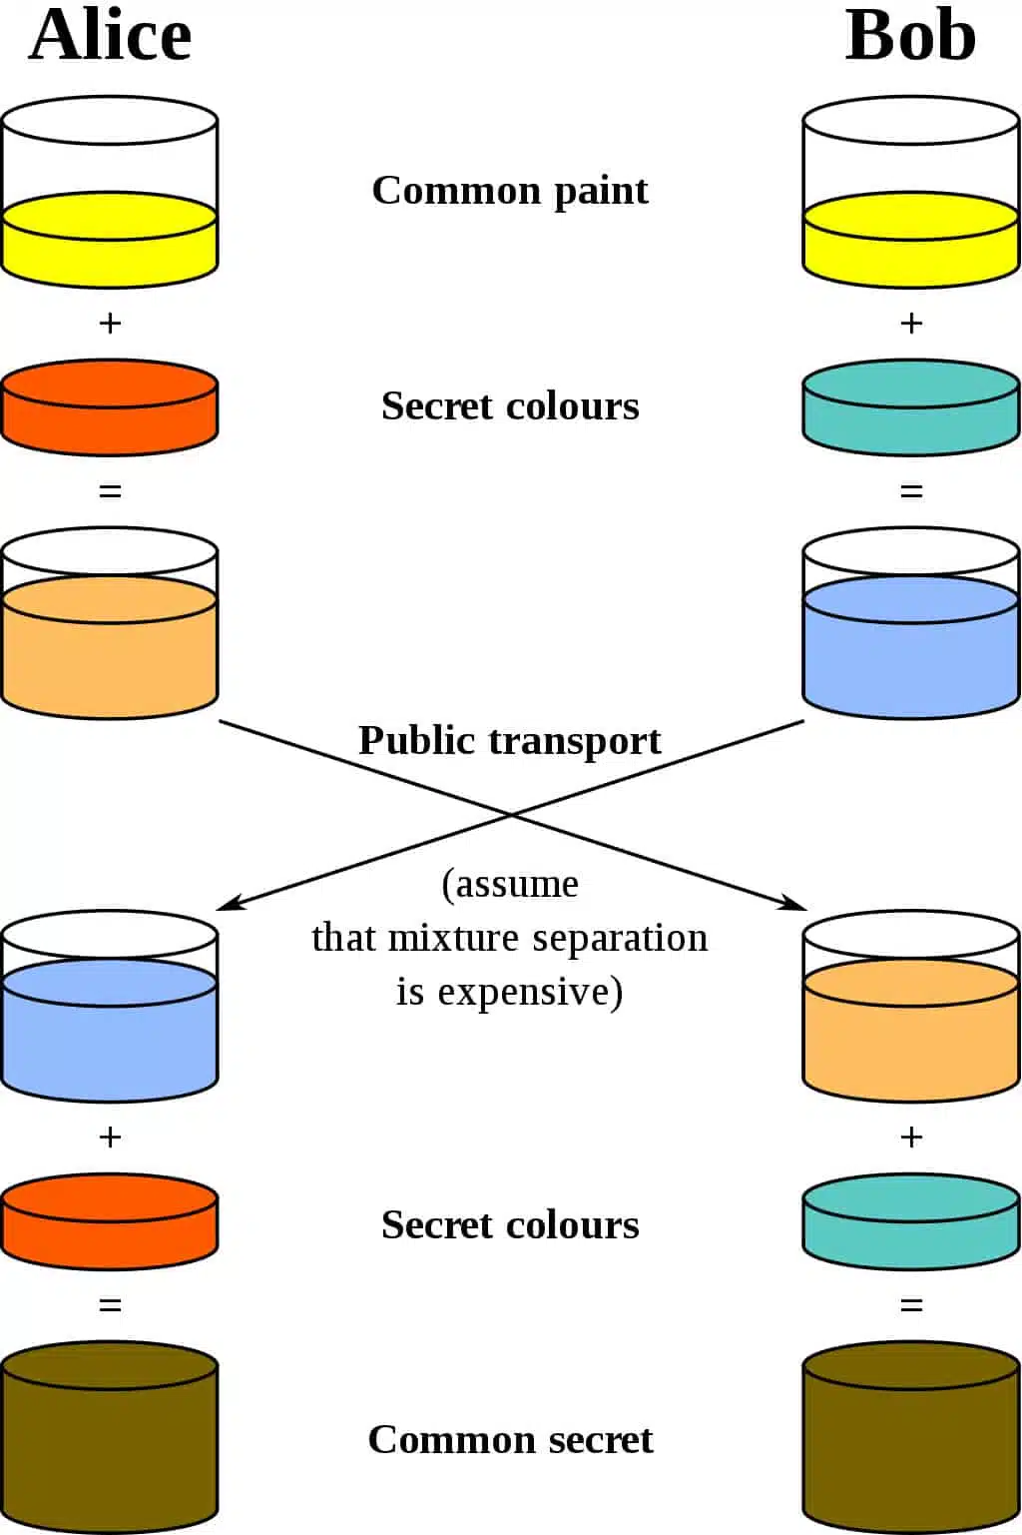
Diffie-Hellman Key Exchange!
Notes:
Alice and Bob again
In the most basic form of the Diffie-Hellman key exchange, Alice and Bob begin by mutually deciding upon two numbers to start with, as opposed to the single common paint in the example above. These are the modulus (p) and the base (g).
In practical use, the modulus (p) is a very large prime number, while the base (g) is relatively small to simplify calculations. The base (g) is derived from a cyclic group (G) that is normally generated well before the other steps take place.
For our example, let’s say that the modulus (p) is 17, while the base (g) is 4.
Once they have mutually decided on these numbers, Alice settles on a secret number (a) for herself, while Bob chooses his own secret number (b). Let’s say that they choose:
a = 3
b = 6
Alice then performs the following calculation to give her the number that she will send to Bob:
A = gª mod p
In the above calculation, mod signifies a modulo operation.
Understanding the modulo operation
These are essentially calculations to figure out the remainder after dividing the left side by the right. As an example:
15 mod 4 = 3
If you understand how modulo operations work, you can do them yourself in the following calculations, otherwise you can use an online calculator.
So let’s put our numbers into the formula:
A = 4³ mod 17
A = 64 mod 17
A = 13
When we do the same for Bob, we get:
B = 4⁶ mod 17
B = 4096 mod 17
B = 16
Alice then sends her result (A) to Bob, while Bob sends his figure (B) to Alice. Alice then calculates the shared secret (s) using the number she received from Bob (B) and her secret number (a), using the following formula:
s = Bª mod p
s = 16³ mod 17
s = 4,096 mod 17
s = 16
Bob then performs what is essentially the same calculation, but with the number that Alice sent him (A), as well as his own secret number (b):
s = A^{b} mod p
s = 13⁶ mod 17
s = 4,826,809 mod 17
s = 16
As you can see, both parties ended up with the same result for s, 16. This is the shared secret, which only Alice and Bob know.

Slide 15
RSA
An abbreviation of Rivest–Shamir–Adleman - who authored this cryptosystem!
An implementation of asymmetric encryption that still holds up to this day – CTF challenges often involve exploiting poorly implemented RSA.
RSA works on the idea that it is easy to generate a number by multiplying two sufficiently large prime numbers together…
But factorising that number back into its original primes is extremely difficult and requires intense computational power. To add to this, RSA keys are often 1024 or 2048 bits in length.
There are many attacks that can be done to find the plaintext if any of the numbers chosen to generate a ciphertext are too small or large in comparison to others.

Slide 16
But wait, there’s something missing?
Block ciphers and stream ciphers will be covered in a Term 2 cafe session – getting this content done is a session in itself!

Slide 17

Things to Try!
Make an account at https://cryptohack.org/ - I cannot recommend this enough, it’s the most comprehensive cryptography challenge resource out there with everything from basic ciphers to some very challenging encryption schemes!
Or you can do some challenges on PicoGym for a taste of simpler cryptography across every discipline!

Slide 18
Tools and Resources
RSACTFTool - https://github.com/Ganapati/RsaCtfTool
CyberChef - https://cyberchef.io/
dCode.fr - https://www.dcode.fr/tools-list#cryptography
Crackstation (DON’T LAUGH IT’S USEFUL) - https://crackstation.net/
Install PyCryptodome for Python – a lot of Crypto challenges involve scripting!

