Slide 1
Keystone
"Talent Knows No Borders—Neither Should Education”.

Slide 2
The Solution: Why Keystone Exists
No government loans
No bank loans
LOGO
Automated models reject without a reason
Family is not always an option

Slide 3
How Keystone Works
Step 1: Student creates profile 📖
Step 2: Keystone reviews & approves ✅
Step 3: Investors fund (donation or loan) 💰
Step 4: Keystone manages payments & repayment 🔄
This approach creates value for everyone:
✅ Students get access to education, based on talent—not financial background.
✅ Investors support meaningful causes while earning a return.
✅ Keystone ensures a fair, transparent, and seamless funding process.

Slide 4
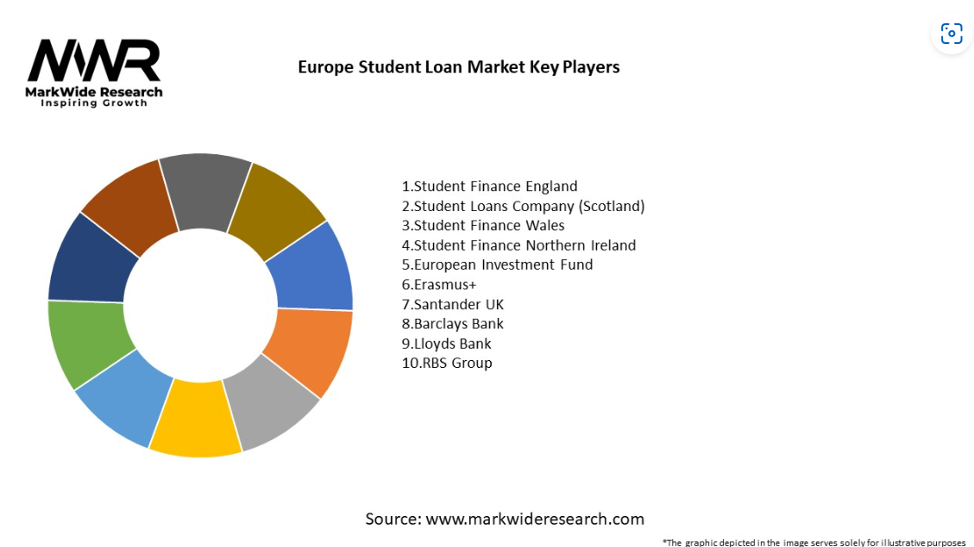
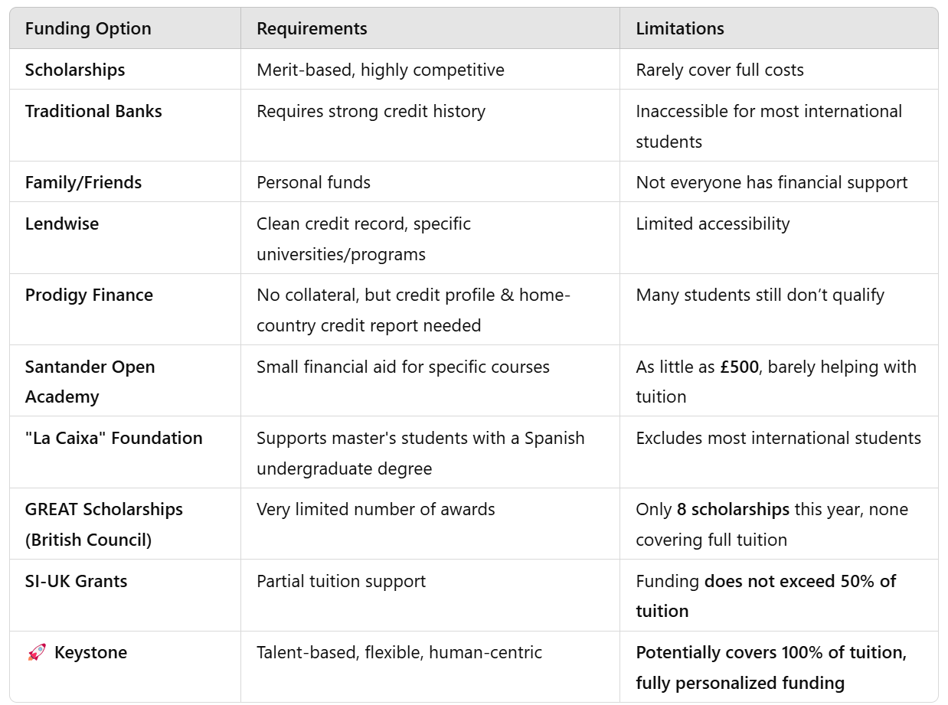
Competition
Keystone is not just another funding platform—we are changing the way international students access education.
Notes:
Personal investment loans for EU students - Hello Fins

Slide 5
Market Opportunity
Rising Education Costs in UK [citation] - universities facing funding gaps, with students taking on even-higher debt burdens.
Post-Brexit Shifts & Regulatory Gaps - increased hurdles for international students in accessing traditional loans and who fall outside standard government-backed schemes or have no prior financial history.
Rapid Expansion of Alternative Lending in EU market [citation]
Social Impact Trends (ESG): Investors prioritising ventures that offer social impact along with competitive returns.
Reverse the trend -> Student review feedback: Reintroducing the human touch.
Notes:
Increasing Tuition & Living Expenses: In regions like the UK, Spain, and wider EU markets, tuition fees and living costs have surged over the past decade. UK House of Common 2024 report, indicate universities are facing significant funding gaps.
Brexit Regulation created hurdles for international students to access traditional student loans.
Alternative Lending market in EU is expanding rapidly …, driven by digital platforms offering flexible, streamlined financing options such as …
Social Impact Trends: The dual focus on financial returns and social impact creates a compelling narrative for investors seeking ESG-compliant opportunities.
Post-Brexit Shifts & Regulatory Gaps
Alternative Lending -> EU Market expanding by 10% CAGR in many segments [citation], traditional models have been disrupted by digital, personalised financial services, yet many rely on AI-driven assessments that overlook the “human” element

Slide 7
Who is the team, and what roles do we have?

Slide 8
Making Keystone Visible, Credible, and Interactive
Visible: Maximize our presence both online & offline
Credible: Build trust through valuable, engaging content
Interactive: Foster two-way communication with our audience
Notes:
Sales and marketing plan
Sales & Distribution channels
Marketing Experience (Visibility, Credibility, Interactivity)
Pricing Strategy
How to measure success (KPIs)
—
GTM - plan that details how an organization can engage with customers to convince them to buy their product or service and to gain a competitive advantage.

