Slide 1

Customer Shopping Behavior Analysis
Uncovering insights from 3,900 transactions across product categories, customer segments, and subscription behavior.

Slide 2
Dataset at a Glance
3,900
18
Purchases
Columns
50
37
Locations
Missing Values
Review Rating only
Customer Data
Purchase Data
Age, Gender, Location, Subscription Status
Item, Category, Amount, Season, Discount, Shipping

Slide 3


Data Preparation in Python
Load & Explore
pandas — df.info(), .describe()
Clean & Standardize
Median imputation for Review Rating; snake_case columns
Feature Engineering
age_group, purchase_frequency_days; dropped redundant promo_code_used
Database Integration
Loaded cleaned DataFrame into PostgreSQL

Slide 4
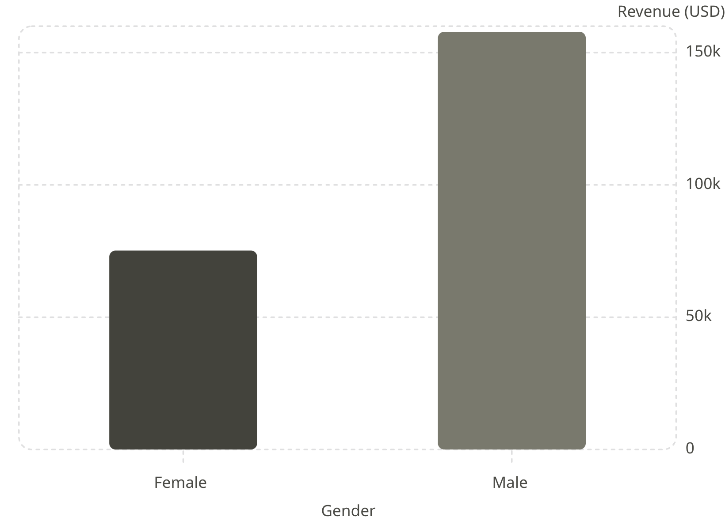

Revenue by Gender
Male Customers Dominate Revenue
Male shoppers generated $157,890 — over 2× more than female customers ($75,191).
Male purchases outnumber female 2,652 vs. 1,248

Slide 5
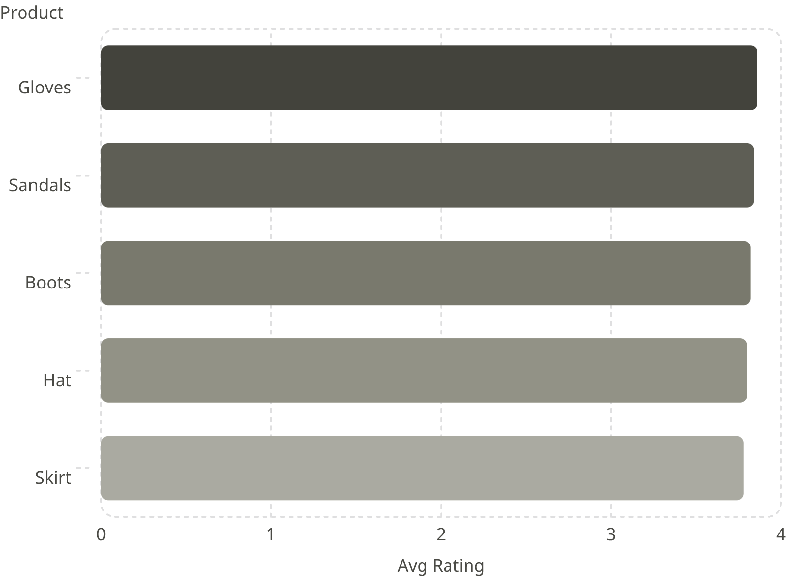
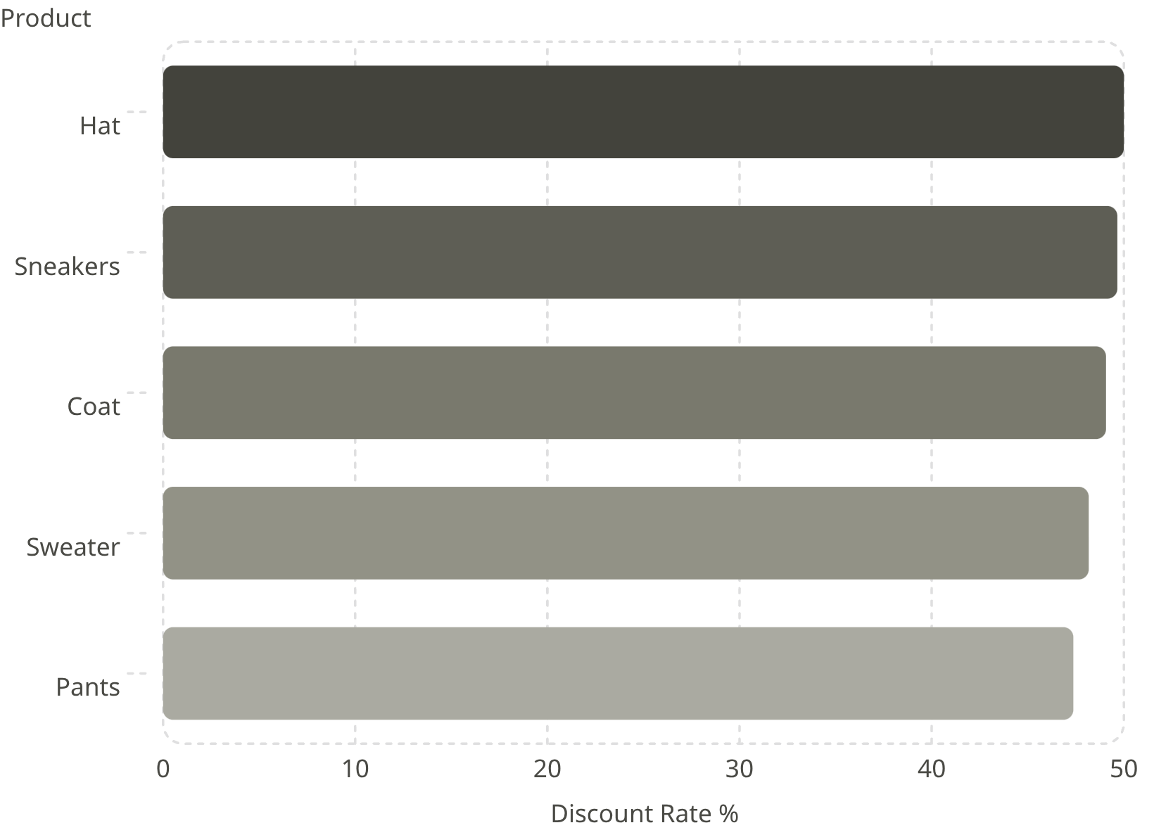
Product Ratings & Discount Dependency
Top 5 Products by Rating
Most Discount-Dependent Products

Slide 6
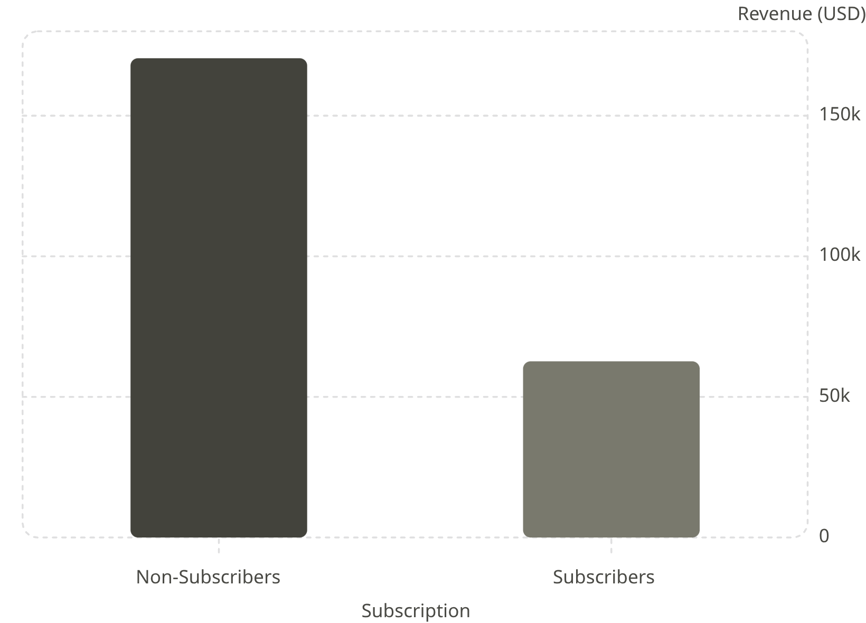
Subscription & Shipping Insights
Subscribers vs. Non-Subscribers
Non-subscribers drive 73% of customers but similar avg spend (~$59).
Express Shipping
Standard Shipping
Avg $60.48
Avg $58.46

Slide 7

Customer Segmentation
Loyal
Returning
3,116 customers
701 customers
New
83 customers
Repeat buyers with >5 purchases: 958 subscribers vs. 2,518 non-subscribers

Slide 8
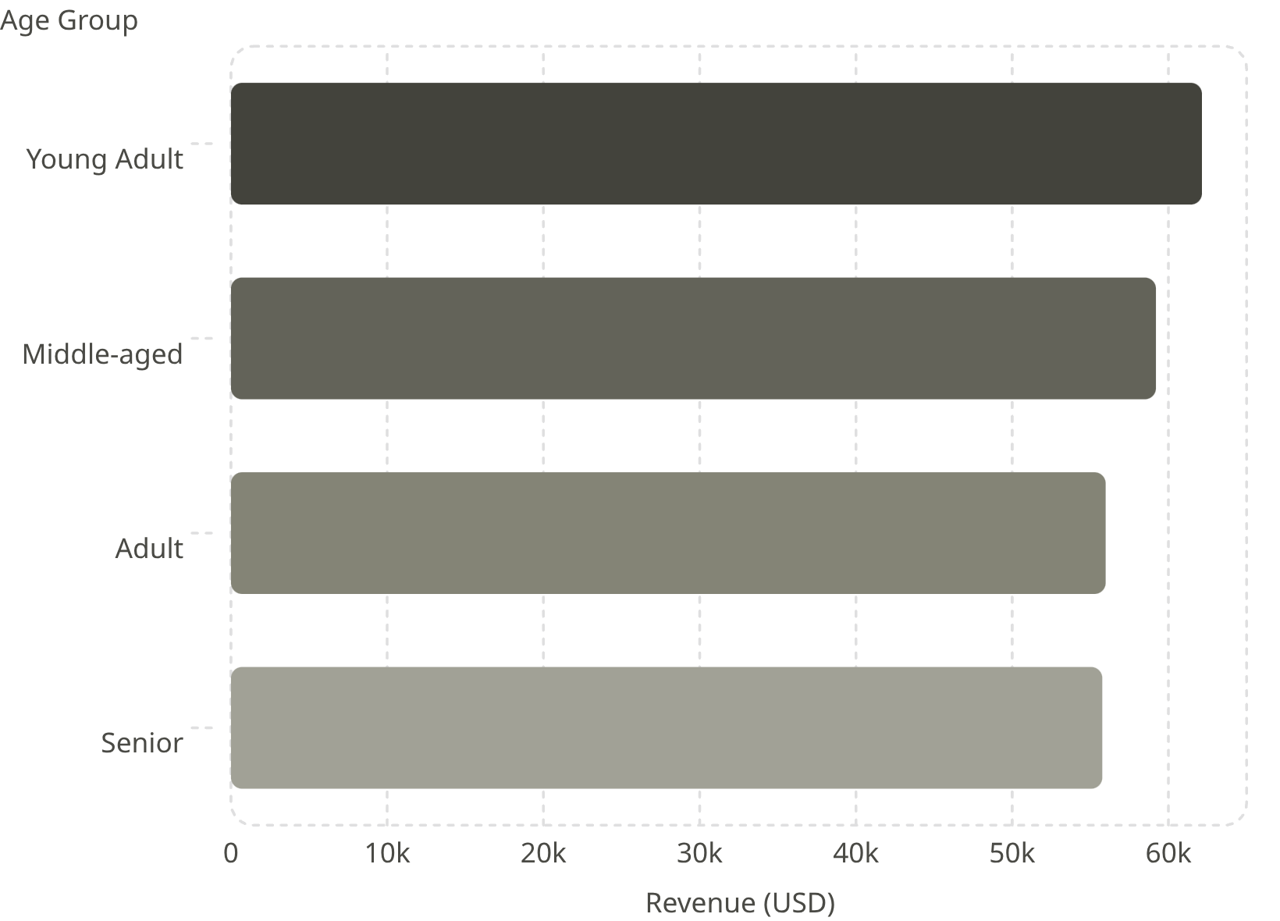

Revenue by Age Group
Young Adults Lead Spending
Young Adults contribute the highest revenue at $62,143, with other groups closely clustered around $55K–$59K.
Age range in dataset: 18–70 years

Slide 9
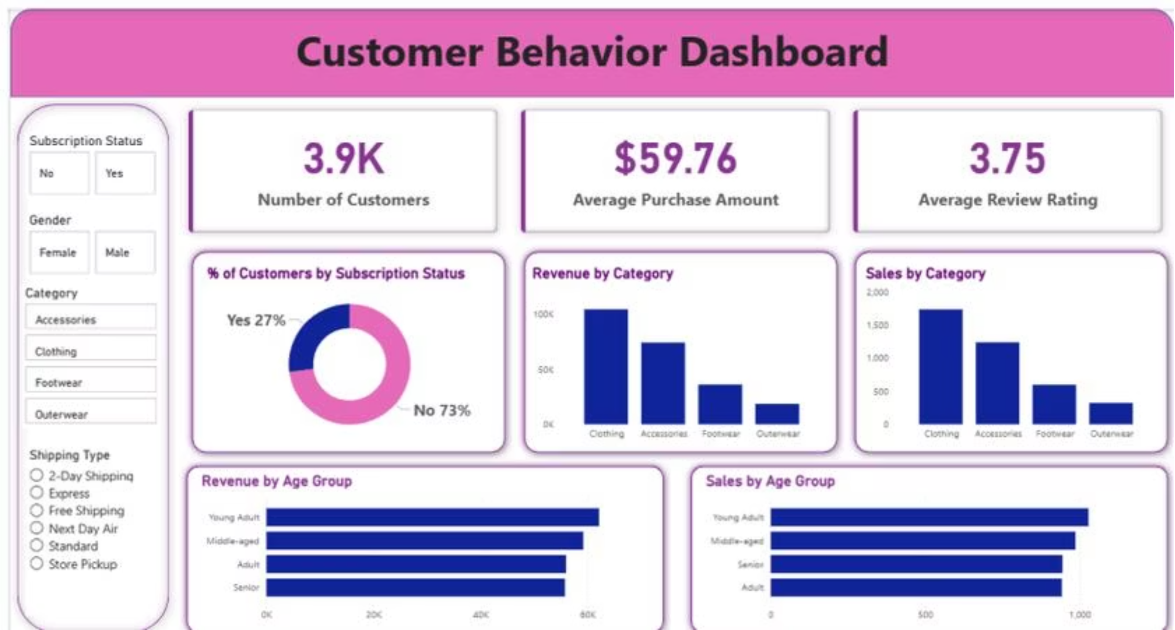
Power BI Dashboard
3.9K Customers
$59.76 Avg Purchase
3.75 Avg Rating
27% Subscribers

Slide 10

Business Recommendations
Boost Subscriptions
Promote exclusive subscriber benefits
Loyalty Programs
Reward repeat buyers toward "Loyal" segment
Review Discount Policy
Balance sales lifts with margin control
Targeted Marketing
Focus on high-revenue age groups & express-shipping users

