Slide 1
Face Mask Detection
Presented by:- Mayank Gupta
Ayan Sohel
Abhishek Soni
Mulayam Singh Yadav

Slide 2
INTRODUCTION
Since the end of 2019, infectious coronavirus disease (COVID-19) has been reported for the first time in Wuhan, and it has become a public damage fitness issue in China and even worldwide. ,is pandemic has devastating effects on societies and economies around the world causing a global health crisis . It is an emerging respiratory infectious disease caused by Severe Acute Respiratory Syndrome Coronavirus 2 (SARS-CoV-2). All over the world, especially in the third wave, COVID-19 has been a significant healthcare challenge. Many shutdowns in different industries have been caused by this pandemic. In addition, many sectors such as maintenance projects and infrastructure construction have not been suspended owing to their significant effect on people’s routine life.

Slide 3
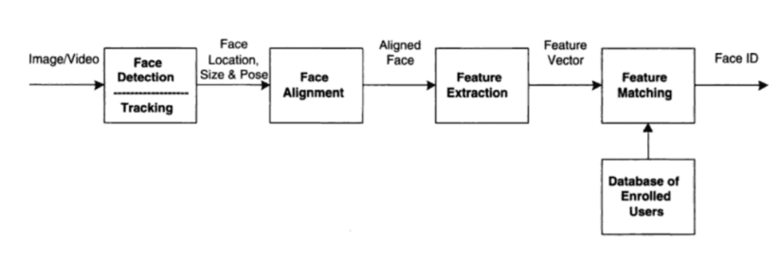
Facial Recognition System

Slide 4
Technology Used
OpenCV
TensorFlow
Keras

Slide 5
OpenCV
OpenCV (Open Source Computer Vision Library) is a free software library for computer vision and machine learning. OpenCV was created to provide a standard infrastructure for laptop vision applications, as well as to speed up the adoption of machine perception in commercial products. Businesses will find it easy to use and change the code thanks to OpenCV.

Slide 6
TensorFlow
TensorFlow is a free and open-source software library for dataflow and differentiable programming that can be used to solve a wide range of problems. It's a symbolic mathematics library that's also used in machine learning applications including neural networks.

Slide 7
Keras
Keras is a human-centric API, not a machine-centric one. Keras adheres to industry best practises for reducing psychological feature load by providing consistent and quick APIs, reducing the number of user actions needed for common use cases, and providing transparent and unfair error messages.

Slide 8
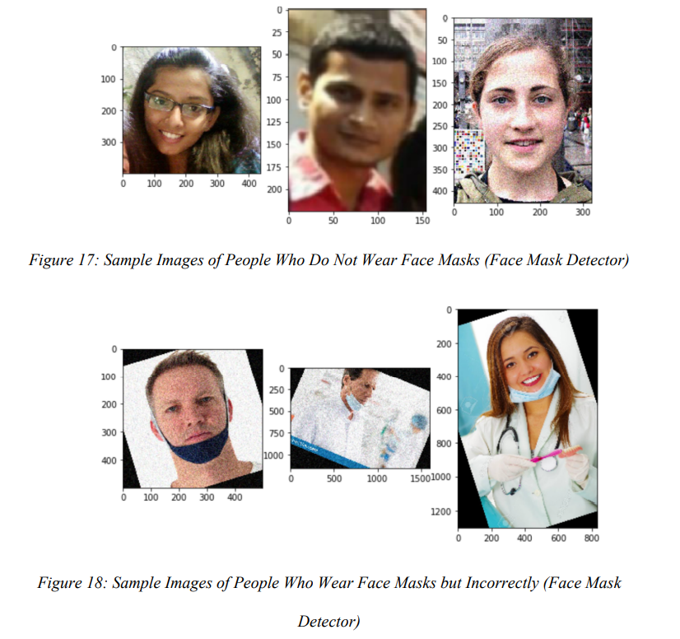
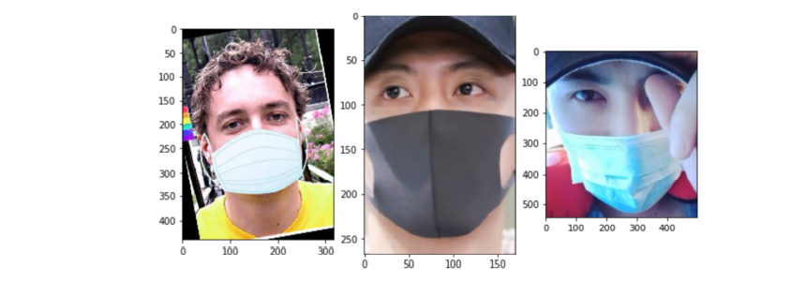
Working

Slide 9
CONCLUSION AND FUTURE WORK
This thesis presented a study on facial recognition and face mask detection through deep learning techniques by building a CNN model using transfer learning and fine-tuning techniques. This process gave accurate and quick results for facial recognition security systems despite the fact that half of the faces are covered with face masks. The test results show a high accuracy rate in identifying individuals wearing a face mask, not wearing a face mask, and wearing a face mask but in an incorrect manner. The model was able to achieve a 97.1% of performance accuracy, which is a significant achievement. Moreover, the study presented a useful tool in fighting the spread of the COVID-19 disease by allowing all individuals to wear a face mask while performing biometric authentication. Facial recognition with face mask is becoming more and more importance over the past year due to the spread of the COVID-19 virus. Our future works include alarm if somebody is not wearing a face mask properly, and detection of the social distancing

Slide 10
ThankYou

