Slide 1
Interaction Flow
ⓐ 계영 APP
ⓑ Input/Output Interface
Model Development
LongTermDemandData.csv
LongTermEVData.csv
LongTermPVData.csv
Forecast and Optimize
shortTermDemandData.csv forecastDemandData.csv
shortTermEVData.csv forecastEVData.csv
shortTermPVData.csv forecastPVData.csv
EV_Config_xxx.csv
GyeYoung
Application
CSV files
Flags / Operation Codes
EX
Flag 0 : Success
Flag 1 : Operation
Flag 2 : Fail
Input
CSV, OP codes
계영
경북대
demandModelDev.dll
Output
CSV, Flags
Model Dev
EVModelDev.dll
PVModelDev.dll
Model Forecast
ⓓ API
ⓒ Shell java script
TEMS.jar/dll
Grid OS
ⓔ Logs
demandForecast.dll
Logs
EVForecast.dll
PVForecast.dll
Shell Java script
Model Optimize
objV2X.dll

Slide 2
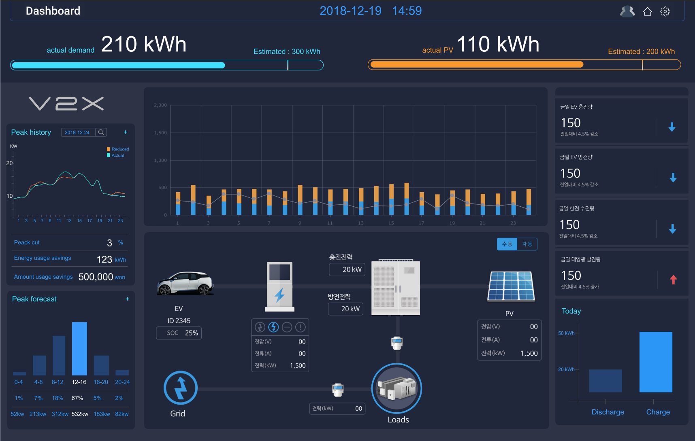
HMI Review: Main
Today amount of electricity from KEPCO
Today amount of PV generation
Today amount of EV charging
Today amount of EV discharging
4.5% less than the previous day
4.5% more than the previous day
4.5% less than the previous day
4.5% more than the previous day

Slide 3
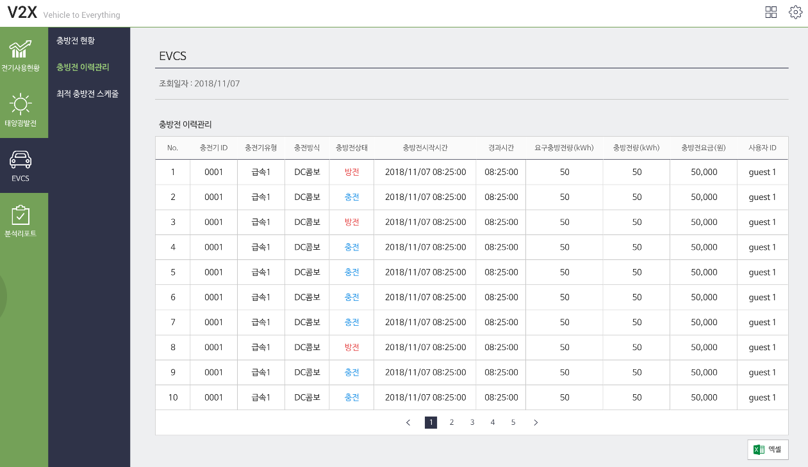
HMI Review: EVCS 2
Char/dischar status
Charge / discharge history management
Optimal charge / discharge schedule
Charge / discharge history management
Charger ID Charger type status char/dischar start time duration required energy charging time price user ID
Charge method

Slide 4
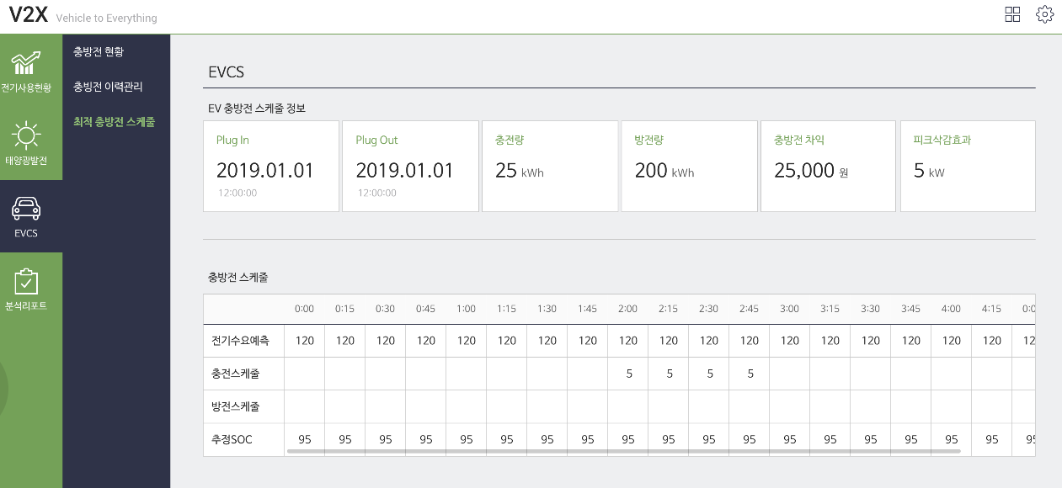
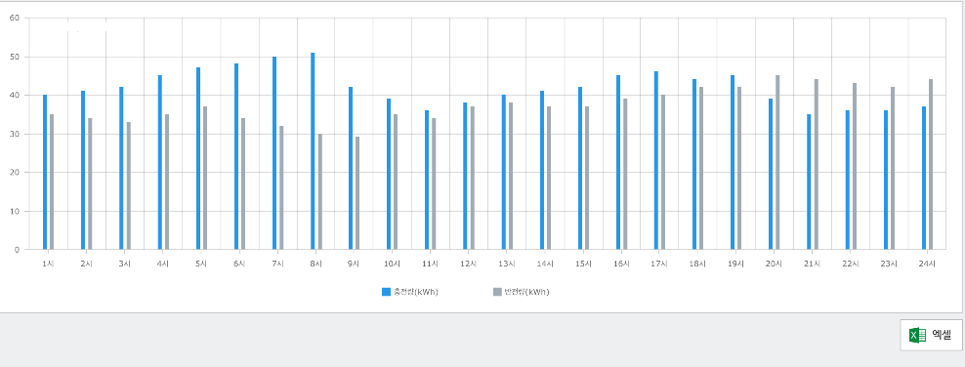
HMI Review: EVCS 3
Char/dischar status
Charge / discharge history management
EV Charge / discharge schedule information
Optimal charge / discharge schedule
Amount of charging
Amount of discharging
Charge / discharge gains
Peak savings
Charge / discharge schedule

