Slide 1
Portfolio Presentation
By Gopikrishna

Slide 2
Problem Statement
Many developers struggle to effectively showcase their skills, projects, and technical expertise through an engaging online portfolio. A well-structured portfolio is essential to attract potential employers or clients.

Slide 3
Project Overview
This project is a personal developer portfolio website designed to highlight skills, showcase projects, and provide an easy way for potential employers or collaborators to get in touch.

Slide 4
End User
The target users include:
- Potential employers
- Recruiters
- Clients looking for web developers
- Fellow developers exploring collaboration opportunities

Slide 5
Tools and Technologies
- HTML
- CSS
- JavaScript
- Java
- CodePen for development and testing
- GitHub for version control

Slide 6
Portfolio Design and Layout
- Clean and modern dark-themed UI
- Sections: Home, About Me, Skills, Projects, Contact
- Responsive design for mobile and desktop
- Organized structure for easy navigation

Slide 7
Features and Functionality
- Personal introduction and about section
- Skills represented with progress bars
- Project showcase with links
- Contact form for direct communication
- Footer with copyright © 2025

Slide 8
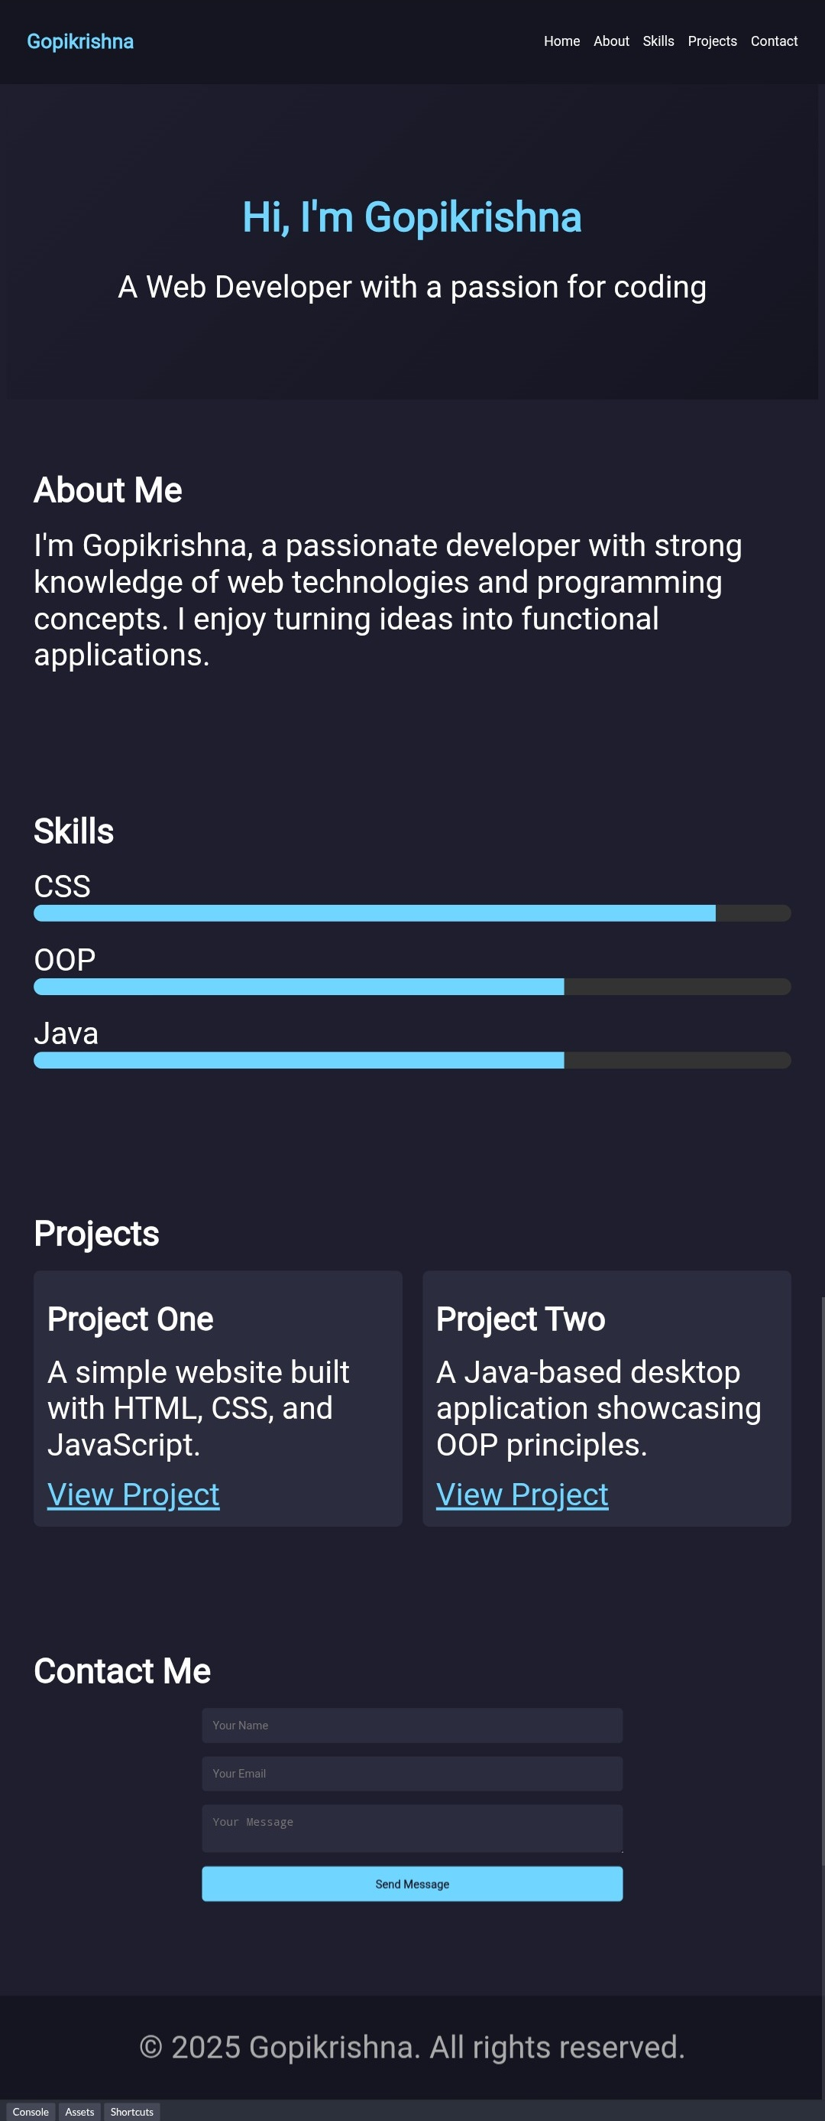
Result and Screenshot
The portfolio successfully represents the developer’s skills and projects.
Below is a screenshot of the portfolio:

Slide 9
Conclusion
The portfolio provides a professional platform for showcasing technical skills and projects. It enhances visibility for recruiters, clients, and collaborators while demonstrating web development expertise.

Slide 10
GitHub Link
GitHub Repository:
https://github.com/mgac32124u18021-ship-it/TNSDC-FWD-GOPIKRISHNA/upload

