Slide 1
Digital portfolio
S.Ishwarya
Astvu32132124u1802
B.Sc computer science
Mithurangam govt arts college-Thiruvalluvar university

Slide 2
My childhood memories portfolio
🌟 “Simple days, unforgettable memories.”

Slide 3
agenda
1.Portfolio design and Layout
2.Tools and Technologies 3.Problem Statement 4.Features and Functionality 5.Project Overview 6.Results and Screenshots 7.Conclusion
8.Github Link

Slide 4
Problem statement
* Childhood memories fade away over time, making it hard to preserve them vividly. * Physical photo albums or handwritten diaries are easily damaged, lost, or forgotten. * Without a structured way to store and revisit memories, special moments may be overlooked. * Sharing these memories with family, friends, or future generations becomes challenging.

Slide 5
Project overview
☑ Digital collection to preserve and showcase childhood memories.
☑ Main idea: Highlight special moments 🌟, emotions 💖, and experiences 🎉 from early life.
☑ Goal: 🌍 Create a lasting archive to revisit memories and share with family, friends, and future generations.

Slide 6
Project overview
Project contains
• About Me – introduction and childhood background.
• Profile – favorite games, hobbies, school life, and friendships.
• Memories – photos, stories, and unforgettable experiences.
• Sharing – connect with family and friends to relive moments together.

Slide 7
Who are the end users?
👨‍👩‍👧 Family members – parents, grandparents, siblings who want to cherish old memories.
👬 Friends – childhood friends who shared those moments.
📖 Future generations – children or relatives who can learn family history.
🎓 Students/Researchers – those studying culture, personal history, or memory preservation.
🌍 General audience – anyone interested in nostalgic stories or experiences.

Slide 8
Tools and techniques used
• Tools – Digital album software, Google Photos, Canva, MS PowerPoint, or simple website builders.
• Techniques –
Photo scanning and digitalization
Story writing ✍️
Memory journaling 📖
Timeline creation 📅
Creative design & layout

Slide 9
Portfolio design and layout
Sections Included:
🏠 Home / About Me – A short introduction and a glimpse into childhood background. 📸 Photo Gallery – Collection of childhood photos, special occasions, and family moments. 🎮 Hobbies & Interests – Activities, favorite games, toys, or pastimes enjoyed during childhood. ✍️ Stories / Memories – Short write-ups or anecdotes describing funny, happy, or meaningful childhood events. 📚 School Days – Achievements, drawings, certificates, or memorable experiences from school life.

Slide 10
Features and functionality
Navigation Bar – Smooth scrolling between memory sections (Home, Photos, Stories, School Days, etc.) 🖼️ Photo Gallery – Display childhood photos, albums, and scanned drawings/certificates. 📖 Memory Showcase – Highlight stories, funny moments, and special events with images or notes. 🎵 Multimedia Support – Option to add background music, voice notes, or videos for a nostalgic touch. ✍️ Guestbook / Comments Section – Allow family or friends to share their own memories and messages. 📬 Contact / Tribute Section – Easy way to connect or dedicate messages to loved ones.

Slide 11
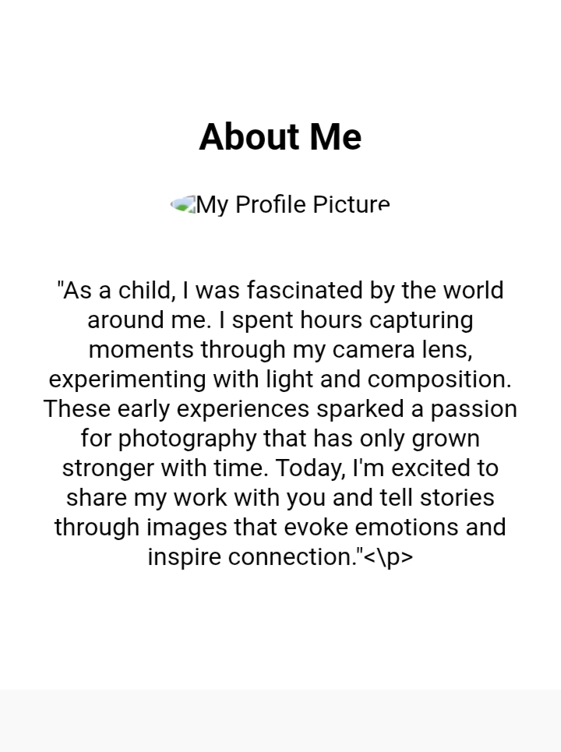
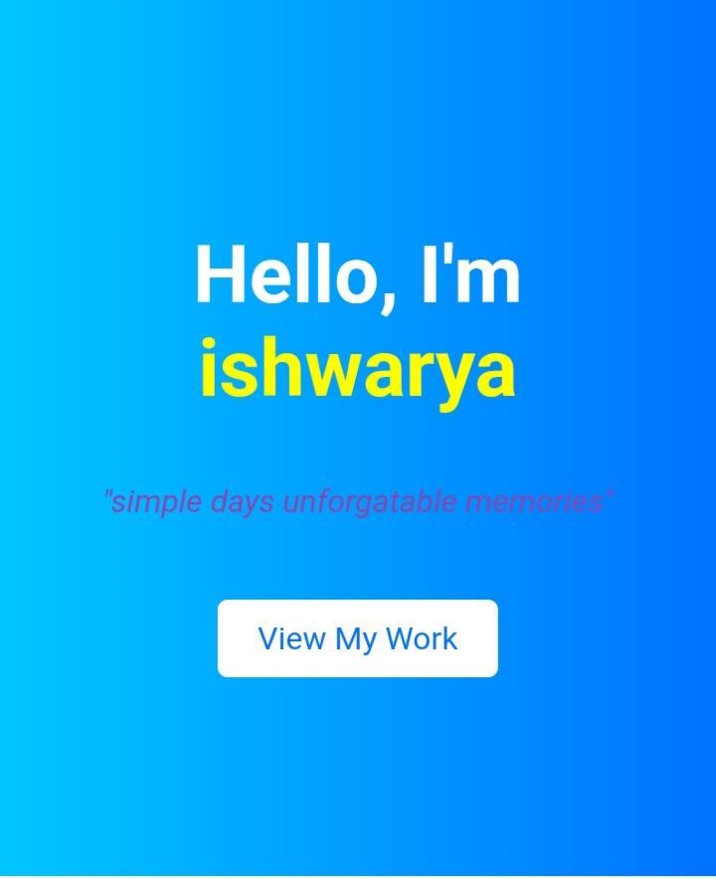
RESULT AND SCREENSHOT

Slide 12
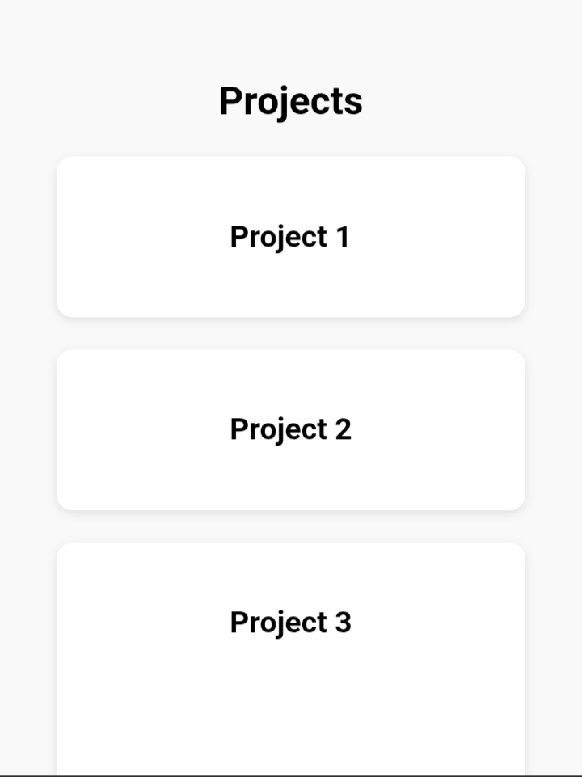
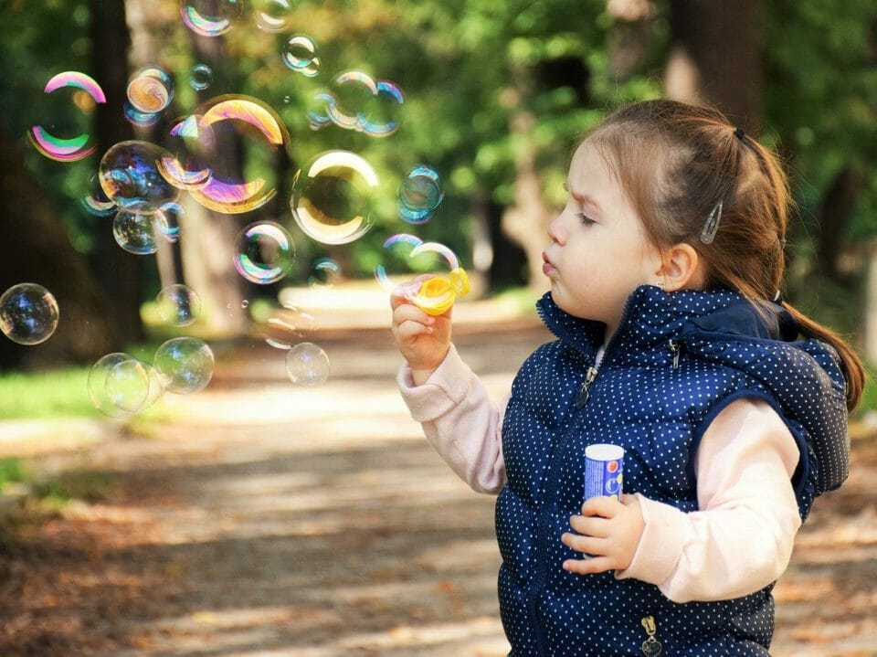
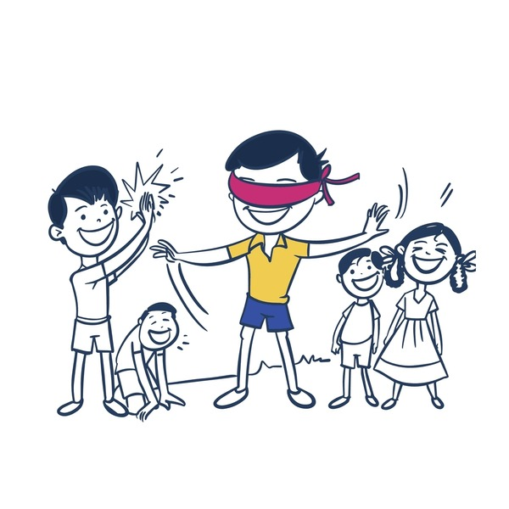
RESULT AND SCREENSHOT

Slide 13
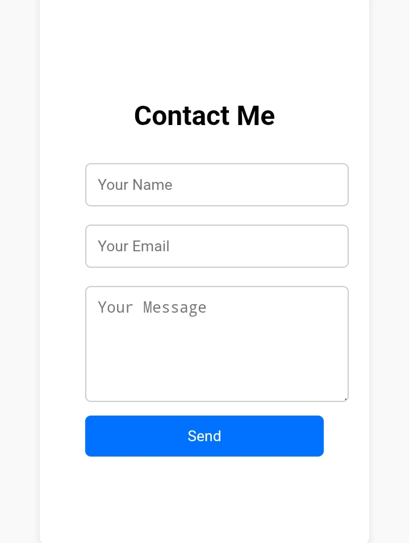
RESULT AND SCREENSHOT

Slide 14
Conclusion
HIGHLIGHTS OF MY PROJECT ➤ Created a portfolio to preserve and showcase childhood memories. ➤ Included photos, stories, hobbies, and school achievements. ➤ Organized sections like Home, Gallery, Stories, and Contact. ➤ Designed in a simple, colorful, and user-friendly layout.

Slide 15
Conclusion
FINAL SUMMARY ➤ The project helps me cherish and preserve my childhood memories. ➤ It allows me to share special moments, stories, and photos in a creative way. ➤ A meaningful step to reflect on the past and stay connected with loved ones.

Slide 16
Conclusion
BENEFITS TO THE SOCIETY ➤ Preserves childhood stories, photos, and traditions for future generations. ➤ Provides families and friends with easy access to shared memories. ➤ Encourages others to document and celebrate their own childhood experiences.

Slide 17
Thanking you

