Slide 1
Digital portfolio
Jagathees.k
Astvu32132124u18024
B sc computer science
Thiruvallur university

Slide 2
Climate change
Climate change refers to long-term shifts in temperatures and weather patterns, primarily caused by human activities such as burning fossil fuels (coal, oil, and gas), deforestation, and industrial processes. These changes can lead to rising sea levels, extreme weather events, and disruptions to ecosystems and human societies.

Slide 3
Agenda
1.Portfolio design and Layout
2.Tools and Technologies
3.Problem Statement
4.Features and Functionality
5.Project Overview
6.Results and Screenshots
7.Conclusion
.8.GithubLink

Slide 4
Problem statement
Present concise and accurate information about climate change impacts. Display a data visualization (e.g., temperature changes over time) via JavaScript. Include an “About Me” section highlighting web development background and interests. Add contact details (email, LinkedIn, GitHub, optional contact form) for professional interaction. Ensure the site is visually appealing and user-friendly (responsive design).

Slide 5
Project Overview
Educational Content: Summarizes the causes, impacts, and solutions relating to climate change for easy understanding. Data Visualization: Includes interactive elements (like temperature timelines) using JavaScript to help users grasp climate trends. Personal Branding: Offers an “About Me” section to introduce the developer and establish credibility.

Slide 6
Who are The end userS
Students and Educators: Those seeking educational information and interactive content to learn or teach about climate change causes, impacts, and solutions. Professionals and Recruiters: Individuals evaluating a developer’s web skills, data visualization ability, and capacity for advocacy or social impact projects. General Public: People looking for accessible, reliable information to increase their awareness and understanding of climate issues. Environmental Advocates and NGOs: Groups or organizations interested in outreach, climate adaptation, and collaboration with skilled individuals to enhance digital resilience and education initiatives.

Slide 7
Tools and techniques
HTML, CSS, JavaScript → for creating the portfolio website VS Code for coding GitHub for hosting & sharing the projects

Slide 8
PoTfOlIo design and LayOut
Header: Clear, centered title with a tagline about the project. About Me: Personal introduction with background, skills, and links. Climate Info: Educational content about climate change with text and bullet points. Data Visualization: Centered interactive chart displaying climate data. Contact: Contact information and optional contact form. Footer: Copyright and data source credits.

Slide 9
Features and functionality
Informative Content: Clear sections explaining climate change, its causes, and impacts with organized text and bullet points. Interactive Visualization: A JavaScript-powered line chart dynamically displaying global temperature changes over time. Responsive Design: Ensures accessibility and optimal viewing on desktops, tablets, and smartphones. About Me Section: Showcases the developer’s background, skills, and relevant links to build credibility. Contact Details and Form: Offers an email link, social profiles, and an optional contact form with input validation for easy communication.

Slide 10
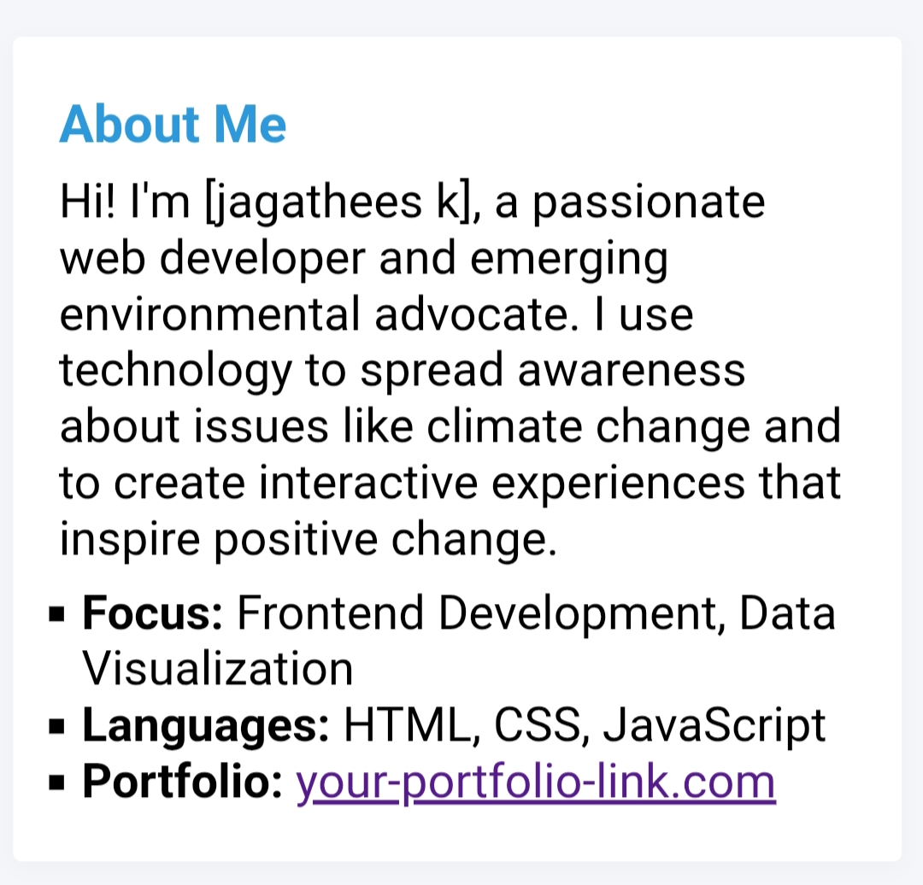
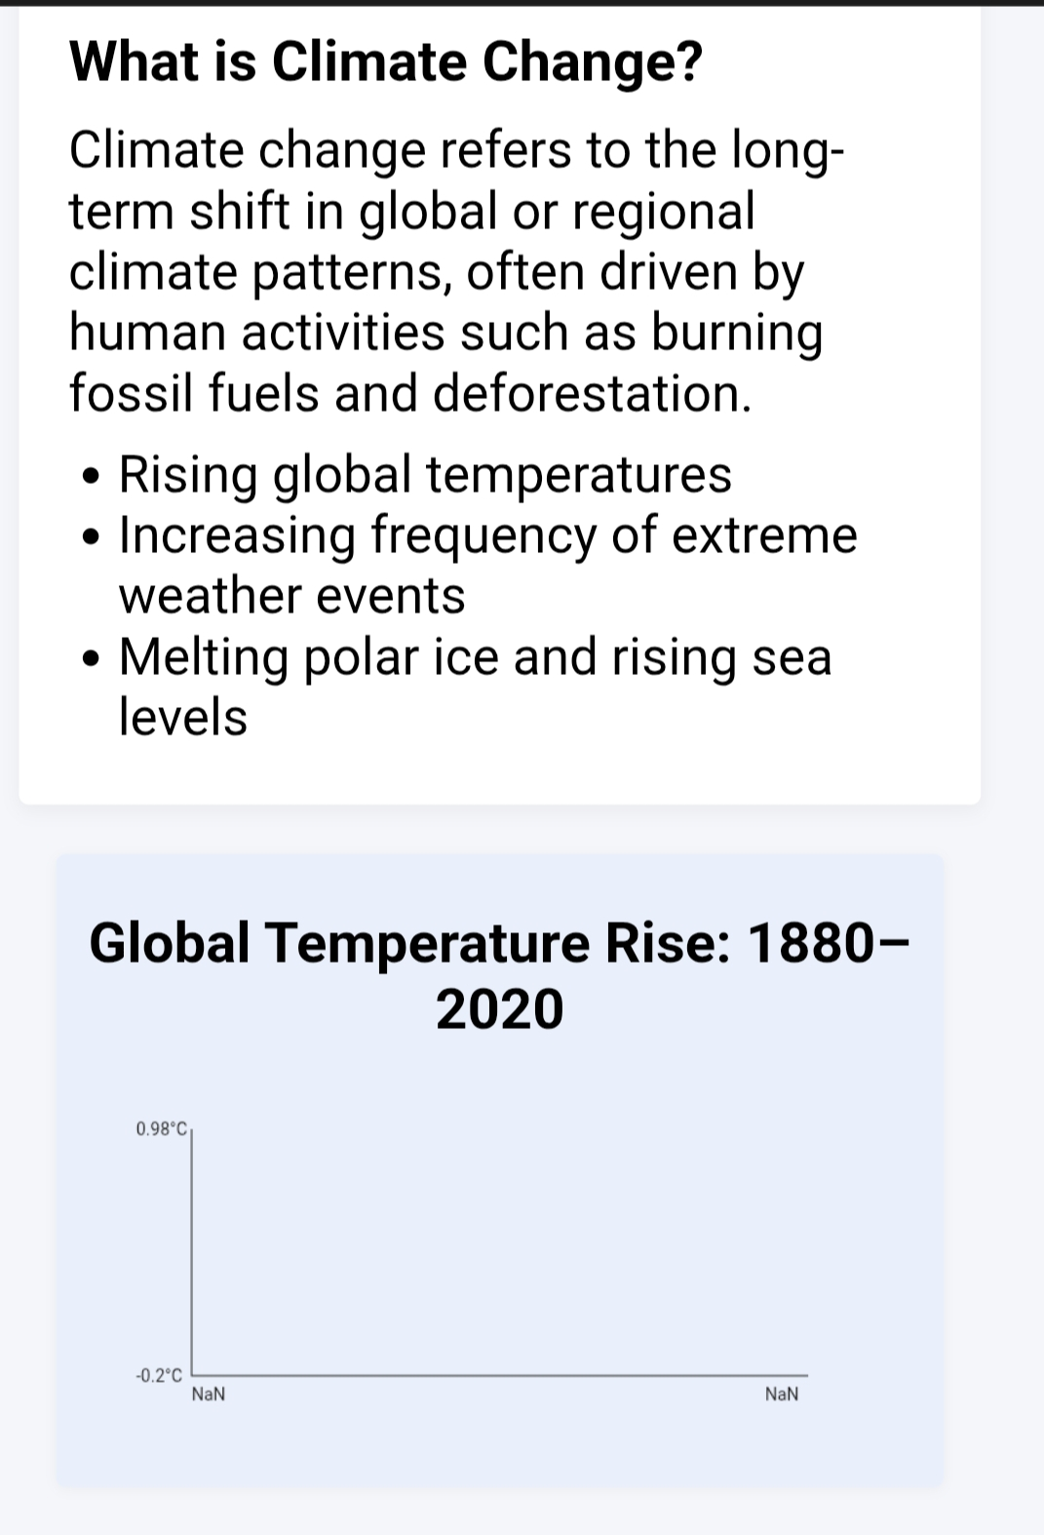
Result and sCreenshot

Slide 11
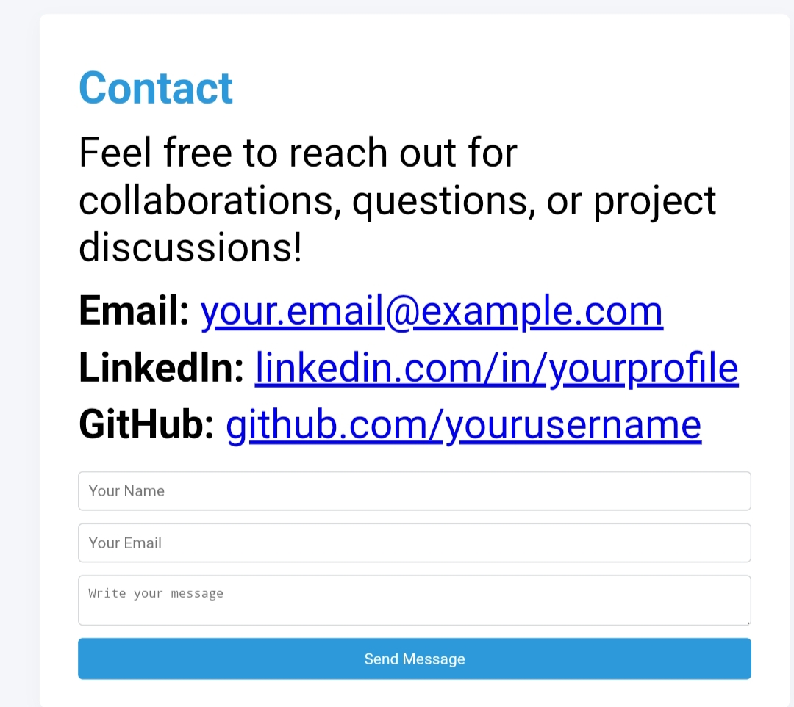
Result and scREenShoTs

Slide 12
Conclusion
In conclusion, the climate change digital portfolio serves as an effective platform to combine technical web development skills with environmental advocacy. It educates visitors on critical climate issues through clear, accessible content and interactive data visualizations, highlighting the alarming trends in global temperature rise and related impacts. By incorporating a personal “About Me” section and contact functionalities, the portfolio also facilitates professional networking, collaboration, and greater outreach.

Slide 13
Thanking you

