Slide 1
Digital portfolio
F
K.Karthika
Astvu32132124u18030
B.Sc computer science
Muthurangam Govt Arts college –Thiruvalluvar University

Slide 2
My Travel experience Portfolio
“The Journey of a Thousand miles Begins with a single step”

Slide 3
AgEnda
1.Portfolio design and Layout
2.Tools and Technologies
3.Problem Statement
4.Features and Functionality
5.Project Overview
6.Results and Screenshots
7.Conclusion8.GithubLink

Slide 4
Problem statement
❖ Travelers face difficulty in planning trips that balance cost, comfort, and convenience
❖ Relying on multiple sources (agents, blogs, scattered apps) makes the process time-consuming and confusing
❖ Lack of personalized recommendations leads to generic experiences instead of meaningful journeys
❖ Without a unified digital platform, exploring destinations, managing itineraries, and discovering local culture becomes stressful
❖ Wider travel opportunities (hidden gems, authentic experiences, budget-friendly options) remain unexplored.

Slide 5
Project overview
* Digital travel platform to explore destinations and plan journeys
* Main idea : Provide personalized itineraries 🌍, travel tips ✈️, and cultural insights 🏞
* Goal : Connect travelers with authentic experiences and make trips stress-free.

Slide 6
Project overview
Project contain
* About Me – introduction and travel journey * Profile – interests, travel style, destinations explored * Experiences – trips, stories, memories, highlights * Gallery – photos, videos, travel diaries * Contact Me – connect, share, and collaborate

Slide 7
Who Are the and Users ?
* TRAVELERS & TOURISTS – People seeking hassle-free trip planning and unique experiences
* FAMILIES & FRIEND GROUPS – Useful for planning vacations, activities, and memorable journeys together
* TRAVEL AGENCIES & GUIDES – Potential partners who can provide services, packages, or local expertise
* GENERAL AUDIENCE (ONLINE EXPLORERS) – Anyone browsing for destination ideas, travel tips, or cultural insights.

Slide 8
TOOLS AND TECHNIQUES USED
🔧 Tools Used
🎨 Techniques
Applied responsive design (works on different devices). Organized sections (Destinations, Experiences, Plan Trip, Contact). Integrated maps & images for better travel visualization. Simple, user-friendly navigation for seamless trip planning
HTML, CSS, JavaScript → for creating the travel website/app. VS Code → for coding and development. Google Maps API → for location and navigation integration. GitHub → for hosting & sharing the project

Slide 9
TRAVEL EXPERIENCE DESIGN AND LAYOUT
Sections Included:
🏠 Home / About Us – Introduction and vision for seamless trave. 🌍 Destinations – Images and details of places to visit. ✈️ Experiences – Activities, culture, food, and adventures. 📅 Plan Trip – Personalized itineraries and travel tips. 📞 Contact Us – Easy way to connect for bookings & queries. Responsive Layout – Works smoothly on both mobile & desktop

Slide 10
FEATURES AND FUNCTIONALITY
🧭 Navigation Bar – Smooth scrolling between travel sections (Destinations, Experiences, Plan Trip, Contact). 🌍 Destination Showcase – Display places with images, maps, and details. 📅 Itinerary Planner – Allows users to create and customize travel plans. 📞 Contact / Booking Form – Easy way for travelers to connect, book, or ask queries.

Slide 11
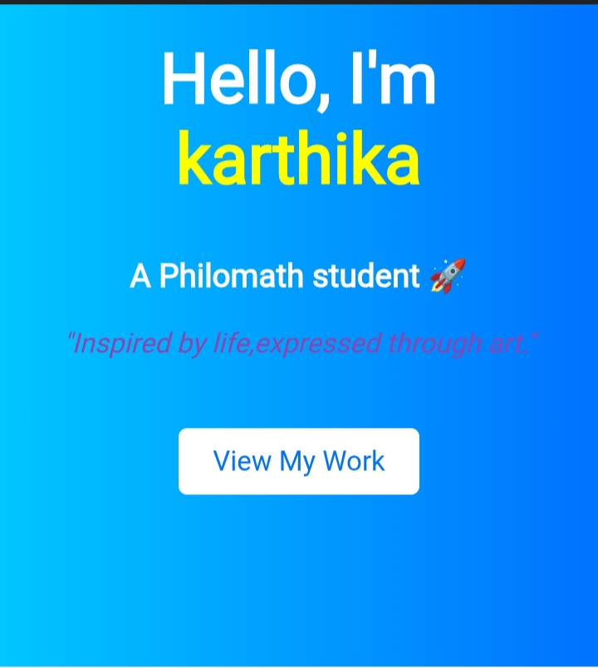
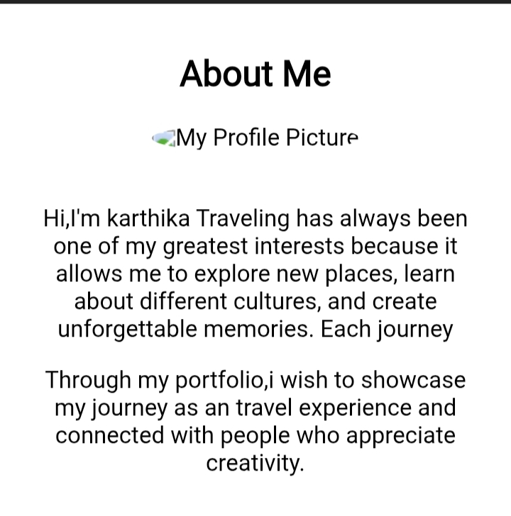
Results and screenshot

Slide 12
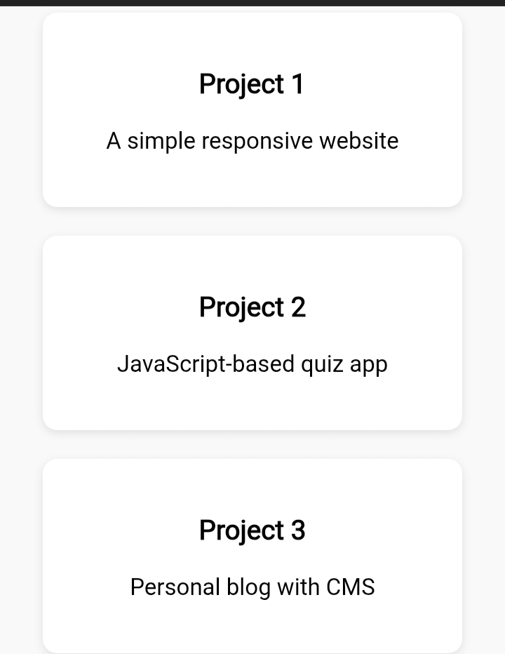
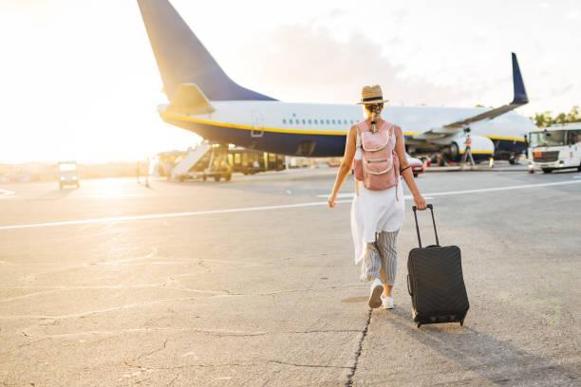
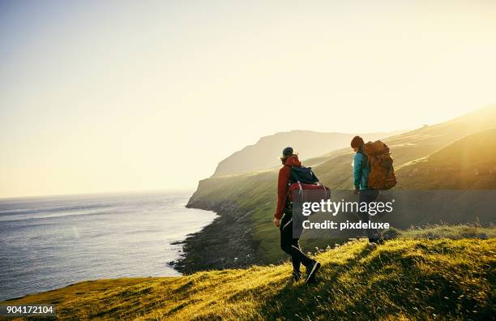
Results and screenshot

Slide 13
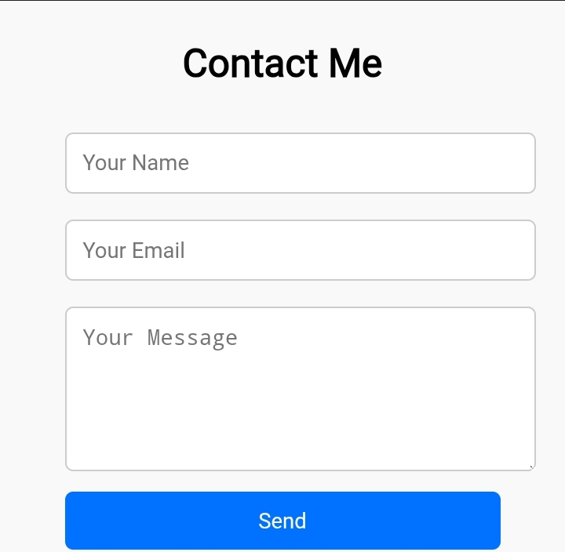
Results and screenshot

Slide 14
CONCLUSION
HIGHLIGHTS OF MY PROJECT
Built a digital travel platform for planning trips.
Used HTML, CSS, and APIs (like Google Maps).
Added Home, Destinations, Experiences, Plan Trip, and Contact sections.
Designed with a simple and user-friendly interface.

Slide 15
CONCLUSION
FINAL SUMMARY
The project demonstrates my skills in web development and design.
Helps travelers explore destinations in an organized and easy way.
A useful step toward enhancing travel planning and cultural discovery.

Slide 16
CONCLUSION
BENEFITS TO THE SOCIETY
Allows travelers to access reliable information and itineraries online.
Easy access for families, tourists, and travel enthusiasts to plan stress-freetrips.
Encourages cultural exchange and promotes tourism opportunities.

Slide 17
Thank you

