Slide 1
Digital Portfolio
STUDENT NAME: M. keerthana
REGISTER NO :32124u18031
NMID:AEF0FE649CFE0609C4D408DE26589D94
DEPARTMENT: COMPUTER SCIENCE
COLLEGE: MUTHURANGAM GOVERNMENT ARTS COLLEGE (A)-VELLORE-2.
COLLEGE/ UNIVERSITY: THIRUVALLUVAR UNIVERSITY

Slide 2
PROJECT TITLE
Digital portfolio

Slide 3


AGENDA
Problem Statement
Project Overview
End Users
Tools and Technologies
Portfolio design and Layout
Features and Functionality
Results and Screenshots
Conclusion
Github Link
3/21/2024 Annual Review

Slide 4
PROBLEM STATMENT
Traditional resumes often fail to highlight technical capabilities, design creativity, and real-time project demonstrations. Without a modern, responsive, and user-friendly portfolio, opportunities for career growth, networking, and personal branding can be missed. There is a need for a personal portfolio website that allows individuals to present their skills, projects, and achievements in a structured, visually appealing, and accessible way. Such a platform not only enhances credibility but also serves as a professional identity in the competitive job market.

Slide 5
PROJECT OVERVIEW
The Personal Portfolio Website is a modern, responsive, and user-friendly web application designed to showcase professional skills, projects, and achievements in an organized manner. It serves as an interactive digital resume that highlights expertise in web development, UI/UX design, and problem-solving through real-world projects. The portfolio includes key sections such as About Me, Skills, Projects, and Contact, ensuring that visitors can easily navigate and access relevant information.

Slide 6
It is developed using HTML, CSS, JavaScript, React, and Node.js, ensuring both functionality and responsiveness across devices. This project aims to build a strong online presence for career opportunities, networking, and personal branding, while also demonstrating technical proficiency in modern web development and design practices.

Slide 7

WHO ARE THE END USERS?
The Personal Portfolio Website is designed for the following groups of users: 1. Recruiters & Hiring Managers – To evaluate technical skills, past projects, and overall expertise in web development and design. 2. Clients & Collaborators – To review capabilities and decide on potential freelance or collaboration opportunities. 3. Peers & Professional Network – To connect, share knowledge, and explore opportunities for teamwork or innovation. 4. Educational Institutions & Mentors – To assess learning progress, practical application of skills, and project outcomes.

Slide 8
4. Educational Institutions & Mentors – To assess learning progress, practical application of skills, and project outcomes. 5. General Audience – Anyone interested in exploring personal work, design creativity, or seeking inspiration for building their own portfolios.

Slide 9
TOOLS AND TECHNIQUES
The development of the Personal Portfolio Website utilized the following tools and technologies: 1. Frontend Technologies HTML5 – For creating the structure and semantic content of the website. CSS3 – For styling, responsive design, and layout formatting. JavaScript (ES6+) – For interactivity and dynamic content handling. React.js – For building reusable UI components and ensuring a smooth user experience.

Slide 10
2. Backend & Development Tools Node.js – For handling backend operations and server-side logic (if required). Git & GitHub – For version control, project collaboration, and hosting repositories. 3. Design & Prototyping Tools Figma – For UI/UX design and prototyping project interfaces. 4. Deployment & Hosting GitHub Pages / Netlify / Vercel – For deploying the portfolio and making it accessible online.

Slide 11
POTFOLIO DESIGN AND LAYOUT
The Personal Portfolio Website is designed with a clean, minimal, and user-friendly layout to ensure easy navigation and accessibility. The design follows modern UI/UX principles, emphasizing simplicity, readability, and responsiveness across different devices. Key Design Elements: 1. Header / Navigation Bar – A simple navigation menu at the top providing quick access to different sections like Home, About, Skills, Projects, and Contact. A welcoming introduction highlighting the name, profession (Web Developer | Designer | Coder), and a call-to-action button like See My Work.
11

Slide 12
2. Hero Section – A welcoming introduction highlighting the name, profession (Web Developer | Designer | Coder), and a call-to-action button like See My Work. 3. About Me Section – A short description showcasing personal background, passion, and expertise. 4. Skills Section – A structured list of technical skills such as HTML, CSS, JavaScript, React, Node.js, Git, and UI/UX Design. 5. Projects Section – Displays completed projects with short descriptions and links to GitHub repositories. 6. Contact Section – A simple contact form allowing visitors to send messages, along with footer details and copyright information.

Slide 13
FEATURES AND FUNCTIONALITY
The Personal Portfolio Website includes the following features and functionality 1. Responsive Design– The website adjusts seamlessly across desktops, tablets, and mobile devices for a smooth browsing experience. 2. Interactive Navigation Bar – Easy-to-use navigation menu that provides quick access to different sections of the portfolio. 3. Hero Section with Call-to-Action – Highlights the user’s name, profession, and a direct button to view projects or download the resume.

Slide 14
4. About Me Section – A brief introduction showcasing background, passion, career goals, and achievements. 5. Skills Section – Displays technical skills using progress bars, icons, or badges for better visualization. 6. Projects Section – Showcases completed projects with descriptions, screenshots, and GitHub/live demo links. Highlights role, tools used, and functionality for each project. 7. Contact Form – Allows visitors to send inquiries directly via email integration (e.g., using Formspree, EmailJS, or backend logic).

Slide 15
RESULTS AND SCREENSHOTS
The development of the Personal Portfolio Website resulted in a fully functional, responsive, and professional platform that successfully showcases personal skills, projects, and achievements. The website provides a smooth user experience with easy navigation, clean design, and engaging visuals.
3/21/2024 Annual Review
15

Slide 16
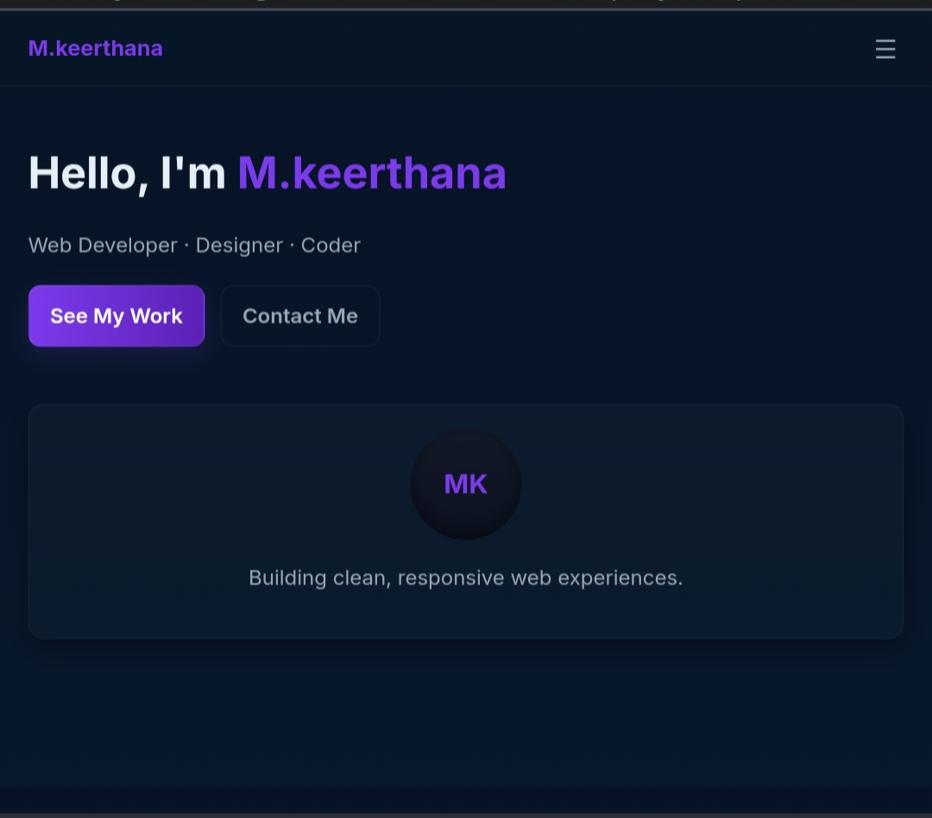

Slide 17
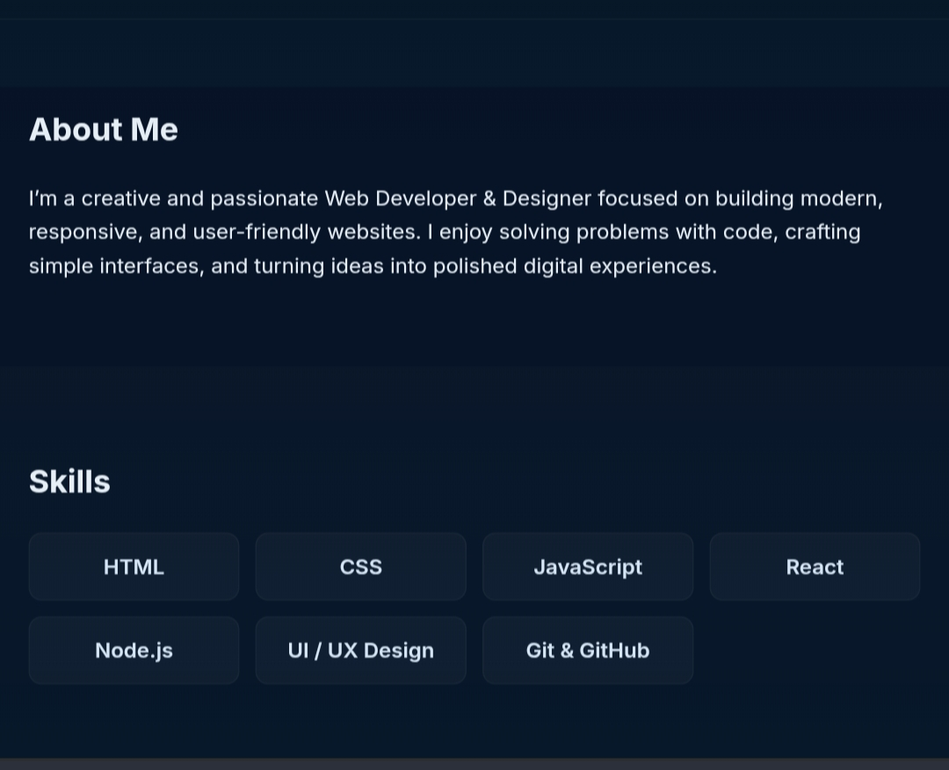

Slide 18
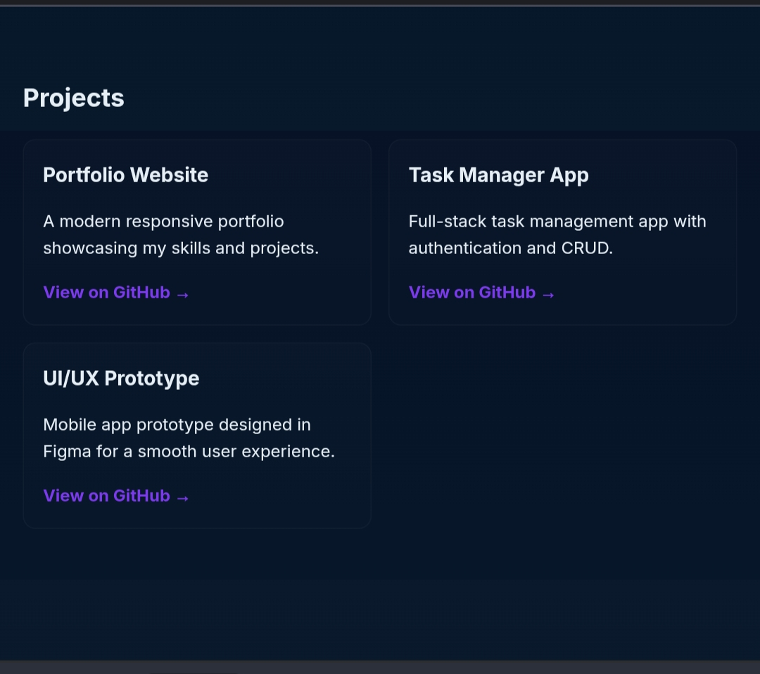

Slide 19
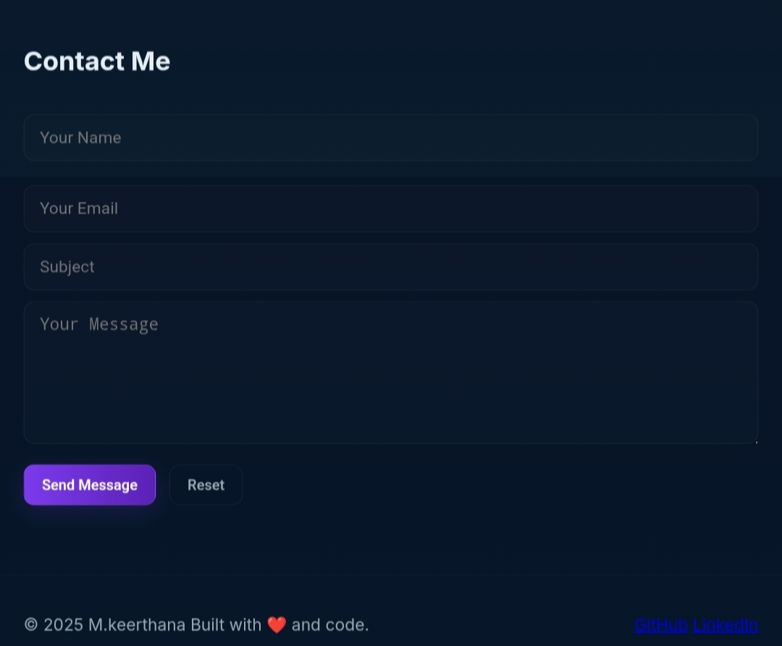

Slide 20
CONCLUSION
The Personal Portfolio Website effectively demonstrates the importance of having a strong digital presence in today’s competitive world. It serves as a professional platform to showcase skills, projects, and achievements in a structured and visually appealing way. The project not only highlights technical proficiency in modern web technologies but also reflects creativity, problem-solving, and design thinking. By implementing a responsive layout, interactive features, and organized content sections, the portfolio ensures a smooth user experience across devices.
20

