Slide 1

Welcome
To
Digital
Portfolio

Slide 2
My Drawing Portfolio
U.LOGESH
32124U18034
II B.SC.COMPUTER SCINECE
MUTHURANGAM GOVT ARTS COLLEGE
THIRUVALLUVAR UNIVERSITY

Slide 3
AGENDA
Portfolio design and layout
Tools and Technologies
Problem Statement
Features and Functionality
Project Overview
Result and Screenshots
Conclusion
Github Link

Slide 4
Problem Statement
An HTML problem statement defines a specific challenge or task that needs to be solved using HTML, often in conjunction with CSS and JavaScript for web development projects. These statements outline the requirements and desired outcome of a web page or component, serving as a guide for developers.

Slide 5
Project Overview
A project overview involving CSS typically refers to a project where Cascading Style Sheets (CSS) is a primary technology used to define the visual presentation and layout of web pages. This type of project focuses on applying styles to HTML elements to control aspects such as:
Layout and Positioning: Arranging elements on the page, creating multi-column layouts, and controlling spacing and alignment.
Typography: Setting font families, sizes, colors, and text decorations.
Colors and Backgrounds: Defining color schemes for text, backgrounds, and other elements.
Visual Effects: Adding transitions, animations, shadows, and other decorative features.
Responsiveness: Ensuring the design adapts and displays correctly across various screen sizes and devices.

Slide 6
Portfolio Design And Layout
Designing and laying out a portfolio using JavaScript typically involves dynamic elements and enhanced user interactions, complementing the structural foundation of HTML and the styling of CSS.

Slide 7
Tools And Techniques
Developing with HTML and CSS involves using various tools and applying specific techniques to structure and style web pages effectively.

Slide 8
Who Are The End Users
Direct Interaction:
They are the ones who actively use the software application, hardware device, or digital service.
Focus on Functionality:
Their primary concern is how the product helps them achieve their specific tasks or goals.
Varying Technical Expertise:
End users can range from novices with limited technical knowledge to experts in a particular system.
Influence on Product Success:
Their satisfaction, feedback, and needs are crucial for guiding product development, ensuring usability, and determining market success.

Slide 9
Features And Functionality
Lightweight and Interpreted:
JavaScript is designed to be a lightweight scripting language, executed directly by web browsers without a separate compilation step.
Dynamic Typing:
Variables are not strictly typed, allowing flexibility in data types during runtime.
Object-Oriented and Prototype-Based:
While it supports object-oriented programming concepts, it utilizes a prototype-based inheritance model rather than traditional class-based inheritance.
Functional Programming Support:
Functions are first-class citizens, meaning they can be treated like any other variable, passed as arguments, and returned from other functions.
Event Handling:
It enables the creation of interactive web pages by responding to user actions and browser events (e.g., clicks, key presses, page loading).

Slide 10
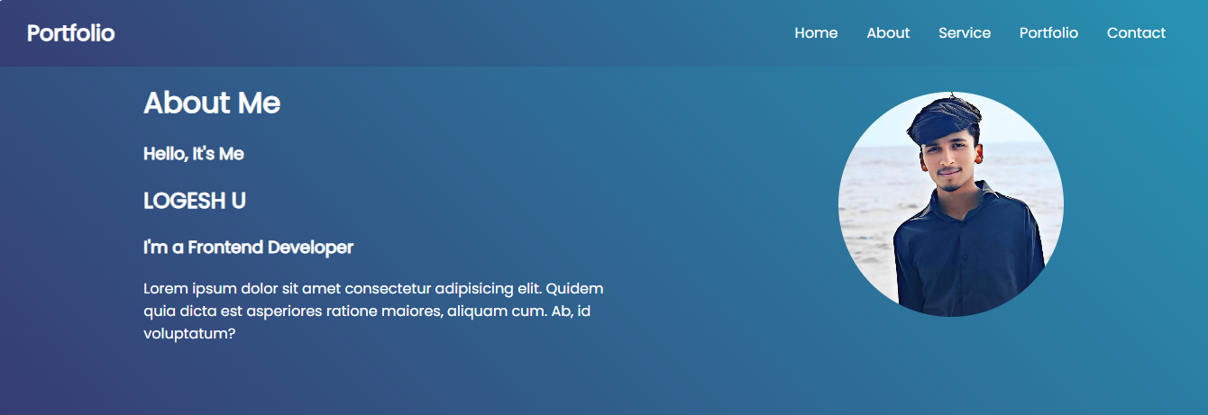
Results And Screenshots

Slide 11
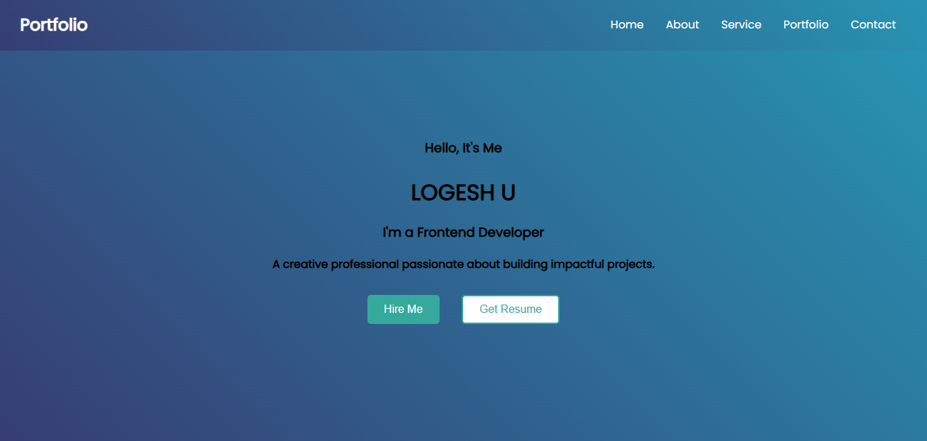
Results And Screenshots

Slide 12
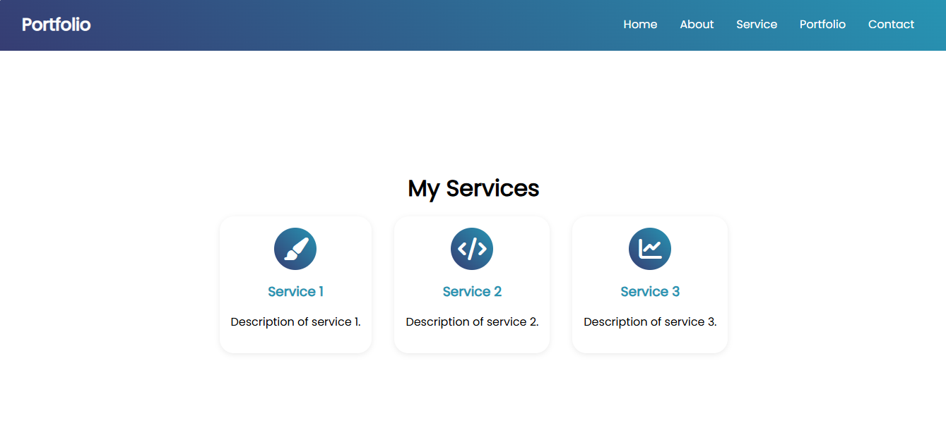
Results And Screenshots

Slide 13
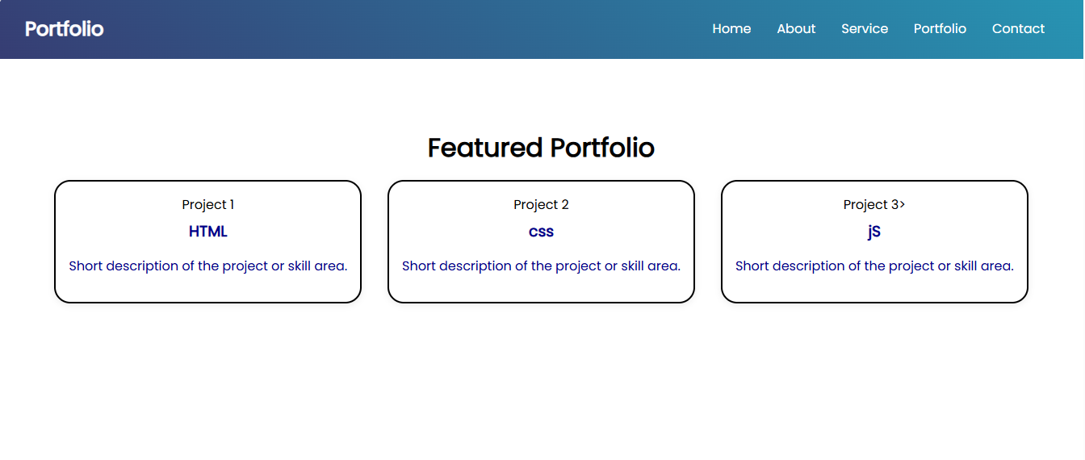
Results And Screenshots

Slide 14
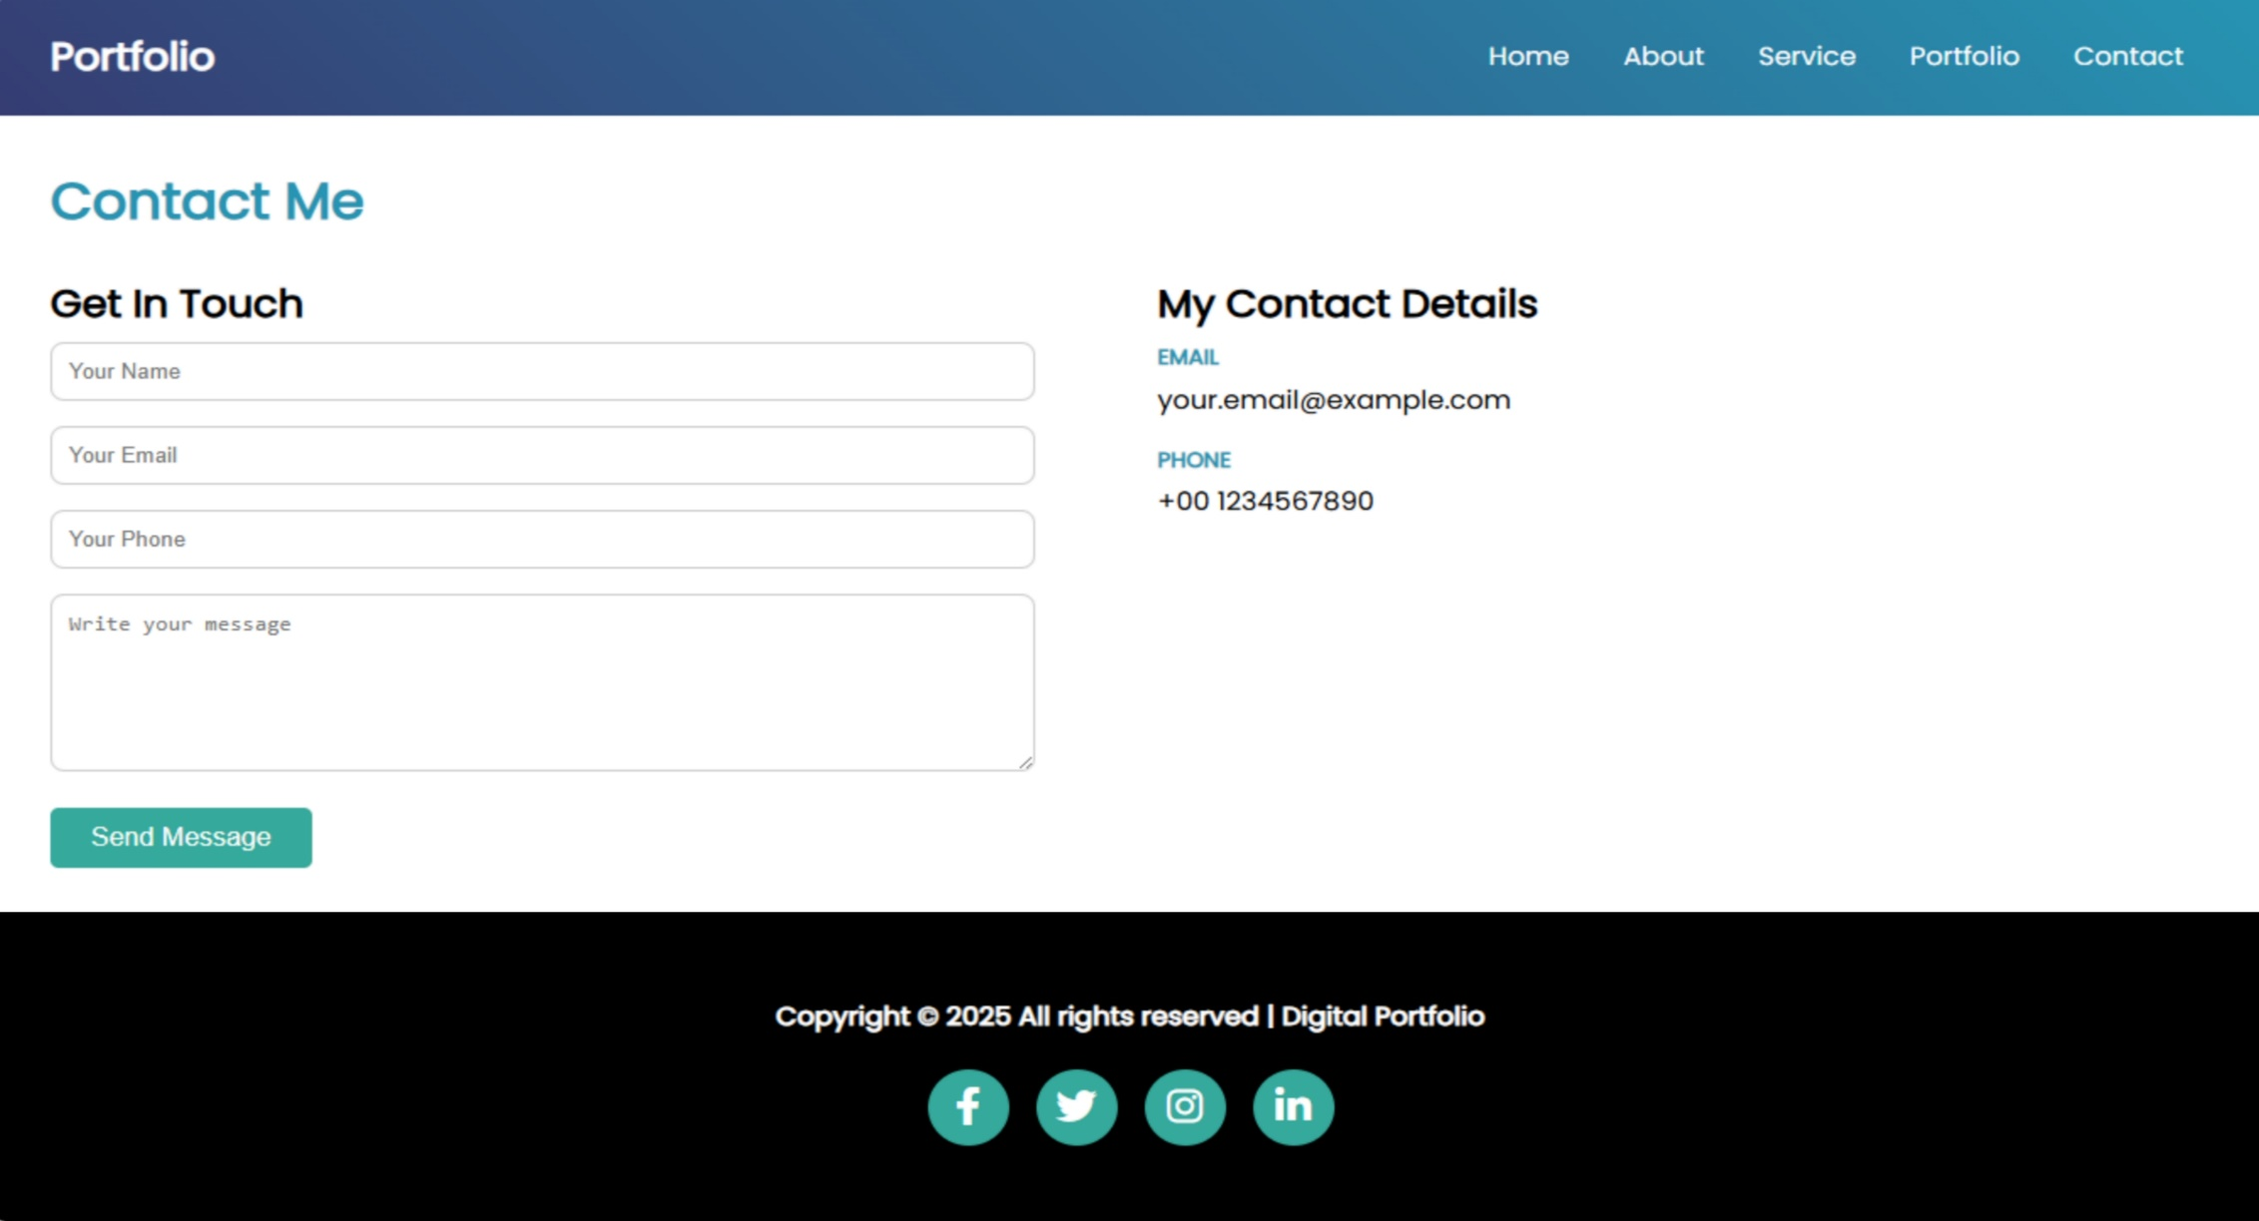
Results And Screenshots

Slide 15
Conclusion
In conclusion, HTML, CSS, and JavaScript form the trifecta of web development languages that not only pave the way for creating dynamic and visually appealing websites but also ensure that learning these skills is accessible and integrated into broader educational goals.

