Slide 1
Digital Portfolio
STUDENT NAME: PARVEENKUMAR.A
REGISTER NO AND NMID: 32124u18047&7E32D86AFCFE7C2974741E4688B7AC74
DEPARTMENT: BSC.COMPUTER SCIENCE
COLLEGE: MUTHURANGAM GOVT ARTS AN SCIENCE COLLEGE

Slide 2
PROJECT TITLE My topic about flowers🌺
Notes:
I am study about flowers 🌺

Slide 3


AGENDA
Problem Statement
Project Overview
End Users
Tools and Technologies
Portfolio design and Layout
Features and Functionality
Results and Screenshots
Conclusion
Github Link
3/21/2024 Annual Review

Slide 4

PROBLEM STATEMENT
🌺Displays detailed information about different flowers. 🌺Uses images and neat diagrams to enhance learning and engagement. 🌺Categorizes flowers based on type, color, or region. 🌺Provides an attractive and user-friendly interface.

Slide 5

PROJECT OVERVIEW
🌺Home Page with an attractive introduction and navigation menu. 🌺Flower Gallery displaying images of flowers in grid or card format. 🌺Flower Details Page for descriptions, diagrams, and interesting facts. 🌺Search and Filter Functionality (by name, type, or color).
🌺Responsive Design to ensure accessibility on mobile Home Page with an attractive introduction and navigation menu.

Slide 6

WHO ARE THE END USERS?
Students & TeachersFor academic projects, classmates and instructors who evaluate design, coding, and creativity.
2. Florists & Flower Shop OwnersTo showcase different flower varieties, arrangements, and business offerings
3. Event Planners / Wedding DecoratorsThey may use the portfolio to choose flower themes, decorations, and arrangements.4
4. Gardeners & HorticulturistsFor exploring flower types, care instructions, and seasonal planting guides.

Slide 7

TOOLS AND TECHNIQUES
Research & Collection Gather information about flower types, uses, seasonal availability, and meanings
Categorization Organize flowers by color, type, occasion, price range
.UI/UX Design Create a neat, colorful, nature-inspired interface for a website/app.Use grid/gallery view to showcase flowers like a catalog.

Slide 8
POTFOLIO DESIGN AND LAYOUT
Cover / Home PageTitle: “Flower Portfolio”Aesthetic: Soft pastel or nature-themed background (light green, lavender, white).Hero Image: Large high-quality flower photo or bouquet.Tagline: “A collection of nature’s beauty”.
2. About SectionA short intro about the portfolio (purpose: showcase, catalog, project).Quote or fact about flowers.Example: “Flowers speak the language of emotions – here’s my curated collection.”
3.Gallery / Portfolio SectionGrid or Card Layout (3–4 flowers per row).Each card contains:Flower ImageName (Botanical + Common)Short description (color, fragrance, use).Hover/Click → More details (flower meaning, season, care tips).
4. Categorization / TabsFlowers by:🌹 Type (Rose, Lily, Orchid…)🎨 Color (Red, Yellow, White…)🎉 Occasion (Wedding, Birthday, Funeral, Festival…)Use tabs, filters, or dropdown menus for easy navigation.
8

Slide 9
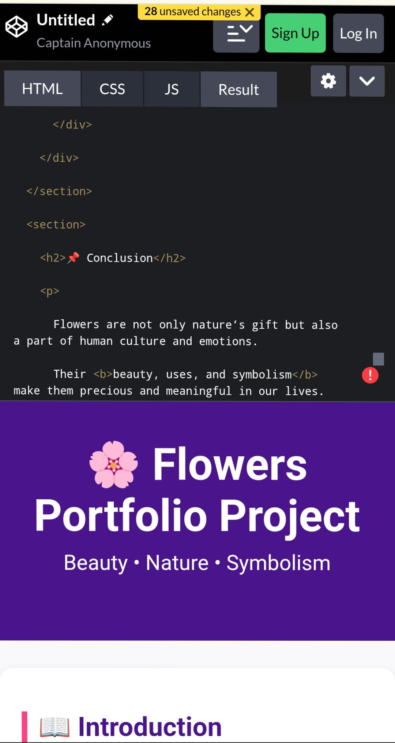
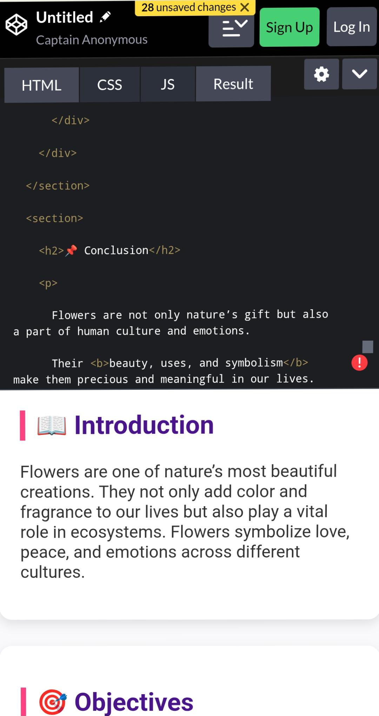

RESULTS AND SCREENSHOTS
3/21/2024 Annual Review
9

Slide 10
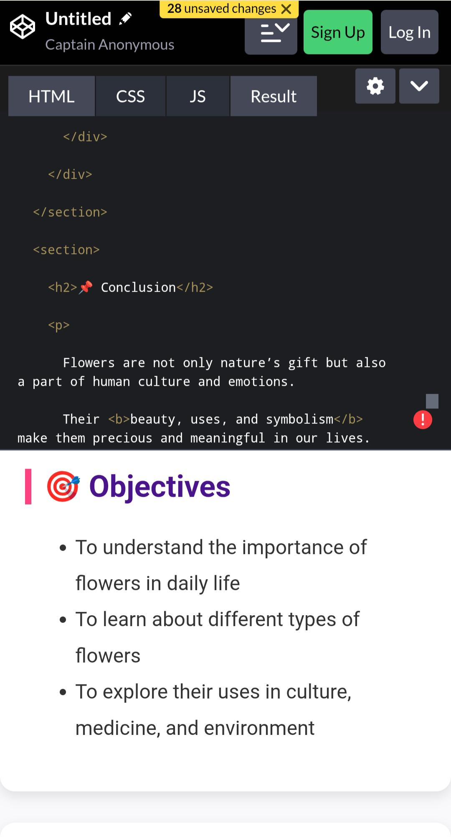
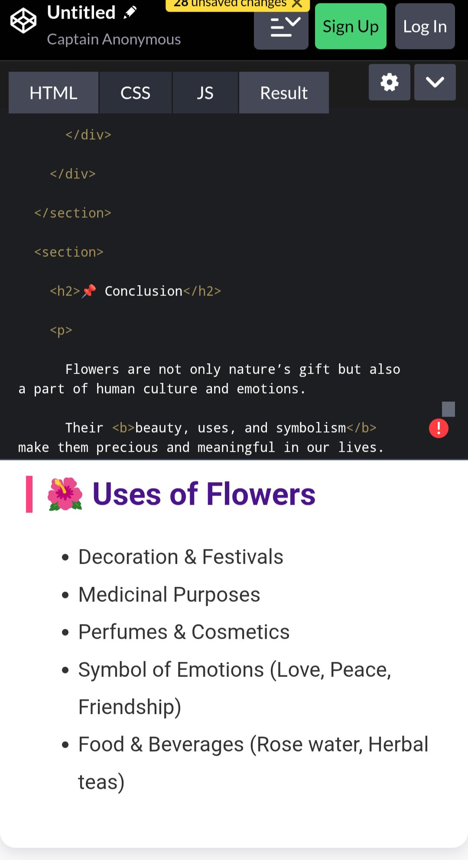
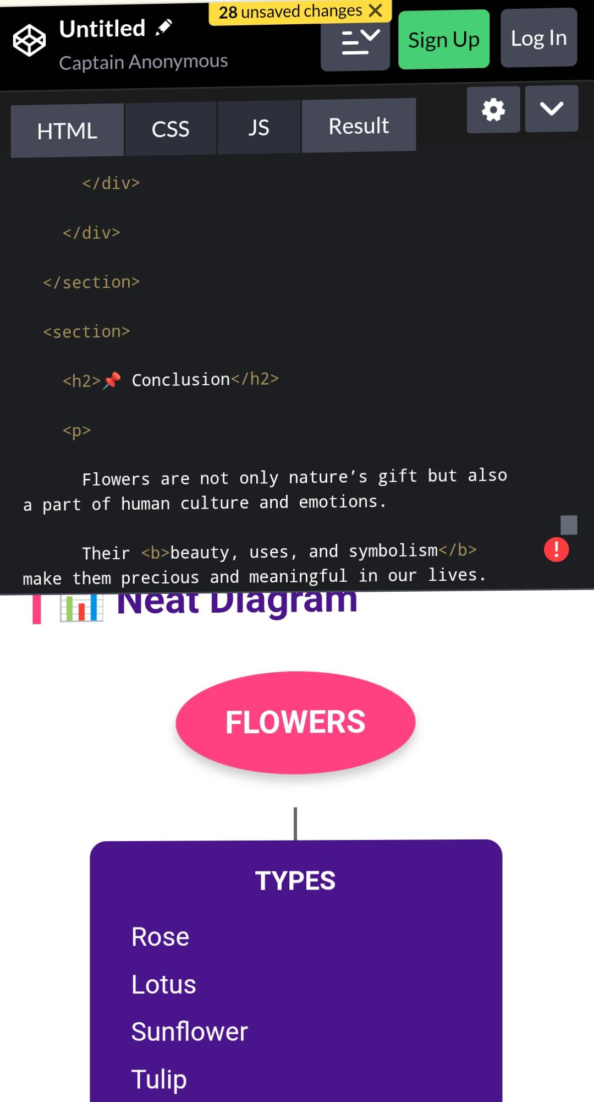
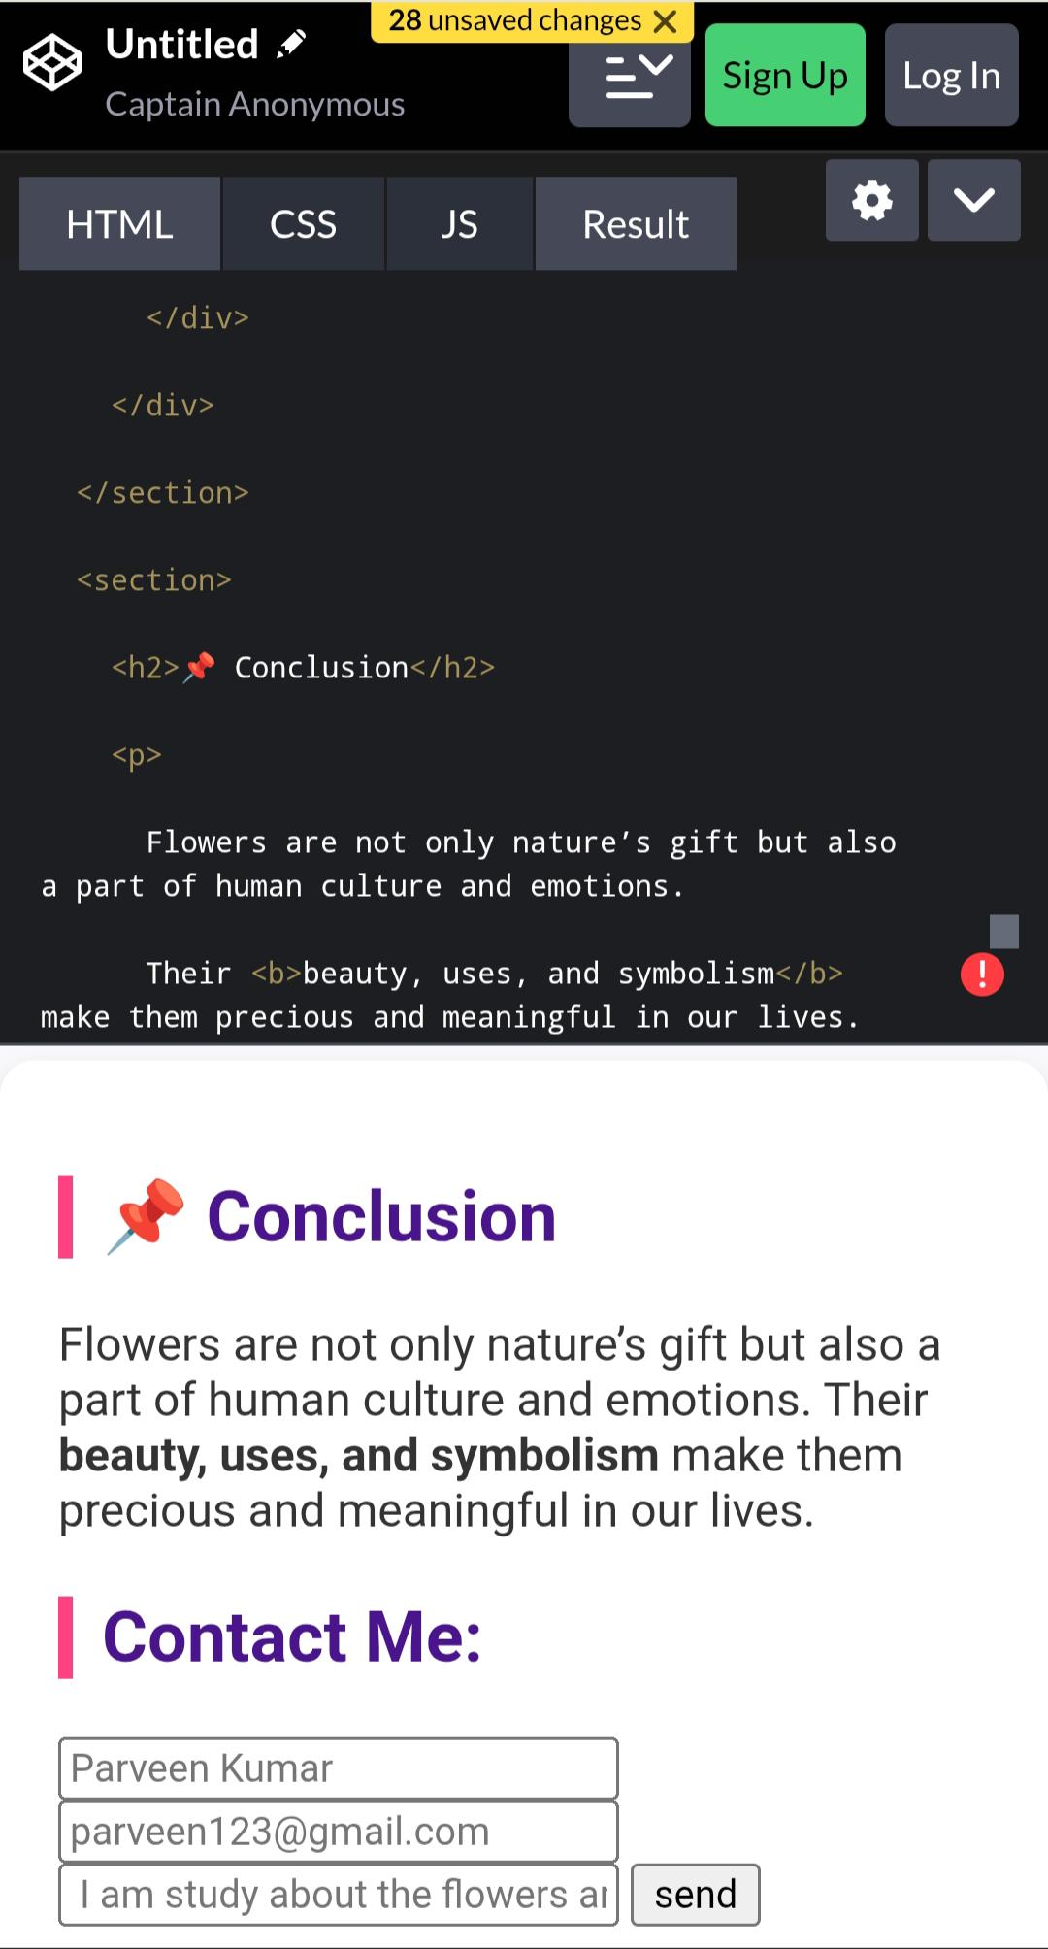
RESULT AN SCREENSHOT

Slide 11
CONCLUSION
🌺Flowers are one of nature’s most beautiful creations and bring joy to people’s lives
🌺They hold cultural, emotional, and religious importance across the world.
🌺Flowers are widely used for decoration, gifts, festivals, and ceremonies
Many flowers also have medicinal and aromatic values
🌺Growing and preserving flowers supports biodiversity and the environment
🌺Floriculture provides employment and income to many people
🌺Flowers remind us of the need to protect nature and promote greenery.
11

