Slide 1
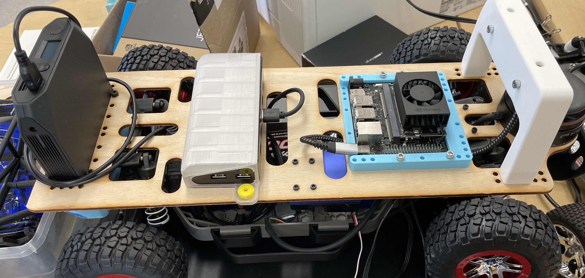
Mid-Year Senior Research Presentation
Manav Gagvani

Slide 2
Table of Contents
1. Project Overview
2. Background and Definitions
3. Key Idea
4. Current Progress
5. Short-Term Goals

Slide 3
Project Overview
Train a scaled R/C car to drive itself autonomously using reinforcement learning in real life.

Slide 4
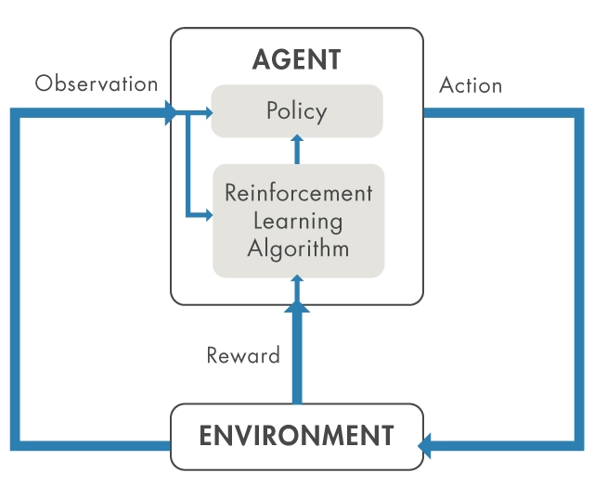
Background and Definitions
R/C = Remote-Controlled
One main component of the project is adapting the car so it can be controlled by a computer.
Autonomously
Given a pre-defined track, the car should navigate it successfully without crashing or leaving the boundaries of the road.
Reinforcement Learning
An agent interacts within an environment and can take certain actions. There are rewards that come with taking actions, and the goal of the agent is to develop a policy, a mapping of environment states to actions which maximizes reward.
Source: https://www.digitalengineering247.com/article/getting-started-with-reinforcement-learning

Slide 5
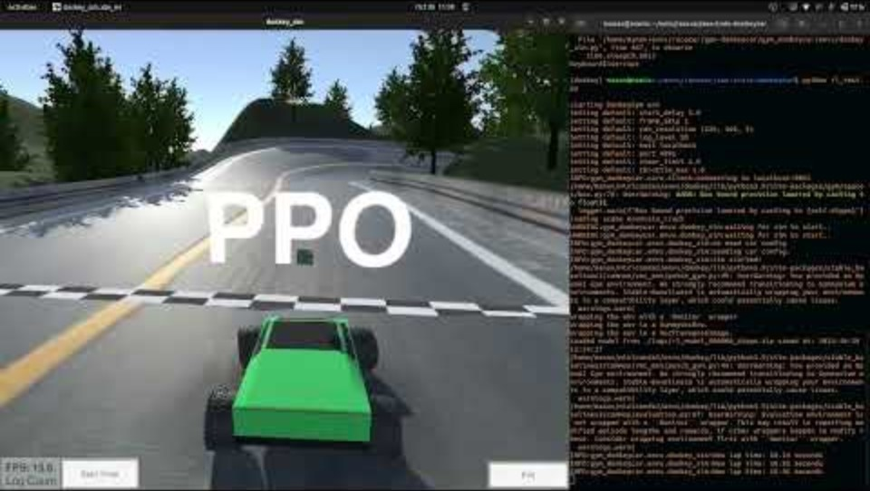
Key Idea - RL, IRL (Reinforcement Learning, In Real Life)
Reinforcement Learning takes a long time to come up with good policies – to speed it up, we train them in simulation
This doesn’t necessarily translate well when trying to apply the RL algorithm trained in simulation to a real-world system, like a self-driving car
We want to learn a driving policy on the real car to eliminate discrepancies between simulation and reality
Using a well-known RL algorithm taking images of the road as input. This took 48 hours to train on a simulation sped up by 4x.

Slide 6
Current Progress
Basic Reinforcement Learning in Simulation
Accelerating Reinforcement Learning in Simulation using an Autoencoder
Assembled Car Hardware/Control of Throttle Motor

Slide 7
1. RL in Simulation Using PPO
Unity simulation of car physics
Implements OpenAI Gym API, a framework for developing RL algorithms
Reward function
Penalize crashing
Penalize high distance from the center of the road
Reward forward velocity, especially if closer to the centerline
Input
The policy learns directly from images of the road

Slide 8
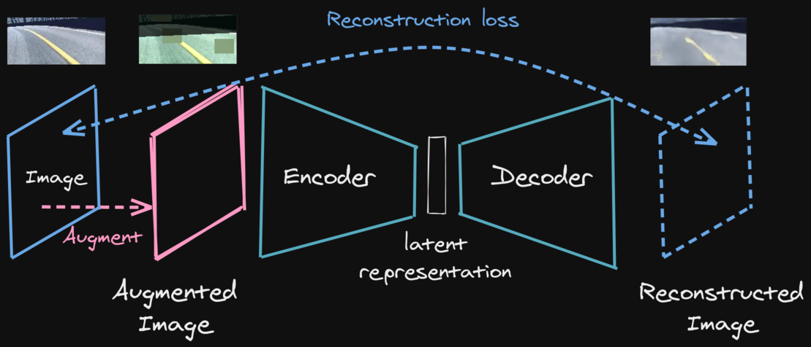
2. Autoencoder – Simplifying the Observation
Source: https://araffin.github.io/talk/learning-race/
Raw pictures of a road contain too much unnecessary detail
Shadows, trees, etc.
Reduce picture of road to latent representation which encodes core details
The autoencoder is trained on manual driving – jump-starting the RL with human intuition

Slide 9
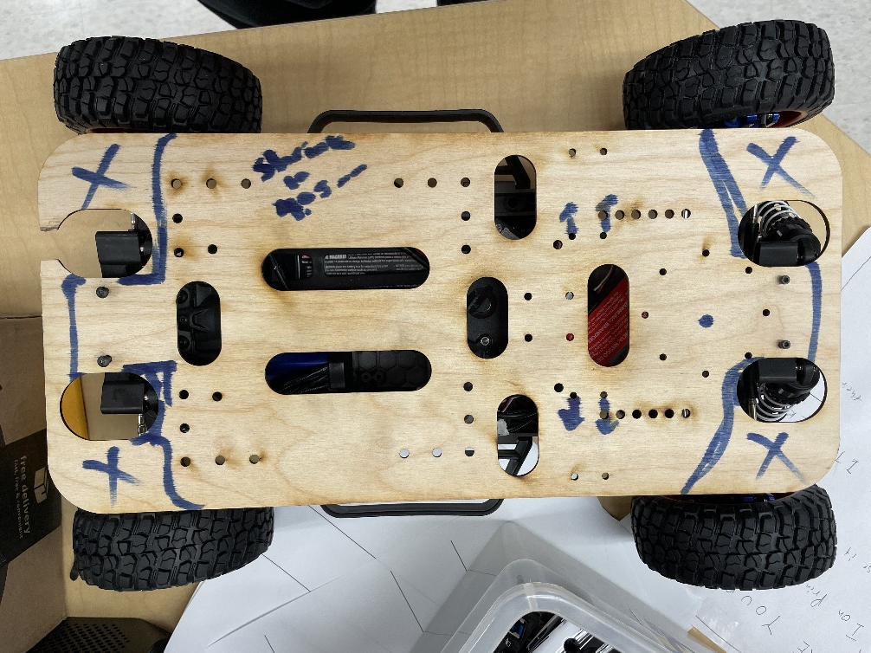
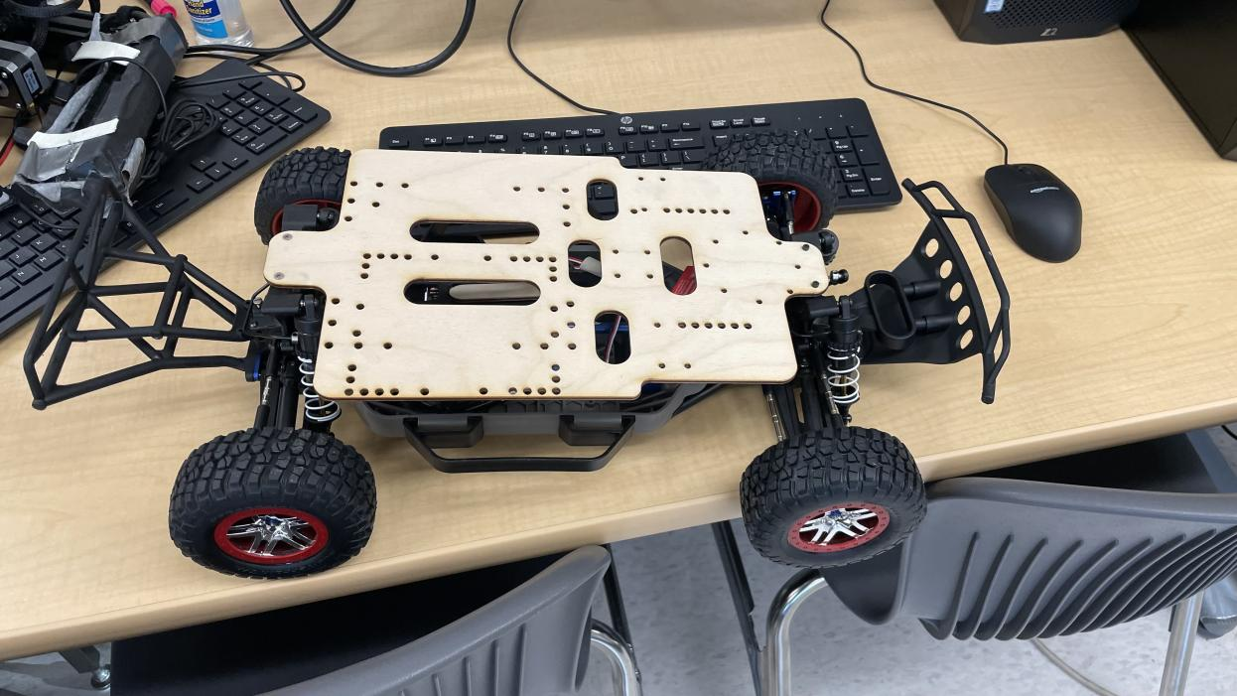
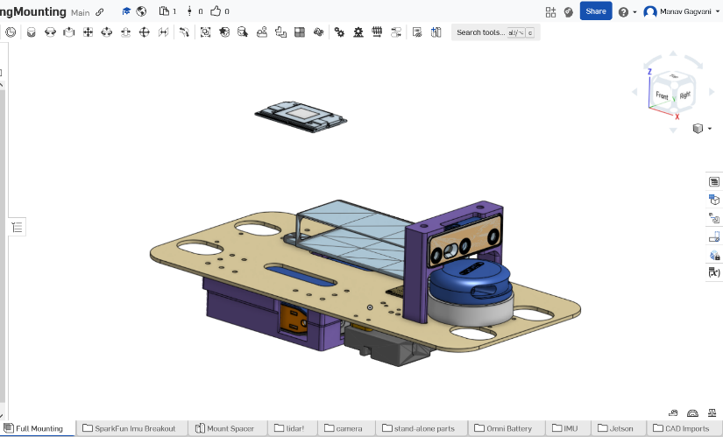
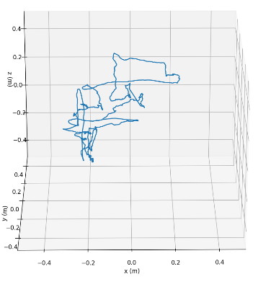
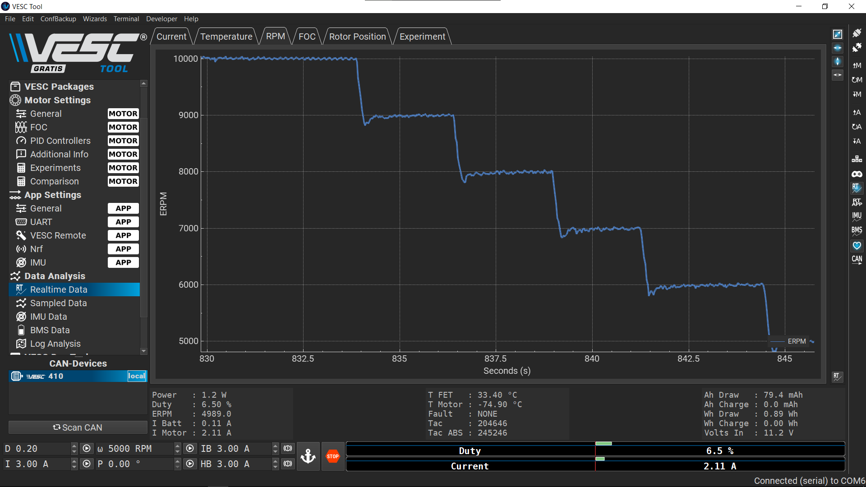
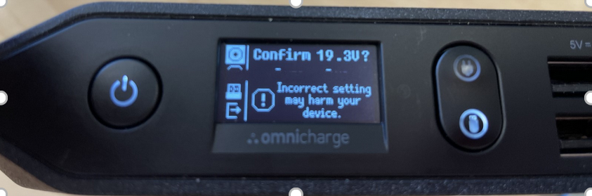
3. Real Car Assembly and Motor Testing

Slide 10
Short-Term Goals
1. Finish assembling car
2. Establish remote access of the car’s onboard computer
3. Send throttle/steering commands remotely to the car

