Slide 1


Clustering International Healthcare Data

Slide 2
Using data from the Organization for Economic Co-operation & Development:
Healthcare spending as a share of GDP has increased globally since 1990.
Increased spending is associated with increased healthcare infrastructure.
Are there any patterns or trends in this data that may inform OECD policy initiatives and identify specific stakeholders to bring to the table?
1. data.oecd.org URL: https://data.oecd.org/healthres/health-spending.htm

Slide 3
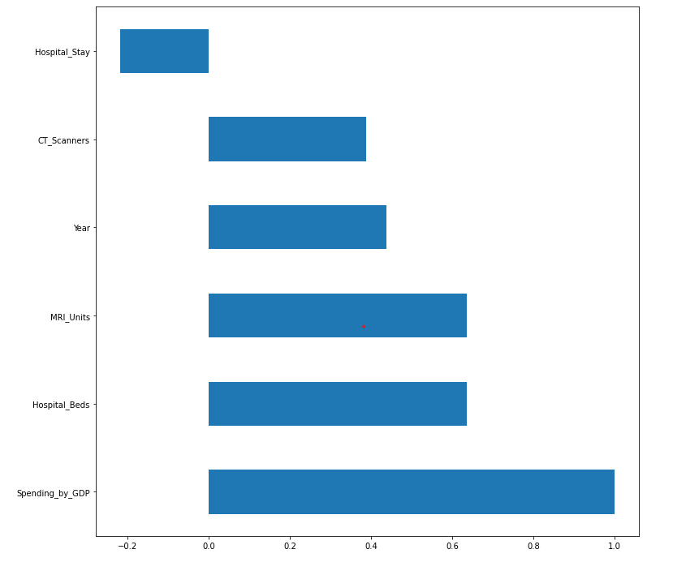
Metrics get better over time.

Slide 4

Years 1990 to 2018
Missing data for GDP spending
518 observations and 7 features
Data from 32 countries.
Many countries did not report information.

Slide 5
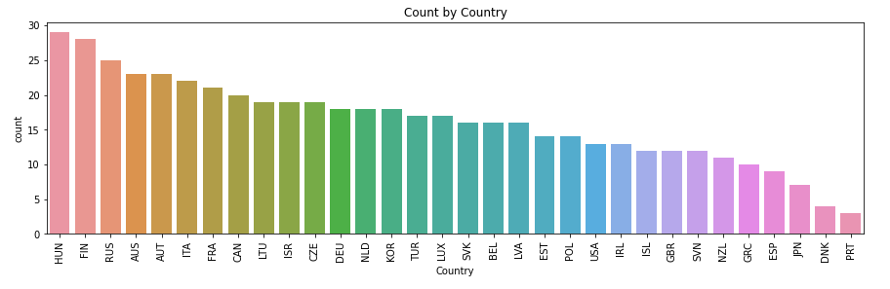
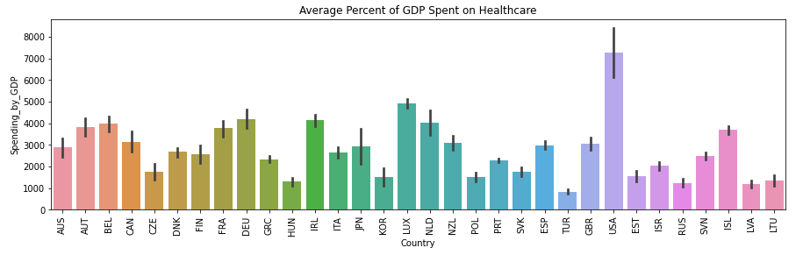

Slide 6
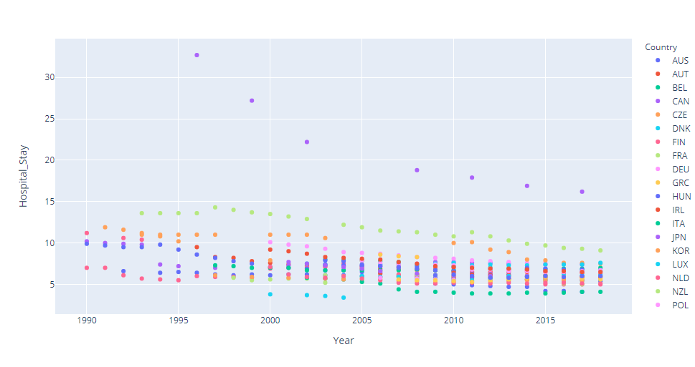
Hospital stays tend to decrease.

Slide 7
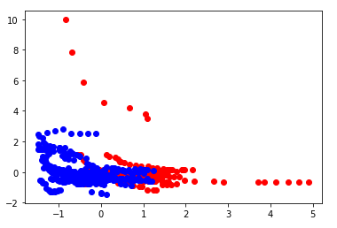
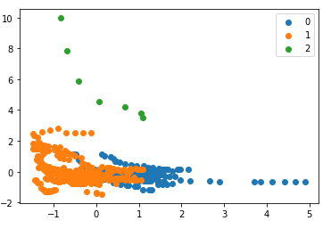
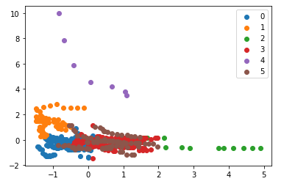
K-Means
Score = 0.4149
Score = 0.4139
Score = 0.3411
K-Means 3 clusters is best because it separates the high hospital stays. Hospital stay metric could be bad or good.

Slide 8
K-Means Cluster Labels
cluster 0 has 38% of the data and low spenders with low stays and low units and beds.
cluster 1 has 12% of the data and are the lowest spenders and lowest units and beds but medium hospital stays lengths.
cluster 2 has 3% of the data with the highest spending but also low stays and relatively high numbers of units and beds.
cluster 3 has 28% of the data and are mid-spenders with low hospital stays but low ROI with units and beds.
cluster 4 has 1% of the data are mid-spenders with the worst hospital stays but best # of units and beds.

Slide 9
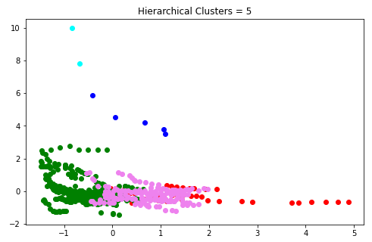
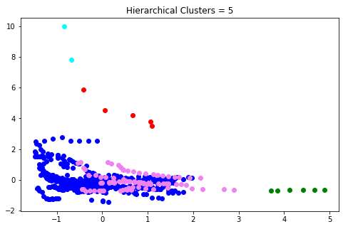
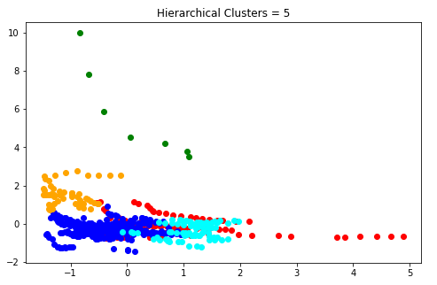
Hierarchical Clustering
Score = 0.3174
Complete Linkage
Score = 0.4135
Average Linkage
Score = 0.3218
Ward Linkage
Using Hierarchical clustering with 5 clusters using Ward Linkage.

Slide 10
Hierarchical Clustering Cluster Labels
cluster 0 has 94 records with high spenders with low stays and high metrics.
cluster 1 has 282 records with mid spenders and low metrics.
cluster 2 has 7 records with mid spending but very high metrics.
cluster 3 has 54 records and are low spenders with somewhat high hospital stays but low ROI with units and beds.
cluster 4 has 81 records and are the highest spenders low stays but somewhat low metrics.

Slide 11
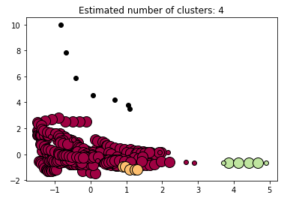
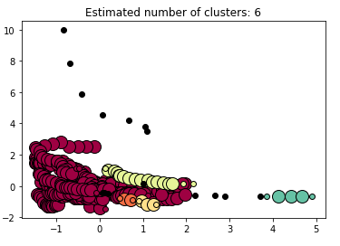
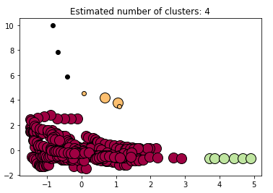
DBSCAN Models
Score = 0.359
3 Clusters
Score = 0.-318
5 Clusters
Score = 0.62
3 Clusters
Using DSCAN clusters has high silhouette score but less useful information.

Slide 12
DBSCAN Cluster Labels
cluster 0 contains the most data and consists of low spenders and low metrics
3 and 4 are higher spenders but relatively better ROI in terms of units and beds.
clusters 1 and 2 are mid spenders but with high CT scanners but relatively low MRI and beds available.

Slide 13
Findings
More Clusters, Less Confidence
Clusters highly varied.
Hierarchical Revealed more useful information.
Comparing the clusters resulting from 4 different clustering models above revealed that more clusters revealed more information or patterns but with less confidence. High confidence in the accuracy of cluster membership did not reveal anything new or interesting while clusters with low membership or low confidence revealed some groups that appear to get a high return on their investment in healthcare spending.
Clusters in the dataset were high varied and not symmetrical suggesting that either too much data is missing or that the data points are not easily separable by the models used here. Testing the models with various parameters did not reveal new information but it often revealed useless information. The number of clusters I determined to be best was based on a conceivable number of clusters such as 4 or 5 that would give some interesting information but lacking somewhat in the confidence of new data belonging to that cluster.
Clusters resulting from K-Means gave us high confidence in their membership but relatively little useful information except when looking at k=6 which revealed high metrics with very low spending which may be quite useful. Clustering with DBSCAN returned the least confident scores and interesting clusters but with extremely low confidence that descriptions are really accurate.

Slide 14
Conclusions
Missing Data
Japan Stands Out
Poor Data
As stated, complete data from all countries during the period studied may prove useful. Barring that, further testing using more categorical data and models using mixed data may reveal more as well. I did not include the Year and Country, both categorical data, because I was interested in comparing across the Country and be able to bring certain stakeholders from certain countries to the table to collaborate and inform policy at OECD.
Japan stands out as having low spending but high metrics such as units and beds but also high hospital stays. While decreasing length of hospital stay is generally considered a positive trend, it may not be the case in countries where median age is increasing and may suggest that Japan's healthcare infrastructure is quite healthy. Of course, more data would be needed to explore this in more detail.
Hierarchical clustering returned the best results with medium level confidence and tended to confirm the high hospital stay rate with low spending that should be investigated more. Clusters also confirmed high spending with very low metrics suggesting a low ROI in healthcare spending on those countries.

Slide 15

Questions?
This Photo by Unknown Author is licensed under CC BY

Slide 16
Sources
OECD (2021), Magnetic resonance imaging (MRI) units (indicator). doi: 10.1787/1a72e7d1-en (Accessed on 26 January 2021)
OECD (2021), Computed tomography (CT) scanners (indicator). doi: 10.1787/bedece12-en (Accessed on 26 January 2021)
OECD (2021), Health spending (indicator). doi: 10.1787/8643de7e-en (Accessed on 26 January 2021)
Healthcare spending data. Data URL: https://data.oecd.org/healthres/health-spending.htm

