Slide 1


Predicting Patient No-Shows

Slide 2
According to.com, Healthcare Innovation:
The total cost of missed appointments in the U.S. in 2016 was 150 billion.¹
No show rates are as high as 30% across the country.¹
1. Evadoption.com URL: https://www.hcinnovationgroup.com/clinical-it/article/13008175/missed-appointments-cost-the-us-healthcare-system-150b-each-year

Slide 3
Currently, 30% of patients do not show up
$200 loss per appointment
Staff not productive
Accurately predicting no-show appointments and adjusting your schedule can save your medical office time and money.

Slide 4
Costs associated with missed appointments include:
patients who needed to be seen but weren’t
Extra work by staff caused by last minute changes
Serious medical conditions may go untreated

Slide 5
Data: Medical Appointment No-Shows
Vitoria Brazil
110,524 appointments
Between 29 April and 8 June 2016

Slide 6
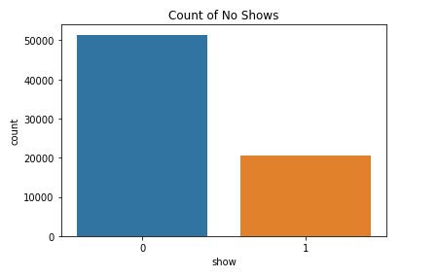
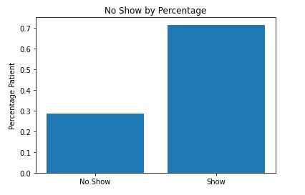
Target Variable – No Show
Notes:
Mention how the colors may confuse. Next time put counts on the percent slide.

Slide 7
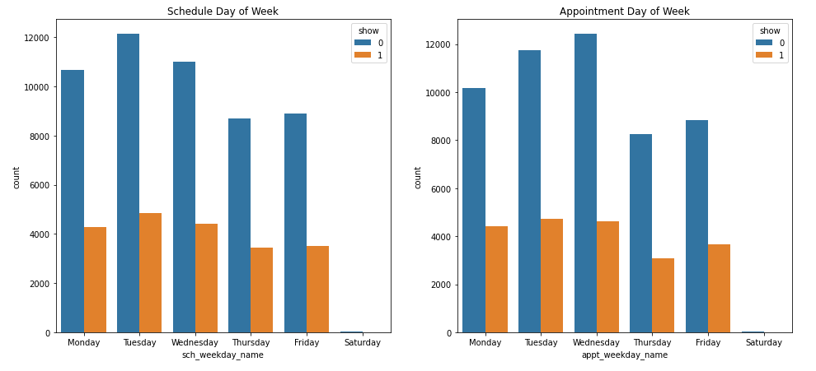
Looking at when the appoint was scheduled and the appointment day

Slide 8
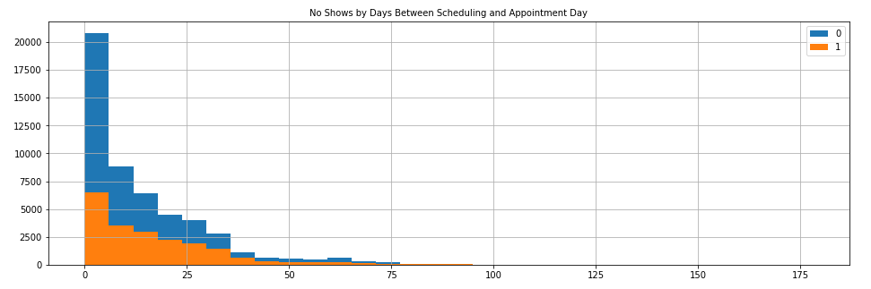
There may be more no shows associated with time.

Slide 9
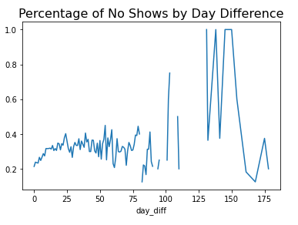
We can see more no shows as time span increases.
Notes:
Show top days of no shows.

Slide 10
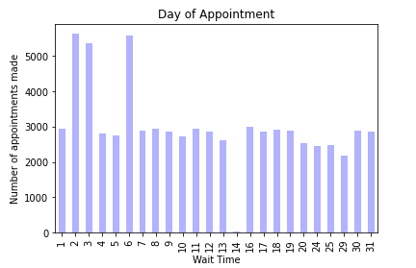
Wait times are mostly evenly distributed.

Slide 11
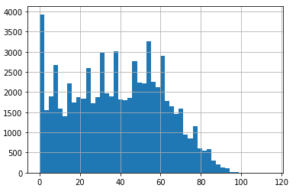
Most missed appointments are by patients between 20 and 60.

Slide 12
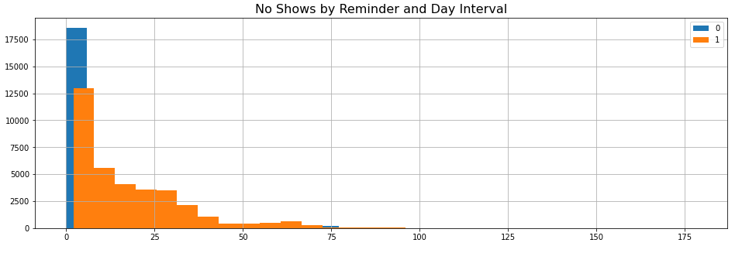
Looks like people who get reminders tend to miss their appointment more often.

Slide 13
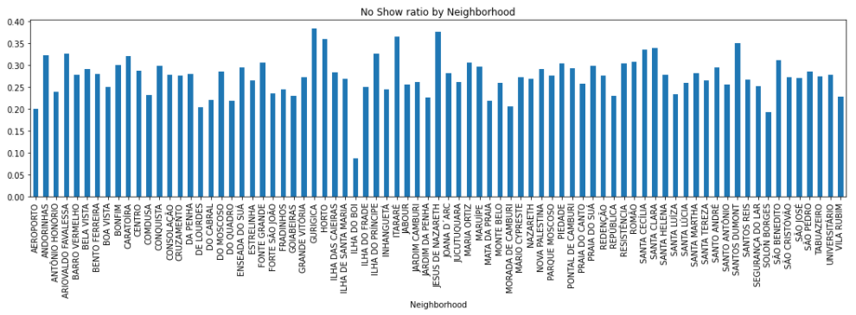
Except for one neighborhood, most seem to have the same proportion of missed appointments.

Slide 14
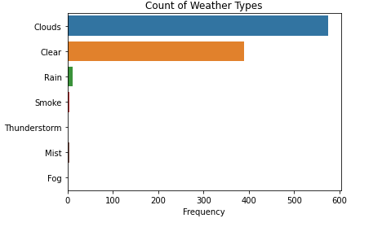
Poor weather was probably not a factor in missing appointments. (in this
dataset)
Notes:
It rained only 1 full day during the 6 week period of appointments and the temperature was mild.

Slide 15
Top 3 of 5 models tested
Extreme Gradient Boosting (XGB): F1 = .39
Accuracy 0.55 with only 50% of no-shows predicted
K Nearest Neighbor (kNN): F1= .39
Accuracy 0.55 with 49% of no-shows predicted
Random Forest (rf): F1= .38
Accuracy 0.57 with 46% of no shows predicted

Slide 16
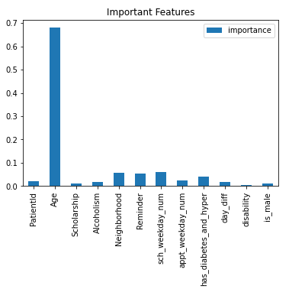
Consistent Important Features Age Reminder Neighborhood Scheduled Day

Slide 17
Findings
Returning Patients
Poor Models
Poor Data
Returning patients have more missed appointments but significance could not be tested with confidence.
Models performed poorly because data had little variance suggesting we need to collect different features or do more tuning of models.
Appointment hour was missing.
Short time span of data.
Clinical specialty was missing.

Slide 18
Conclusions
Weather Data
Distance Data
Mode of Transport
Weather data used had only 1 day of rain and climate was mild. Need more timespan in the data.
How far a patient has to travel might be very useful to analyze.
How a patient travels to the appointment.
Quality of public transportation in neighborhood.

Slide 19
Dummy Model Predicted 0 no-shows $200 x 4 appointments $800 dollars lost 20% accuracy
Using XGBoost
Predicted 50% of no-shows
$800 x .50
$400 dollars lost with 55% accuracy.
Notes:
XGB train test was .58 and testing was .58 Recall was .50. Precision was .32 and f1 was .39

Slide 20

Questions?
This Photo by Unknown Author is licensed under CC BY

Slide 21
Sources
Missed appointments cost the U.S. healthcare system $150B each year: HealthCare Innovation, Apr 26, 2016, Gier, Jamie https://www.hcinnovationgroup.com/clinical-it/article/13008175/missed-appointments-cost-the-us-healthcare-system-150b-each-year
Medical Appointment No Shows, Data URL: https://www.kaggle.com/joniarroba/noshowappointments/notebooks

