Slide 1
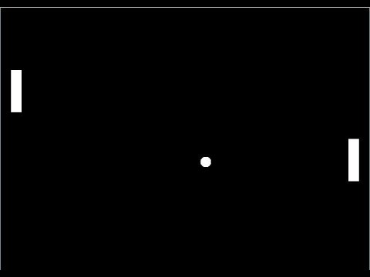
Pong!
By: McKenna Galle, Alex Blair, and Andrew Hutson

Slide 2
Goals
Ultimate goal:
To successfully implement Pong using VHDL and our Nexys 4 DDR Board.
Stepping Stones:
To reduce the size of the box in the bouncing box example
Add paddles
Map paddles to switches
Successfully implement collision
Map score to the 7seg display

Slide 3
Status of Goals
Ultimate goal:
To successfully implement Pong using VHDL and our Nexys 4 DDR Board. – Mostly Successful
Stepping Stones:
To reduce the size of the box in the bouncing box example - Successful
Add paddles - Successful
Map paddles to switches - Successful
Successfully implement collision – Mostly Successful
Map score to the 7seg display - Unsuccessful

Slide 4
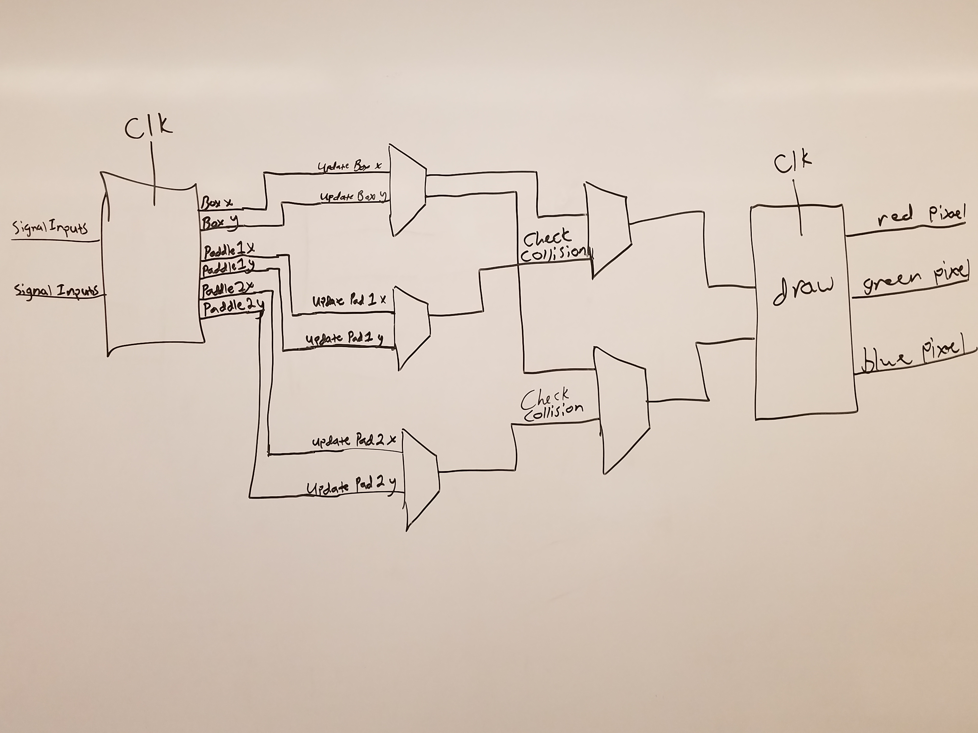
High Level Design

Slide 5
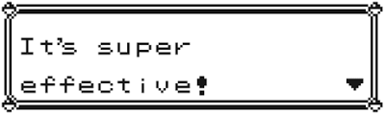
What went well
Creating paddles that interact with two of the switches on the board.
Successful scaling of ball and paddles.
Proper bounce off of paddles.
Gained a better understanding of how VHDL functions.

Slide 6

Challenges
Proper collision with empty space.
Functional 7seg display for scoring.
Reaching some of our other stretch goals such as utilizing the attachable joysticks.
It’s the move that is important…..

Slide 7
Demo:
Here is a demo of Pong!

