Slide 1
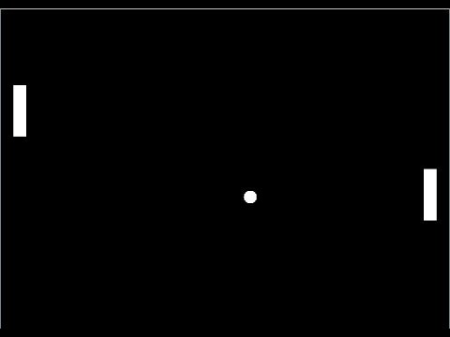
Pong!
By: McKenna Galle, Alex Blair, and Andrew Hutson

Slide 2
Goals
Ultimate goal:
To successfully implement Pong using VHDL and our Nexys 4 DDR Board.
Stepping Stones:
To reduce the size of the box in the bouncing box example
Add paddles
Map paddles to switches
Successfully implement collision
Map score to the 7seg display

Slide 3
Status of Goals
Ultimate goal:
To successfully implement Pong using VHDL and our Nexys 4 DDR Board. – Mostly Successful
Stepping Stones:
To reduce the size of the box in the bouncing box example - Successful
Add paddles - Successful
Map paddles to switches - Successful
Successfully implement collision – Mostly Successful
Map score to the 7seg display - Unsuccessful

Slide 4
High Level Design
CLK
Check Collision x
Box X Next
Box X
Signal Inputs
Paddle 1 X
Paddle 1 X Next
Box
Update position
Paddle 2 X Next
Draw Pixels
Paddle 1
Paddle 2 X
Paddle 2
Box Y Next
Box Y
Check Collision y
Paddle 1 Y Next
CLK
Paddle 1 Y
Paddle 2 Y
Paddle 2 Y Next

