Slide 1

Signal Processing in IDL
Professional Services Group
Research Systems, Inc.
Copyright © 2003
All rights reserved
Notes:
A Webex presentation on signal processing, focusing on using IDL's built-in FFT routine. This presentation is intended for new or beginning-level users of IDL who wish to learn how to perform some common signal processing tasks in IDL.
The data files and IDL programs used in this presentation are found in
/rsi/psg/mpiper/webex/SPWebinar.zip
Mark Piper, Ph.D. (mpiper@rsinc.com)
Professional Services Group
Research Systems, Inc.

Slide 2
Signal Processing in IDL
Goal: Learn how to use IDL to perform common signal processing tasks.
Scope: One-dimensional signal processing using built-in IDL routines, primarily the fast Fourier transform (FFT) function.
Notes:
The goal of this presentation is to demonstrate at a high level how to use IDL to perform some common signal processing tasks.
Be aware that signal processing is an awfully broad topic—it can mean different things to different people. Therefore, this presentation is limited in scope to discussing the fast Fourier transform (or FFT) and its application to one-dimensional signals, like a time series. We'll focus mainly on the topics of preconditioning and filtering signals.
We assume the user of this presentation has some familiarity with IDL. No knowledge of signal processing is required.

Slide 3
Outline
Introduction: what is signal processing?
The fast Fourier transform (FFT)
  implementation in IDL
  computation and display of spectra
Preconditioning
  detrending
  windowing
Filtering
  filtering operations
  filter types
  filtering process
Notes:
Here’s the outline for this presentation.
To begin, we’ll look at what signal processing is. I’ll give definitions and some examples.
Next, we’ll look at the primary tool for signal processing, the fast Fourier transform, or FFT for short. What is it? What does it allow us to do? And how is it implemented in IDL? I’ll also discuss how to interpret and display the results of performing an FFT on a signal.
Next, we’ll discuss preconditioning, the process of preparing a signal for Fourier analysis. The techniques of detrending and windowing are examined.
Finally, we’ll discuss filtering. It’s probably the most common application in signal processing. We’ll look at different filter types and filtering operations. I’ll also describe a filtering process—this is a set of instructions for performing a filtering task.
Before we proceed, I’d like to remind you that the sound can get out of synch with the slides in a webex recording such as this. If this happens, just use the rewind button on your webex player to back up a few seconds in the presentation. This should resynch the presentation.
OK, let’s begin.

Slide 4
Introduction
Signal ≡ The record of a process that occurs over time. Also called a ‘time series.’
  Examples: daily high temperatures, traffic flow through an intersection, rate of blood flow through an artery.
Signal processing ≡ The body of methods used to analyze and extract quantitative information from signals.
  Examples: moment calculations, frequency analysis, noise removal.
Notes:
To start, I've given two definitions.
A signal is the record of a process that occurs over time. "Time" is used generically here and throughout this presentation; it can be used to represent itself, or it can represent a spatial dimension or some arbitrary measure. (Examples)
A signal, by definition, contains information. However, any signal obtained from a physical process also contains noise. It is often difficult to make sense of the information contained in a signal by looking at it in its raw form.
Signal processing, then, is the body of methods used to analyze and extract quantitative information from signals. (Examples)
Signal processing transforms offer natural, meaningful, alternate representations of the information contained in a signal. Different disciplines in science and engineering have developed different techniques to extract necessary information from the signals they study.

Slide 5
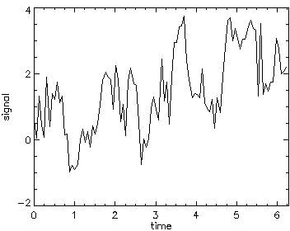
A Sample Data Set
Create and display a test signal with this IDL code:
n = 100
t = (2*!pi/n)*findgen(n)
dt = t[1]-t[0]
s = 0.5*t $
+ sin(4*t) $
+ 0.5*cos(10.5*t) $
+ 0.5*randomn(123L,n)
plot, t, s, $
xrange=[0,2*!pi], $
xstyle=1
Use these data to test some common signal processing tasks in IDL.
Notes:
For this presentation, we’ll use a synthetic signal to test and explain the behavior of some signal processing techniques.
As you can see from the IDL code on the left, the test signal is composed of 100 points, defined on a range from zero to 2 pi. The signal is a superposition of a line, a sine wave, a cosine wave and some normally distributed numbers; these numbers simulate the effects of noise. As we move through the presentation, I'll be using the variables n (the number of elts in the signal), t (the abscissa values of the signal), dt (the interval between data points) and s (the values of the signal itself).
The graph of the signal s appears on the right. It looks pretty erratic. However, I’ll show—using signal processing techniques—that we can recover or remove components of the signal.
Imagine that these data could represent, for example, the increase in air temperature with time in the morning hours after sunrise. Or, maybe, stock market indices over some span of time.
A tip: try pausing the presentation and entering this code into IDL.

Slide 6


The Fourier Transform
and are different representations of the same information!
signal: time domain
signal: frequency domain
Fourier transform
Notes:
I'd like to start with a high-level discussion of the FT. I hope that by doing this, I can give some rationale for why signal processing techniques can be useful.
In very general terms, the FT is used to convert the information in a signal between the time domain and the frequency domain. As the graphic shows, the signal s in the time domain is a function of t, for time. The FT can be used to transform s to the frequency domain. In the frequency domain, the transformed signal, s_hat (this is a syntax used by many textbooks) is a function of f, for frequency. Using the inverse FT, we can transform s_hat back to the time domain.
Why is this useful? Let me give an example. Imagine you have a thermometer & you measure the temperature outside your door every hour. Now, let's say you're really into meteorology & you do this for 20 years! (That's quite a temperature record.) This signal that you’ve recorded has several periodic components driven by physical processes: there's a diurnal cycle from the earth's rotation; a seasonal cycle from the earth's revolution about the sun; there may be effects of El Nino; there may also be longer-term effects of climate change; and there will certainly be random variations.
The point is this: these oscillations cannot readily be quantified by examining the temperature signal in the time domain. What the FT gives us is a way of representing the temperature signal as a function of its frequency components: a slowly varying process (such as climate change) has a low frequency, whereas a rapidly varying process (such as the diurnal cycle) has a high frequency. By application of SP techniques, the frequency components driven by the diurnal, seasonal & other cycles can be made to stand out! We can also apply SP techniques to selectively remove or return individual signal components, or to reduce or remove noise from the signal.

Slide 7
FFT
The IDL FFT function
  s_hat = fft(s)
  s = fft(s_hat, /inverse)
  Normalizing factor n
  Nyquist frequency f_{N}
  Organization of s_hat
  Check the IDL Online Help for further information
signal: frequency domain
signal:time domain
forward transform
inverse transform
Notes:
The FFT function is used to perform Fourier transforms in IDL. Using FFT, we can transform a signal s to the frequency domain. The result, denoted here by the variable s_hat, is a complex-valued array with the same dimensions as s. Using FFT, we can also transform s_hat back to the time domain by setting the INVERSE keyword.
So, the syntax of the FFT function is pretty straightforward, as you can see in the code listed here. However, there are three side effects of using an FFT that need to be explained.
First: When the forward transform is performed, the result is normalized by the number of points in the signal, n. We need to account for this in calculations.
Second: Because data in IDL are discrete rather than continuous, a critical frequency is defined. This frequency, called the folding or Nyquist frequency, is a property of the sampling interval of the data (our variable dt). Basically what this means is that we have no information about what is happening to the signal between samples, so we can't represent it. We'll see that the Nyquist freq is imp when we display and work with signals in the frequency domain.
Third: The organization of the Fourier coefficients in s_hat differs from the mathematical definition of the FT. The first elt in s_hat is the zero or DC component. The coeffs then increase in freq to the Nyquist freq. After this, the negative freqs are listed.
The IDL Online Help has more information about working with the FFT function.
Next, let's actually look at the transformed signal, s_hat.

Slide 8
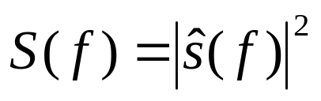
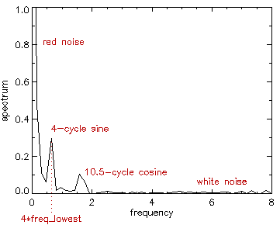
Spectra
Definition
Computation
Display
power spectrum
s_hat = fft(s)
s_mag = 2*abs(s_hat[0:(n+1)/2-1])
if (n mod 2) eq 0 then $
s_mag = [s_mag, sqrt(2)*abs(s_hat[n/2])]
s_pwr = 0.5*s_mag^2
freq_lowest = 1/(n*dt)
freq_nyquist = 1/(2*dt)
freq = findgen(n/2+1) $
* freq_lowest
plot, freq, s_pwr
Notes:
There are several ways of looking at a transformed signal. One of the most common is called the power spectrum. The mathematical definition of the power spectrum is simply the squared amplitude of the transformed signal. When working with a discrete signal, however, we have to take into account the side effects of working with an FFT.
The first four IDL statements show how to compute the one-sided power spectrum of the signal s; here denoted s_pwr. This spectrum is called one-sided because, for display purposes, the redundant negative frequencies are folded into the positive frequencies.
The next four statements are used in the display the power spectrum. First, we compute the lowest nonzero frequency. This is the frequency of the sine wave that could complete one cycle in the interval the signal occupies. Next, we compute the Nyquist frequency for this signal. Both of these quantites are useful for explaining the plot of the spectrum. We next compute the frequency vector for this signal. Finally, we plot the power spectrum of s versus frequency.
In the plot of the spectrum, the lowest frequency shown is zero, representing the DC component of the signal. The highest frequency shown is the Nyquist frequency, with a value of approx 8. The units of the frequency domain are the reciprocal of the units in the time domain.
There are three peaks in the spectrum. The middle peak corresponds to the 4-cycle sine wave in the test signal. The peak occurs exactly at 4 times the lowest frequency. The peak on the right is not as well-defined; it's spread over a wider range of frequencies. This peak comes from the 10.5-cycle cosine wave. The technical term for this spreading is leakage; it occurs because a non-integral mode can't be represented cleanly in a spectrum.
Notice the overall shape of the spectrum: it decays rapidly as frequency increases. This type of spectrum is called "red"; it's common in geophysical signals. This shape is caused by a trend in the signal & the effects of a trend are the strongest at low frequencies. In fact, this signal is a strong candidate for preconditioning, which we'll talk about next.

Slide 9
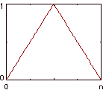
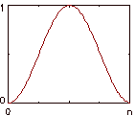
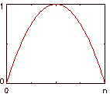
Preconditioning
Detrending
  Removes drift or trend from signal
  Techniques: linear, polynomial, other curve fits
  Use with caution
Windowing
  Taper ends of signal to improve performance of FFT
  Common windows:
Bartlett
Hanning
Welch
Notes:
Preconditioning is the process of preparing a signal to be analyzed in the frequency domain.
Detrending is used to remove a constant trend or drift from a signal. Common detrending techniques include: removing a straight line between endpoints, calculating and subtracting a line of regression, or a polynomial fit of degree 2 or 3. Note that detrending is more of an art than a science; one should be careful when detrending so that information is not lost. Detrend only when necessary!
Windowing is used to taper the ends of a signal to the same value. Some common windows shown here are the Bartlett, Hanning & Welch. Windows have unit amplitude & have the same number of points as the signal they're being used with. We'll use the Welch window a bit later in an example.
The techniques of detrending and windowing act on the periodic extension property of the FT.

Slide 10
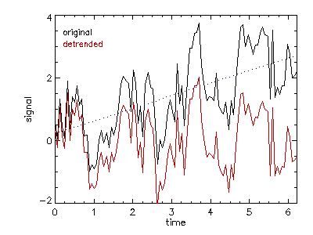
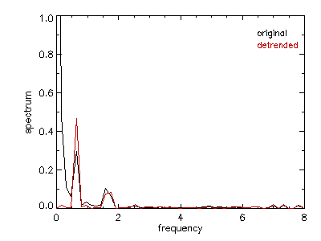
Example: Detrending
Remove a linear trend from the test signal s.
  Linear fit
  Spectrum
    calculated as before,
    using s_dtr
    red noise is removed
c = linfit(t, s)
s_fit = c[0] + c[1]*t
s_dtr = s - s_fit
Notes:
In this first example, we'll remove a linear trend from the test signal s.
Here, a linear LS fit to s is calculated using the IDL LINFIT function. LINFIT accepts a vector of abscissas (here, t) and a vector of ordinates (here, s) & returns a vector of coefficients (here, c); because this is a linear fit, there are only two coefficients, the intercept and the slope of the line of regression. To detrend the signal, we just subtract the line of regression s_fit from the original signal. The detrended signal is then denoted by the variable s_dtr (for s detrended).
The two plots on the right demonstrate the effect of detrending on the signal and on its spectrum. The original signal is in black in the top plot. The line of regression is given by the dotted blue line. The resulting detrended signal is given by the red line. As you can see, detrending in this manner also serves to remove the mean from the signal.
The lower plot shows the spectra of the original and detrended signals. The detrended spectrum is red.
The effects of detrending on the spectrum are more dramatic. The "red" noise spectrum (sorry about that) has been removed. Also, the zero frequency in the spectrum has zero amplitude because we've removed the mean from the signal.
The two peaks from the sine and cosine waves in the signal have increased amplitude. This is because the amount of leakage to the "red" noise spectrum has decreased.
You can see that the overall effect of detrending has been to improve the quality of the spectrum.

Slide 11
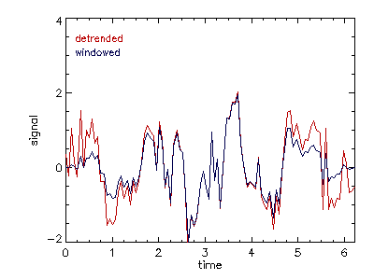
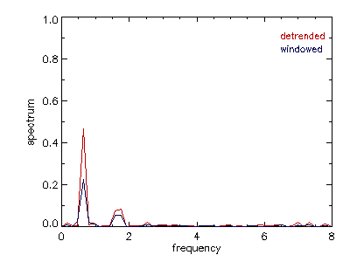
Example: Windowing
Taper the ends of the test signal s.
  Welch window
  Spectrum
    calculated as before,
    using s_win
    amplitude is decreased
welch = 1 - (findgen(n) $
/ (n-1)*2 - 1)^2
s_win = s_dtr * welch
Notes:
In this next example of preconditioning, we're going to taper the ends of the test signal s using a window.
First, we construct the window. Here, I've chosen to use a Welch window. You can see, in the first IDL statement, that the Welch window is simply a parabola with a negative curvature.
We then apply the window by multiplying it by the detrended signal. The new signal, s_win, will be used to show the cumulative effects of detrending and windowing.
You can see the result in the top plot. The detrended signal is red, the detrended + windowed signal is blue. The windowed signal tapers to zero at both endpoints.
Now we'll examine the effects of windowing on the spectrum of the signal. We calculate one-sided power spectra for the signals displayed in the top plot. They're displayed in the bottom plot. The detrended spectrum is in red, the detrended and windowed spectrum is in blue.
You can see that the spectral amplitude of the detrended + windowed signal has been attenuated compared to that of the detrended signal. This is because we've actually changed the values of the signal by tapering the ends to zero. (not as much variance in the signal)
Because the spectrum of our test signal was cleaned up by detrending, the cumulative effect of detrending and windowing was not substantial. I'll neglect the use of windowing in later examples.

Slide 12
Filtering
Used to alter the spectral properties of a signal.
  Smooth signal
  Remove noise from signal
  Isolate (remove) signal component
Filtering operations:
  Lowpass, Highpass, Bandpass, Bandstop
Filter types:
  Ideal, Butterworth, Exponential
Filtering process
Notes:
OK, now let's look at filtering. As I mentioned earlier, filtering is probably the most common signal processing task.
Filtering, in short, is used to alter the spectral properties of a signal. For example, we could use a filter to smooth a signal. We could use a filter to remove a particular kind of noise from a signal. We could use a filter to isolate or possibly remove particular signal components. One example I'm familiar with is filtering to remove line noise from an AC power source.
I'll break the discussion of filtering into three areas.
First, filtering operations; that is, what we can do with filters. I'll define and explain lowpass, highpass, bandpass and bandstop filtering operations.
Second, filter types; this is a sample of some commonly used filters. I'll define and explain what ideal, Butterworth and exponential filters are.
I'll also show one filtering process. This is a series of steps to follow in order to filter a signal.
To complete the discussion of filtering, I'll then show a series of examples.

Slide 13
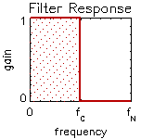
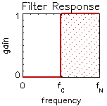
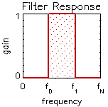
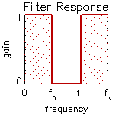
Filtering Operations
Lowpass
Highpass
Bandpass
Bandstop
Allows frequency components less than a cutoff frequency f_{c}; rejects frequency components greater than f_{c}.
Allows frequency components greater than a cutoff frequency f_{c}; rejects frequency components less than f_{c}.
Allows frequency components between a start frequency f₀ and an end frequency f₁; rejects all other frequency components.
Rejects frequency components between a start frequency f₀ and an end frequency f₁; accepts all other frequency components.
Notes:
First, filtering operations. I've listed here the four filtering operations: lowpass, highpass, bandpass and bandstop. I've given a short explanation of each. I've also provided a graphic displaying the response of an ideal filter; that is, what an ideal filter would look like in the frequency domain.
I'll start with lowpass filtering. A lowpass filter allows frequency components less than some cutoff frequency; I've denoted the cutoff frequency by f sub c. Any frequency component greater than the cutoff is rejected.
Highpass filtering is the complement of lowpass filtering. A highpass filter only allows frequencies greater than the cutoff; lower frequency components are rejected.
A bandpass filter only allows frequency components between a start and an end frequency. Any spectral component less than the start frequency or greater than the end frequency is blocked. In this presentation, I've denoted the start frequency as f sub zero & the end frequency as f sub one.
The bandstop filtering operation is the complement of the bandpass, in that the spectral components between the start and end frequencies are blocked, whereas any other component is allowed to pass.

Slide 14
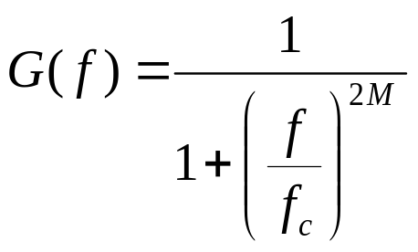
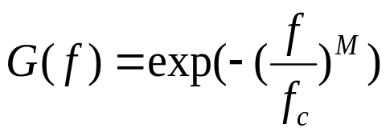


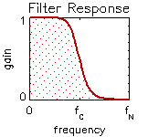
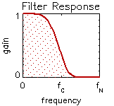
Filter Types
Ideal | Butterworth | Exponential
sharp transition
induces ringing
maximally flat
slow roll-off
recursive design
slow roll-off
Notes:
Next, I’d like to dicsuss the types of filters one can construct. I’ve listed three of the most common types: ideal, Butterworth and exponential. These aren’t the only filter types available, but they are the most common. Here, I’m demonstrating these filter types with only a lowpass filtering operation, for simplicity.
I’ll start with the ideal filter. The mathematical form of an ideal filter is simply a linear combination of Heaviside step functions. In thes case of a lowpass filter, we use the complement of the step function, where the step occurs at the cutoff frequency, f_c. As you can see in the graphic, the ideal filter has a sharp transition in the frequency domain. This means that we can specify exactly which frequencies to filter. However, this reveals a problem that lies at the heart of the FT—localization in one domain (time or frequency) results in globalization in the other domain. So, because we specified exactly which frequencies to filter in the frequency domain, this causes global repercussions in the time domain—it may introduce something called ringing in the signal. Ringing often takes the form of spurious wiggles in the signal near the signal's endpoints. This is a problem with using ideal filters, making them not always the best choice.
However, that's why we have other filters, like the Butterworth filter. Let me discuss it next. The mathematical form of a lowpass Butterworth filter is given. Here, the M refers to the order of the filter. The Butterworth filter is designed to have a passband is maximally flat, as you can see in the graphic. This design also introduces a transition band which attenuates ringing in the filtered signal. So, rather than specifying exactly which frequencies to pass and which to block, there will be some influence of frequencies near the cutoff frequency. Butterworth filters are a very common choice in SP applications.
The exponential filter also has a design that reduces ringing. The mathematical form of the filter is given first. Again, M is the order of the filter. As shown in the graphic, the exponential filter doesn't have as flat a passband as the Butterworth filter; it has a slower roll-off to high frequencies. So, as with a Butterworth filter, we can’t specify exactly which frequencies to pass and which to block. The advantage of an exponential filter is that it has a recursive design--we can create a new filter by combining a sequence of exponential filters.

Slide 15
Filtering Process
original
signal
precondition
signal
transform signal
to
frequency domain
construct filter
multiply signal
by filter
transform result
to
time domain
filtered
signal
Notes:
So, how do we put all this together? I'd like to show an example of a filtering process. This is a series of steps we can use to perform a filtering task. I'd like to try to put together everything I've talked about so far in this presentation.
We start with a signal that we wish to filter.
We can then precondition original signal. We need to prepare it for analysis in the frequency domain.
We then transform the signal to the frequency domain. In the frequency domain, we could view the signal's spectrum to discern how information is distributed in the signal as a function of frequency. This information can be used in constructing a filter. We need to choose a filter type (ideal, Butterworth, exponential, or some other) and a filtering operation (lowpass, highpass, bandpass or bandstop).
Once we've constructed the filter, we multiply the signal by the filter in the frequency domain. We then perform an inverse FT on this result, thereby transforming it back to the time domain. At this point, we have a filtered signal.
With the steps illustrated here, we have performed a filtering task.
What I'd like to do next is show some examples, using the test signal we constructed earlier.

Slide 16
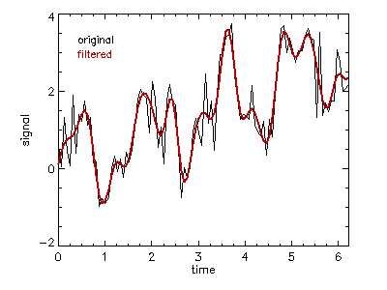
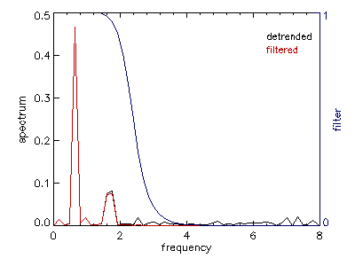
Example: Lowpass Filtering
Remove the high-frequency noise from the test signal.
freq_c = 0.3*freq_nyquist
order = 5
kernel = (dist(n))[*,0]/(n*dt)
filter = 1 / $
(1 + (kernel/freq_c)^(2*order))
s_hat = fft(s_dtr)
s_f = fft(s_hat*filter, /inverse)
s_f = s_f + c[0] + c[1]*t
Notes:
Our first example is lowpass filtering. The goal of this example is to remove the high-frequency noise from the test signal s. Here, I’ve chosen to use a Butterworth filter to perform the filtering. Let me start by describing the IDL code on the left. I'll explain how it follows the filtering process I laid out in the previous slide. Then we'll examine the diagrams on the right.
To begin, I'll choose a cutoff frequency. I think it's descriptive to specify the cutoff frequency as a fraction of the Nyquist frequency. Here, I’ve chosen the cutoff frequency (denoted by the IDL variable freq_c) to be three-tenths of the Nyquist frequency. This frequency is higher than the frequencies at which the peaks for the 4-cycle sine wave and 10.5-cycle cosine wave occur, yet lower than the noise at frequencies approaching the Nyquist frequency. I've chosen the order of the Butterworth filter to be 5. As order increases, the BW filter becomes more like an ideal filter, in that the transition band shrinks to zero. Given these parameters, I'll construct the filter.
The filter is constructed using the discrete (or digital) version of the equation for the Butterworth filter. The IDL variable filter is a one-dimensional array the same length as the signal. I used the IDL built-in function DIST to create the array used to build the filter. I've already preconditioned the signal. I'll take the detrended signal and transform it to the frequency domain using the FFT function. I'll call the transformed signal s_hat. In order to create the filtered signal, I'll take the transformed signal s_hat, multiply it by the filter and then transform that result back to the time domain with an inverse FFT. This gives us the filtered signal. For the purposes of comparison, I'll take that filtered signal and add to it the linear trend we removed in preconditioning.
Let's look at the results now in the graphics on the right. The top plot shows the original signal in black and the filtered signal in red. You can see that the filtered signal follows the original signal well, yet it is smoother than the original. That's because we've removed the noise that exists at higher frequencies. The bottom plot shows the spectra of the detrended signal (in black) and of the filtered signal (in red). The filter response is also plotted in blue; it uses the axis on the right. You can see that the two spectra are identical at low frequencies, but as the filter begins to take effect, the amplitude of the filtered spectrum is damped to zero--this means that there is no information from higher frequencies in the filtered series.
So we have successfully lowpass filtered this signal. The result, as you can see, is a smoothed signal.

Slide 17
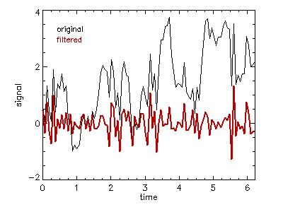
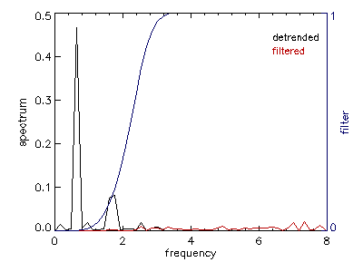
Example: Highpass Filtering
Remove the low-frequency components of the signal.
freq_c = 0.3*freq_nyquist
order = 5
kernel = (dist(n))[*,0]/(n*dt)
filter = 1 - $
exp(-(kernel/freq_c)^order)
s_hat = fft(s_dtr)
s_f = fft(s_hat*filter, /inverse)
Notes:
Our next example is highpass filtering. In this example, the goal is to remove the low-frequency components of the signal, leaving only the high-frequency components. The low frequencies are where most of the structure of the signal exists, so by removing these, we should be left with only noise.
Again, I'll first go through the IDL code on the left, then describe the graphics on the right.
I've chosen to use an exponential filter in this example. As in the previous example, I've chosen the cutoff frequency to be at three tenths of the Nyquist frequency. Recognize, however, that this time, we'll be blocking any frequency components less than the cutoff frequency.
I've constructed the filter using the discrete form of the equation for the exponential filter, given earlier. The result is a one-dimensional array. I've already preconditioned the signal. I'll take the detrended signal and transform it to the frequency domain using FFT. In order to create the filtered signal, I'll take the transformed signal s_hat, multiply it by the filter and then transform that result back to the time domain with an inverse FFT. This gives us the filtered signal.
The top plot shows the original signal in black and the filtered signal in red. The filtered signal doesn't really have any large-scale characteristics; it is dominated by random values.
The lower plot shows the spectra of the original and filtered signals, in black and red, respectively. I've also shown the repsonse of the highpass exponential filter in blue. Examination of the filtered spectrum shows that the low frequency components of the signal have been almost completely blocked--the peaks from the 4-cycle and 10.5-cycle waves are no longer present. The only frequencies that have passed are those greater than the cutoff frequency.
So, here we have successfully highpass filtered this signal, blocking the low frequencies. The result is a signal dominated by random noise.

Slide 18
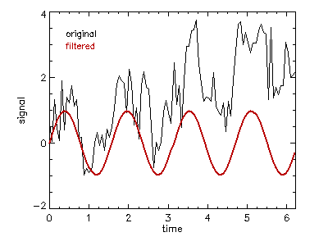
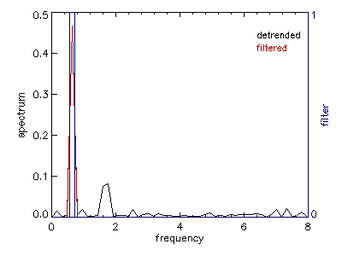
Example: Bandpass Filtering
Attempt to isolate the 4-cycle component of the signal.
freq_0 = 3.5*freq_lowest
freq_1 = 4.5*freq_lowest
kernel = (dist(n))[*,0]/(n*dt)
filter = (kernel le freq_1) $
and (kernel ge freq_0)
s_hat = fft(s_dtr)
s_f = fft(s_hat*filter, /inverse)
Notes:
Our next example is bandpass filtering. Here, our goal is to attempt to isolate the 4-cycle component of the test signal. Recall this is a sine wave. I've chosen to use an ideal filter to perform this filtering operation.
I'll start again with the IDL code on the left. Because this is a bandpass filtering operation, I need to define two frequencies: a start and an end frequency. In the previous two examples, I've defined frequencies as a fraction of the Nyquist frequency. Another technique, which I use here, is to specify frequencies as multiples of the lowest or fundamental frequency. So, here I'm specifying the start frequency at 3.5 times the fundamental frequency & the end frequency at 4.5 times the fundamental frequency. This band isolates the 4-cycle component of the signal.
I've constructed the filter using the DIST function and the LE, GE and AND relational operators in IDL. Note that these relational operators are array-based. They return a value of 1 for true and 0 for false. The resulting filter is a one-dimensional byte array. I'll take the detrended signal and transform it to the frequency domain using FFT. In order to create the filtered signal, I'll take the transformed signal s_hat, multiply it by the filter and then transform that result back to the time domain with an inverse FFT. This gives us the filtered signal. So we've followed the same filtering process for each of these three examples.
Let's examine the graphics on the right. On the top is a plot of the original signal (in black) and the filtered signal (in red). You can see that we've done a pretty good job of recovering the 4-cycle component--we have what looks like a sine wave. The amplitude and phase aren't exactly right, but they're close. We could also add back the linear trend removed in preconditioning the signal to facilitate direct comparison with the original signal.
Let's look at the spectra of these signals next. The spectrum of the detrended signal is plotted in black. The spectrum of the filtered signal is overplotted in red. The filter response is shown in blue, using the axis on the right side of the diagram. You can see that the filter allowed only the spectral components between 3.5 & 4.5 times the fundamental frequency inclusive. The filtered spectrum is zero everywhere else. The filtered spectrum exactly matches the detrended spectrum within the pass band.
So, we've done a good job of isolating the 4-cycle component and returning it to the time domain.

Slide 19
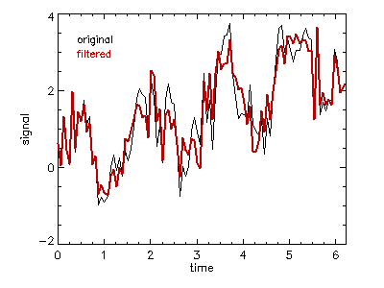
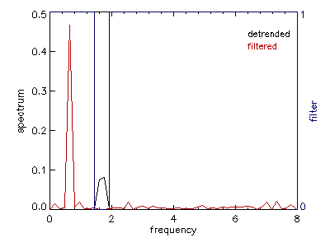
Example: Bandstop Filtering
Remove the 10.5-cycle component of the test signal.
freq_0 = 9.0*freq_lowest
freq_1 = 12.0*freq_lowest
kernel = (dist(n))[*,0]/(n*dt)
filter = (kernel le freq_0) $
or (kernel ge freq_1)
s_hat = fft(s_dtr)
s_f = fft(s_hat*filter, /inverse)
s_f = s_f + c[0] + c[1]*t
Notes:
My last example is bandstop filtering. The goal in this example is to remove the 10.5-cycle component from the signal, allowing all other frequency components to pass. In this example, as in the previous exmaple, I've chosen to use an ideal filter to perform this filtering operation.
As you can see in the IDL code on the left, I've set start and end frequencies that are multiples of the fundamental frequency. They are centered on the 10.5-cycle component.
I'll take the detrended signal and transform it to the frequency domain using FFT. In order to create the filtered signal, I'll take the transformed signal s_hat, multiply it by the filter and then transform that result back to the time domain with an inverse FFT. This gives us the filtered signal. For the purposes of comparison, I've added the line of regression removed from the original signal back to the filtered signal.
The results are on the right. In the top plot are the original and filtered signals. The filtered signal follows the original well, but it's lacking the 10.5-cycle component.
The results of the filtering operation are a bit more apparent if you compare the spectra of the original and filtered signals. Here, the original spectrum is in black, the filtered spectrum is in red & the filter itself is in blue. You can see that the filtered spectrum matches the original spectrum, except that the 10.5-cycle component has been removed from the filtered spectrum, with only some leakage across the stop band.

Slide 20
Resources
IDL Documentation Set (hardcopy/PDF)
IDL Online Help
Newsgroup: comp.lang.idl-pvwave
User libraries: www.rsinc.com/related
IDL Codebank: www.rsinc.com/codebank
Notes:
Before we finish, I’d like to point out some resources available for people interested in performing SP tasks using IDL.
The IDL Documentation Set consists of 8 manuals. These manuals can be purchased from RSI in sofbound form. They are also available for free in PDF format. For IDL versions 5.5 and earlier, check the /docs subdirectory of your IDL distribution. For IDL version 5.6 and newer, the doc set has been rolled into the IDL Online Help system. In particular, see Ch 21 “Signal Processing” in the Using IDL manual.
There is a Usenet newsgroup devoted to the use of IDL: comp dot lang dot idl dash pvwave. This NG can be accessed from any news reader; for example, Netscape, Mozilla or Outlook Express. The Google search engine also has a searchable interface to this group. The NG is a great place to ask questions about using IDL. There are many knowledgeable people who regulary scan the NG and offer to answer questions from users.
The RSI website (www dot rsinc dot com) also has a lot of useful information. The Related Sites page holds a set of links to various IDL code libraries and archives created by users of IDL. RSI also supports its own user-contributed library. In fact, the RSI IDL Codebank even has a section for signal processing routines!

Slide 21
References
Bendat, J.S., and A.G. Piersol, 1971: Random Data; Analysis and Measurement Procedures. Wiley, New York, 407 pp.
Box, G.E.P., and G.M. Jenkins, 1970: Time Series Analysis; Forecasting and Control. Holden-Day, San Francisco, 553 pp.
Bracewell, R., 1965: The Fourier Transform and Its Applications. McGraw-Hill, New York, 381 pp.
Jackson, L.B., 1986: Digital Filters and Signal Processing. Kluwer Academic, Boston, 410 pp.
Press, W.H., B.P. Flannery, S.A. Teukolsky, and W.T. Vetterling, 1988: Numerical Recipes in C: The Art of Scientific Computing. Cambridge University Press, Cambridge, 735 pp.
Priestley, M.B., 1981: Spectral Analysis and Time Series. Academic Press, London, 890 pp.
Notes:
Here are a list of references used to make this presentation. Good gen'l stuff.

Slide 22
Contact Information
For information on RSI training or consulting, please contact us
  by email: training@rsinc.com
  consulting@rsinc.com
  by phone: 303-786-9900
  Thank you for viewing Signal Processing in IDL!
Notes:
Done!

