Slide 1
NPS High Performance Computing (NPS HPC) Day 1 – Basics
LTC Smith
OA3802

Slide 2
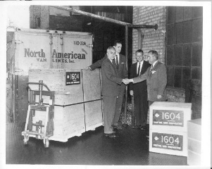
Environments LOCAL: Your computer REMOTE: High Performance Computing (HPC), Cloud
YOUR COMPUTER
NPS HPC RESOURCES
CLOUD SERVICES
This is your primary tool, so get to know it well!
what can it do well?
what are the limitations?
My Primary System:
Global Storage: 1.6 PiB
Hamming Cluster:
81 Nodes
4,282 CPU cores
79,744 GPU cores
11TB Memory
Grace Cluster
25 Nodes
600 CPU cores
11.8 TB Memory
Cloud services allow us to ‘borrow’ infrastructure for a fee
DoD (and beyond) are rapidly racing to the cloud
Specific security requirements for impact level of data; goes beyond just classification levels
Dell XPS
Processor: 11th Gen Intel(R) Core(TM) i7-11800H @ 2.30GHz 2.30 GHz
RAM: 16 GB
OS: Windows 10
Shipment of early CRAY Model 1604 supercomputer to NPS (1960)
LOCAL
REMOTE

Slide 3
HPC Roadmap
Daily Lessons (with practical exercises):
Day 1 Basics: Understanding HPCs and the DoD HPC Landscape; Logging onto NPS HPCs
Day 2 Parallel Computation: Submitting and Running batch Jobs using Slurm
Day 3+: Python and Web Apps with HPCs
HPC Lab

Slide 4

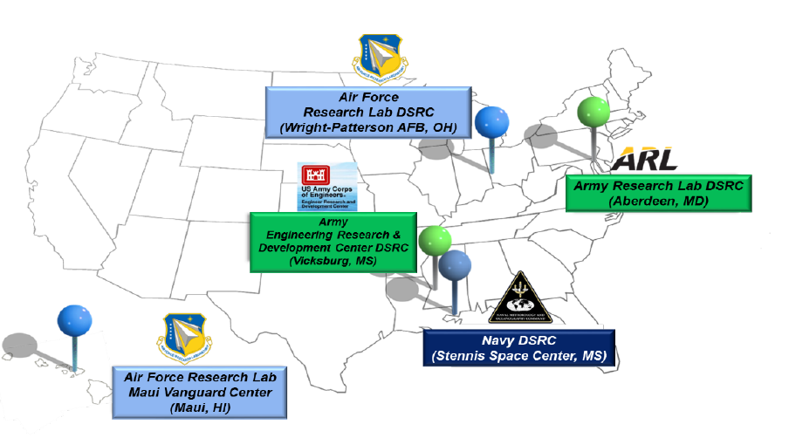
DoD HPC Overview
DoD Supercomputing Resource Centers (DSRCs)
Delivers a range of compute-intensive and data-intensive capabilities to the DoD science and technology, test and evaluation, and acquisition communities.
Accessible to any DoD researchers and engineers, including contractors.
Provides unclassified, secret, and TS/SCI systems.
Potential HPC Benefits
Greater compute capability.
No cost to organizations other than professional staff years (personnel hours).
Limited administrative, maintenance, and funding burden.
Will potentially be integrated with the other cloud environments.
Potential HPC Challenges
Shared resources with reservation system (Noisy Neighbor problem).
Data transfer on and off system.
Expertise.
Cloud and Data Center Closure Update
Notes:
No cost to organizations other than professional staff years (personnel hours).
Limited administrative, maintenance, and RMF burden.
Shared resource with reservation system.
Will potentially be integrated with the cARMY-X environment.

Slide 5


Unclassified DoD HPC Systems
Part of DoD HPC Modernization Program (HPCMP)
 | SCOUT | WARHAWK | RAIDER | CARPENTER | NARWHAL | NAUTILUS | HAMMING
GPUs | V100 | V100 | A100 | A40 | V100 | A100 | V100
Resource Manager | LSF | PBS | PBS | PBS | PBS | PBS | Slurm
Contains ML Accelerated (MLA) or AI/ML Nodes |  | ✓ | ✓ |  | ✓ | ✓
Aberdeen PG, MD
Wright Patterson AFB, OH
Vicksburg, MS
Stennis Space Center, MS
Monterey, CA
Table Notes:
Data compiled from HPC Centers and HPC Centers: Unclassified Systems, as of 2OCT2024.
GPUs rated by CUDA Cores: A100 (6912), V100 (5120), P100 (3884), K40c (2880)
DSRC = DoD Supercomputer Resource Center.
Resource Managers: Portable Batch System (PBS), Load Sharing Facility (LSF).
Classified DoD HPC Systems: BETTY (ARL, V100 GPUs), DURHAM (Navy, P100), and PINTADO (Navy, A100)

Slide 6
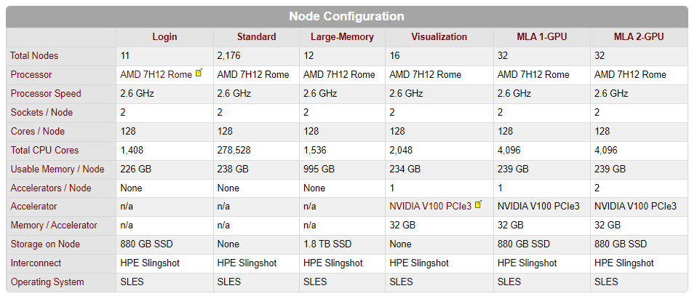
Capabilities of Narwhal HPC
NARWHAL HPC system on Navy DSRC has advanced GPU capabilities, including some systems with Machine Learning Accelerated (MLA) configurations.
From https://centers.hpc.mil/systems/unclassified.html

Slide 7
Getting Started on DoD HPCs We will not explore DoD HPCs further in OA3802, instead focusing on the easier-to-access NPS HPCs, but DoD HPCs can be a useful (and free) resource for any DoD analyst.
DoD HPC Home page: https://www.hpc.mil/
To get account, follow instructions at https://centers.hpc.mil/users/index.html#accounts.
Key Step: Select appropriate Service/Agency Approval Authority (S/AAA, aka OrgID):
NPS Personnel: Use NPSCA POC Odessa Murray, odessa.s.murray.ctr@us.navy.mil.
Other Army personnel: Recommend using OARMY OrgID, and reaching out to designated POCs to confirm.
Helpful Resources:
DoD HPC Modernization Program (HPCMP) home page: https://www.hpc.mil/.
Dcoumentation: See https://centers.hpc.mil/systems/unclassified.html for links to capabilities and user guides for all HPC systems. For Narwhal see Navy DSRC: Documentation (hpc.mil) and Navy DSRC: Narwhal PBS Guide (hpc.mil).
HPC Portal: Offers web-based clients to connect to HPC systems, https://centers.hpc.mil/portal/. Recommend “Web Shell” for command line interface, and “Enhanced File Manager” for file transfers.
Running Jupyter Notebook: Reference article for running Jupyter notebook on DoD HPC: ARL DSRC - Running Jupyter Notebooks on SCOUT from a Windows Client (hpc.mil)
Training: HPCMP offers Productivity Enhancement and Training (PET) sessions, and can even request help in particular area. See HPC Centers: PET FAQs and also HPC Centers: HPC Training.
Data Analysis and Assessment Center (DAAC, https://daac.hpc.mil/) which serves the needs of DoD HPCMP scientists to analyze an ever increasing volume and complexity of data.
Secure Remote Desktop enables users to launch a gnome desktop on an HPC system.

Slide 8
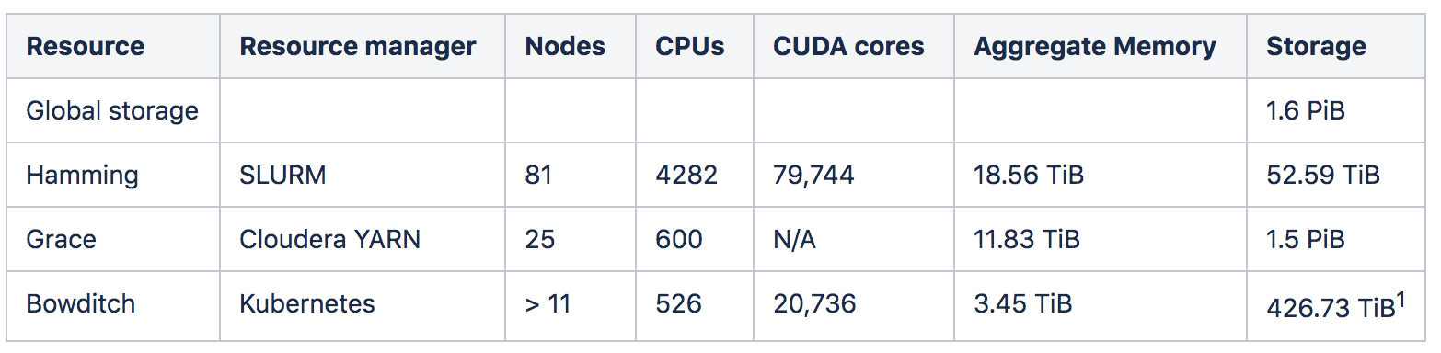
NPS HPC Resources
NPS HPC Mission Statement: The HPC Center at NPS strives to promote scientific computing at NPS by providing support to researchers and departments who wish to engage in scientific computing, and establish NPS as a nationally recognized HPC "Center of Excellence.
Grace platform was decommissioned on 20MAR2023, and Bowditch is more experimental platform with some neat containerized applications (like JupyterHub). We will focus on Hamming.
NPS HPC Homepage: https://hamming.uc.nps.edu/
Notes:
table : https://wiki.nps.edu/display/HPC/Resources
xx:

Slide 9
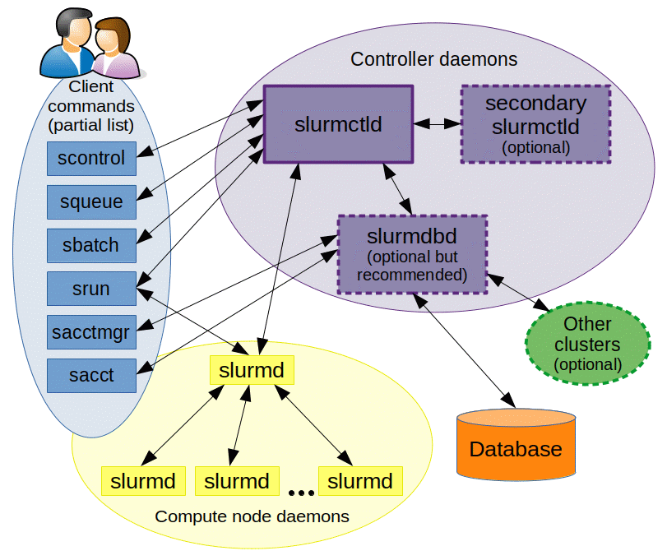
Requesting HPC Resources
To run jobs on HPC resources, we need to use a Resource Manager to request computing resources.
NPS Hamming cluster uses the SLURM* resource manager, which performs three key functions:
Allocate resources to users for jobs.
Start, execute, and monitor work.
Arbitrate contention for resources by managing queue of pending work.
See Slurm Homepage for more information. Particularly useful are:
Quick Start Guide (as an initial overview)
Manuals Pages (as a frequent reference).
Overview of Slurm Components, from Slurm homepage
*Slurm stands for Simple Linux Utility for Resource Management

Slide 10
NPS HPC Accounts
Request NPS HPC Account: Please submit an account request for access to NPS HPC resources. List me (matthew.smith@nps.edu) as your account request sponsor.
Account Request Form: https://hamming.uc.nps.edu/ssar
NPS HPC homepage: https://hamming.uc.nps.edu
For help or password reset contact HPC@nps.edu
Notes on VPNs
All NPS HPC resources can only be accessed from the NPS internal network (just like accessing NPS Python). If off campus you will need to VPN onto NPS network, see GlobalProtect Virtual Private Network (VPN) - Technology Assistance Center (TAC) Computer Help Desk - NPS Wiki (BLUF: From GlobalProtect, add connection to “vpn.nps.edu”)
Note that there are two separate VPNs you may encounter here at NPS. The one described above is vpn.nps.edu, which connects you from an outside network onto the NPS ERN (education resource network, aka the “.edu” domain).
There is also a separate VPN for connecting from NPS network to the DREN (Defense Research and Engineering Network, aka the “.mil” domain). See ERN to MIL Redirect and VPN Access and Instructions - Technology Assistance Center (TAC) Computer Help Desk - NPS Wiki for those instructions (BLUF: From GlobalProtect, add connection to “comet.nps.navy.mil”).

Slide 11
NPS HPC Workspaces
Every NPS HPC user is provisioned with multiple workspaces.
Starting workspace is your home:
Typically at /home/username, and also captured in your environmental variable $HOME.
Limited to 26 GB per user, and should be used to test and develop code and hold small-ish datasets.
For larger jobs, you should use other workspaces:
If creating a large number of files, but still under 1-2 TB, can use $SMALLWORK (/smallwork/username)
If creating large volume of data, can use $WORK directory, also referred to as the data directory, stored at /data/username.
See HPC Getting Started Guide (nps.edu) for more details and guidance.
NOTE: In AUG 2024, the NPS HPC system crashed due to users overloading their HOME directories. Ensure you follow the guidelines!

Slide 12
NPS HPC Filesystem
In addition to the HPC-specific directories like /data and /smallwork, you will see many other standard linux directories on the NPS HPC system.
Here are some standard linux subdirectories that are commonly in the root directory (view with ls /). Some folders will always exist and always contain the same type of information, but others can vary between different flavors of linux. See Hour 3. Moving About the File System | Unix in 24 Hours, Sams Teach Yourself: Covers OS X, Linux, and Solaris, Fifth Edition (oreilly.com) for more details.
/bin | (binary) - contains executable binary files. Running "ls -F /bin" will show that most files there are programs with the appended "*". It's actually common now to find executables spread across several locations as well, such as /sbin, /usr/bin.
/dev | Device drivers
/etc | The "etcetera" folder. Contains hodgepodge of files and info needed to conduct unix administration, which can be complex task involvement management of user accounts, file system, security, device drivers, hardware configuration, and more.
/lib | Library. Place to store common features and capabilities, so that programs can use these rather than storing their own copy.
/lost+found | Stores any files that are recovered after any type of errors. Born out of efforts to handle errors caused by multiple users running programs simultaneously.
/mnt | Place to "mount" external media. Not important for everyday unix users.
/sys | Contains system config files. Not too important for everyday unix users.
/tmp | "Temp", place to make temporary copies of files as they're being processed.
/usr | "User". Originally intended to store user-specific files and commands, but murky definitions now and contents can vary from system to system.
/home | Place to store all files owned by system users. This is also a handy way to see what users have accounts on the system, since every user will have a folder in the /home directory.
/opt | Stores add on programs from third parties
/var | Idea is to store "variable" files that naturally change with the system's operation. However, different unix versions tend to use var (and usr) for vague and overlapping purposes.

Slide 13
Practical Exercise 1: Access and Explore Hamming
Task 1: Establish SSH connection to Hamming:
Connect to hamming-sub1.uc.nps.edu, using your NPS HPC username and password.
You must be on NPS campus, or have VPN onto NPS to connect to NPS HPCs.
The NPS HPC Getting Started documentation recommends using MobaXterm for Windows, and OpenSSH for Mac.
In MobaXTerm, you can set up a new SSH Session, specifying hamming-sub1.uc.nps.edu as the Remote Host, and using your username. May want to edit Bookmark Settings to give this session an appropriate name.
Once logged on, run the following to get your bearings:
Run whomai and id to see who you are logged in as
Can also get info on other by running users (to see who else is logged on) or simply w (which will tell you who is on, what they’re running, when they started… think “5 W’s”)
Run hostname to see what node you are on. (should be a “submit” node)
Run du –sh from your home directory to see how much disk usage you are taking up. You are allocated 26GB of storage for your account by default. Can also run df –h to see how much disk free space there is.
Check what shell you are using with echo $SHELL.
Check what linux distribution you are using by running cat /etc/os-release.
View the items in your home directory by running ls -l. Can you identify which items are symbolic links that point to your various workspaces?

Slide 14
Practical Exercise 2: SFTP
Task 2: Establish SFTP (Secure File Transfer Protocol) connection to Hamming:
Historically, you had to use a pure-FTP tool like WinSCP for either Mac or Windows, of FileZilla is another popular option. With either of those you connect to hamdata.uc.nps.edu using your same NPS HPC username and password (and port 22).
You can also use the same MobaXterm interface to upload and download files through its SSH connection, a very handy functionality!
Using any of these tools, go through the following:
Create a new folder in your HPC home directory called “mydata” (create it with mkdir mydata)
Upload any two documents from your local machine into the mydata folder.
List the contents of the mydata folder in HPC environment
Download the entire data folder to your local machine and confirm that it contains both original files. Does it download as a zip file or as a regular folder?

Slide 15
Practical Exercise 3: Launch Interactive Bash Shell
Task 3: Lets run our first slurm commands! Run the following:
First, view the help for the “srun” slurm command by running man srun or man --help. Type “q” to quit manual and return to command prompt.
Now run the following:
On Windows: srun --x11 --pty bash
On Mac: srun --pty bash
What is going on here?
You are using the srun Slurm command to allocate resources and launch a job.
The job you are running is the bash command, which launches a new bash shell on one of the Hamming compute nodes. The --x11 and --pty options tell SLURM how to handle the connection and data coming back.
Alternative Command: Another quick way to launch an interactive shell on a compute node is by simply running salloc. See A Gentle Introduction to Hamming (nps.edu) footnote 1 for discussion of srun vs salloc.
Things to Do after running the command (Need a partner):
See what node you are on by running hostname. Note that running this job changes us from being on the submit node (which only handles admin functions like logging in and working with files) to one of the compute nodes where we can actually run work on Hamming.
Check all of your current active jobs by running squeue –u your.user.name. Do you see your bash job running? If you ran the “srun” command, your job will be called “bash”. If you ran the “salloc” command, your job will be “interactive”.
Check you partner’s active jobs. Do you see their job running?
When done, run exit to quit your bash job and return to the submit node.

