Slide 1

Springboot Reactive Programming Day1
25-11-2024

Slide 2
Topic covered
Introduction to Reactive programming.
Key features
Mono & Flux in spring webflux

Slide 3
Introduction to Reactive Programming:
Key Features:
Non-blocking I/O: Operations do not block the executing thread.
Backpressure: The ability to manage the flow of data and prevent overwhelming the system with too much data at once.
Asynchronous Data Streams: Data can be processed as it arrives without waiting for the entire dataset to be available.

Slide 4
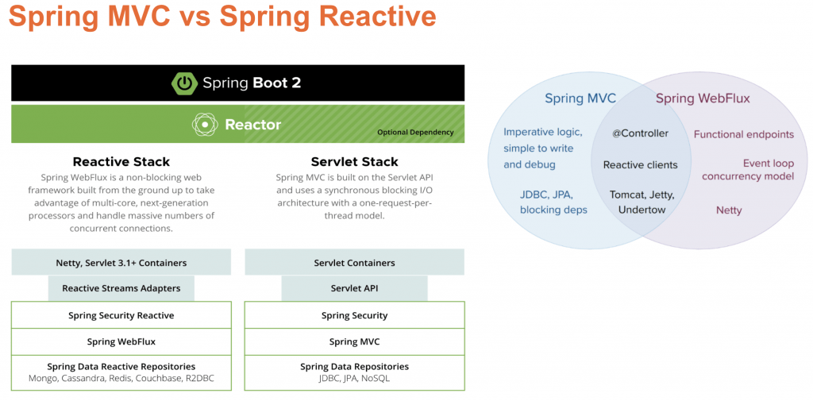

Slide 5
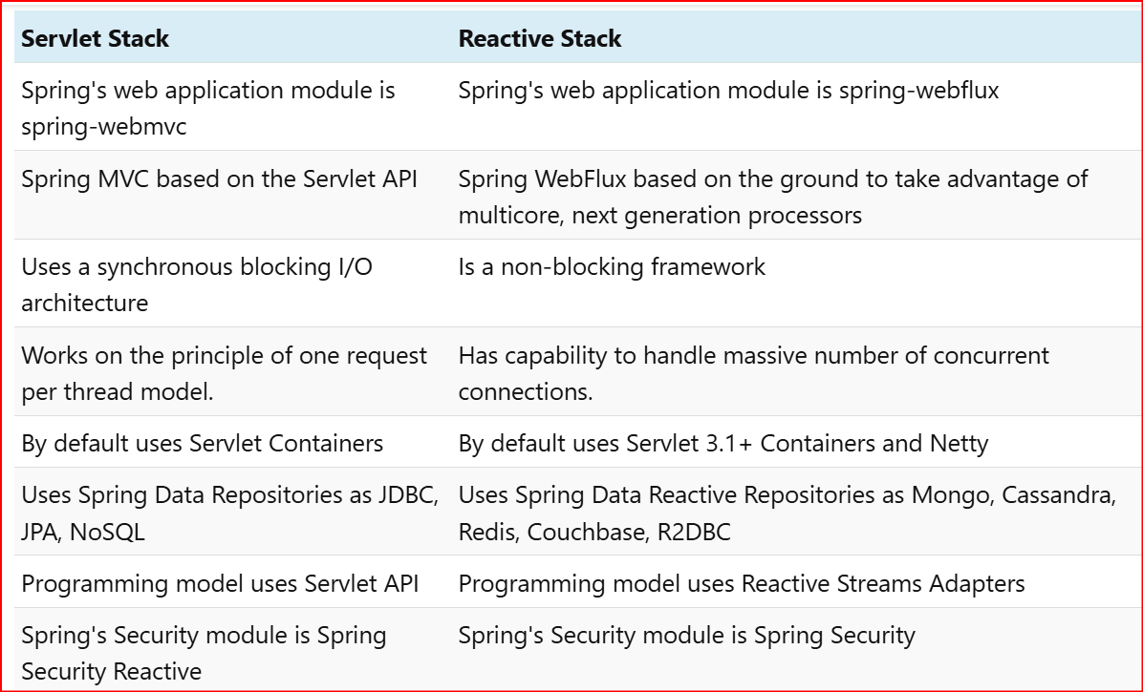
Servlet vs Reactive stack
Springboot REST vs Springboot Reactive
- blocking / non blocking

Slide 6
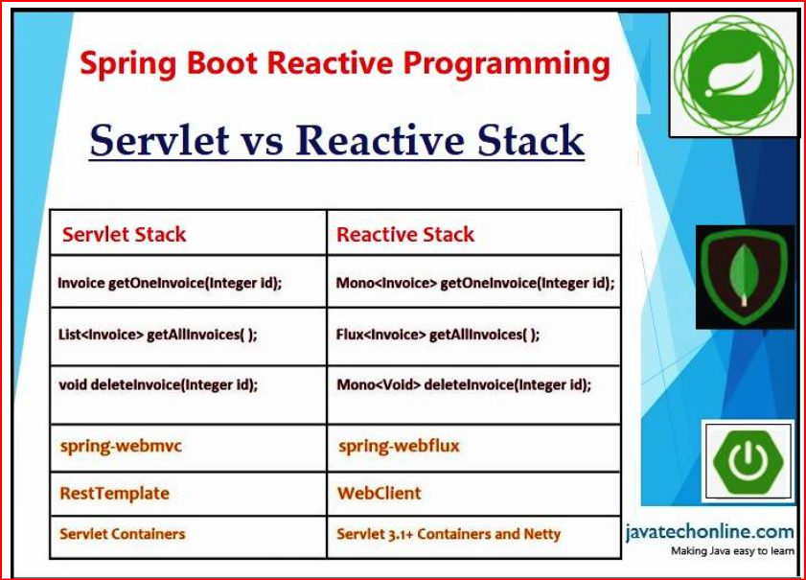
Spring mvc vs Spring webflux

Slide 7
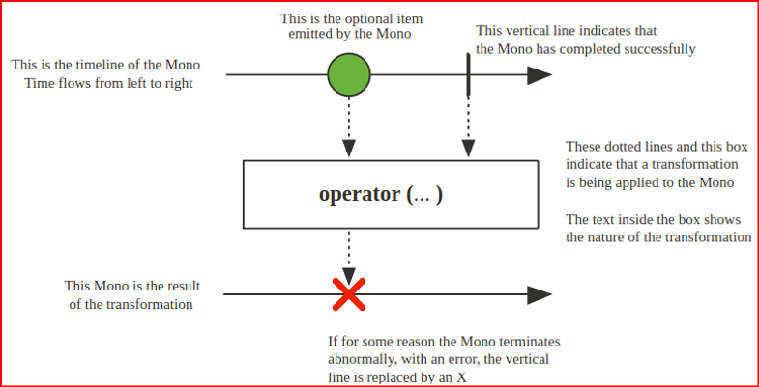
Mono
Mono – A Mono object represents a single asynchronous value or empty value (0 to 1) item, e.g. Mono<T>
Example:
Mono<String> mono = Mono.just("Hello, Reactive World!"); mono.subscribe(System.out::println);
// Outputs:
Hello, Reactive World!

Slide 8
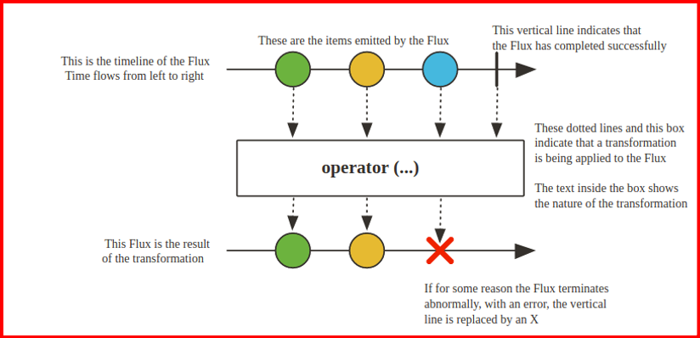
Flux
Flux – It represents a reactive sequence of 0 to N asynchronous items.
For example: Flux<T>
Streaming a list of database records or handling multiple HTTP requests reactively.
Flux<String> flux = Flux.just("Hello", "Reactive", "World"); flux.subscribe(System.out::println);
// Outputs:
// Hello
// Reactive
// World

