Slide 1

Springboot Reactive Programming Day2
26-11-2024

Slide 2
Topics covered
Setup spring boot project with webflux starter
Router Configuration Setup
Create Reactive controller & service
Data Access Layer Setup

Slide 3
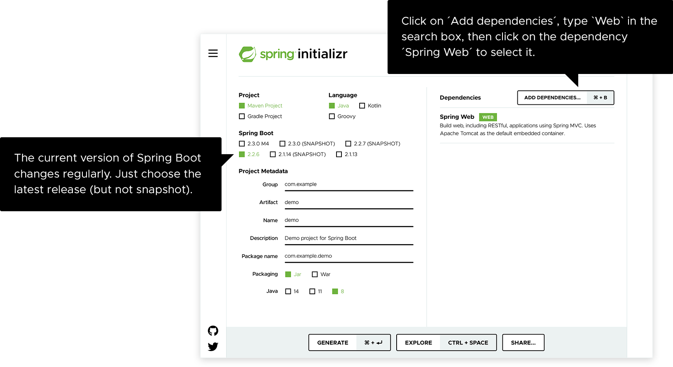
Setup Springboot Project with webflux starter

Slide 4
Router Functions
The Router Functions are an alternative to the annotated-based Spring MVC programming model.
Router functions we get rid of annotations.
Instead of using annotations like @GetMapping, @PostMapping and we can define routes using functional program paradigms and this approach provides a more flexible and composable way to define routes.
Traditional MVC supports annotations like @Valid – bean validation, @RequestMapping – root path, in router functions doesn’t
Handling of swagger doc is different here, need to use OpenApi with @RouterOperation, @Operations annotations.

