Slide 1
Springboot Reactive Programming Day4
28-11-2024

Slide 2
Topics covered
Event sourcing
Big Query integration

Slide 3
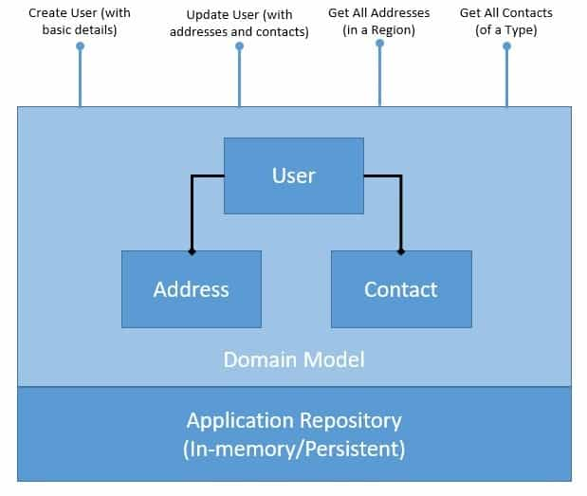
Traditional application design
Problems in This Application:
Domain Model: we may need to optimize our domain model and the underlying storage for them to suit the individual needs of the read and write operations.
Persistence: if we have to perform a historical audit of how the domain object has changed state, it’s not possible here. We have to supplement our solution with some audit logs to achieve this.

Slide 4
CQRS & Event Sourcing Design Patterns:
Command Query Responsibility Segregation (CQRS) - is about segregating the command and query side of the application architecture.
Event Sourcing gives us a new way of persisting application state as an ordered sequence of events. We can selectively query these events and reconstruct the state of the application at any point in time.

Slide 5
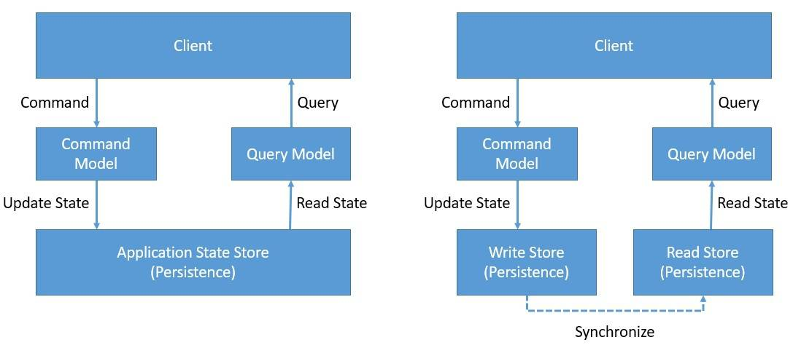
CQRS:
we’ll separate the domain model and its persistence to handle write and read operations.
Queries return a result and do not change the observable state of a system. Commands change the state of the system but do not necessarily return a value.

Slide 6
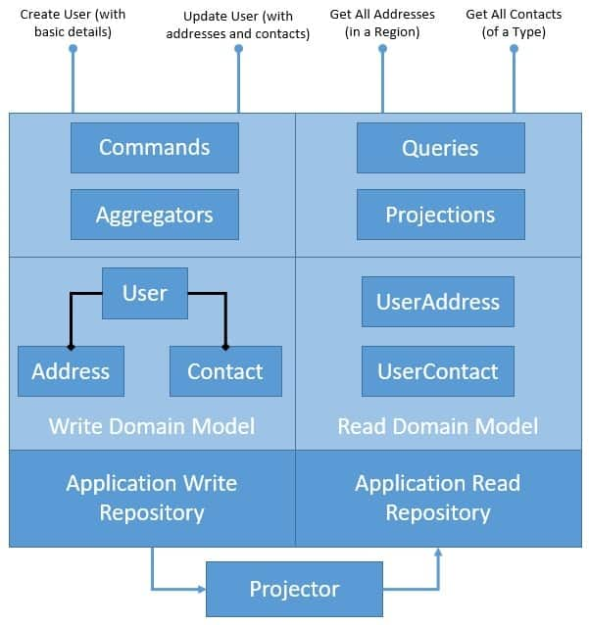
CQRS:

Slide 7
CQRS Pros vs Cons:
Pros:
a convenient way to select separate domain models
select repositories that are individually suited
complements event-based programming models
Cons:
Only a complex domain model can benefit , simple domain model can be managed without all this.
leads to code duplication
Separate repositories lead to problems of consistency, and it’s difficult to keep the write and read repositories in perfect sync always

Slide 8
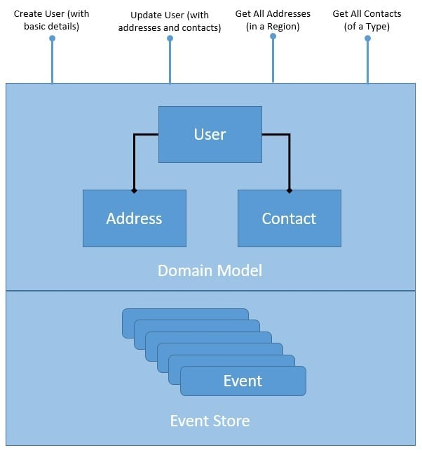
Event Sourcing:
Persistence: if we have to perform a historical audit of how the domain object has changed state, it’s not possible here. We have to supplement our solution with some audit logs to achieve this.
Event Sourcing dramatically changes the way we think of the application state storage.
we’ve structured our repository to store an ordered list of domain events.

Slide 9
Events and Event Store
The fundamental objects in event-driven applications are events, and event sourcing is no different. As we’ve seen earlier, events represent a specific change in the state of the domain model at a specific point of time.
public abstract class Event {
public final UUID id = UUID.randomUUID();
public final Date created = new Date();
}
This just ensures that every event we generate in our application gets a unique identification and the timestamp of creation.
public class UserCreatedEvent extends Event {
private String userId;
private String firstName;
private String lastName;
}
…
public class UserService {
private EventStoreRepository repository;
public void createUser(String userId, String firstName, String lastName) {
repository.addEvent(userId, new UserCreatedEvent(userId, firstName, lastName));
}

Slide 10
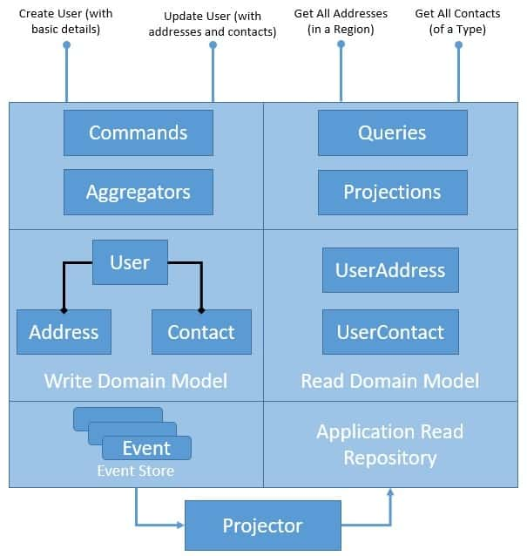
CQRS with Event sourcing:
The event-based projection is rather convenient and easier to implement. All we have to do is process all occurring domain events and apply them to all read domain models. Typically, in an event-based application, the projector would listen to domain events it’s interested in

