Slide 1
TSC MIA RNAseq
Michael Gandal MD PhD
Geschwind Lab

Slide 2
Experimental Design
Postnatal Exposure
Adult Brain Region
Mouse Genotype
Hemisphere
MIA (n=3)
Control (n=3)
MIA (n=3)
PFC, HC, CBL R, L
PFC, HC, CBL R, L
PFC, HC, CBL R, L
TSC+/-
WT

Slide 3
RNA Sequencing Workflow
Dissection, RNA Extraction
Library Prep: RiboZero Gold + TruSeq Strand Specific
Illumina HiSeq Paired End 69bp Multiplex 24 samples / lane
QC: FastQC
Alignment: STAR, mm10, Gencode v10 annotation
QC: PicardTools
Quantification: HTSeq-Count
Differential Expression DESeq2
Network Analysis WGCNA
Pepke et al, Nature Methods (2009)

Slide 4
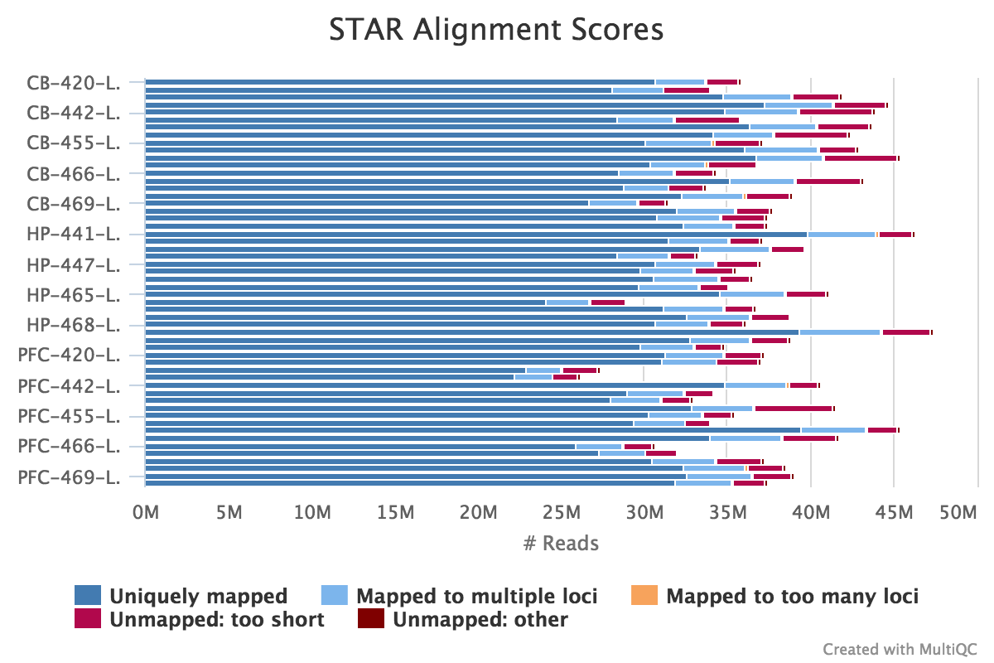
RNAseq Mapping

Slide 5
Brain Region = Major Source of Variance

