Slide 1
Beer Production
2007 – 2017 Beer Production in the US

Slide 2
Matt RJ Peter Paul Mary

Slide 3
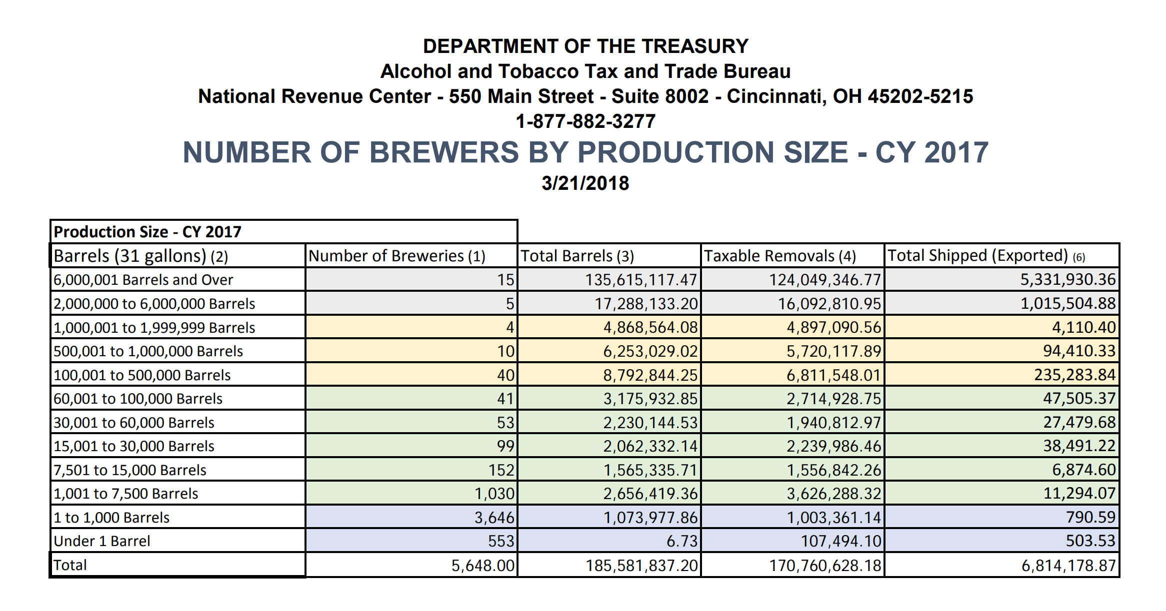
The Data

Slide 4
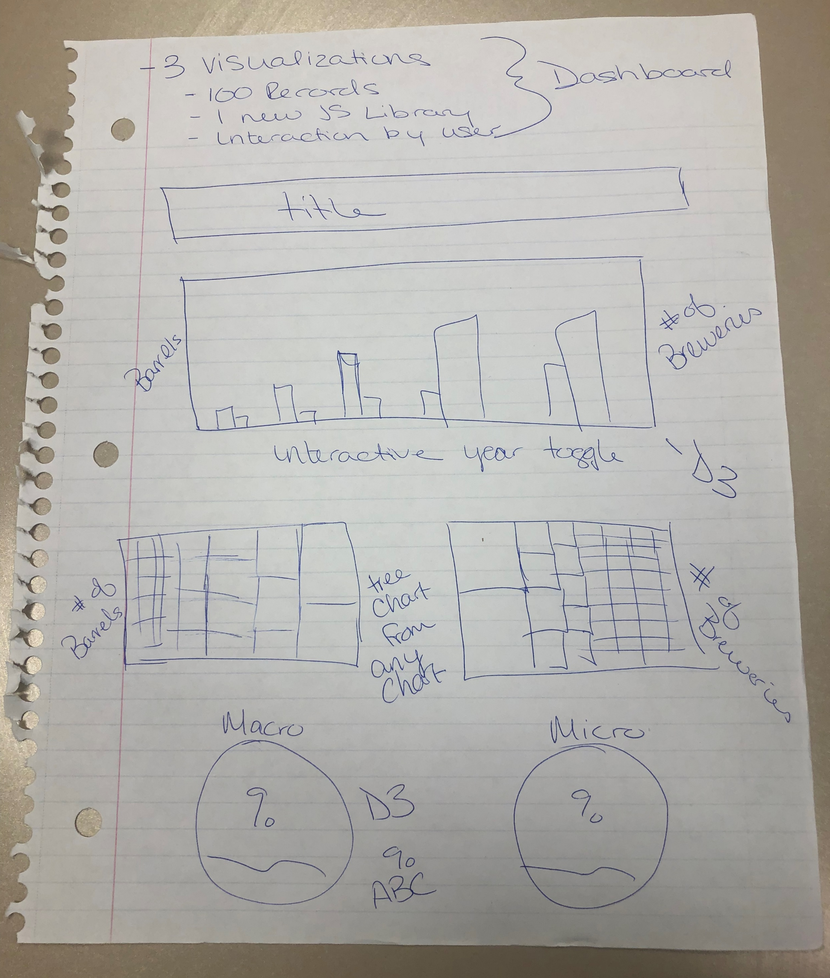
The vision
Dashboard Project
3 Visualizations
100 Records
1 new JS Library
Interaction from user
Is this where we end up? Stay tuned to find out…

Slide 5
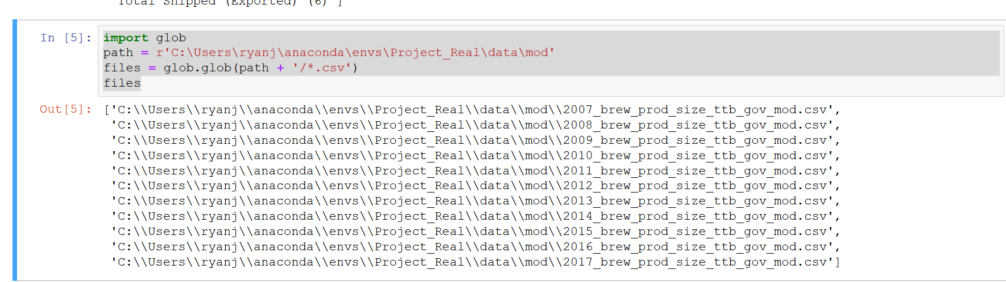
The Data
Induvial files for 2007 - 2017
Download CSV
Looped through each CSV to add to the data frame
Loaded the data frame to a table
Simplified header data

Slide 6
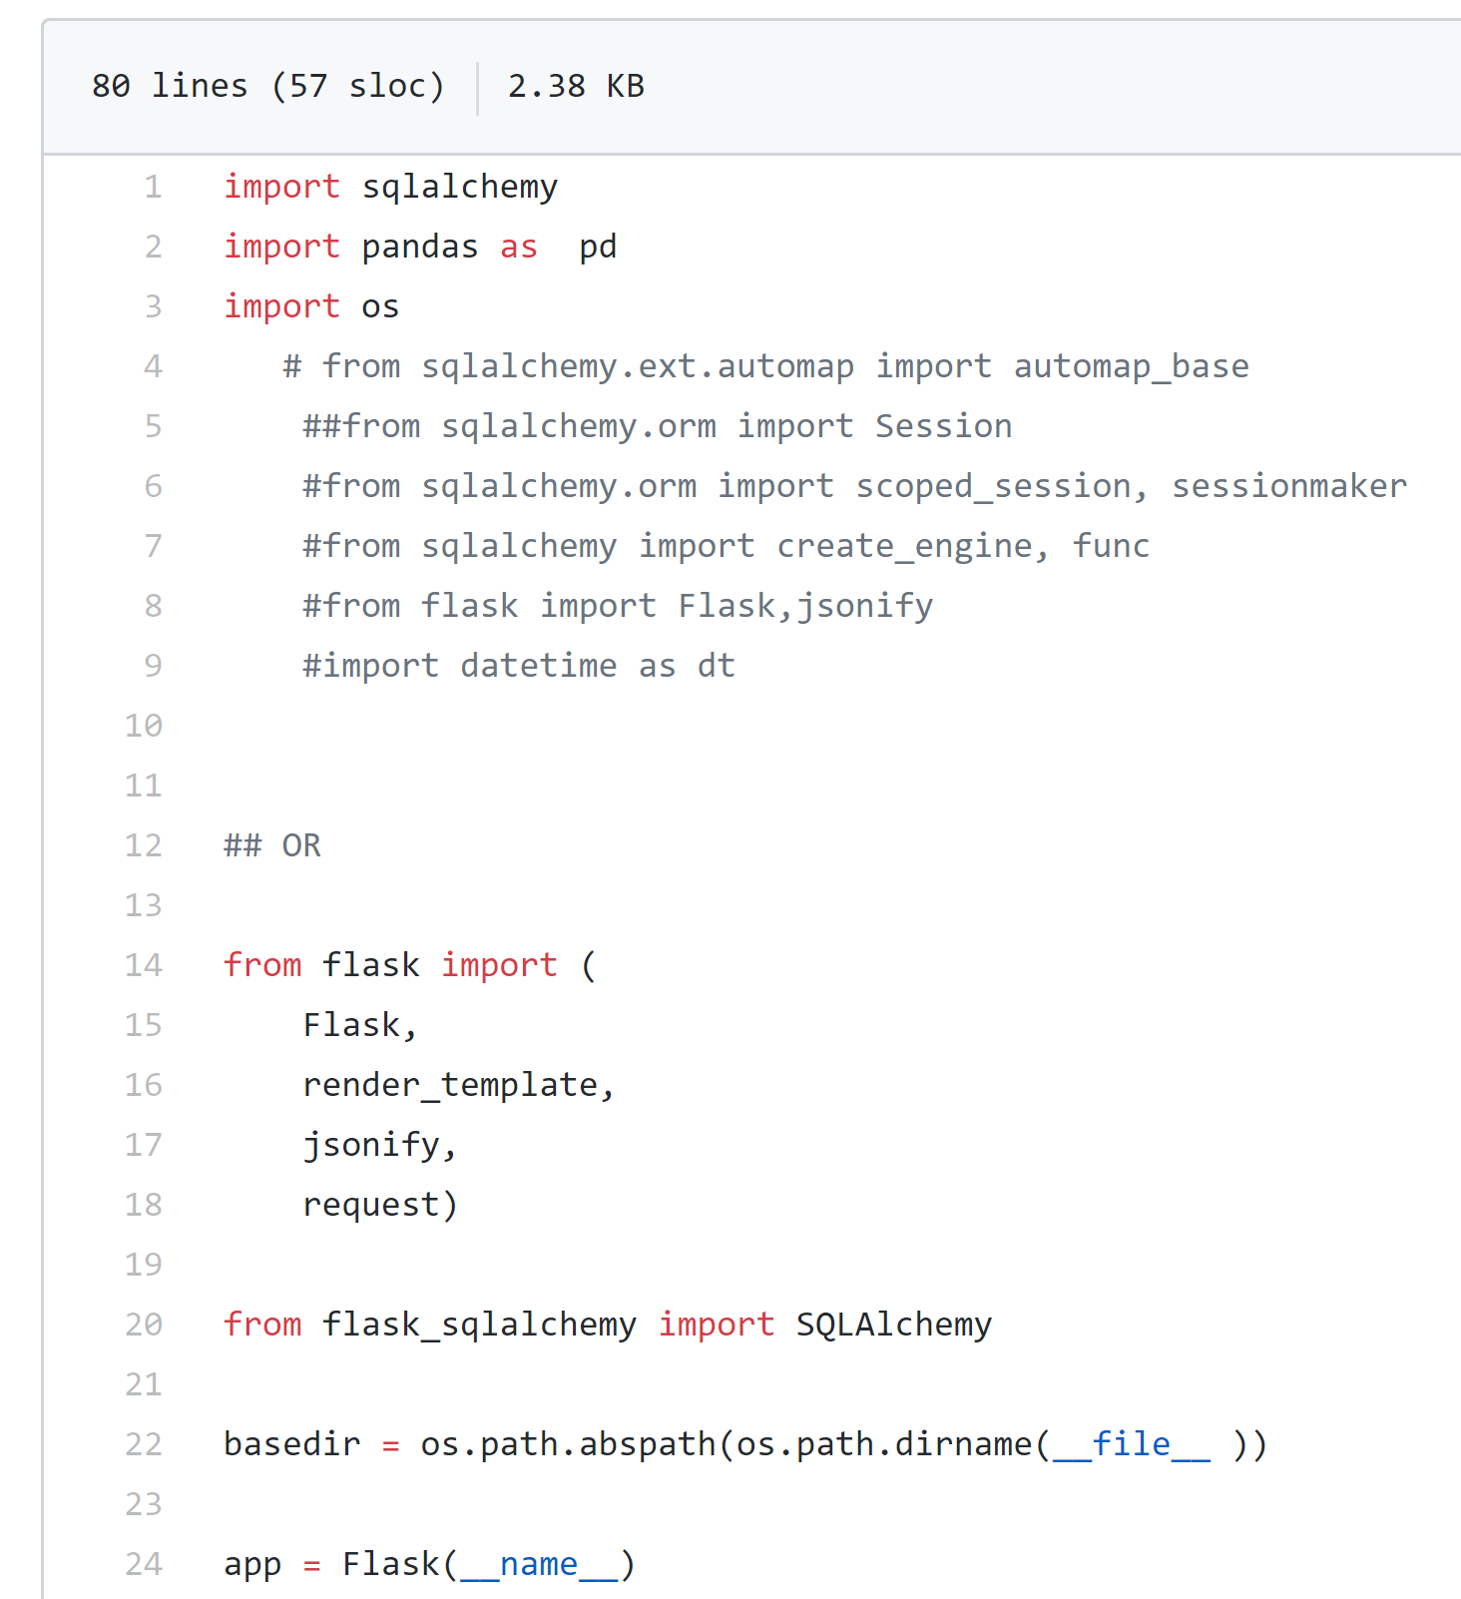
The Data – part 2
Created flask app.py
2 Routes
Restful API
Jsonify the get request

Slide 7
The app structure
HTML
App.js
Beer.sqlite
Beer.db
App.py
Style.css

Slide 8
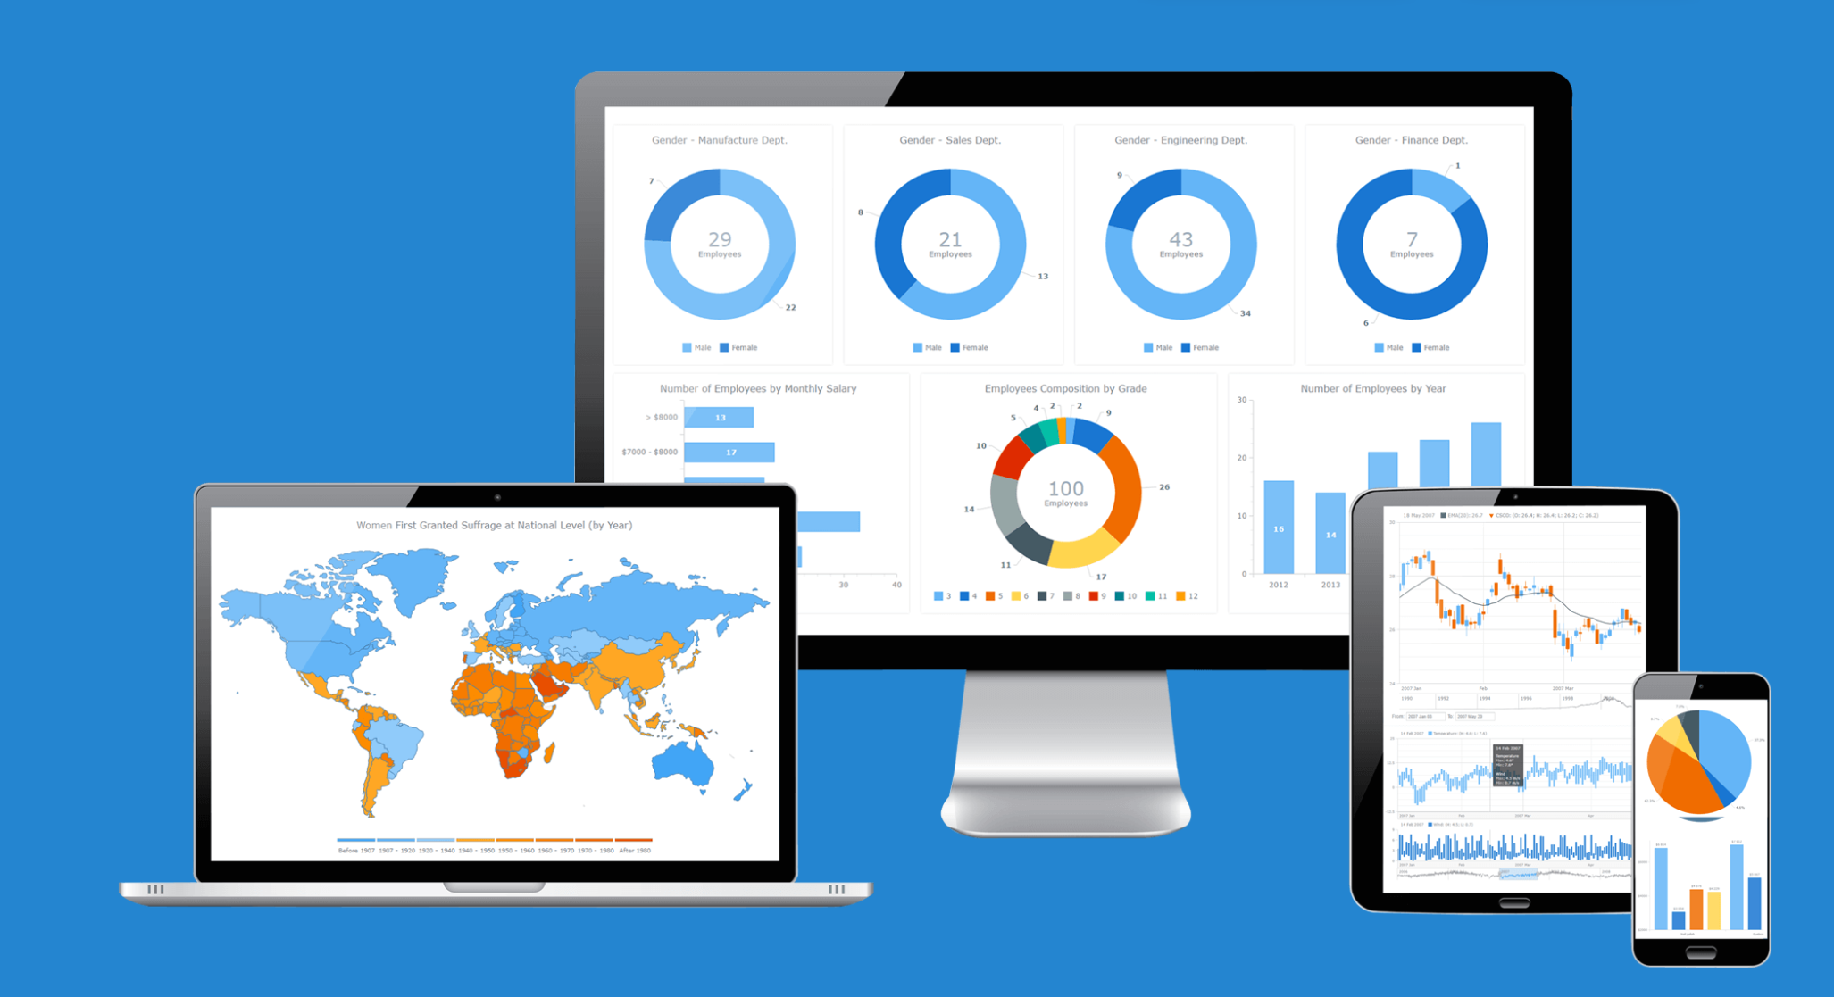
Any chart – Hello new JS Library!
Extensive variety of charting options
“More than 75% of Fortune 500 companies are happy with AnyChart.”

Slide 9
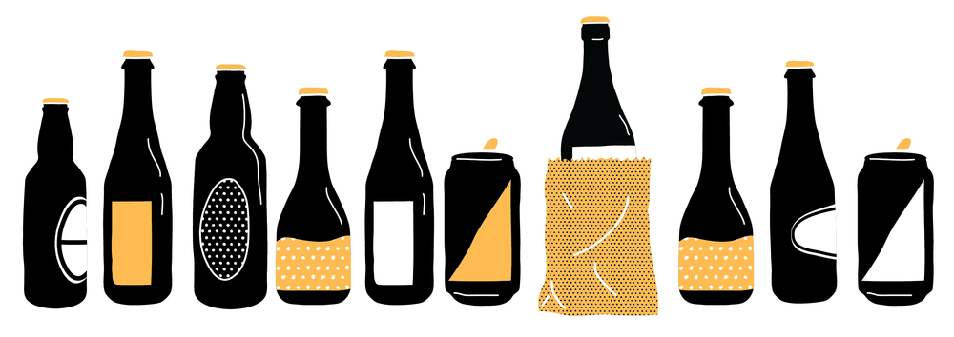
Who is ready for beer?

