Slide 1

PahktheCah
A walking guided tour of Boston
App developed by:
Yash Agarwal, Margaret Bolick, Samantha Chua, Melissa Garcia, Jeraldin Guerrero

Slide 2

Synopsis:
Park your car and set out on a walking guided tour with PahktheCah! PahktheCah takes you through Boston to a destination of your choice while allowing you to take your time and explore the numerous sites along the way. The intent behind this app is to introduce newcomers to the locations that the developers felt were unique to Boston.

Slide 3

App Classes:
Each page in the app corresponds to an XML page, which corresponds to an activity.
Options Page/Menu/Category Page Classes:
Initializes button, sets OnClickListener
Initiates appropriate activity

Slide 4

Home Page:
The home screen is the first screen that the user sees when they open the app. It simply introduces our app.
Go to Categories page
Button to the About page

Slide 5
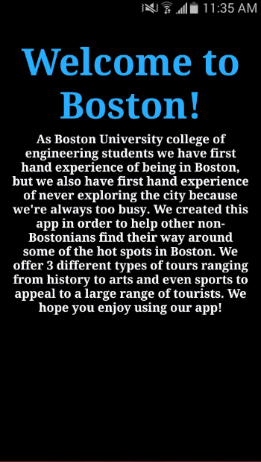
About Page:
This page welcomes the user to Boston and describes the purpose behind the making of this app
Press the back button or use the Navigation Menu to return to the Home Page

Slide 6
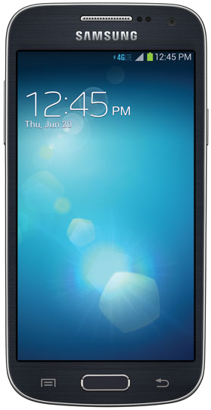
Phone Button Usage:
The buttons on the phone are used to help the user navigate through the app.
Brings up Navigation page
Goes back to the previous page

Slide 7
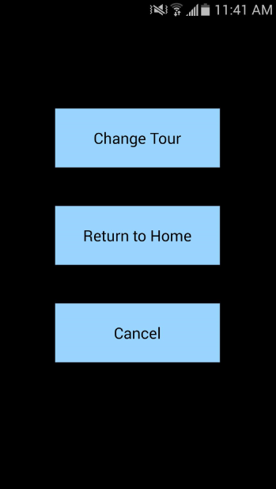
Navigation Page:
This page allows the user to go to certain pages within the app regardless of what page they are on. It is accessible at all times.
Goes to the Categories page
Redirects to the Home page
Cancel the redirect action

Slide 8
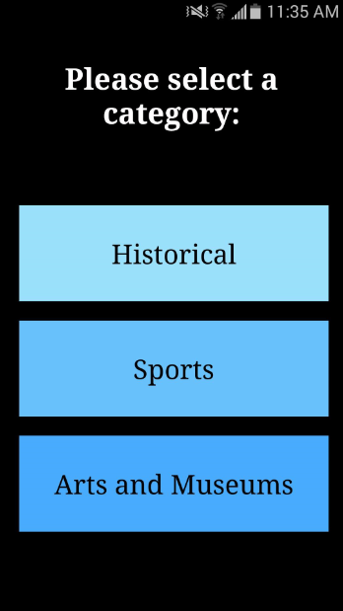
Categories Page:
This page allows the user to pick a location by first having them choose what kind of location they’re interested in - historical, sports, or arts.
Goes to the page with historical locations
Goes to the page with sports locations
Goes to the page with museum and arts locations

Slide 9
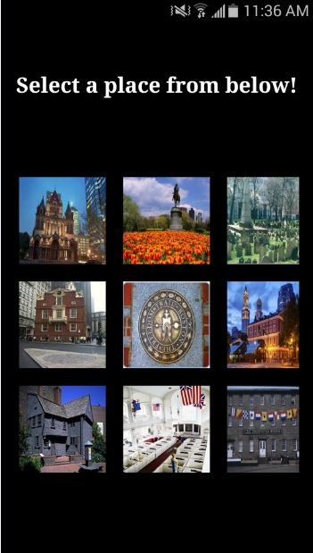
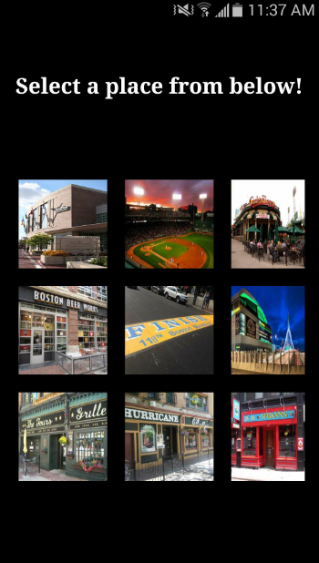
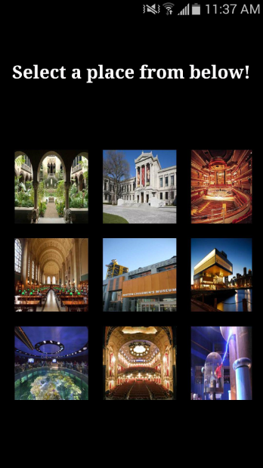
The Three Categories Pages:
Historical
Sports
Arts & Museums
This pages display the different locations that user has to choose from within each category. The pictures of the places are the buttons – the user simply has to tap on the picture of the desired destination.

Slide 10
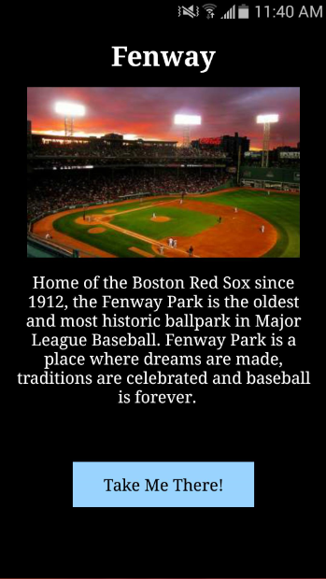
Location Page:
This page elaborates a little bit on the chosen destination. If the user taps the “Take Me There!” button, the button will open Google Maps with the place as the end destination.
Picked location’s name
Enlarged image on button
A small description of the location
Opens Google Maps, which will lead the user to this location

Slide 11
About_____ Class:
If the user presses the “Take Me There” button, it creates an Intent to the MapsActivity class
Each intent has an extra string added to it which is used in the MapsActivity class to figure out where the Intent came from
if the back button on the phone is pressed, the previous activity on the stack resumes
if the menu page is pressed, the menu activity is initiated

Slide 12
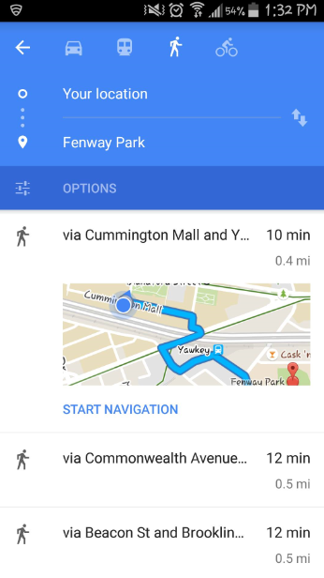
In Google Maps
Google Maps searches for the name of the location chosen, and sets that place as the user’s destination.
Automatically set to give walking directions
Chosen location as destination
If user choses, can be guided visually
Shows directions to get to destination by walking

Slide 13
MapsActivity Class:
Connects app to the Google API client
Sets up the map
Depending on which activity that the intent came from, it initiates the opening of Google Maps on the user’s phone with the location that they had previously pressed as the destination
In Google Maps, the user will be able to get turn by turn directions depending on their mode of transport

Slide 14

Thank you!

