Slide 1
Process
A process is usually defined as an instance of a running program and consists of two components:
A kernel object that the operating system uses to manage the process. The kernel object is also where the system keeps statistical information about the process.
An address space that contains all the executable or DLL module's code and data. It also contains dynamic memory allocations such as thread stacks and heap allocations.

Slide 2
Process
It must have a thread that runs in its context; this thread is responsible for executing the code contained in the process's address space.
A single process might contain several threads, all of them executing code "simultaneously" in the process's address space.
Each thread has its own set of CPU registers and its own stack. Each process has at least one thread that executes code in the process's address space. If there were no threads executing code in the process's address space, there would be no reason for the process to continue to exist, and the system would automatically destroy the process and its address space.

Slide 3
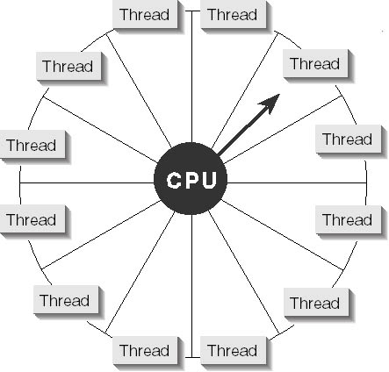

Slide 4
Writing Your First Thread Function
Entry-point function for your primary thread: main, wmain, WinMain, or wWinMain.
If you want to create a secondary thread in your process, it must also have an entry-point function, which should look something like this:
DWORD WINAPI ThreadFunc(PVOID pvParam) {
DWORD dwResult = 0;.
return(dwResult);
}

Slide 5
The CreateThread Function
HANDLE CreateThread(
PSECURITY_ATTRIBUTES psa,
DWORD cbStack,
PTHREAD_START_ROUTINE pfnStartAddr,
PVOID pvParam,
DWORD fdwCreate,
PDWORD pdwThreadID
);
The system allocates memory out of the process's address space for use by the thread's stack.
The new thread runs in the same process context as the creating thread.

Slide 6
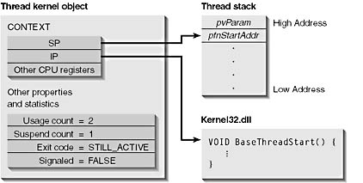

Slide 7
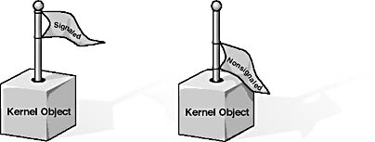
Thread Synchronization With Kernel Objects
The following kernel objects can be in a signaled or nonsignaled state:
Processes
File change notifications
Threads
Events
Jobs
Waitable timers
Files
Semaphores
Console input
Mutexes

Slide 8
Wait Functions
DWORD WaitForSingleObject(
HANDLE hObject,
DWORD dwMilliseconds
);
DWORD WaitForMultipleObjects(
DWORD dwCount,
CONST HANDLE* phObjects,
BOOL fWaitAll,
DWORD dwMilliseconds
);

Slide 9
Memory Management
Internally, a heap is a region of reserved address space. Initially, most of the pages within the reserved region are not committed with physical storage.
When a process initializes, the system creates a heap in the process's address space. This heap is called the process's default heap.
HANDLE GetProcessHeap();

Slide 10
Reasons to Create Additional Heaps
In addition to the process's default heap, you can create additional heaps in your process's address space. You would want to create additional heaps in your own applications for the following reasons:
Component protection
More efficient memory management
Local access
Avoiding thread synchronization overhead
Quick Free

Slide 11
How to Create an Additional Heap
HANDLE HeapCreate(
DWORD fdwOptions,
SIZE_T dwInitialSize,
SIZE_T dwMaximumSize
);
Allocating a Block of Memory from a Heap
PVOID HeapAlloc(
HANDLE hHeap,
DWORD fdwFlags,
SIZE_T dwBytes
);
Freeing a Block
BOOL HeapFree(
HANDLE hHeap,
DWORD fdwFlags,
PVOID pvMem);

Slide 12
GetThreadTimes Function
Retrieves timing information for the specified thread.
BOOL WINAPI GetThreadTimes(
__in HANDLE hThread,
__out LPFILETIME lpCreationTime, __out LPFILETIME lpExitTime,
__out LPFILETIME lpKernelTime, __out LPFILETIME lpUserTime
);

Slide 13
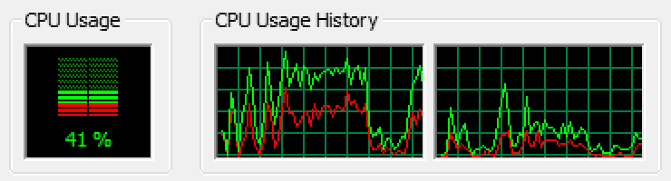
Understanding User and Kernel Mode
CPU usage is generally represented as a simple percentage of CPU time spent on non-idle tasks. But this is a bit of a simplification. In any modern operating system, the CPU is actually spending time in two very distinct modes:
Kernel Mode In Kernel mode, the executing code has complete and unrestricted access to the underlying hardware. It can execute any CPU instruction and reference any memory address. Kernel mode is generally reserved for the lowest-level, most trusted functions of the operating system.
User Mode In User mode, the executing code has no ability to directly access hardware or reference memory. Code running in user mode must delegate to system APIs to access hardware or memory. Due to the protection afforded by this sort of isolation, crashes in user mode are always recoverable. Most of the code running on your computer will execute in user mode.

