Slide 1
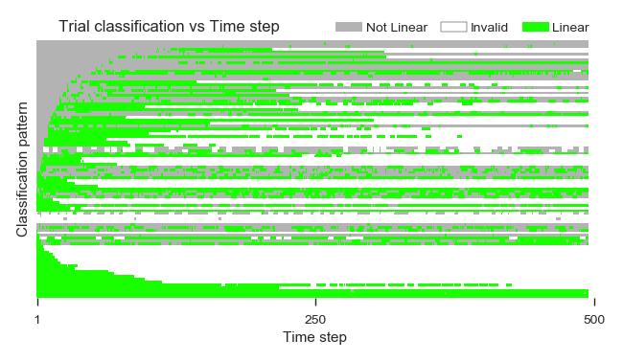
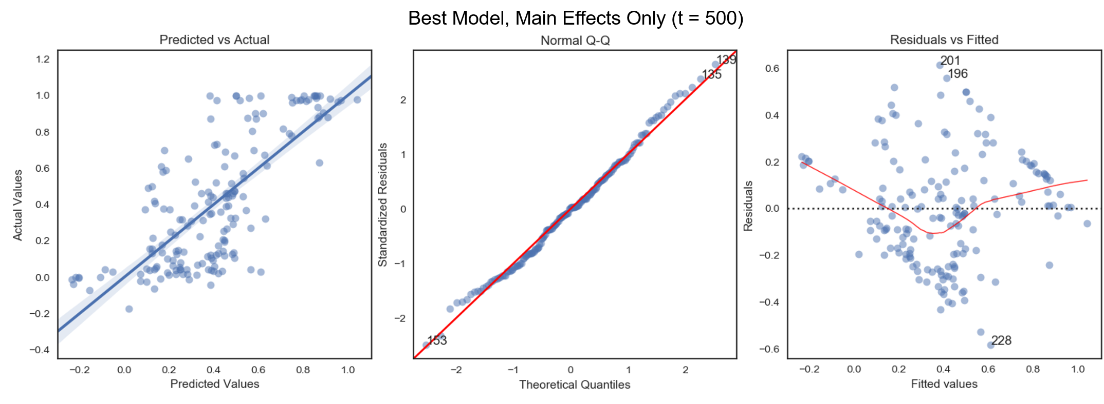


Simulation Output Database
Regression on Simulation Output
100 observations for Trial 1, 𝑡=1
+ Data cleaning
+ Linear regression model
1 $\left(R_{adj}^{2}, \text{Significance}\right)$ pair
500 $\left(R_{adj}^{2}, \text{Significance}\right)$ pairs
Moving Average / Smoothing
Classifier
500 (MA-AR², MA-Significance,
Classification) tuples for Trial 1
Repeat for
each time $t$
Analysis Database
Repeat for
each trial
Analysis Database
Time Series/State
Change Study
Regression on
Experimental Design
Factor-Level
Classification

