Slide 1
Sector: Electronics Sub sector: Communication and Broadcasting Job role: ELE/Q8106: Digital Cable Technician Task: 1. Overhead (aerial) installation of fiber optic cable on suspension clamp
2. Installation of cable on anchoring clamp assembly
3. Fitment of joint closure and cable loop on the pole
4. Clipping of drop cable on the wall

Slide 2
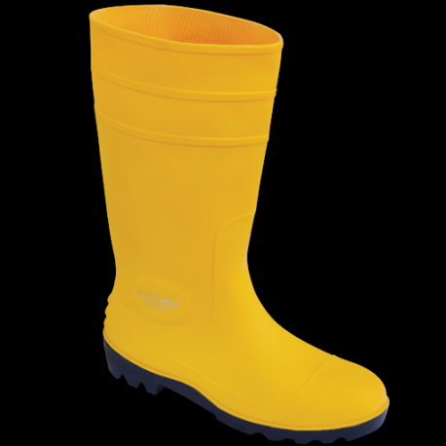
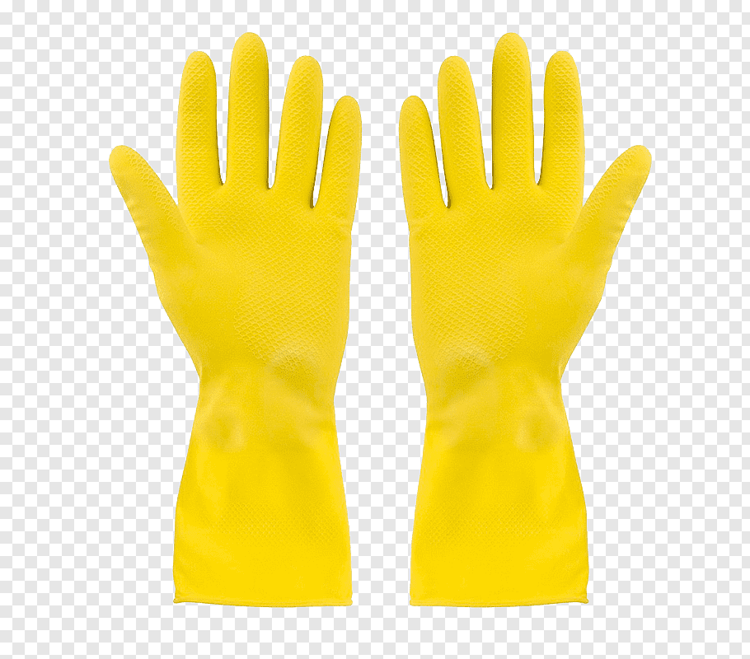

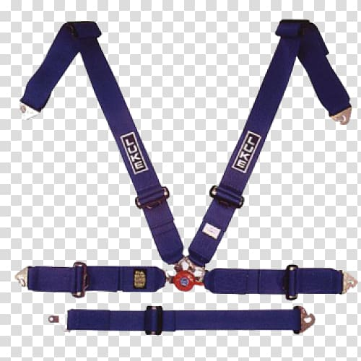
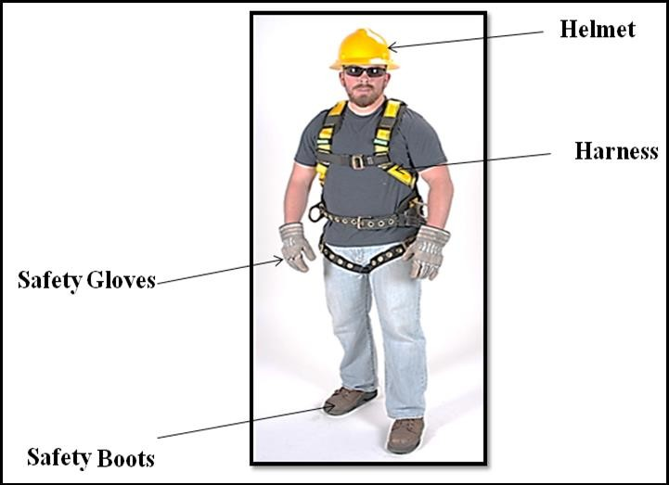
Overview:
Task:-1 To execute aerial installation of fiber optic cable on suspension clamp.
Step-1
a) Click on Add button to wear safety precautions like Helmet, Safety Boots, Safety Gloves and Harness.

Slide 3

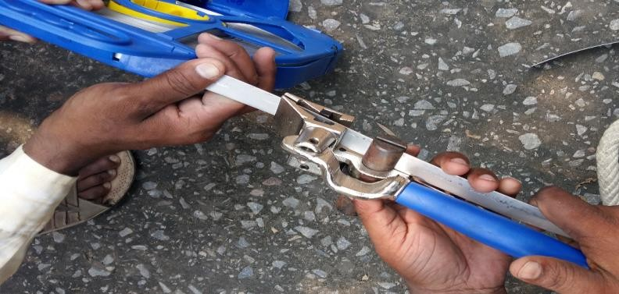
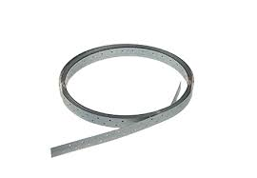
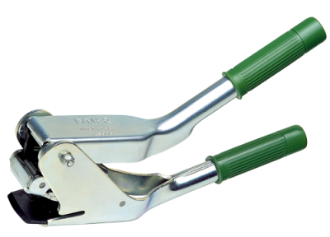


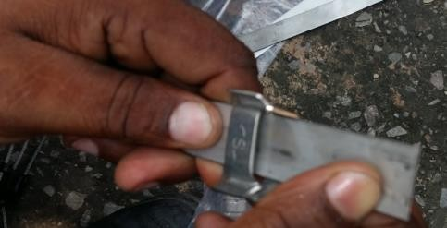
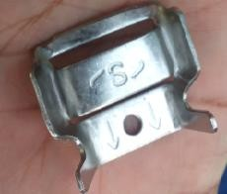
Step:-2
b) Bring Mat
c) Click on strap binding and cutting tool to Cut the Stainless strip strap of minimum 30 cm length for 3 inches diameter of pole.
Stainless Strap
Cutting Tool
d) Put the 30 cm length of stainless strip one end into buckle.
Buckle

Slide 4
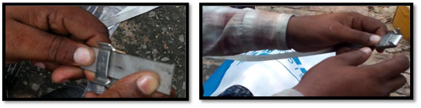

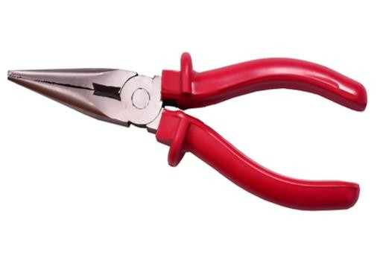

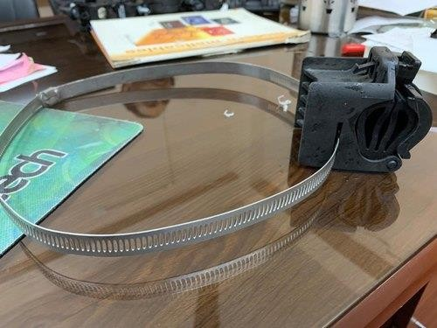

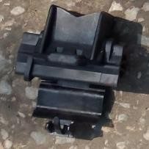
e) Fold the strap and tight the buckle using plier.
Step:3
Plier
f) Click on suspension clamp to Insert the suspension clamp in the strap from other end and fit other end into buckle.
Step:4
Suspension Clamp

Slide 5
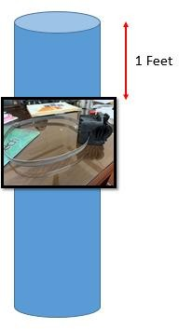
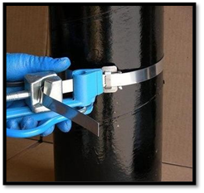
g) Click on prepared assembly to put it on a pre-existing pole of 3 inch diameter, at 1 feet from the top of pole.
h) Tight the strap on the pole.
i) cut the residual strap using strap binding
and cutting tool.
j) Close the buckle using plier.
Step:5

Slide 6
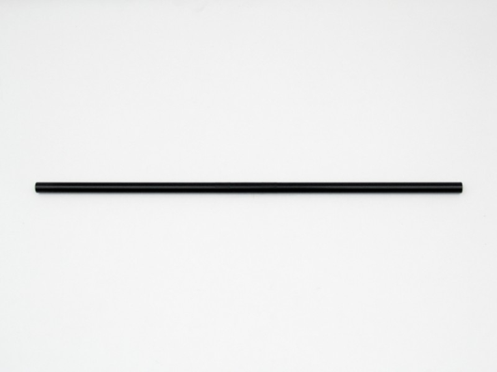


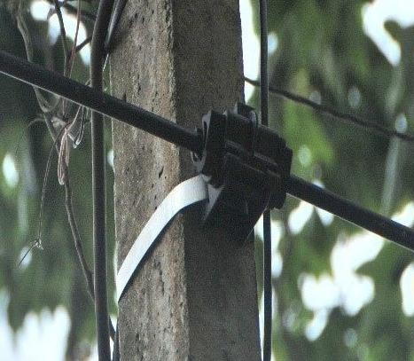
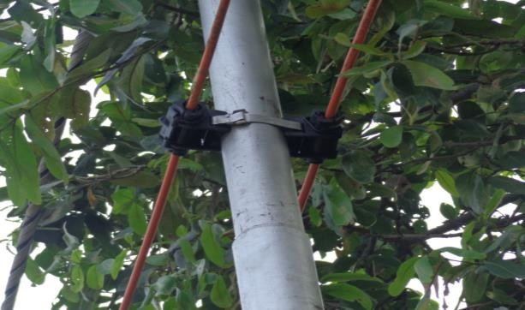
k) Click add button to bring the fiber optic cable.
l) Place the fiber optic cable in suspension clamp and lock it.
Step:6

Slide 7
Step:-2 To attach the cable on anchoring clamp assembly
a) Click on Add button to wear safety precautions like Helmet, Safety Boots, Safety Gloves and Harness.
b) Bring table
c) Click on strap binding and cutting tool to Cut the Stainless strip strap of minimum 30 cm length for 3 inches diameter of pole.
d) Put the 30 cm length of stainless strip one end into buckle.
e) Fold the strap and tight the buckle using plier.

Slide 8

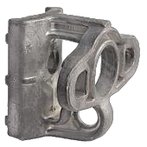

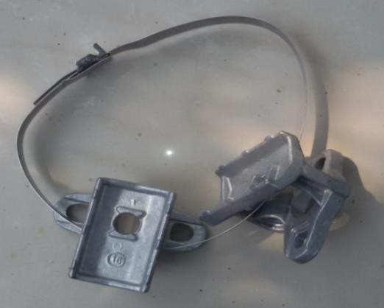
f) Bring the universal bracket on the mat.
g) Insert the universal bracket in strap fit other end into buckle.

Slide 9
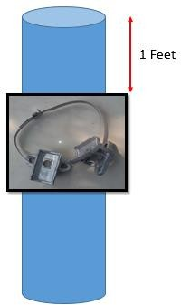

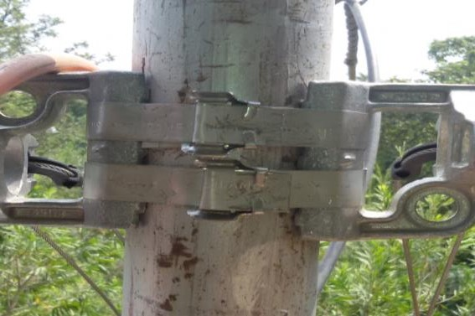
h) On a pre-existing pole of 3 inch diameter, put the above prepared assembly at 1 feet from the top of pole
i) Adjust the universal brackets with direction opposite to each other. Tight the strap on the pole and cut the residual strap using strap binding and cutting tool. Close the buckle using plier.

Slide 10
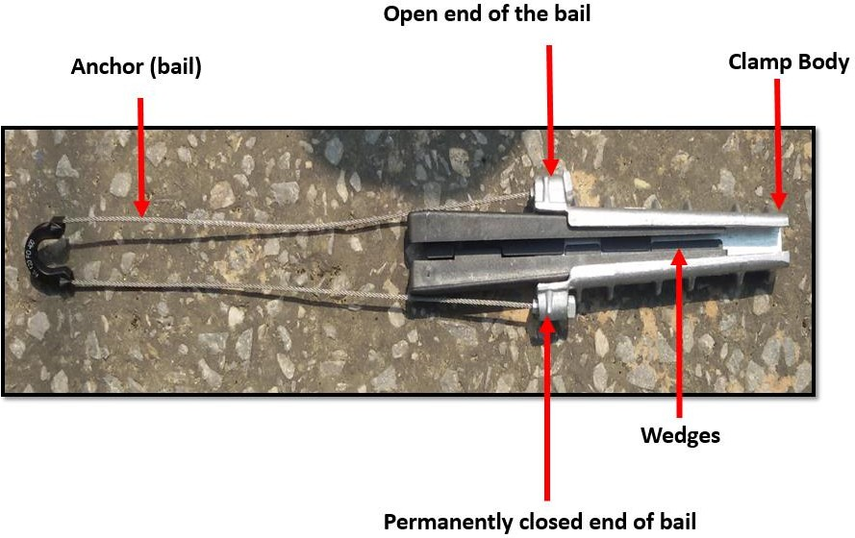

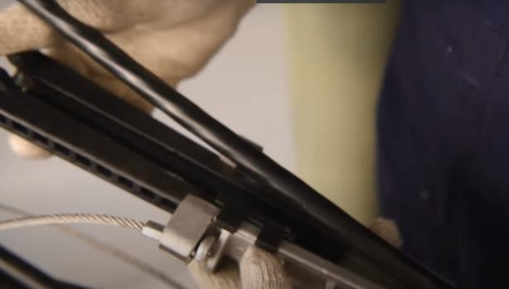

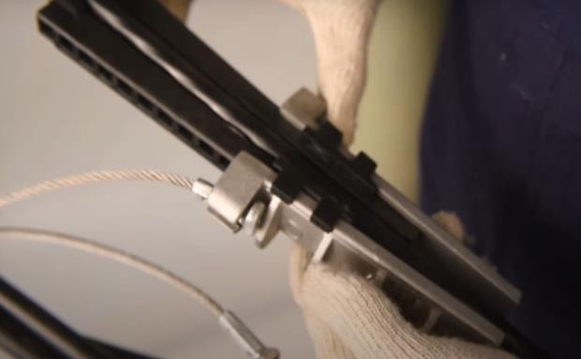
j) Bring the cable.
k) Click on cable to place the cable between the wedges of the anchoring clamp.
Anchoring Clamp

Slide 11
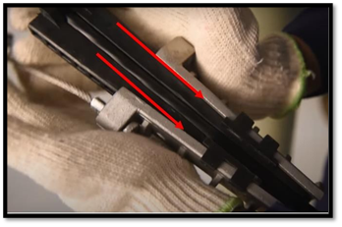

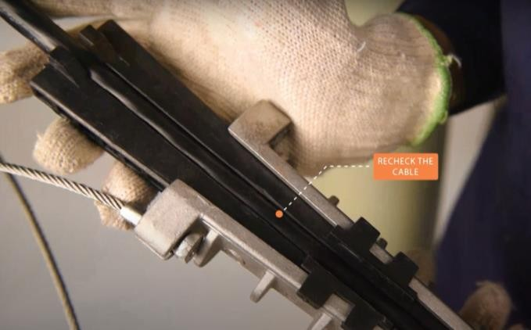


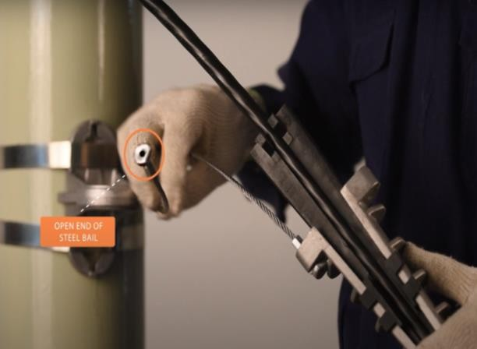
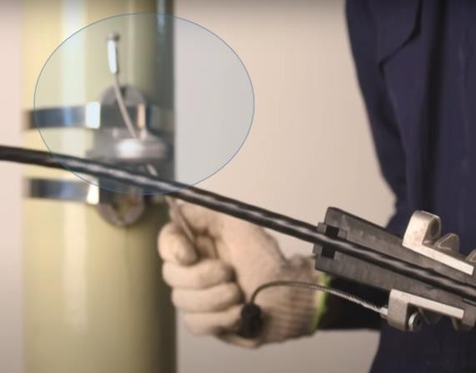
l) Once cable is placed, click on wedges to slide the wedges down till it strongly grips the cable.
j) Pass the open end steel bail (anchor) of the anchoring clamp from the hole of the universal clamp.

Slide 12


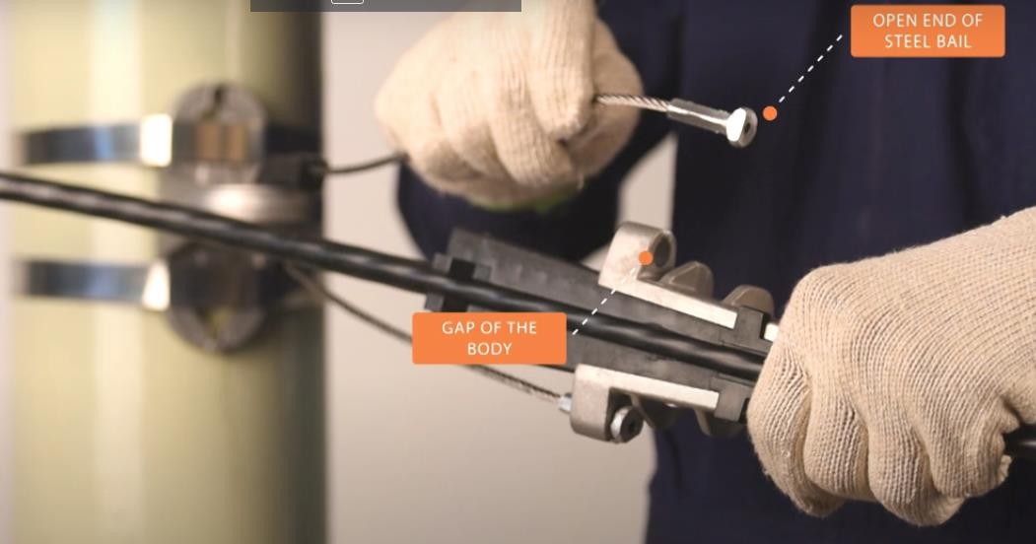
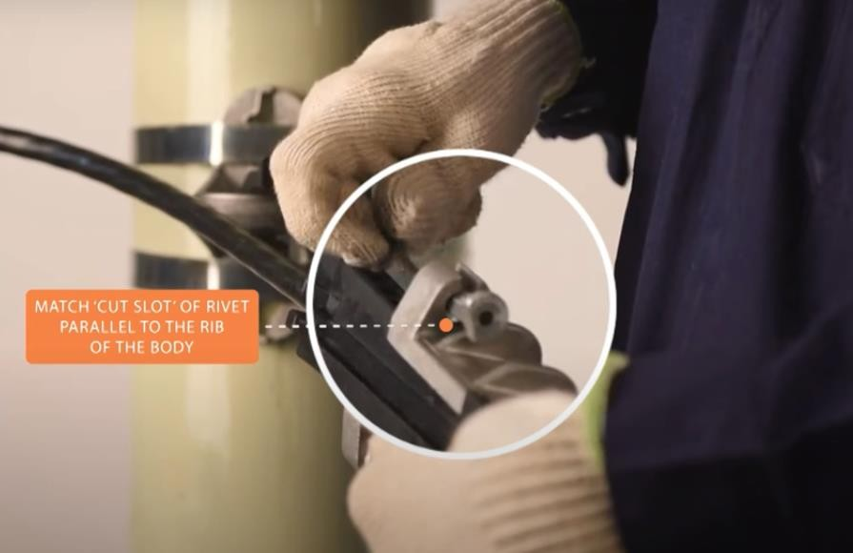
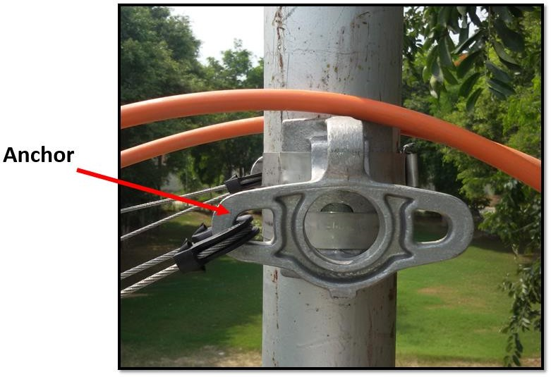

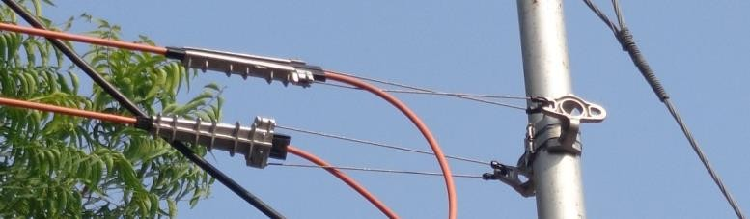
k) Insert the open end of the steel bail (anchor) into the gap of the body. Cable is now attached to the pole through anchoring clamp.

Slide 13
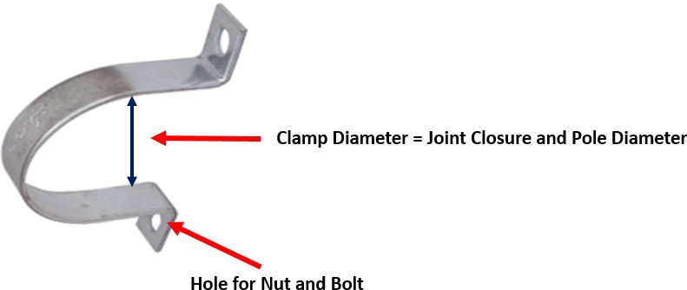
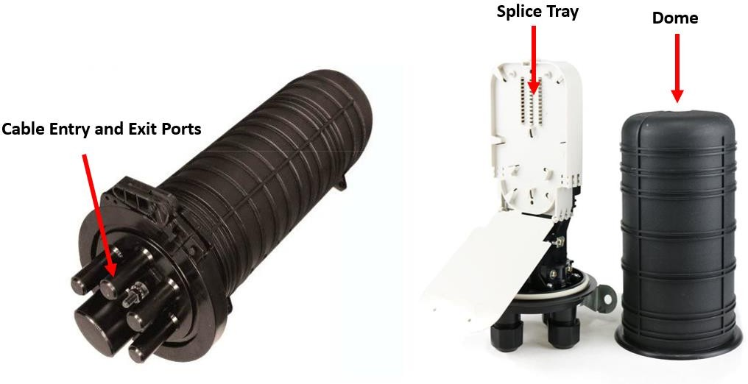
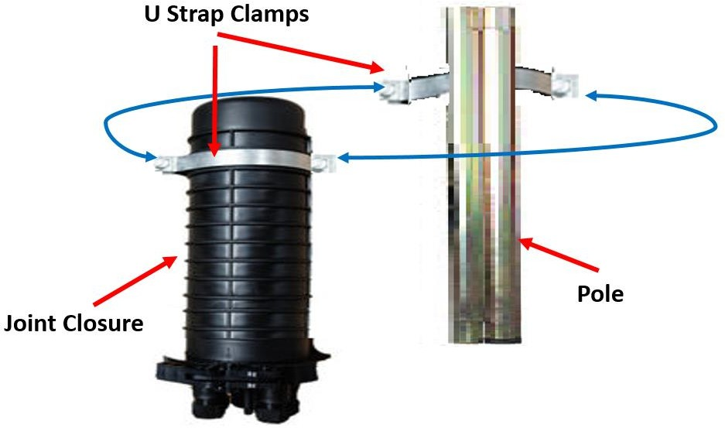
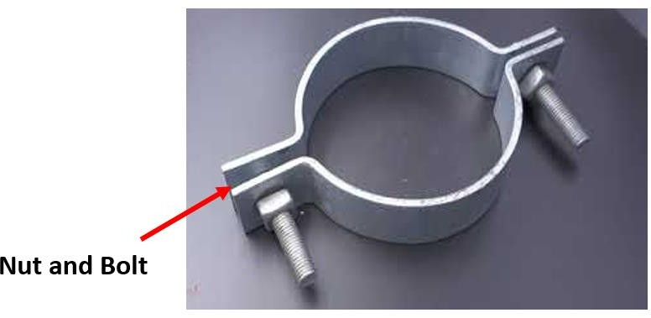
Step:-3 To fit the joint closure and cable loop frame on the pole
Click on Add button to wear safety precautions like Helmet, Safety Boots, Safety Gloves and Harness.
Bring the U Strap Clamp Joint Closure.
c) Fit the first (top) U strap clamp on joint closure and one on pole and tight the both clamps using nut and bolts.

Slide 14
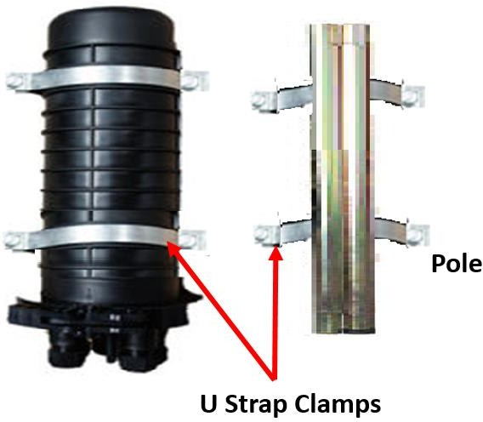

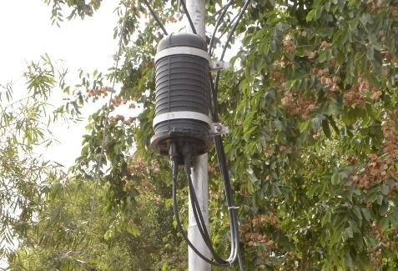
d) Fit the second (bottom) U strap clamp on joint closure and one on pole and tight the both using nut and bolts. Joint closure is installed on pole.

Slide 15
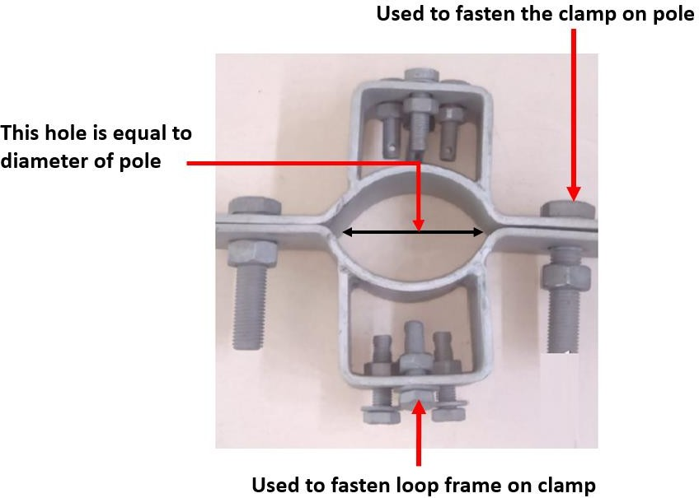

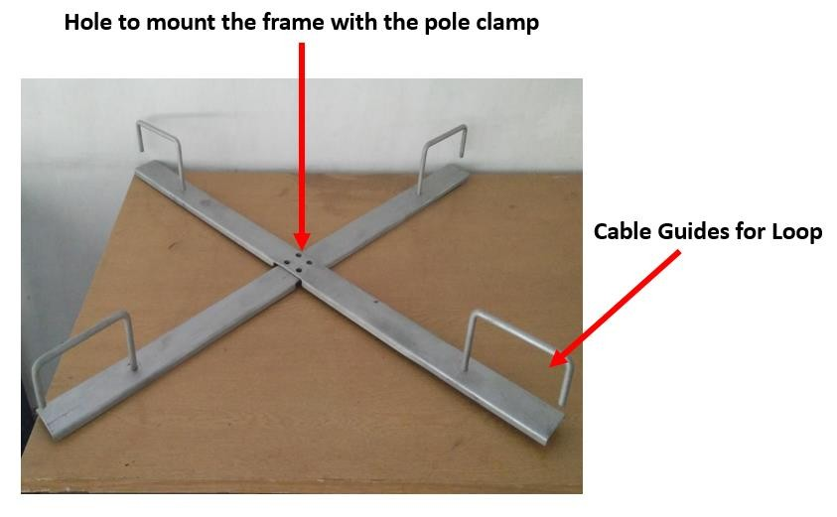
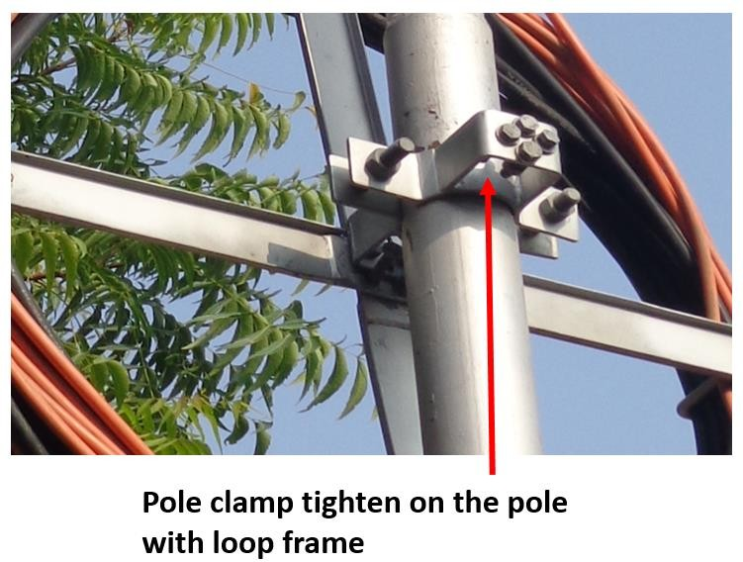
e) Tight the loop frame on the pole clamp
f) Place the loop frame assembly on pole at appropriate height and Join the two parts of pole clamp on the pole to attach the assembly with the pole by tightening the nuts and bolts

Slide 16

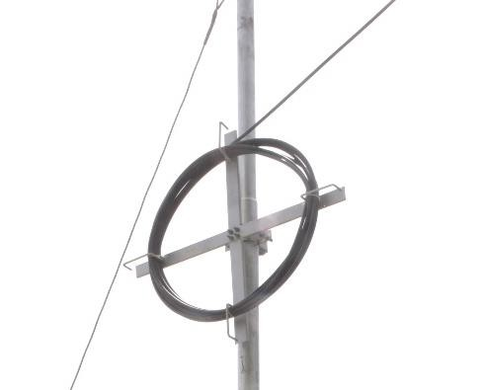
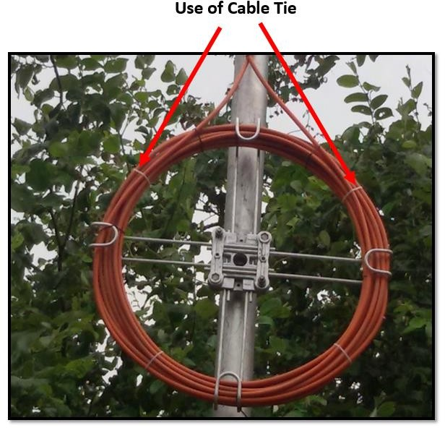
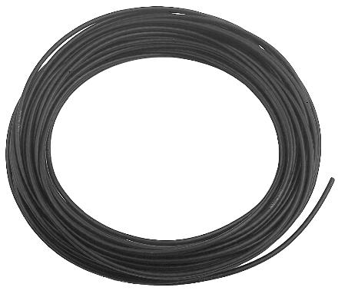
g) Place the cable inside the cable guides of the loop frame to make cable loop of recommended bend radius.
h) Use cable tie to ensure effective binding of cable loop.

Slide 17
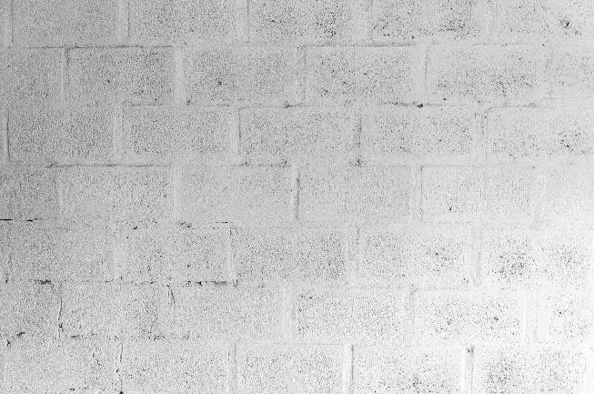
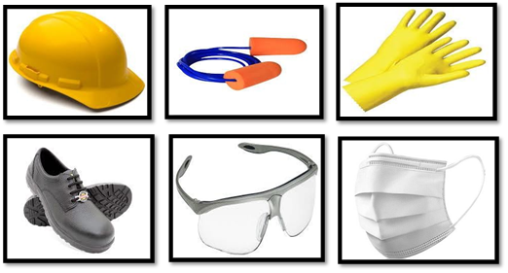
Step:-4 To clip the fiber optic drop cable on a wall.
a) Click on add button to bring a wall over which cable clipping will be performed.
b) Click on add button to Wear Helmet, Safety Boots, Safety Gloves, Safety Glass, Ear Plug and Dust Mask.

Slide 18
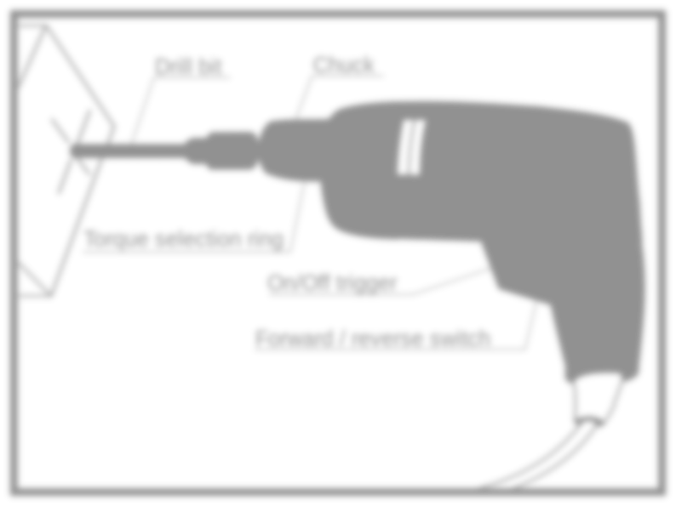
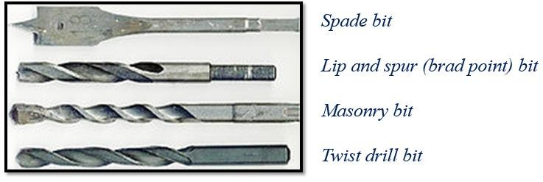
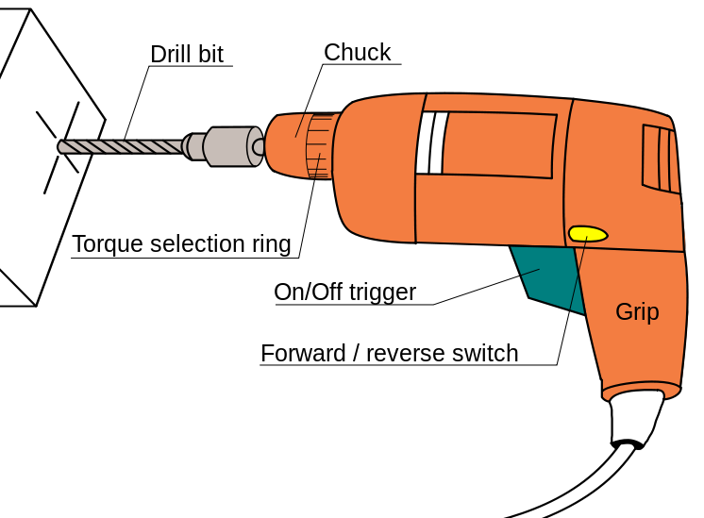



c) Click on masonry drill bit to insert it in drill machine.
Types of drill bits
Chuck Key

Slide 19



d) Click on wall to Mark the drilling spot on wall.
e) Hold the drill machine properly and drill the hole on wall. The depth of hole should be ½ inch more than the length of wall plug.

Slide 20







f) Tap the wall plug in wall using hammer.
Wall Plug
Hammer
Wall Plug Inserted into Wall
g) Click on add button to bring the cable.

Slide 21










h) Put the cable clip on the cable.
Cable clip
i) Align the nail of clip over royal plug and tap the nail into the plug using hammer. Cable is now clipped to the wall.

Slide 22

j) attach the cable on wall without compromising bend radius of fiber.

