Slide 1
Topic extraction over skills data
and online profiles
CBS, June 24th 2019
Martin Garriga
Bert-Jan Butijn
Pam Pjinenborg
Itzel Belderbos

Slide 2


Outline
Business understanding
Data understanding, preparation, preprocessing
Topic Modeling
Visualizations
Discussion

Slide 3
1. Business understanding

Slide 4
Business understanding
Context
Online recruitment
Semantic matching employee – employer
Goals
Understand information about employees
Improve matching process
Explorative data profiling
Ultimately extract concepts for ontology enrichment/matching

Slide 5
Business success criteria
Insights in employees’ competences and skills
Identify the information available/unavailable and ‘hidden’ relationships in data.

Slide 6
2. Data understanding, preparation, preprocessing

Slide 7
Data understanding – Skills Dataset
 | name | related_1 | related_2 | related_3 | related_4 | related_5 | related_6 | related_7 | related_8 | related_9 | related_10
26274 | termite | pest | bed bugs | pest control | rodents | fumigation | bird control | mosquito control | integrated pest management | pesticide application | insect
21878 | reflection | serialization | lambda expressions | garbage collection | log4net | net remoting | linq | generics | enterprise library | ioc | gdi
16542 | microsoft windows server | microsoft exchange server | microsoft servers | microsoft active directory | microsoft system center | microsoft exchange | microsoft office 365 | active directory | microsoft hyperv | microsoft sql server | microsoft windows 7
25195 | strategic planning | strategic planning facilitation | team building | budgets | negotiation | business strategy | new business development | business planning | executive management | marketing strategy | management
23785 | sharepoint administration | sharepoint server | sharepoint designer | sharepoint development | windows sharepoint services | infopath forms | sharepoint | sharepoint online | sharepoint 2013 | nintex | microsoft project server
JSON file with 28,934 instances
Related skills that frequently appear together
Grouped per row
Several languages
Source: https://data.world/peopledatalabs/

Slide 8
Data understanding – LinkedIn Dataset
CSV File with ~5000 LinkedIn profiles
Profiles divided in themes:
accomplishments
experiences
interests
personal_info
skills
Mainly Dutch profiles
Source: Linkedin Crawler

Slide 9
Data understanding
Data profiling goals (LinkedIn)
Gain insights in the content and relations among/within different themes
Assess suitability of DataCleaner open source tool
Data mining goals (Skills dataset)
Gaining insights into the content and the relations of the words in the unstructured skills dataset
Translated into a topic modeling problem
Clustering words into topics / topics into instances

Slide 10
Data understanding
Research questions
To what extent can latent topics be extracted from unstructured human resources data?
To what extent do these topics contribute to a simplification and better understanding of unstructured textual human resources data?
To what extent the data is complete and meaningful?
Are there hidden relationships among different registries (rows) or attributes (columns)?

Slide 11
Success criteria
Data Mining
Topic coherence
Visualizations
Data Profiling
We don’t know… is Exploratory!

Slide 12
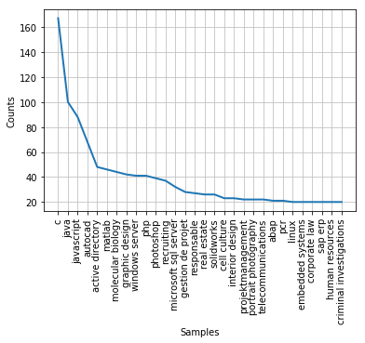
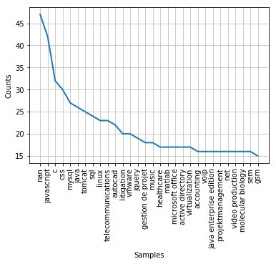
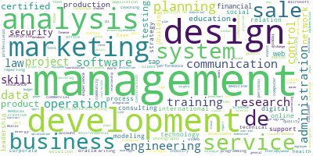
Data exploration/profiling – Skills dataset
Word Cloud
Word Frequency (sample columns)

Slide 13
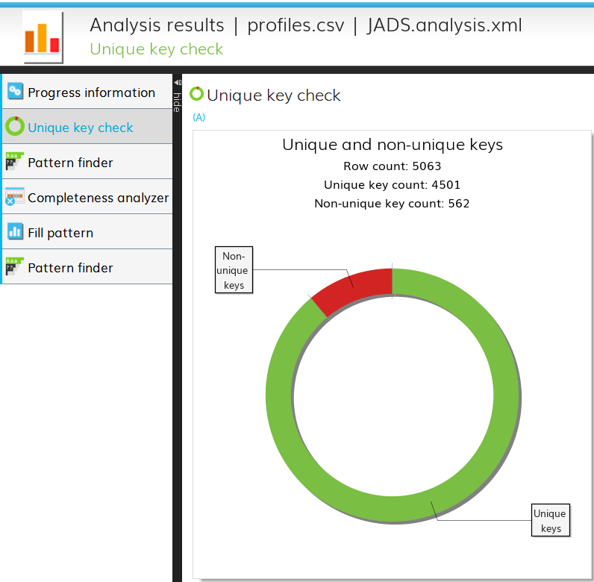
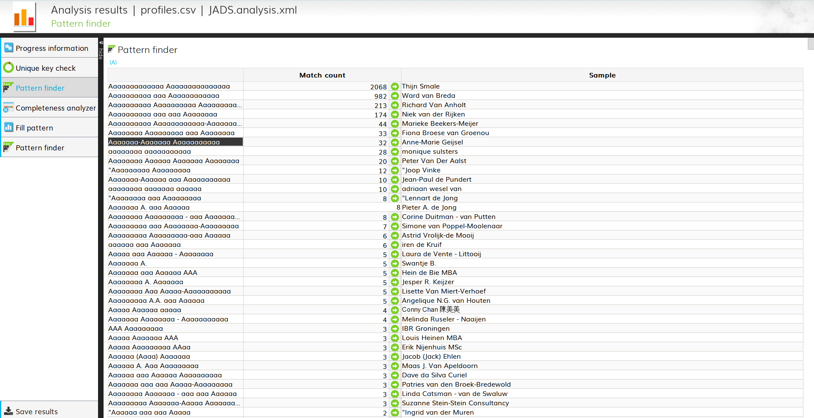
Data exploration/profiling – LinkedIn
Unique values for attributes
Patterns Finding

Slide 14
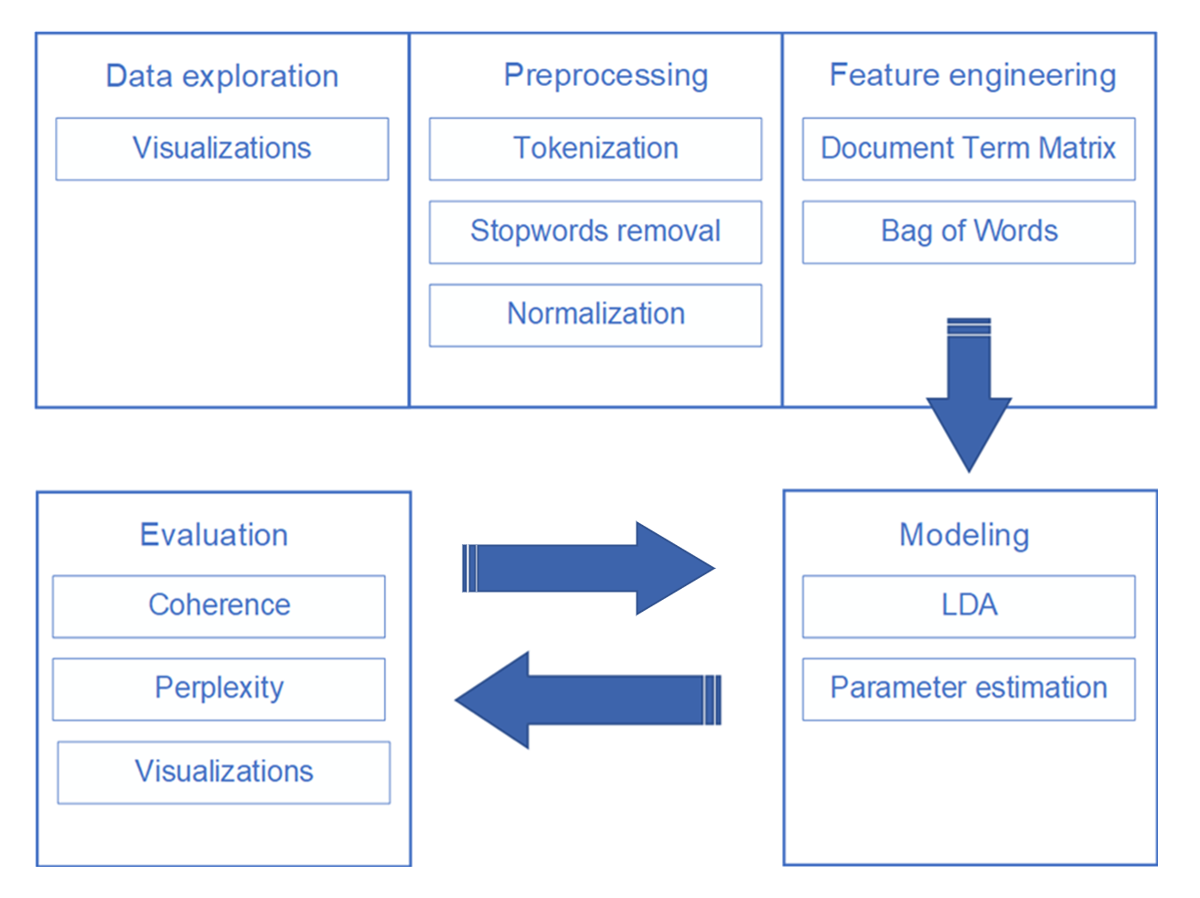
Analysis Pipeline

Slide 15
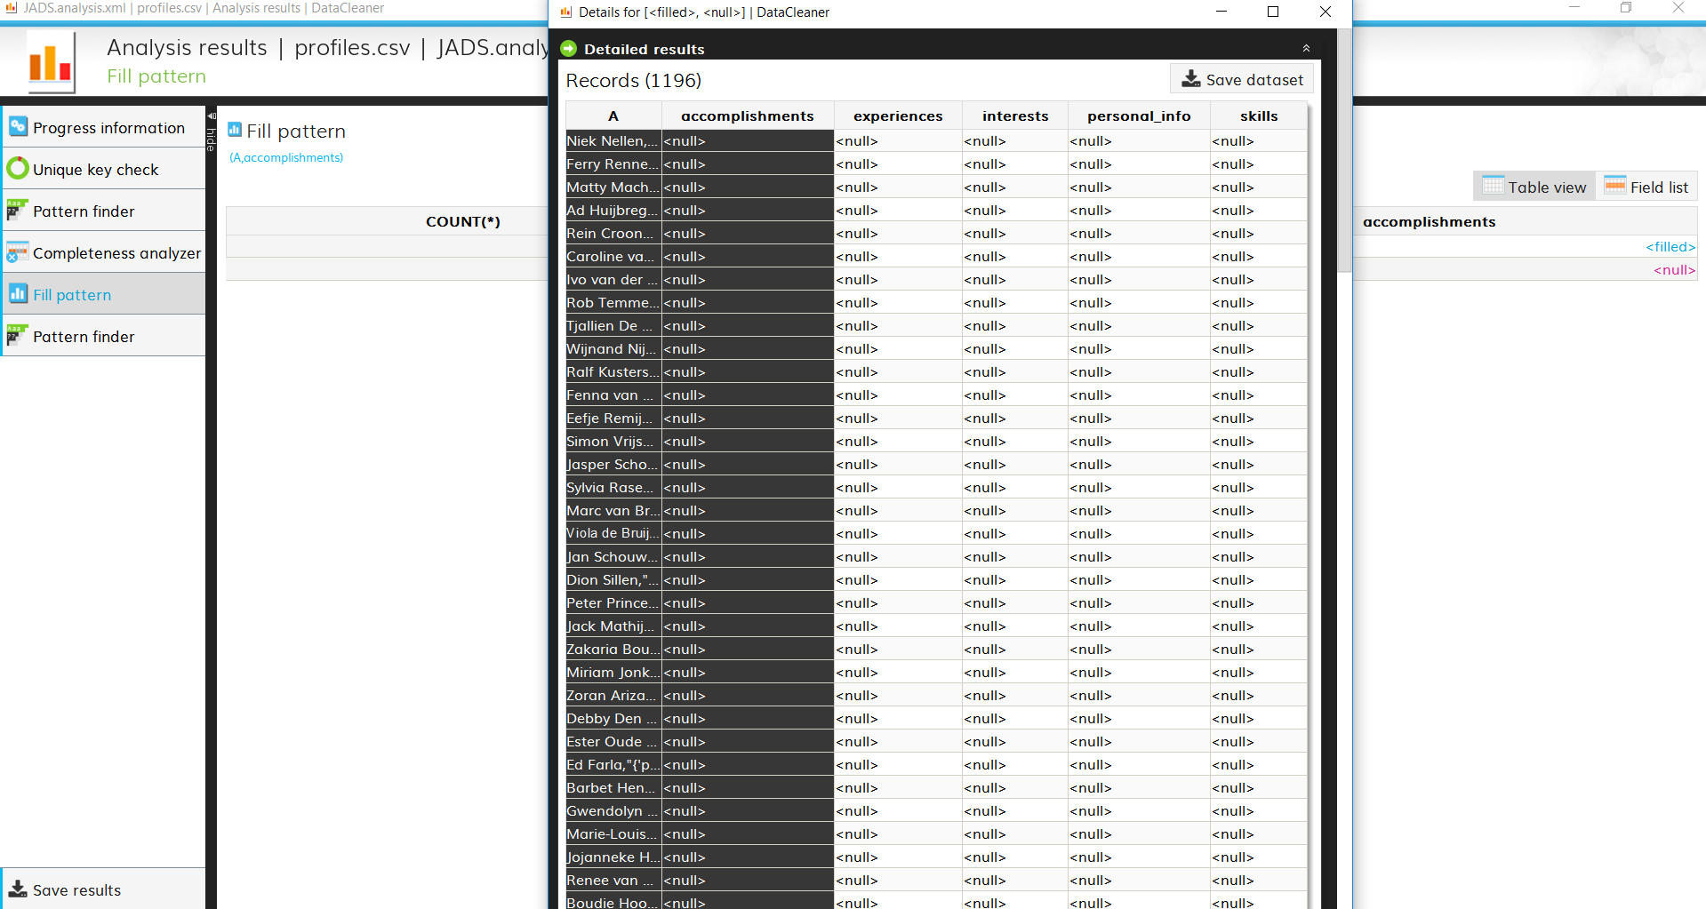
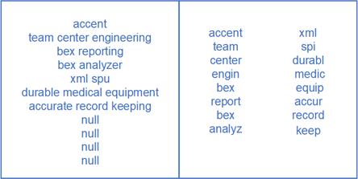
Data preprocessing
Removal operations
Null values
Tokenization
Stop words removal
Word normalization
LinkedIn (DataCleaner)
Skills dataset (Python preprocessing)

Slide 16
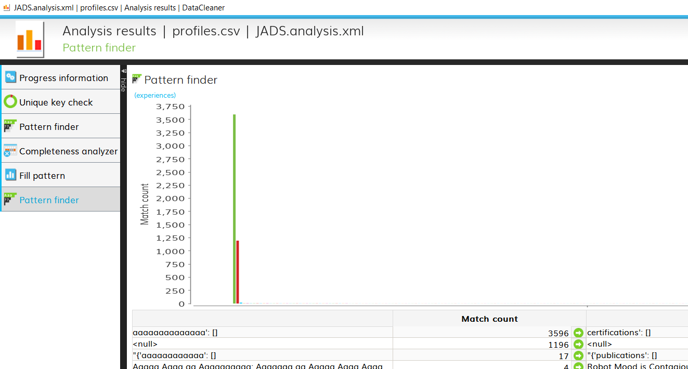
Data preprocessing
Pattern finding
1196/5000 profiles do not list “accomplishments”
3596/5000 do not list “certifications”

Slide 17
3. Topic modeling

Slide 18
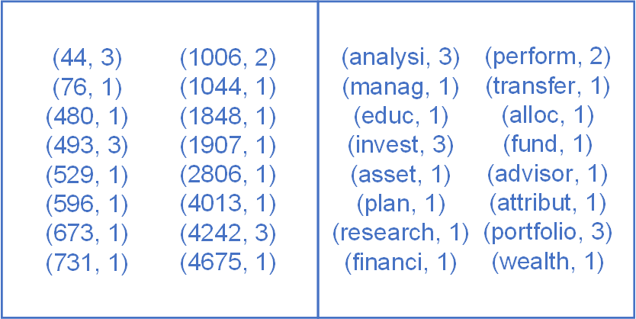
Frequency vectorization
Dictionary
Corpus
Bag of Words

Slide 19
Latent Dirichlet Allocation
Number of topics
Distribution of topics per instance
Distribution of words in the topics

Slide 20
Coherence score and model perplexity
Model perplexity | -7.915
Topic coherence score | 0.445
how well a model predicts a certain sample.
median of the pairwise word-similarity scores

Slide 21
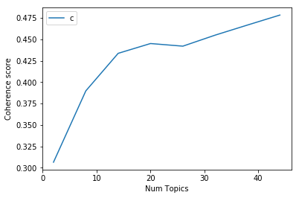
Model training with parameter estimation
Number of topics | Coherence Value
2 | 0.3066
8 | 0.3898
14 | 0.4336
20 | 0.4450
26 | 0.4419
32 | 0.4548
38 | 0.4666
44 | 0.4782

Slide 22
4. Visualizations

Slide 23
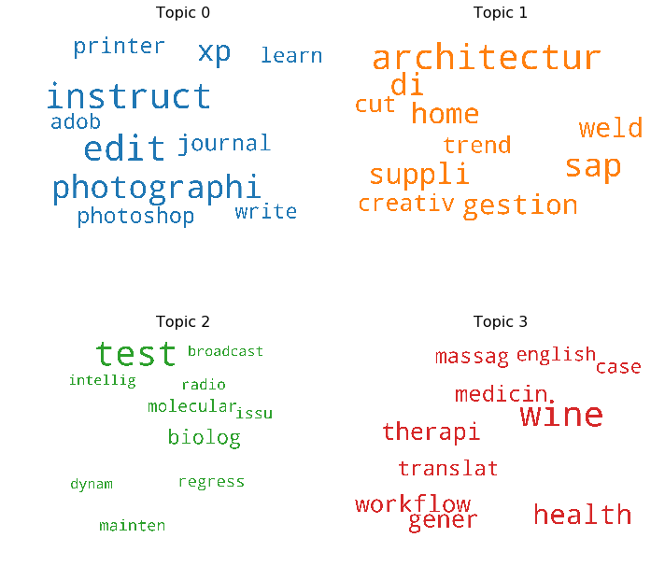
Word clouds

Slide 24
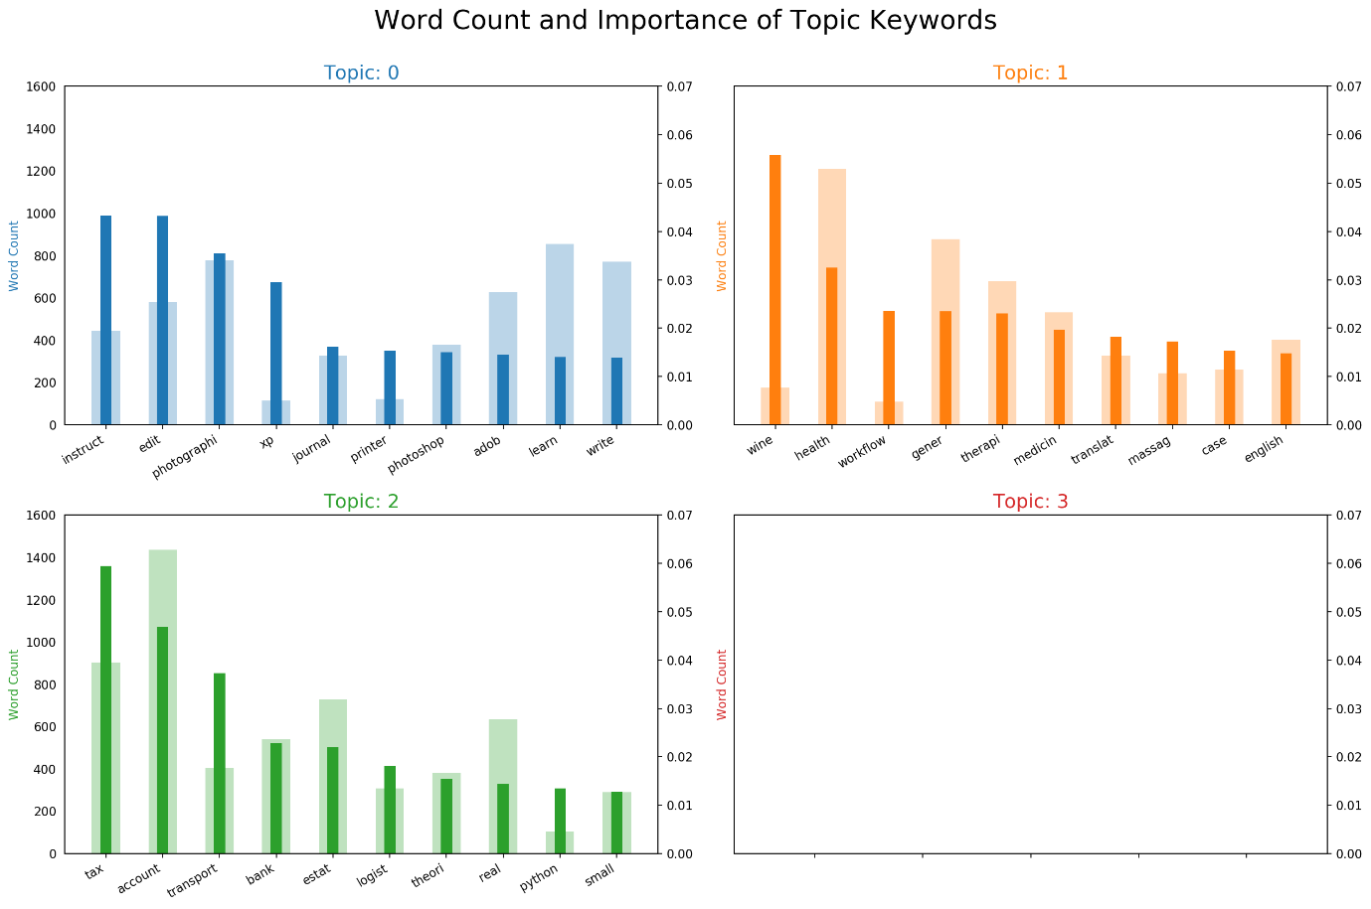
Keyword frequency and weights

Slide 25
Distribution of topics across instances
Topic number | Topic keywords | Number of rows | Percentage of rows
0.0 | instruct, edit, photographi, xp, journal, printer, photoshop, adob, learn, write | 1020 | 0.0353
1.0 | c, wireless, java, technolog, consult, intern, anim, insur, environment, treatment | 1465 | 0.0506
2.0 | tax, account, transport, bank, estat, logist, theori, real, python, small | 1286 | 0.0444
3.0 | youth, oper, onlin, safeti, search, yacht, util, commerci, mine, chain | 1087 | 0.0376
4.0 | work, well, skill, linux, custom, learn, power, commun, written, solari | 1646 | 0.0569
5.0 | plan, law, travel, solut, yoga, traffic, protect, analysi, tour, tree | 1088 | 0.0376
6.0 | educ, research, vendor, organ, event, structur, wealth, plan, supervis, direct | 1162 | 0.0402
7.0 | water, javascript, game, css, workplac, php, mysql, jqueri, webspher, studi | 1793 | 0.0620
8.0 | develop, commun, social, workshop, manag, relat, public, person, volunt, present | 1483 | 0.0513
9.0 | video, secur, trade, product, energi, scienc, valu, map, manufactur, librari | 1718 | 0.0594
10.0 | wine, health, workflow, gener, therapi, medicin, translat, massag, case, english | 2728 | 0.0943
11.0 | train, de, sale, music, content, industri, inform, deliveri, fit, employ | 1803 | 0.0623
12.0 | design, women, urban, graphic, wed, pro, tool, wordpress, live, sustain | 1212 | 0.0419
13.0 | window, server, vmware, microsoft, administr, activ, network, softwar, user, sql | 1754 | 0.0606
14.0 | architectur, sap, di, home, suppli, gestion, weld, cut, creativ, trend | 1246 | 0.0431
15.0 | manag, system, servic, process, control, framework, report, project, integr, busi | 1991 | 0.0688
16.0 | test, biolog, molecular, regress, mainten, issu, radio, dynam, broadcast, intellig | 1198 | 0.0414
17.0 | market, strategi, visual, media, studio, digit, art, financi, busi, film | 1096 | 0.0379
18.0 | engin, analysi, technic, model, coach, team, wind, build, xml, wildlif | 1136 | 0.0393
19.0 | web, websit, applic, virtual, analyt, mobil, optim, googl, qualiti, restor | 1022 | 0.0353

Slide 26
Dominant topic per instance (row)
Row number | Most important topic | Topic percentage contribution | Keywords | Original row text
18814 | 17 | 0.8048 | market, strategi, visual, media, studio, digit, art, finance, busi, film | painting, acrylic, figurative, mixed media, figurative art, watercolor, abstraction, murals, studio art, fine art, oil painting
12286 | 1 | 0.5495 | wine, health, workflow, gener, therapi, medicin, translat, massag, case, english | hormone balancing, digestive disorders, hormones, bioidentical hormone replacement, menopause, naturepathy, detoxification, functional medicine, homeopathy, chronic fatigue, chronic illness
23048 | 14 | 0.5025 | architectur, sap, di, home, suppli, gestion, weld, cut, creative, trend | sap projects, sap project management, sap erp, sap implementation, sap, sap solution architecture, sap functional consultant, sap rand3, sap production planning, sap application development, sap mm

Slide 27
Most important instance per topic
Topic number | Topic importance | Topic contribution | Keywords | Original row text
1.0 | 1 | 0.7985 | c, wireless, java, technolog, consult, intern, anim, insur, environment, treatment | [homeown, renter, umbrella, insur, properti, casualti, insur, commerci, insur, insur, flood, ins...
15.0 | 2 | 0.7839 | manag, system, servic, process, control, framework, report, project, integr, busi | [kung, fu, tai, chi, wing, chun, tai, chi, chuan, martial, art, jiujitsu, qigong, kickbox, karat...
13.0 | 3 | 0.8584 | window, server, vmware, microsoft, administr, activ, network, softwar, user, sql | [certifi, profession, network, certifi, comptia, network, certifi, n, certifi, microsoft, certif...
8.0 | 4 | 0.7465 | develop, commun, social, workshop, manag, relat, public, person, volunt, present | [cultur, diplomaci, public, diplomaci, intern, relat, diplomaci, cultur, polici, foreign, polici...
7.0 | 5 | 0.7989 | water, javascript, game, css, workplac, php, mysql, jqueri, webspher, studi | [flexion, distract, chiropract, diversifi, techniqu, extrem, adjust, neck, pain, sport, chiropra...

Slide 28
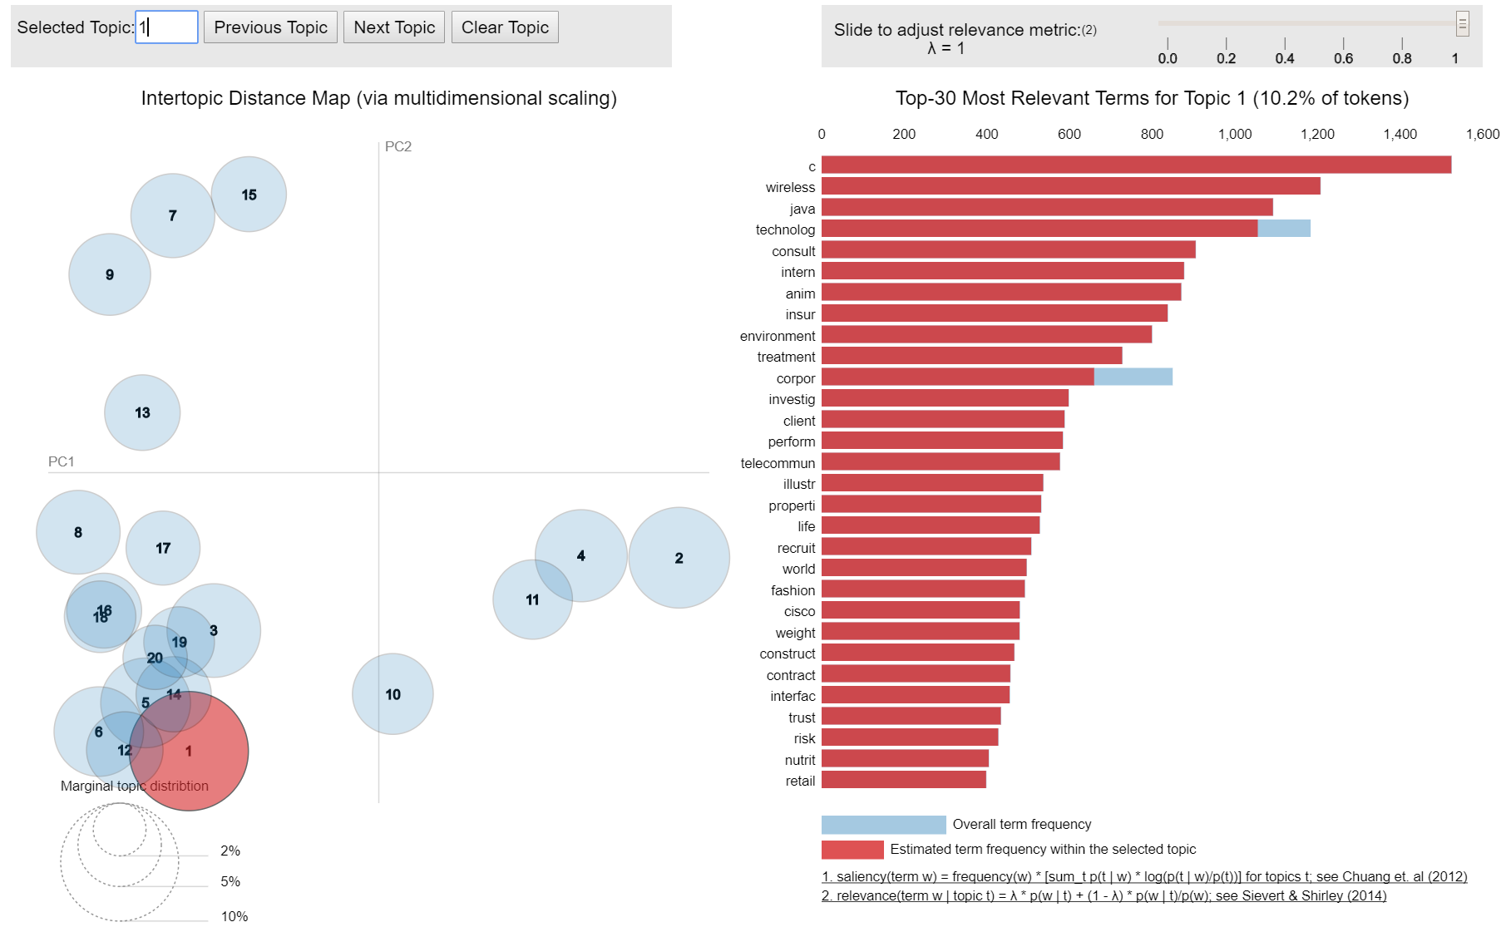
PyLDAvis

Slide 29
Topic interpretation
0 | Creativity / media | 5 | Leisure time | 10 | Healthcare | 15 | Management / service
1 | Programming technology | 6 | Education | 11 | Sales | 16 | Biology research
2 | Industry / finance | 7 | Computer tools | 12 | Design tools | 17 | Marketing
3 | Internet | 8 | Personal development | 13 | Microsoft Windows | 18 | Engineering
4 | Skills / work | 9 | Science / trade | 14 | Companies | 19 | Web analytics

Slide 30
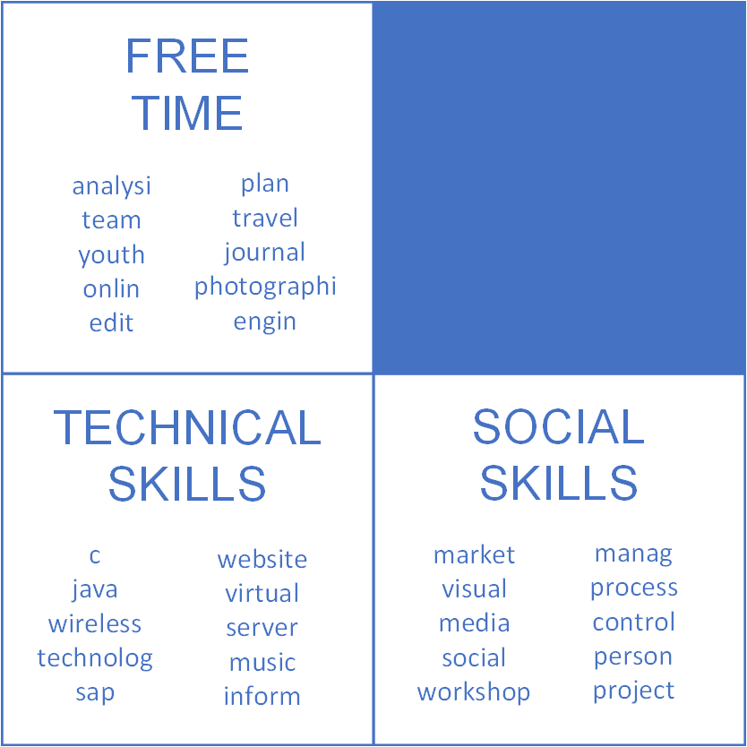

Slide 31
5. Discussion

Slide 32
Discussion
From Skills dataset + Topic Modeling
Some weird words in the topics
However, also logical words in topics
Three “categories”: free time/creativity, technical skills, social skills
The most important topics are (in subsequent order) topic 1, 15, 13, 8 and 7. They concern programming technology, management/service, Microsoft Windows, personal development and computer tools.
From LinkedIn dataset + DataCleaner tool
Most profiles are incomplete, there are some repetitions
Further correlation analysis is needed
DataCleaner seems useful and promising, even for more complex tasks!

Slide 33
Conclusion
Research questions
1. To what extent can latent topics be extracted from unstructured human resources data?
20 topics can be extracted, which are separable intro three categories.
2. To what extent are these extracted topics meaningful and significant?
The coherence value is somewhat low and some topics show strange words, but most topics show coherence according to logic.
3. To what extent do these topics contribute to a simplification and better understanding of unstructured textual human resources data?
The topic extraction and the visualizations help with understanding the content of the dataset and to categorize possible employees.

Slide 34
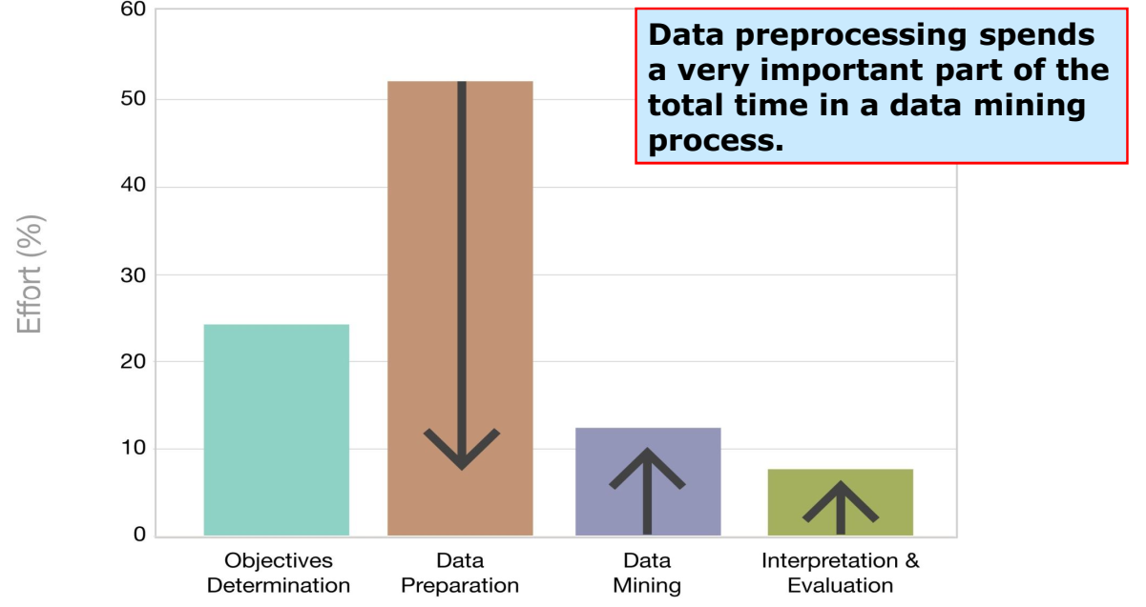

Challenges
?
?
S. García, J. Luengo, F. Herrera. Data Preprocessing in Data Mining Springer, 2015. http://sci2s.ugr.es/books/data-preprocessing

Slide 35
TL;DR
Topic Modeling (LDA) over skills dataset (and this presentation):
https://github.com/mgarriga/skills-topic-modeling
Skills dataset source:
https://data.world/peopledatalabs
Data Cleaner tool (1° in Open Source tools):
https://datacleaner.github.io/

Slide 36
Thank you!

