Slide 1
MakeOverMonday1
File created on: 15/08/2019 22:58:25 GMT-03:00

Slide 2
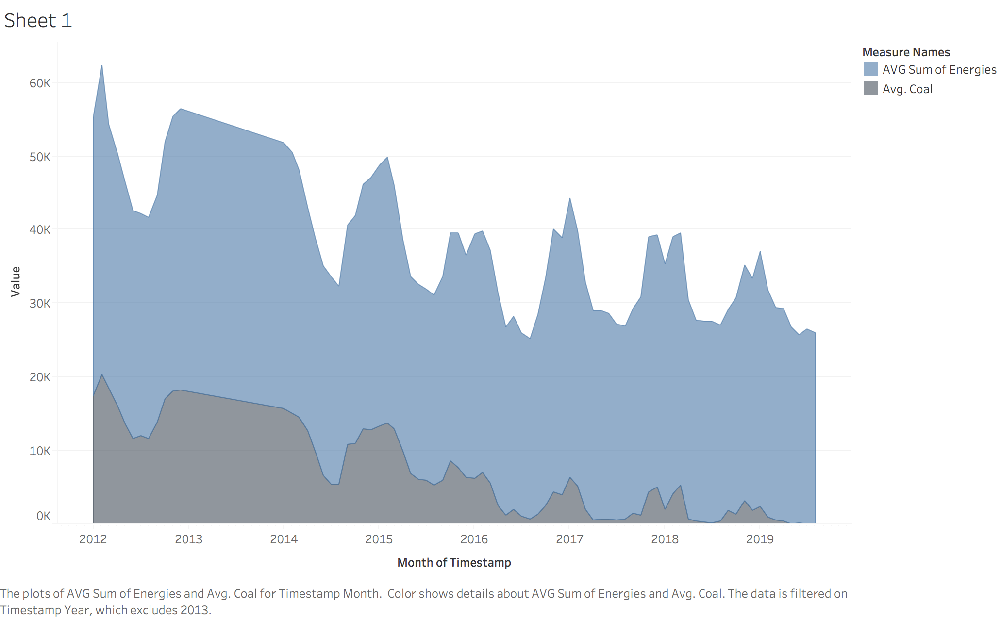

Slide 3
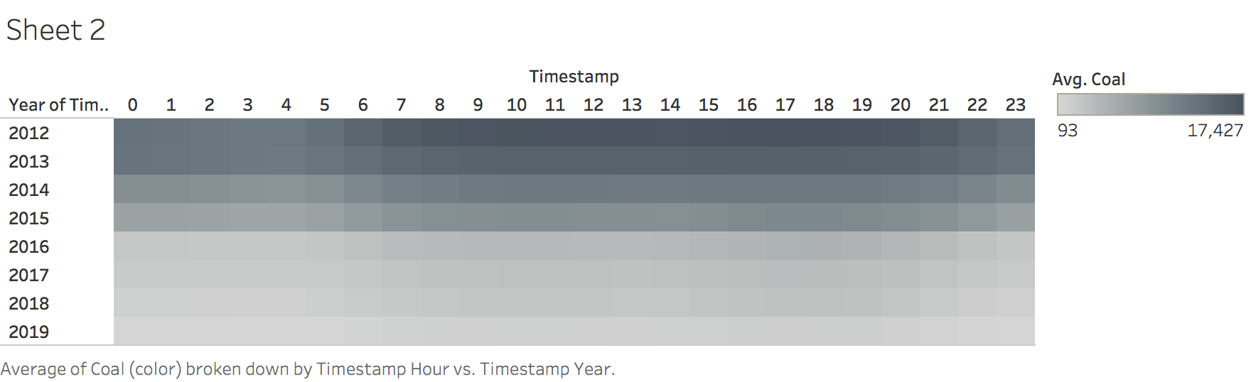

Slide 4
