Slide 1

The Rise of Superstars in the NHL
Michael Garrity
https://en.wikipedia.org/wiki/National_Hockey_League#/media/File:05_NHL_Shield.svg

Slide 2
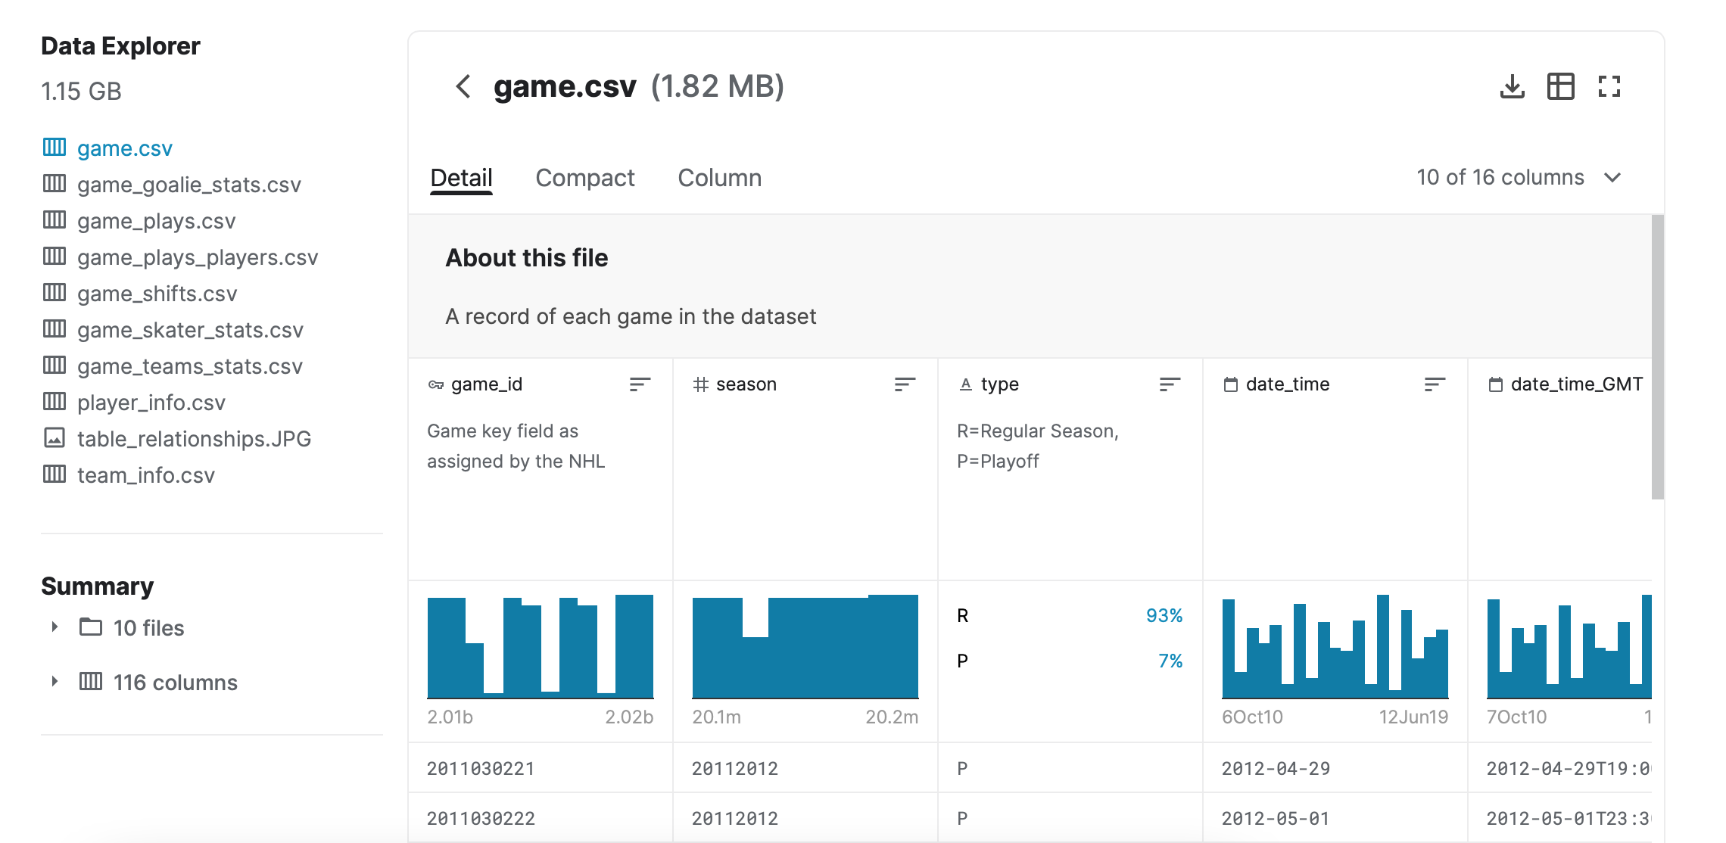
Introduction
Data Set is from Kaggle
2011-2019 NHL Season Play by Play Data
6 data sets used from Kaggle
Link: https://www.kaggle.com/martinellis/nhl-game-data

Slide 3
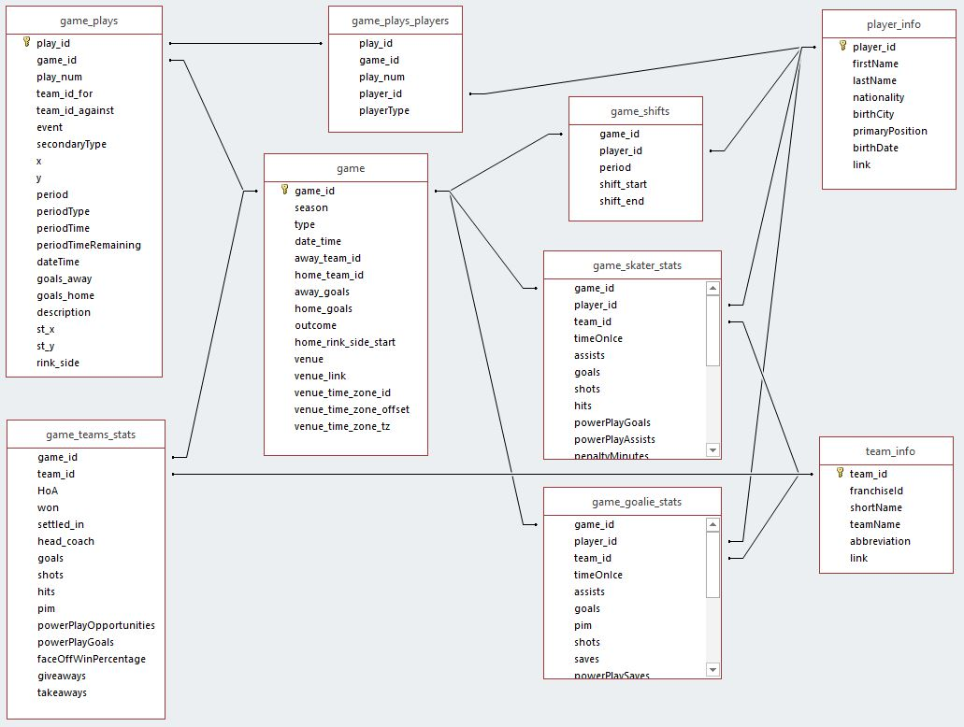
Overview of the Data

Slide 4
Questions
Question 1: How has the style of play changed recently by year?
Question 2: Who are the best NHL players statistically?
Question 3: Who are the best NHL players per dollar spent?
Question 4: Do the best goal scorers all score from the same place?

Slide 5
Hockey Terminology to Know
Assist – Both person who passes to goal scorer and the person that passes before
Points – Goals + Assists for a player
Penalty Minutes – Total minutes for that specific player
Hits – Hit by specific player on another player
Per 60 – Any statistic adjusted so it is by 60 minutes played by that player
Per Game – Same as above but by game

Slide 6
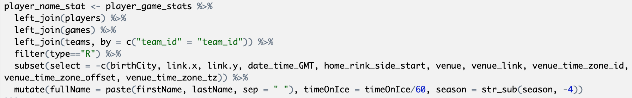
Overall Data Processing
Made a new dataframe that combined most of the tables I needed
Removed columns that I would not use
Mutated columns to create full name of player, time on ice in minutes, and the season as a 4 digit number

Slide 7
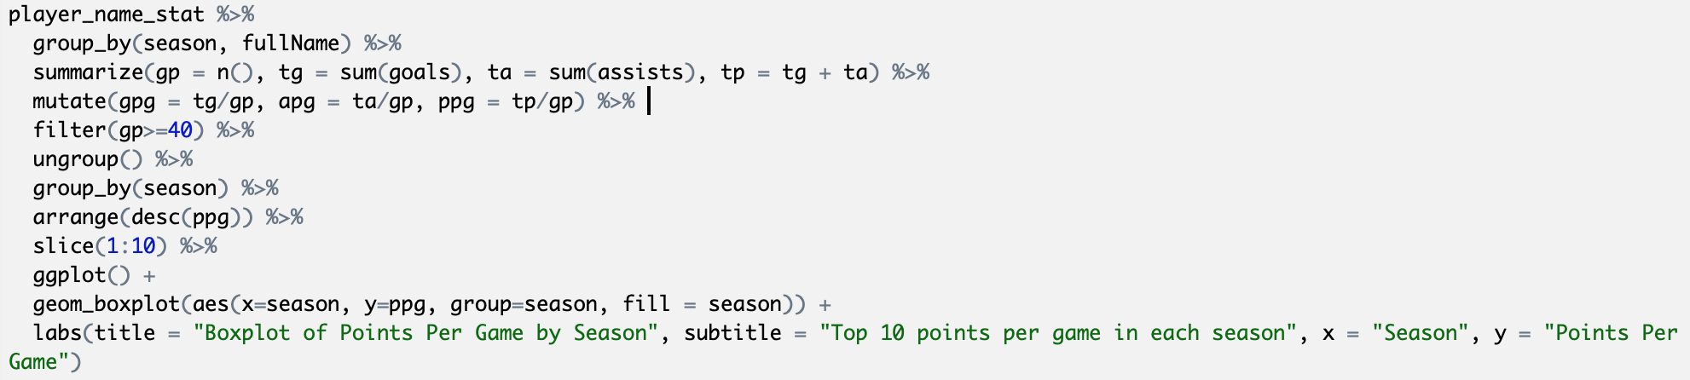
Yearly Changes – Data Processing
Created games played, total goals, assists, and points
Added per game categories for those statistics
Arrange by points per game
Plot top 10 by year

Slide 8
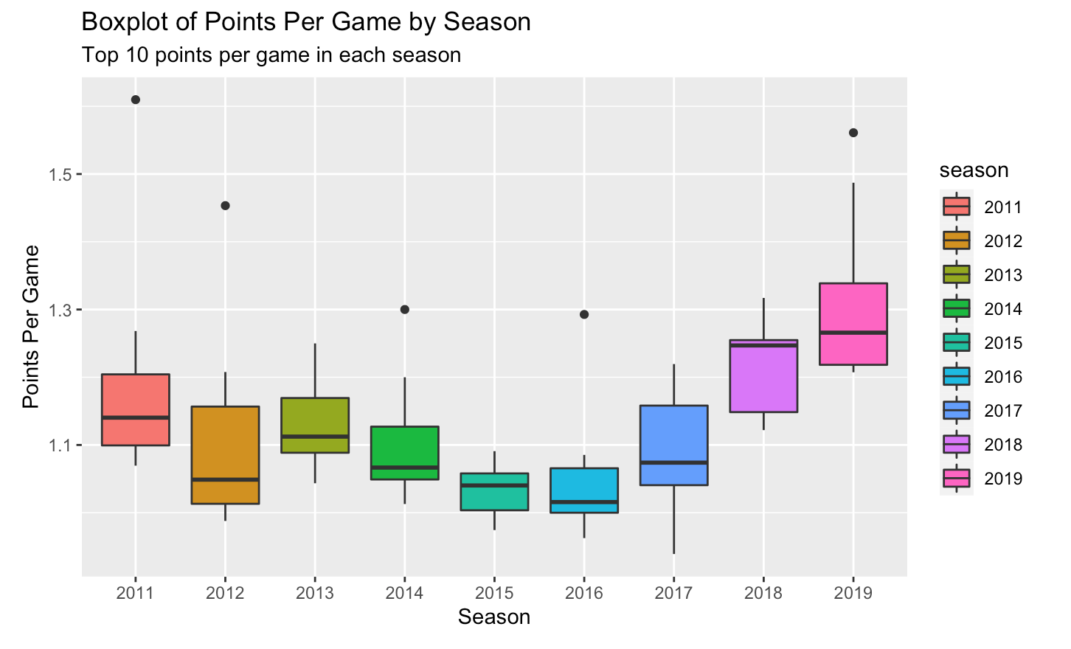
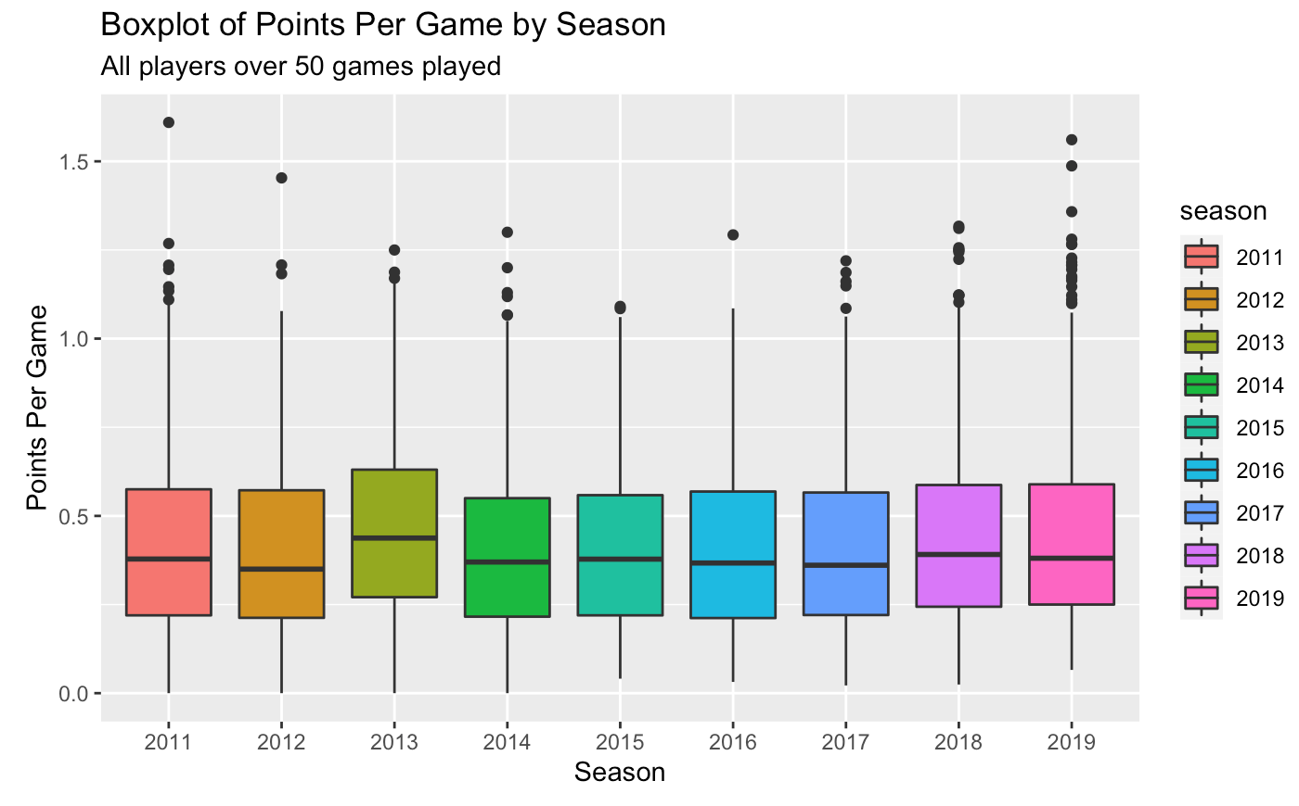
Yearly Changes – Results

Slide 9
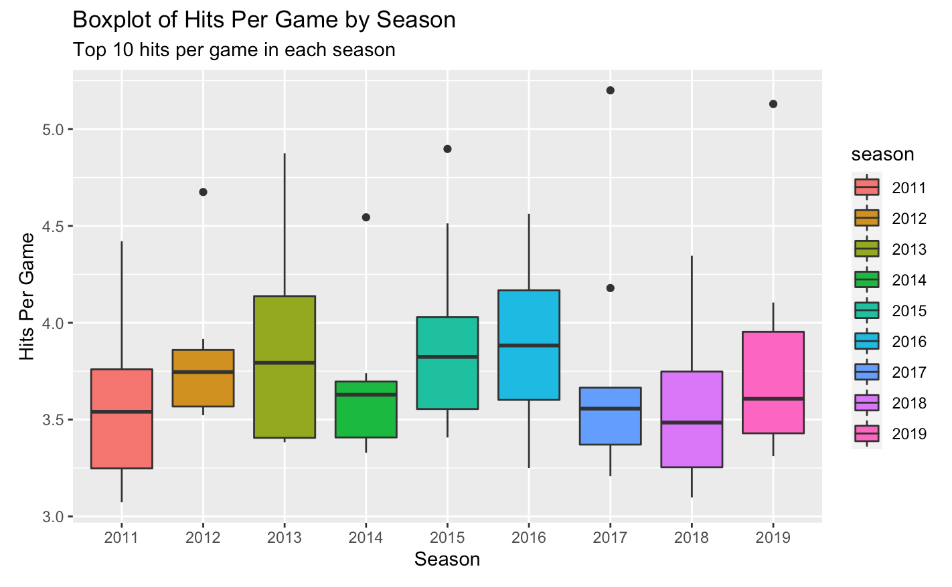
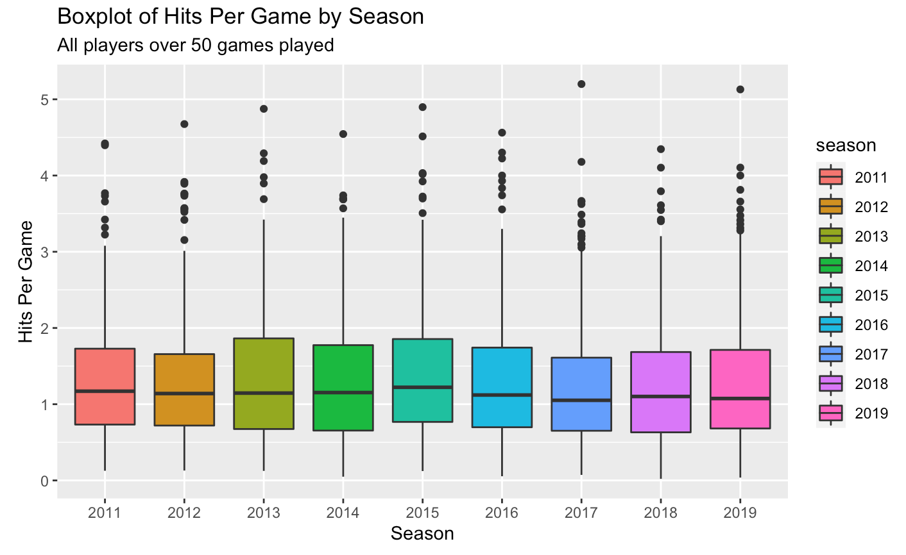
Yearly Changes –Results Cont.

Slide 10
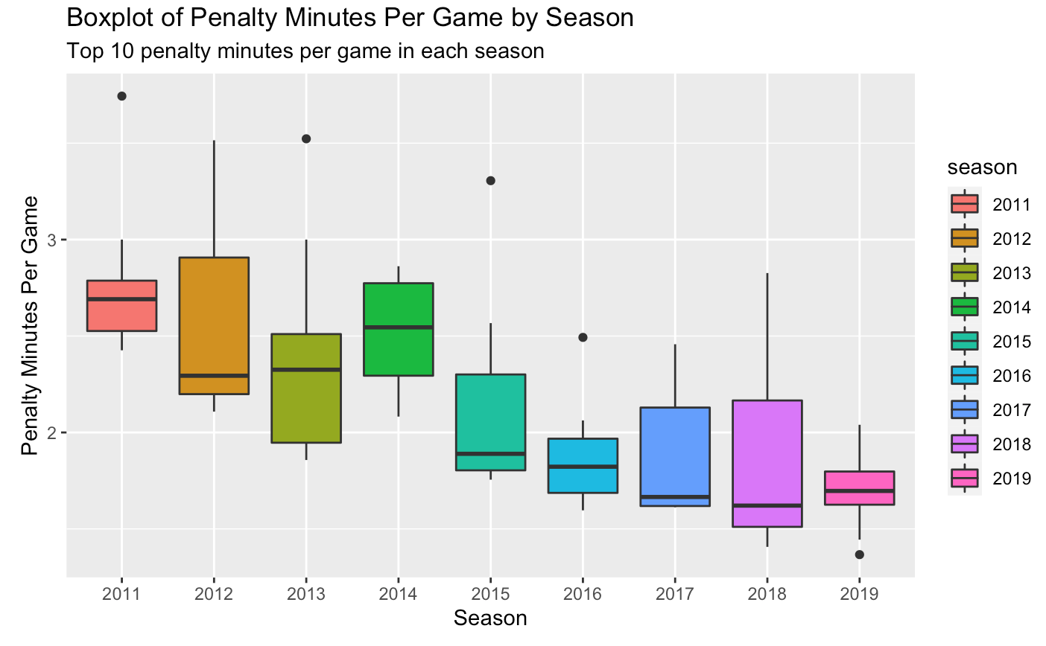
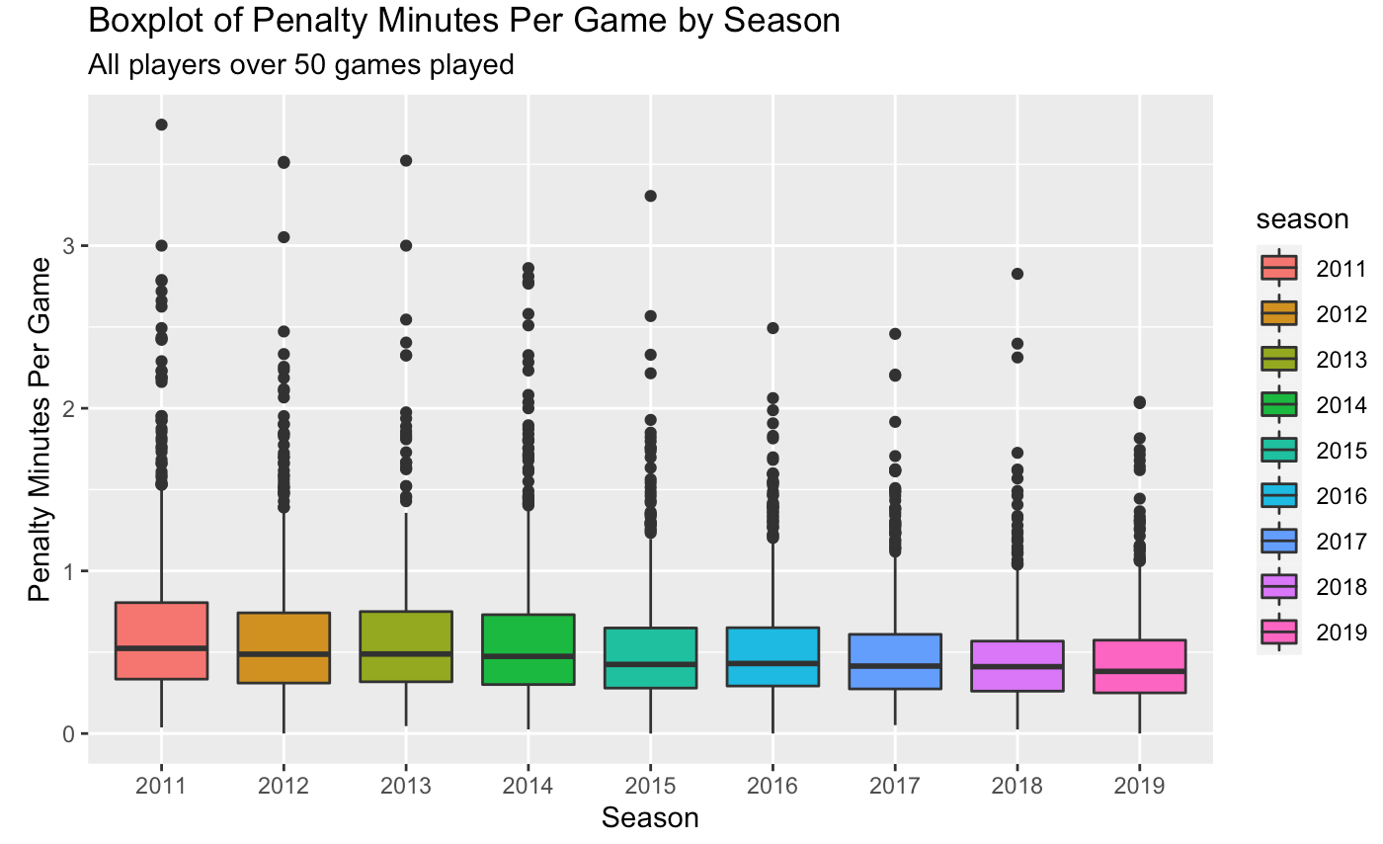
Yearly Changes –Results Cont.

Slide 11
Yearly Changes – Findings Summarized
Top players points per game increased
Top penalty minute getters have decreased minutes
All 3 stay constant league wide besides penalty minutes which slightly decreases

Slide 12
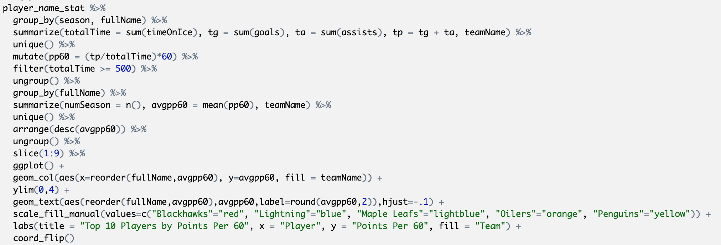
Best Players Statistically – Data Processing
Get Points per 60
Find average points per 60 over the number of years played
Plot the top players, with their team as fill aesthetic

Slide 13
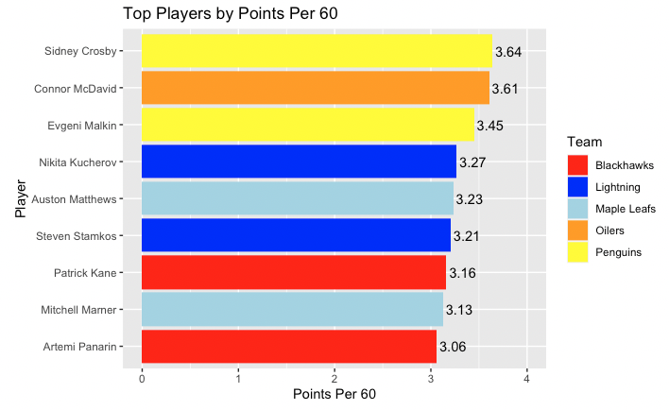
Best Players Statistically - Results

Slide 14
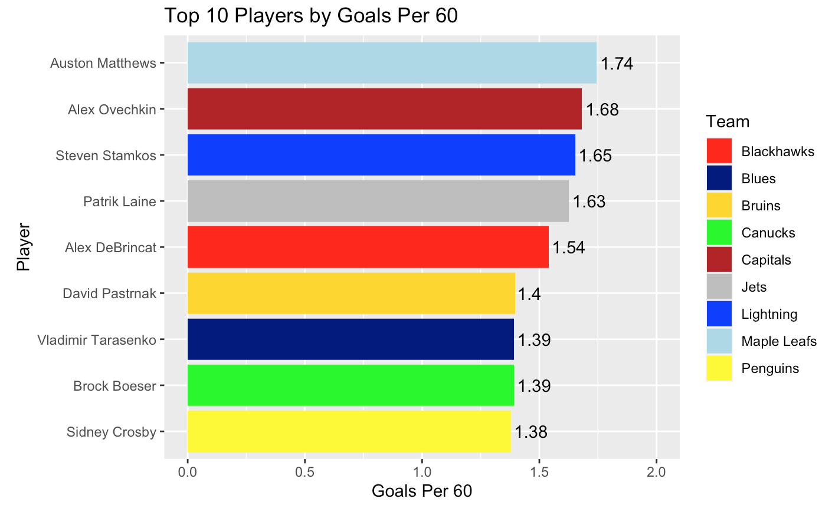
Best Players Statistically - Results

Slide 15
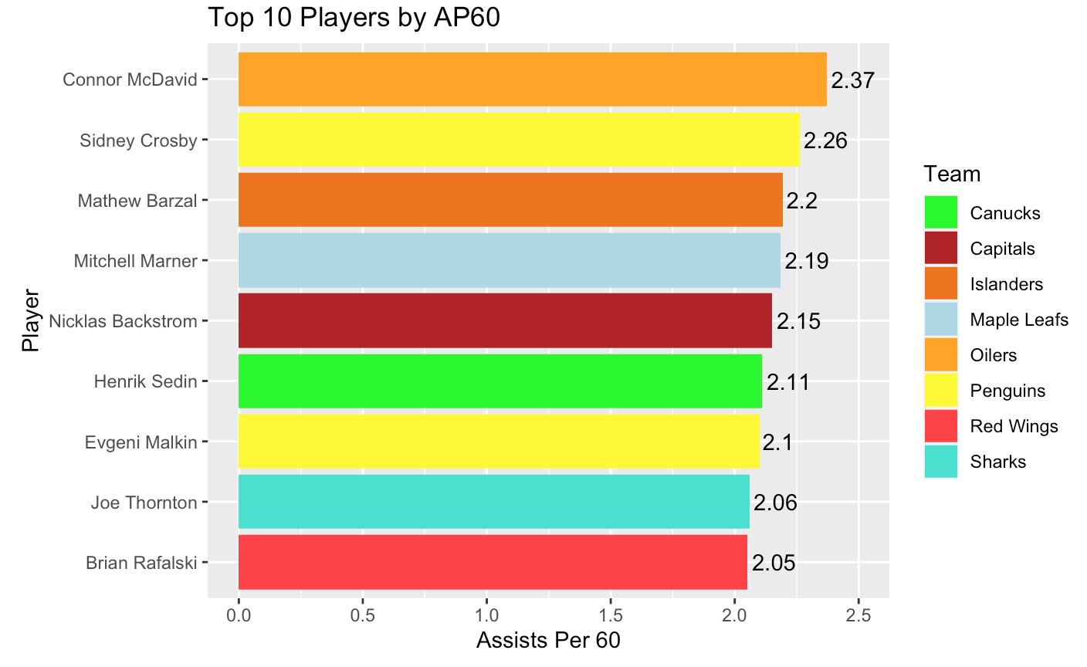
Best Players Statistically - Results

Slide 16
Best Players Statistically – Findings Summarized
For Points Per 60, all but one player has a teammate also on the list
No overlap of teams for Goals Per 60
Assists Per 60 do not have clear correlation

Slide 17
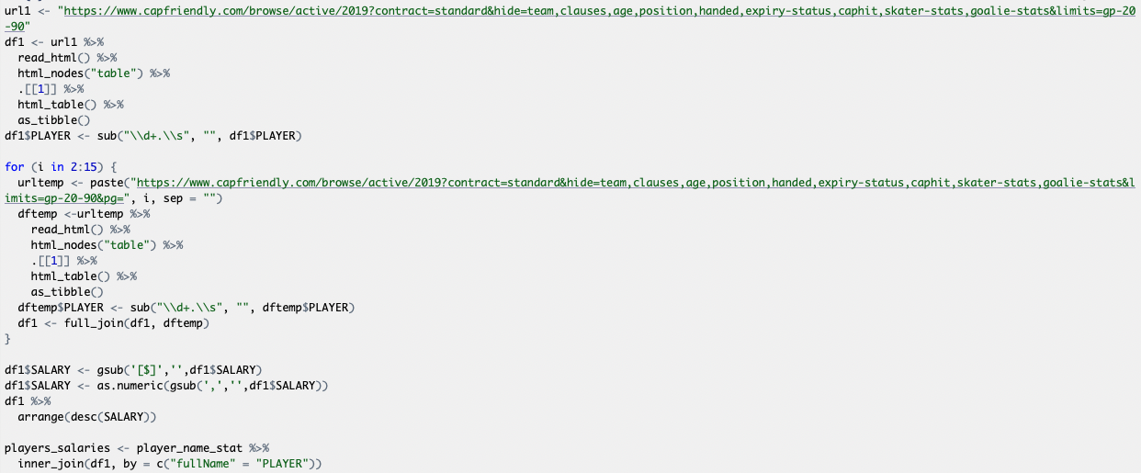
Best Players by Value – Data Processing
Scraped data for 2019 season from CapFriendly
Had to use for loop to join 15 URLs into 1 dataframe

Slide 18
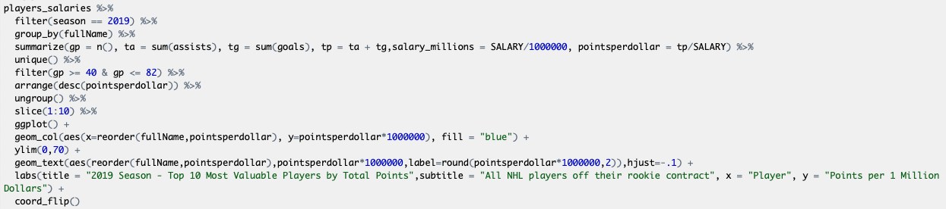
Best Players by Value – Data Processing Cont.
Calculate total points and salary in millions
Find points per dollar

Slide 19
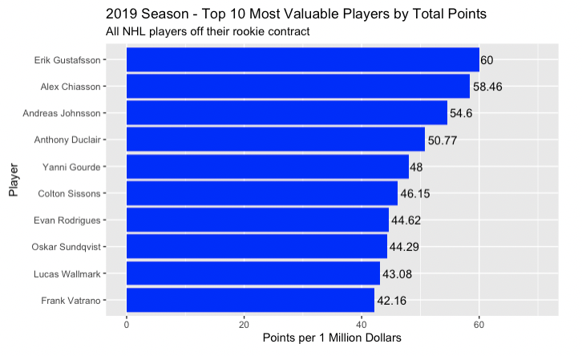
Best Players by Value - Results

Slide 20
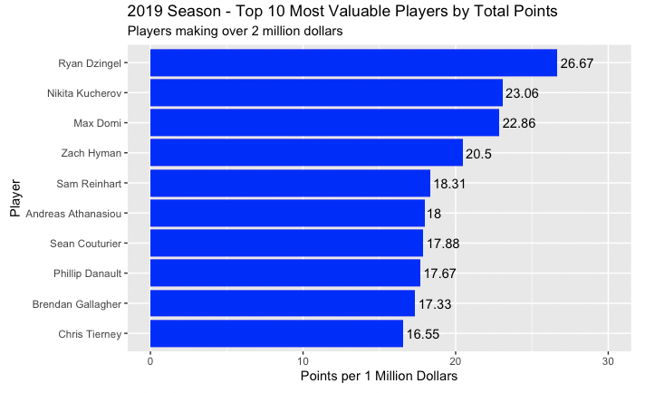
Best Players by Value – Results Cont.

Slide 21
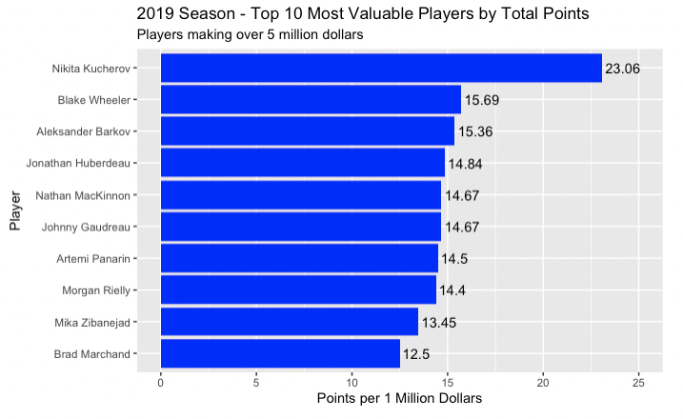
Best Players by Value – Results Cont.

Slide 22
Best Players by Value – Findings Summarized
Most players in the first chart are one time wonders, either need to be paid more or won’t produce at that same rate again
Second chart could be a similar situation with the possibility of a great contract if the players continue performing at that high level, and their contract doesn’t end soon
Final chart shows superstars that are worth the money

Slide 23
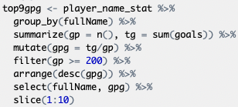
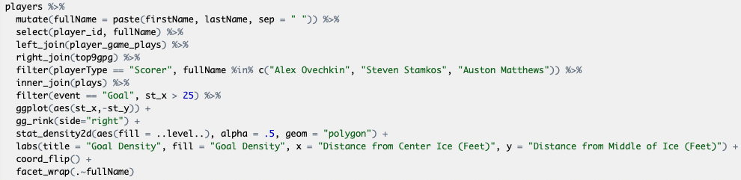
Best Goal Scorers Shot Locations– Data Processing
Get top 9 goal scorers who have played more than 200 games
Select 3 players at a time
Use ggrink() add on to ggplot
Plot density chart of only goals scored
ggrink() code from: https://github.com/mtthwastn

Slide 24
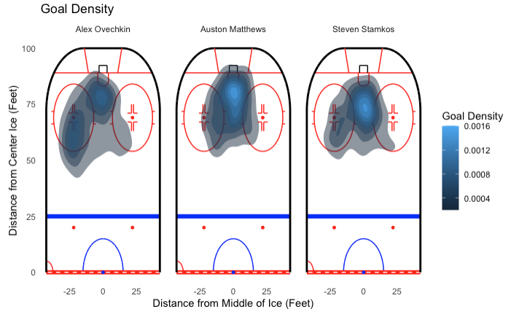
Best Goal Scorers Shot Locations – Results (1-3)

Slide 25
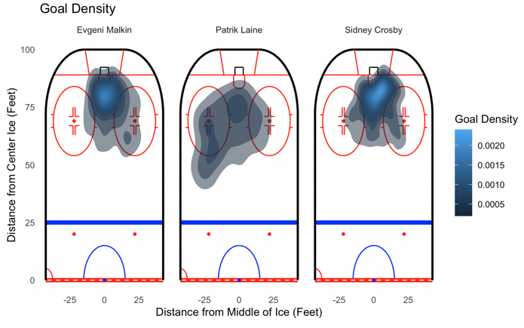
Best Goal Scorers Shot Locations – Results (4-6)

Slide 26
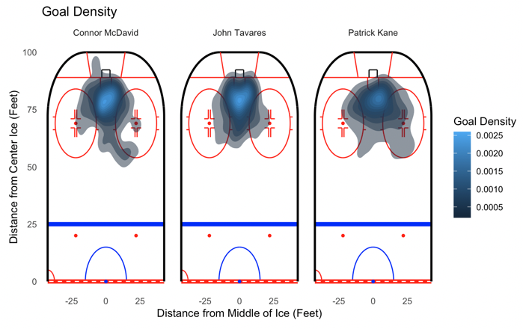
Best Goal Scorers Shot Locations – Results (7-9)

Slide 27
Best Goal Scorers Shot Locations– Findings Summarized
Best Right handed goal scorers like to score from the left side
Left handed goal scorers score more from right in front of the net

Slide 28
Technical Challenges and Surprises
Reading in the salary from the URL
Learning to use Density Plot
Surprised that right handed players seem to score from further away more often
Points per game don’t seem to be increasing as much as I had thought

Slide 29
Extending the Project
Look more into the shot densities (type of shot, shooting on the powerplay vs even strength, by team)
Add in contract length to see what teams might have a very good player at a cheap price and for a long time

