Slide 1
Workday Resilience AI
Privacy-first, offline-ready, context-aware prevention for desk workers
Detect early risk patterns: MSK strain • eye strain • burnout • dehydration
Generate safe, non-diagnostic recommendations + reminders
Hybrid AI: works offline (Ollama) with optional online models
Measurable impact: weekly metrics + progress tracking
AI for Good Hackathon 2026 • Team submission

Slide 2
1) Problem
Sedentary work silently drives a health decline cycle
Common workday pattern:
neck/back pain → fatigue → reduced focus → stress → worse sleep → burnout
Musculoskeletal strain & repetitive injury (neck/shoulders/back)
Digital eye strain (dry eyes, headache, blurred vision)
Stress overload → burnout → reduced performance & quality of life
Poor hydration + poor sleep recovery amplify all other risks
Why existing tools fall short:
Many apps track data but don't translate it into actionable guidance
Cloud-only AI can be unrealistic (low connectivity) and raises privacy concerns
AI for Good Hackathon 2026
Workday Resilience AI

Slide 3
Who this helps
Primary users
AI for Good relevance
Office & remote desk workers
Knowledge workers with long screen hours
People with posture pain, fatigue, or eye strain
Privacy-conscious users (local-first)
Humanitarian / low-resource settings:
High workload + chronic stress + limited recovery
Weak internet → offline mode matters
Protect staff wellbeing → protects community services
Example persona (demo)
Ahmed, rural humanitarian project manager — extreme risk due to continuous sitting, dehydration, screen overload, and stress. The platform detects the pattern early and proposes realistic interventions.
AI for Good Hackathon 2026
Workday Resilience AI

Slide 4
2) Solution design
Multi-tab structured input → local storage → contextual memory → guidance + reminders
Key modules:
Baseline • Workspace • Longitudinal (labs)
MSK • Eye • Mental • Hydration • Productivity • Recovery/Sleep
Checklist • Reminders • Context • Reports • Settings
Dashboard: Risk scores + weekly impact metrics
User Inputs
(tabs)
Local JSON
(storage)
Context
(memory layer)
Outputs
(scores + advice)
Offline-ready by default. AI is optional and can run locally (Ollama) or online if configured.
AI for Good Hackathon 2026
Workday Resilience AI

Slide 5
3) How AI is used
Reasoning capabilities
Hybrid AI (offline-first)
Cross-domain pattern detection (e.g., hydration + headache + screen time + poor sleep)
Risk flagging with explainable drivers (0–100 scores)
Safe recommendation generation (non-diagnostic)
Action plans: tasks + reminders
Local inference via Ollama (no data leaves device)
Optional online models when available
Graceful fallback: rules/templated guidance if AI unavailable
Safety guardrails
No diagnosis. Urgent warnings for severe symptoms or concerning signals. Clear escalation guidance to seek professional care.
AI for Good Hackathon 2026
Workday Resilience AI

Slide 6
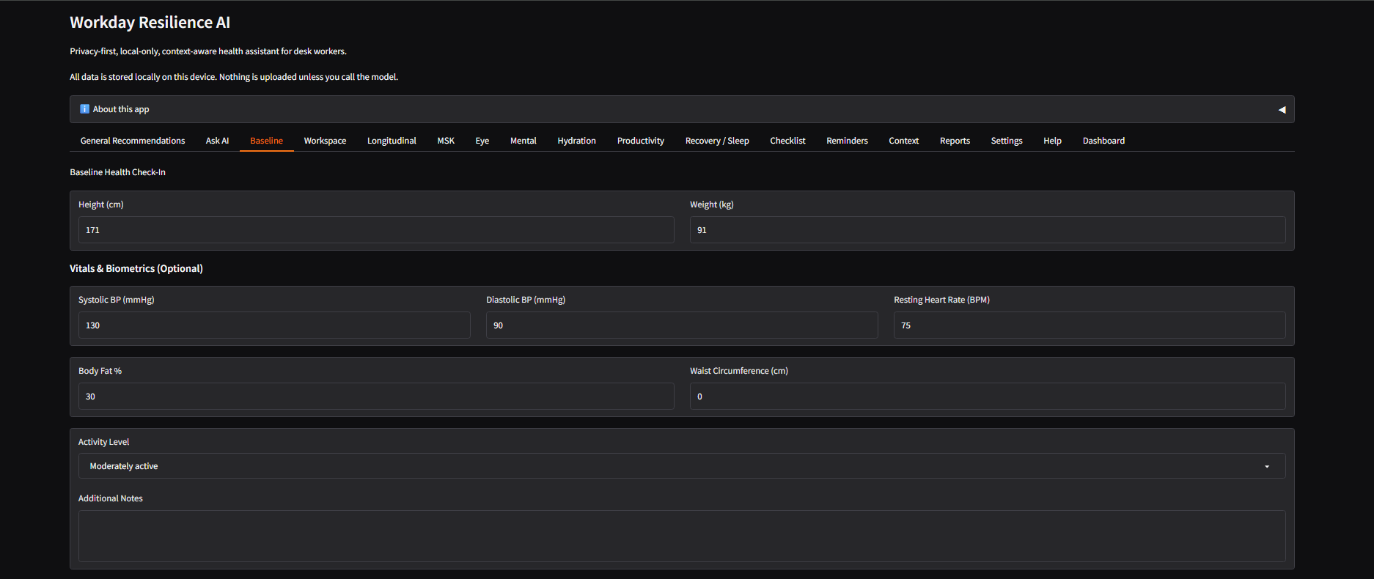
4) Prototype (Working app)
Gradio prototype with modular tabs and local JSON storage
AI for Good Hackathon 2026
Workday Resilience AI

Slide 7
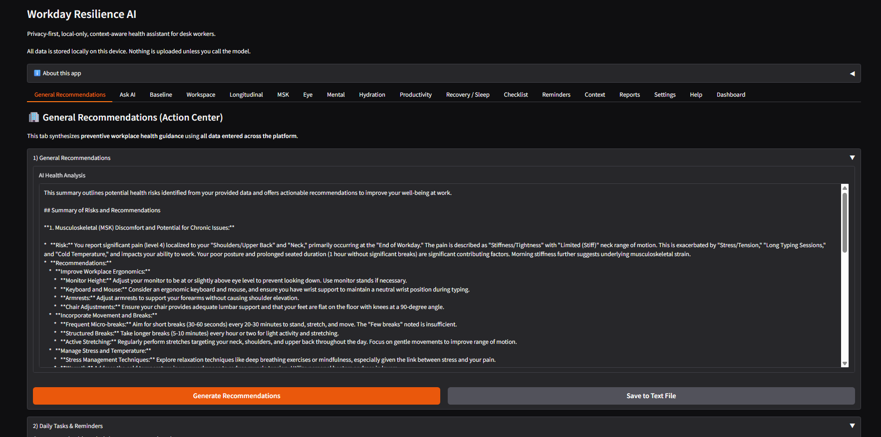
Prototype output: Action Center
Cross-domain synthesis: summary of risks + actionable recommendations
AI for Good Hackathon 2026
Workday Resilience AI

Slide 8
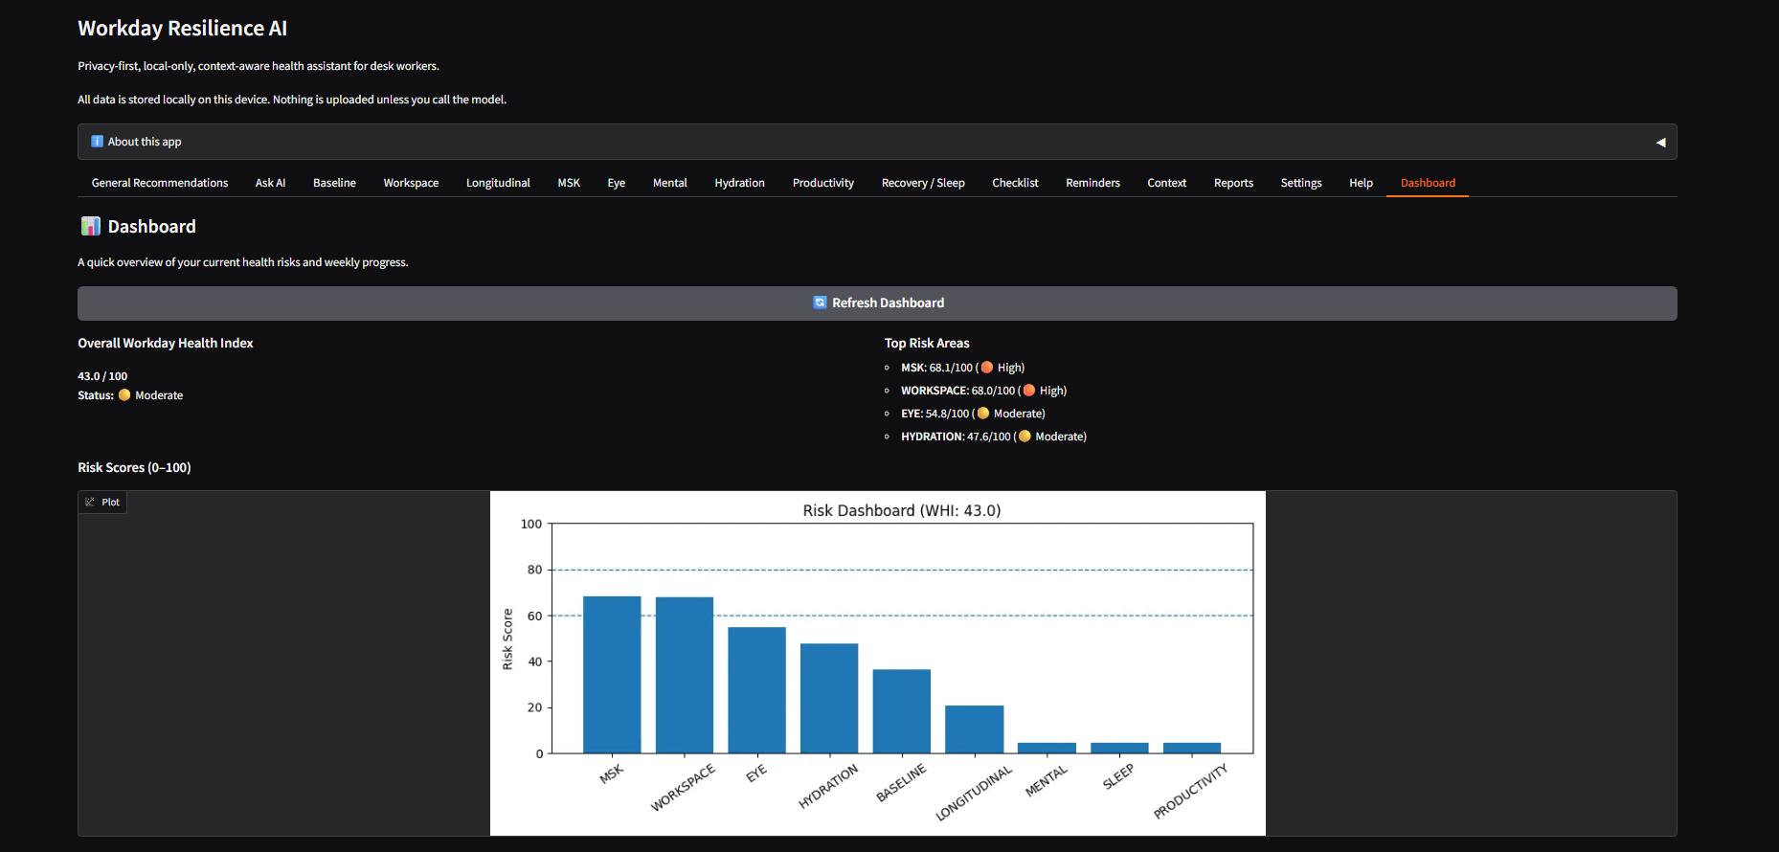
Risk Dashboard
User-friendly risk overview (WHI + domain scores, 0–100)
AI for Good Hackathon 2026
Workday Resilience AI

Slide 9
Measurable impact metrics
Weekly progress indicators (behavior change)
Sedentary time reduction: avg seated block hours (this week vs last week)
Hydration compliance %: compliant days / total days
Sleep improvement trend: weekly avg sleep hours (+/–)
Reminders completed: adherence count per week
High-risk days avoided: # days with WHI ≥ 60 (week-over-week)
Why judges care: these metrics demonstrate measurable change, not just tracking.
The dashboard updates automatically from local history (e.g., last 7 days vs previous 7 days).
AI for Good Hackathon 2026
Workday Resilience AI

Slide 10
Demo scenario ()
Ahmed — rural humanitarian project manager (extreme risk)
Context:
10–14 hour days, constant calls & reporting, limited rest
Hot/noisy office, weak internet, laptop-only setup
Hydration drops, caffeine increases, screen time continuous
Platform detection (cross-domain):
Pattern: dehydration + headaches + eye strain + poor sleep → risk escalation
MSK tension + poor posture → chronic pain risk
Stress overload signals → burnout risk flagging
Interventions:
24-hour stabilization plan + 7-day realistic habit plan
Reminders (hydration / micro-breaks / 20-20-20)
Safety escalations when severe symptoms appear
AI for Good Hackathon 2026
Workday Resilience AI

Slide 11
Responsible AI: privacy & safety
Built for trust in real-world settings
Privacy-first: local JSON storage, no automatic uploads
Offline-ready: works without internet; optional online AI when configured
Non-diagnostic: focuses on prevention & behavior change
Guardrails: urgent warnings for high-risk signals; clear escalation guidance
Explainability: scores + top drivers shown to the user
AI for Good principle: prevention improves wellbeing and reduces burnout-related service disruption.
AI for Good Hackathon 2026
Workday Resilience AI

Slide 12
Roadmap & next steps
What's next
Field testing with desk workers and humanitarian staff (user feedback loops)
Improve personalization: adaptive reminders + trend-based coaching
Add more impact indicators (focus time, pain days avoided, sleep quality)
Deploy as a lightweight desktop/mobile-friendly app
Partnerships with organizations for workforce wellbeing programs
Prototype link: [Add GitHub / Hugging Face Space URL]
Contact: [Add email]
AI for Good Hackathon 2026
Workday Resilience AI

