Slide 1


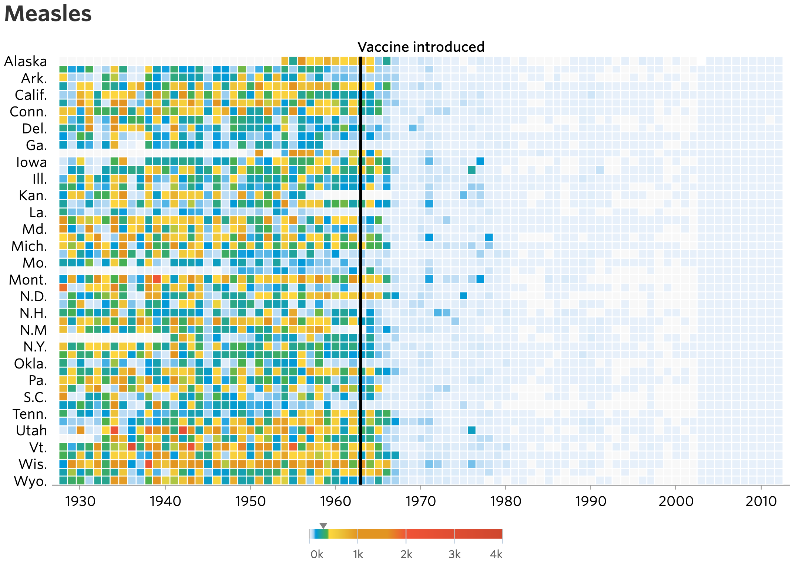



Visualizing Measles Incidence in the USA (1928–2001) Michael T. Gastner*
Introduction
Data
Tools Used
Pitch to the Editorial Board
Measles is a highly infectious viral disease with significant impact on public health. However, observational studies confirm that vaccination is highly effective.
Project Tycho (Van Panhuis et al., 2018): Weekly counts of measles cases
STATS Indiana (2021): Decennial U.S. census data for each state
Tidyverse (Wickham et al., 2019): R packages for data analysis and visualization
ColorBrewer (Brewer, 2014): “Reds” palette
Why Should You Adopt Our Visualization?
Boost Reader Engagement
Clearer titles to the plot and the color legend deliver immediate insight.
Including grid lines and all state abbreviations eliminates the need for guesswork.
A colorblind-friendly palette broadens accessibility.
Colors from a discretized sequential palette highlight the overall trend.
Enhanced Credibility and Trust
Mistakes in handling missing data have been corrected.
The clearer visual distinction between zero and missing data ensures accuracy.
A perceptually balanced color scale avoids overstating medium-level incidence.
These improvements strengthen the impact of and trust in journalistic reporting on public health data. This aspect provides a crucial advantage amid heightened vaccine skepticism fueled by misinformation.
Original Visualization
Improved Visualization
The figure below was published by the Wall Street Journal (DeBold and Friedman, 2015):
Although the heatmap layout garnered praise in the blogosphere (e.g., Lee, 2017) it exhibits several weaknesses:
Nearly half of the state labels are omitted.
The rainbow palette lacks a meaningful progression through color space and is not colorblind-­friendly.
Missing data are erroneously treated as zero.
The logarithmic color scale addresses the skewed incidence (mostly near zero) by emphasizing subtle differences at low values.
Horizontal and vertical grid lines in the background facilitate retrieving the state and year for individual data points.
References:
*Information and Communication Technology Cluster, Singapore Institute of Technology • michael.gastner@singaporetech.edu.sg • https://michael-gastner.com • Published: 2025–01–24
Notes:
\

