Slide 1



Smart Street Lighting with Predictive Control
State Level Hackathon
Team Infinity Sparks
Smart street lights that respond to daylight and road activity, helping save energy and improve safety.

Slide 2
Title & Team Identity
Design and Execution
  Project Name: Smart Street Lighting with Predictive Control
  Theme Selected: Smart City – Embedded Systems and IoT
  Team Name & City: Infinity Sparks, Chennai – Prince Shri Venkateshwara Padmavathy Engineering College
  Team Members: Ashwithaa B, Gayathri M, Kamaladevi SP
  Value Proposition:Our system automatically controls street lights based on daylight and road activity. It also lights the next zone in advance to improve road safety and reduce unnecessary energy use.

Slide 3
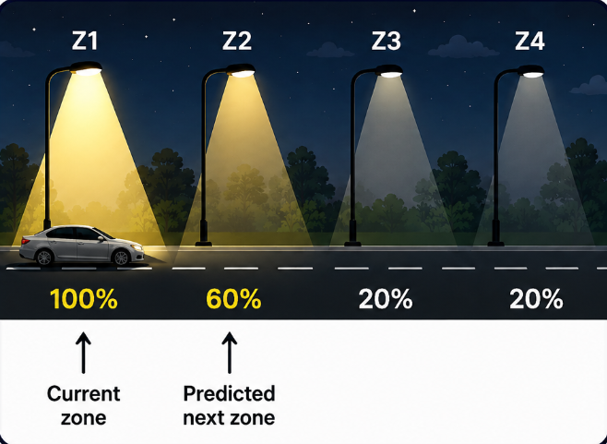
Problem Synthesis & Scenario
Design and Execution
  The Scenario: Street lights often stay at full brightness throughout the night, even when the road is empty. This wastes energy.
  The Gap: Normal sensor-based street lights react only when a vehicle or person reaches that area. The next area remains dark until movement reaches it.
  Criticality: The system must detect movement and change the lights quickly. Any delay can leave the road ahead poorly lit.
  Success Metric: Correct day/night operation, reliable vehicle and pedestrian detection, and fast lighting of the current and next zone.

Slide 4
QNX Architectural Approach
Design and Execution
  QNX Architecture: The smart lighting application runs on QNX 8.0 on Raspberry Pi 4. QNX reads the sensors and controls the street lights through GPIO.
  Real-Time Control: Sensor values are checked continuously so that changes in daylight, vehicle movement, or human movement can quickly update the lights.
  Priority Approach: Lighting control is treated as the main real-time operation. Other activities such as displaying sensor values should not delay the lighting response.
  Why QNX: QNX provides predictable task scheduling and reliable hardware control, which are useful when the lights must respond at the correct time.

Slide 5
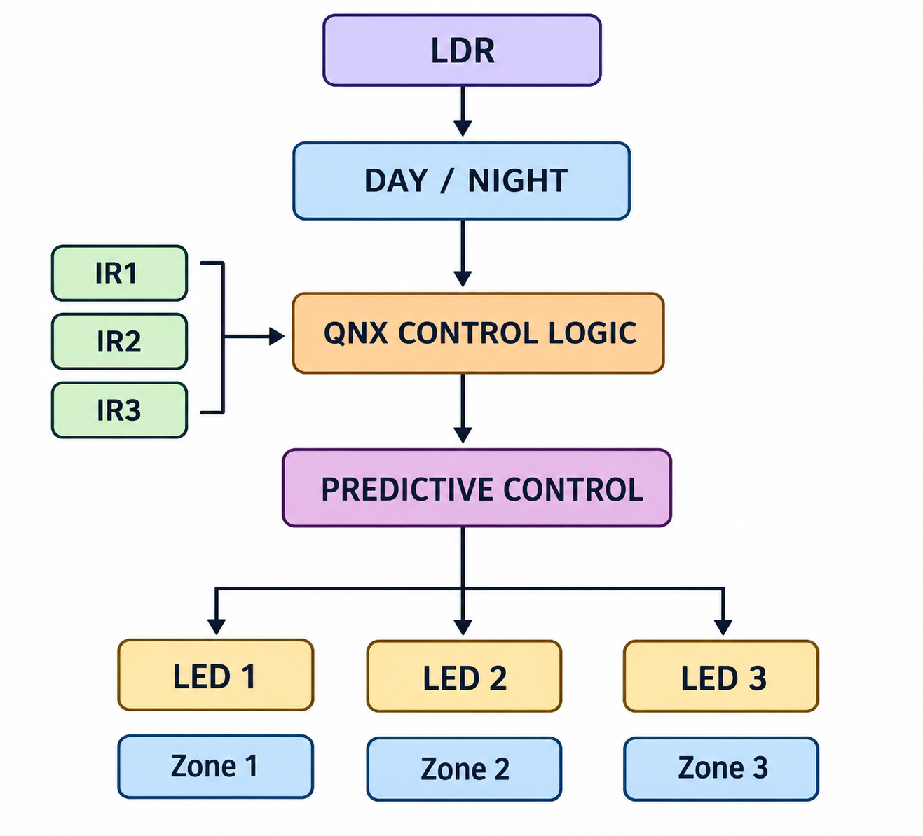
Technical Execution (Hardware & Logic)
Design and Execution
  RPi Integration: Raspberry Pi 4 running QNX 8.0. LDR is connected through GPIO26 for day/night detection. Three IR sensors on GPIO5, GPIO6 and GPIO13 detect vehicles across three zones. LEDs on GPIO23, GPIO24 and GPIO25 represent the street lights.
  The Logic: During daytime, all lights remain OFF. At night, IR sensors detect vehicle movement. When a vehicle enters Zone 1, Zone 1 and Zone 2 are switched ON, pre-lighting the next zone. When it reaches Zone 2, Zone 2 and Zone 3 are switched ON. A stability filter rejects fluctuating sensor readings to prevent unwanted LED switching.
  QNX Integration: The application uses the QNX Raspberry Pi GPIO interface for real sensor input and LED control. GPIO communication uses QNX message-passing IPC through the GPIO resource manager.

Slide 6
Performance Proof (The Profiler Slide)
Demonstration
  System Profiler Screenshot: QNX Momentics System Profiler capture was not obtained for the current prototype.
  Latency Benchmarks: Sensor-to-light response time - Not measured
  Analysis: The prototype was functionally tested using real LDR, IR and PIR sensor inputs with Raspberry Pi GPIO-based LED control. The tests verified sensor detection, zone-wise lighting response and programmed energy-saving behaviour.

Slide 7
Future Scalability & Conclusion
Demonstration
  Innovation Arbitrage: The current 3-zone prototype can scale to city-wide road corridors using additional zone controllers, wireless communication, traffic sensors, and industrial LED drivers. The same predictive concept can be extended to larger smart-city lighting networks.
  Learning Outcome: We successfully integrated real LDR and IR sensor inputs with Raspberry Pi GPIO on QNX 8.0 and implemented rule-based predictive lighting, where the next road zone is illuminated before the vehicle reaches it. QNX message-passing IPC is used in the GPIO communication layer.
  Closing Statement: Integrating real-time GPIO sensors with QNX and handling fluctuating sensor readings while maintaining stable lighting output.

