Slide 1


Post-ENM
University of Florida

Slide 2
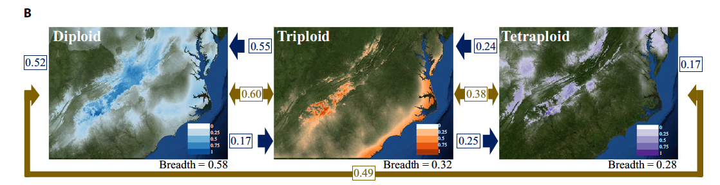
Post-ENM: Niche Breadth
Niche breadth:
is a means of calculating the breadth of suitable climatic factors for a species, providing a value ranging from 0 to 1.
larger values represent more generalist species with wider climatic tolerances
smaller values represent more specialized species with more narrow tolerance
Gaynor et al. 2018

Slide 3
Post-ENM: Niche Overlap
Niche overlap (gold):
Schoener’s D ranges from 0 to 1
0 represents no niche similarity between the models
1 represents completely identical niches
Geographic Overlap (blue):
percentage of points found in the models A distribution relative to those in the model Bs distribution.
Gaynor et al. 2018

Slide 4
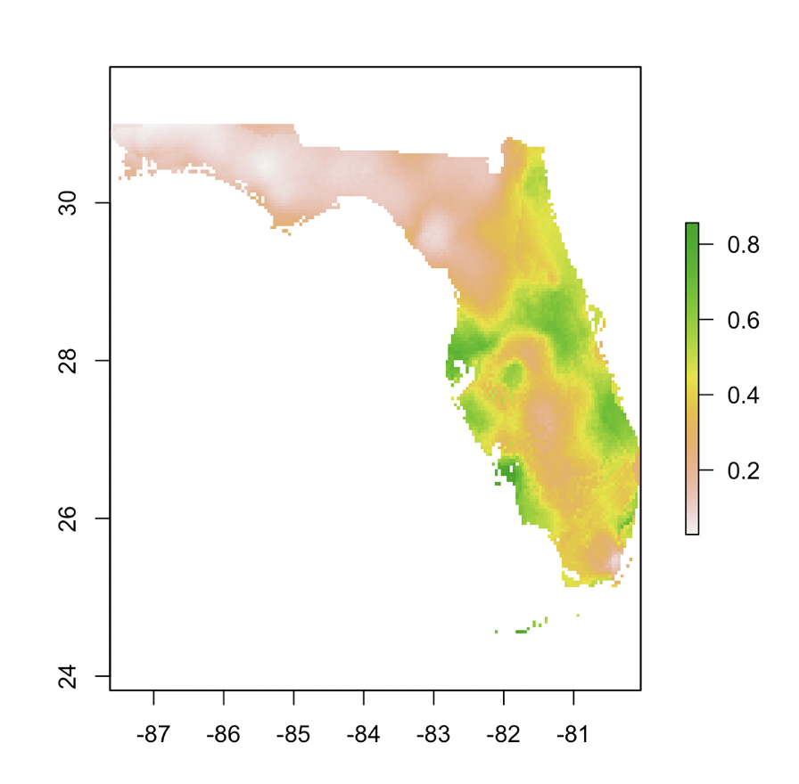
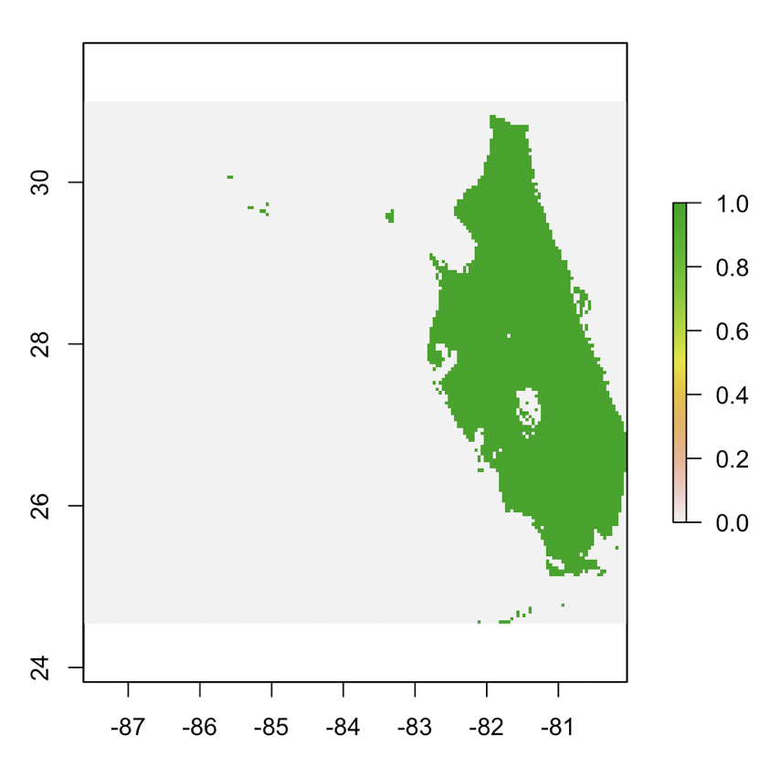
Post-ENM
Geographic Overlap
Reclassify

Slide 5
Post-ENM: Geographic Overlap
Geographic Overlap (blue):
percentage of points found in the models A distribution relative to those in the model Bs distribution.
Gaynor et al. 2018

Slide 6
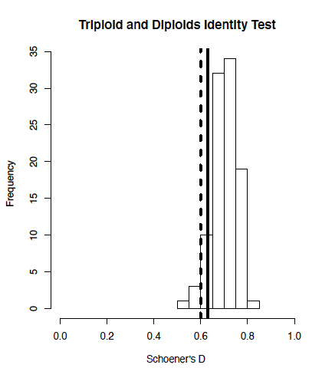
Niche Identity and Background Test
Niche Identity Test:
Is niche overlap more different than expected if drawn from the same underlying distribution?
Comparing niche models with the same number of occurrence records as the original models, but with randomly distributed localities x 100
Niche Background Test:
Is niche overlap more similar than expected by chance based on the geographical regions they reside?
Warren et al. 2010. ENMTools: a toolbox for comparative studies of environmental niche models

Slide 7
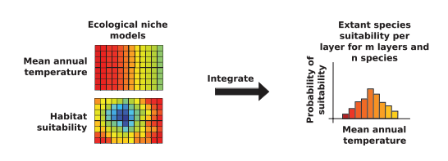
Niche and Phylogenetics
Point-Based
Principal Component Analysis (PCA)
Age-overlap correlation test:
Range &point based
Model-based
Phylogenetic PCA (pPCA)
Blomberg’s K statistic and Pagel’s lambda
Ecological Niche Shifts
R package l1ou
Predicted Niche Occupancy
Folk et al. 2018. The American Naturalist.

Slide 8
Niche and Phylogenetics
Point-Based
Principal Component Analysis (PCA)
Age-overlap correlation test:
Range &point based
Model-based
Phylogenetic PCA (pPCA)
Blomberg’s K statistic and Pagel’s lambda
Ecological Niche Shifts
R package l1ou
Predicted Niche Occupancy
Folk et al. 2018. The American Naturalist.

Slide 9
Age overlap correlation test
identical niches
1
Ecological Niche Overlap
Schoener’s D
no overlap
0
Age (MYA)

Slide 10
Age overlap correlation test
identical niches
1
Ecological Niche Overlap
Schoener’s D
no overlap
0
Age (MYA)
Mode of Speciation | Intercept | Slope
Sympatric | > 0.5
Allopatric | < 0.5 | positive
Parapatric | < 0.5 | near or below 0
Fitzpatrick & Turelli. 2006. Evolution.

Slide 11
Age overlap correlation test
Range Overlap
Point Overlap
Local
co-occurrence
Allopatric
Allopatric
Sympatric
Sympatric
Cardillo and Warren. 2016. Global Ecology and Biogeography.

Slide 12
Age overlap correlation test
Point-based
Galax urceolata
0.233
0.890
Pyxidanthera barbulata
Pyxidanthera brevifolia
0.068
0.213
Ecological overlap
Shortia sinensis
0.000
0.000
Shortia uniflora
0.000
0.000
0.000
0.000
Shortia rotundifolia
0.003
0.000
Shortia galacifolia
0.026
0.033
Age (MYA)
0.216
0.670
Schizocodon soldanelloides
Range-based
Schizocodon ilicifolius
0.002
0.009
Diapensia wardii
0.093
0.068
0.350
0.339
0.211
0.269
Diapensia obovata
Diapensia lapponica
Ecological overlap
0.006
0.017
0.377
0.394
Diapensia purpurea
Diapensia himalaica
Berneuxia thibetica
Gaynor et al. 2020
Age (MYA)
Notes:
Both suggested lots of instances of Parapatric, which has been associated with phylogenetic niche divergence

Slide 13
Age overlap correlation test
Point-based
Galax urceolata
0.233
0.890
Pyxidanthera barbulata
Allopatric
Pyxidanthera brevifolia
0.068
0.213
Ecological overlap
Shortia sinensis
0.000
0.000
Shortia uniflora
0.000
0.000
0.000
0.000
Shortia rotundifolia
0.003
0.000
Shortia galacifolia
0.026
0.033
Age (MYA)
0.216
0.670
Schizocodon soldanelloides
Allopatric
Range-based
Schizocodon ilicifolius
0.002
0.009
Diapensia wardii
0.093
0.068
0.350
0.339
0.211
0.269
Diapensia obovata
Parapatric
Diapensia lapponica
Ecological overlap
0.006
0.017
0.377
0.394
Diapensia purpurea
Parapatric
Diapensia himalaica
Berneuxia thibetica
Gaynor et al. 2020
Age (MYA)

Slide 14
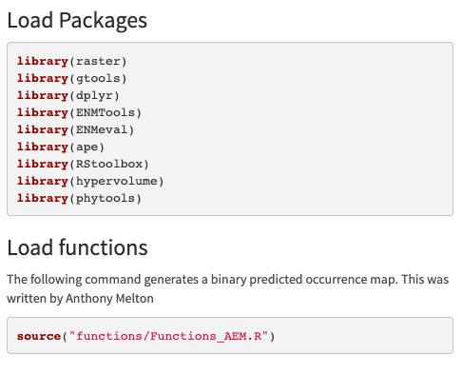
Load Packages and Functions

Slide 15
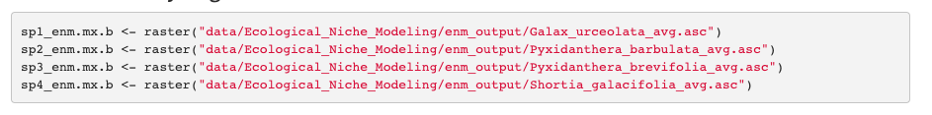
Load ENM Models

Slide 16
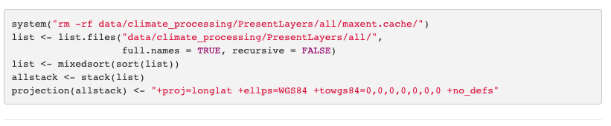
Load Bioclim layers

Slide 17
ENM Breadth
Niche breadth is the breadth of environmental factors for a species’ niche, ranging from 0 to 1.
When breadth is closer to 1 the more generalist species with wider tolerances.
Values closer to 0 indicate a more specialized species.
The raster.breadth command in ENMTools measures the smoothness of suitability scores across a projected landscape. The higher the score, the more of the available niche space a species occupies.

Slide 18
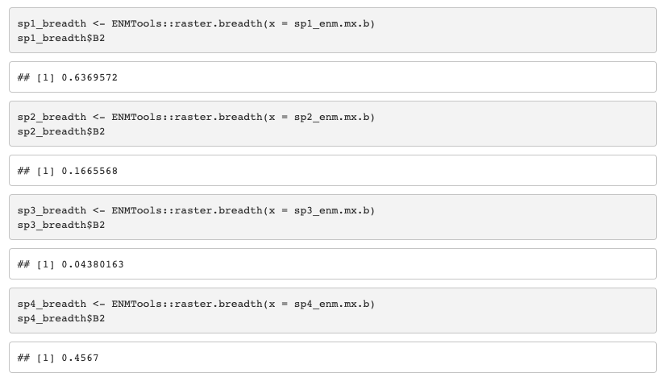
ENM Breadth

Slide 19
ENM Overlap
Calculating niche overlap:
Schoener’s D, with ENMEval - Schoener’s D ranges from 0 to 1
0 represents no similarity between the projections
1 represents completely identical projections.

Slide 20
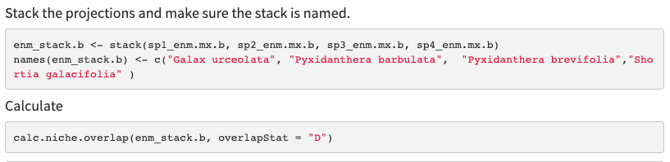
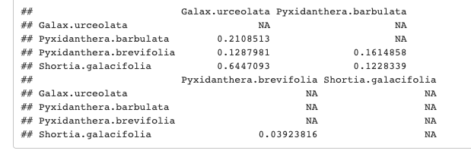
ENM Overlap

Slide 21
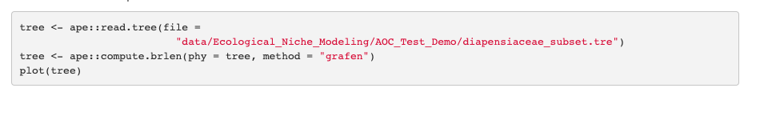
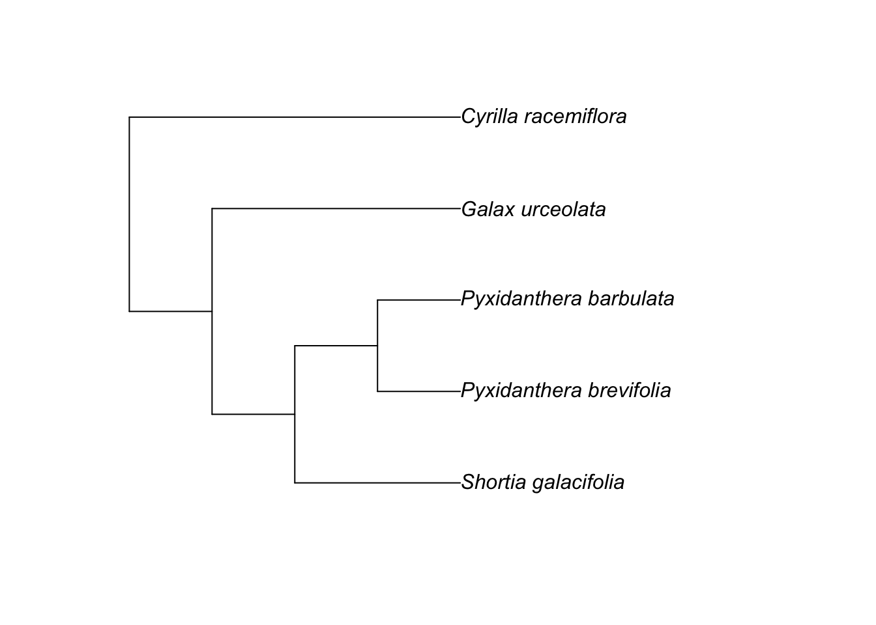
Phylogenetic correlation

Slide 22

Phylogenetic correlation

Slide 23
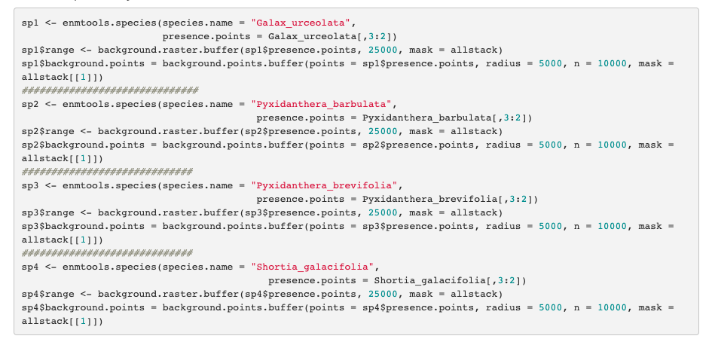
Phylogenetic correlation

Slide 24

Phylogenetic correlation

Slide 25
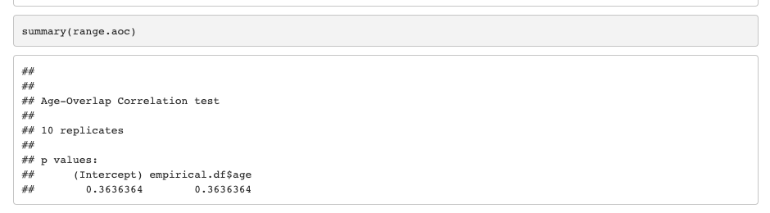
Phylogenetic correlation

Slide 26
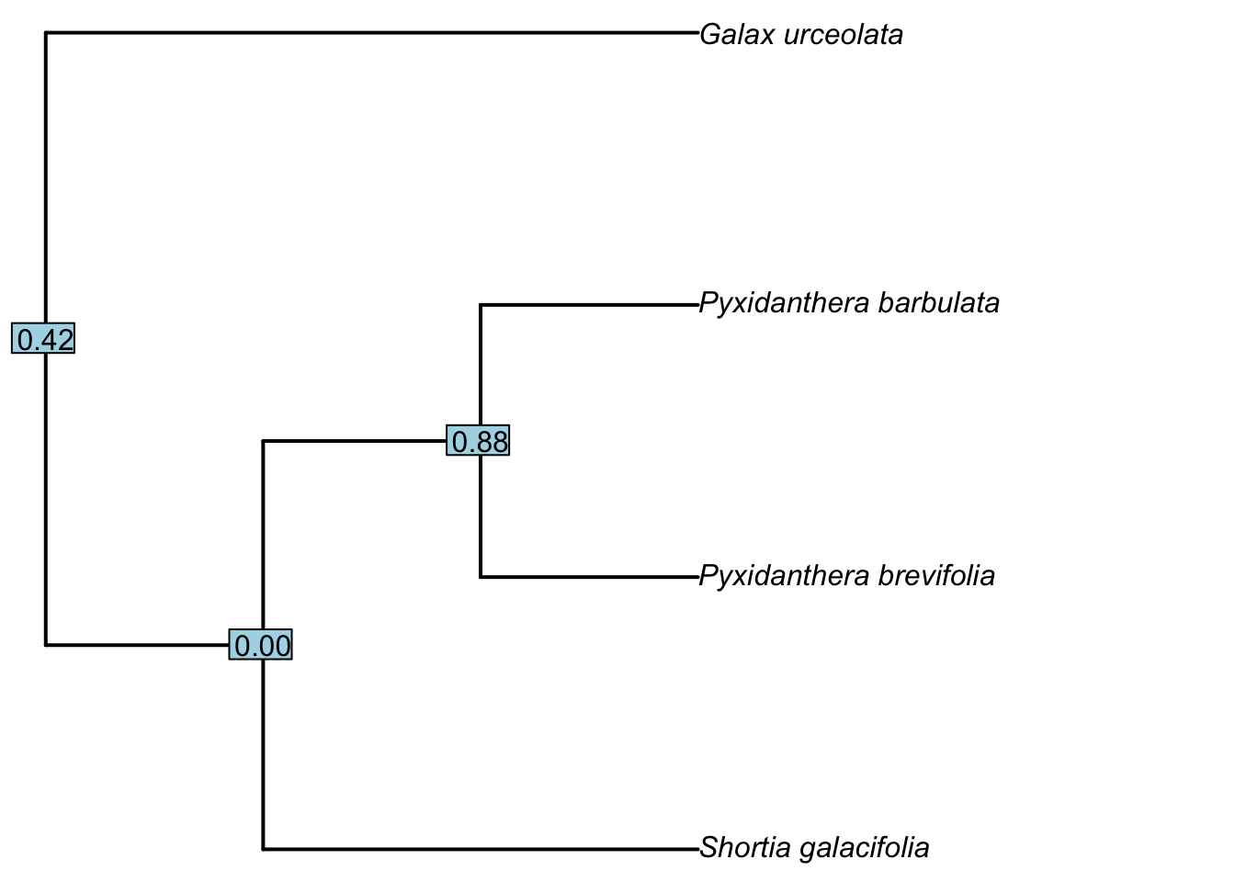
Phylogenetic correlation

Slide 27
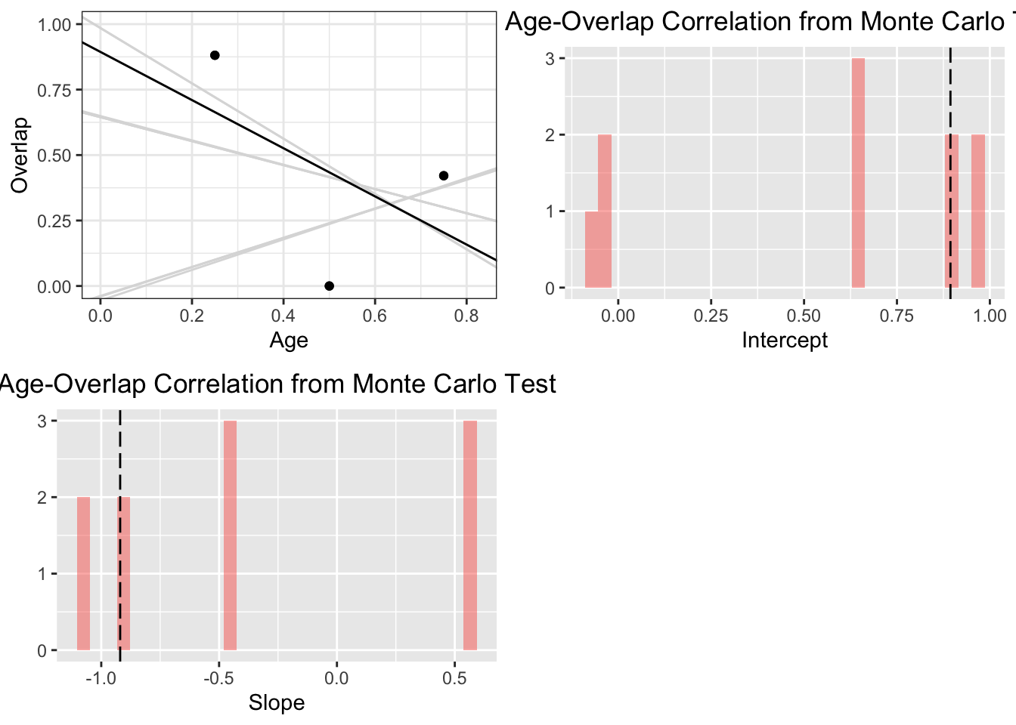
Phylogenetic correlation

Slide 28
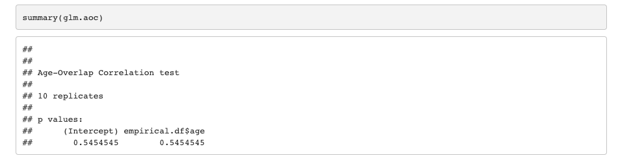
Phylogenetic correlation

Slide 29

Phylogenetic correlation

Slide 30
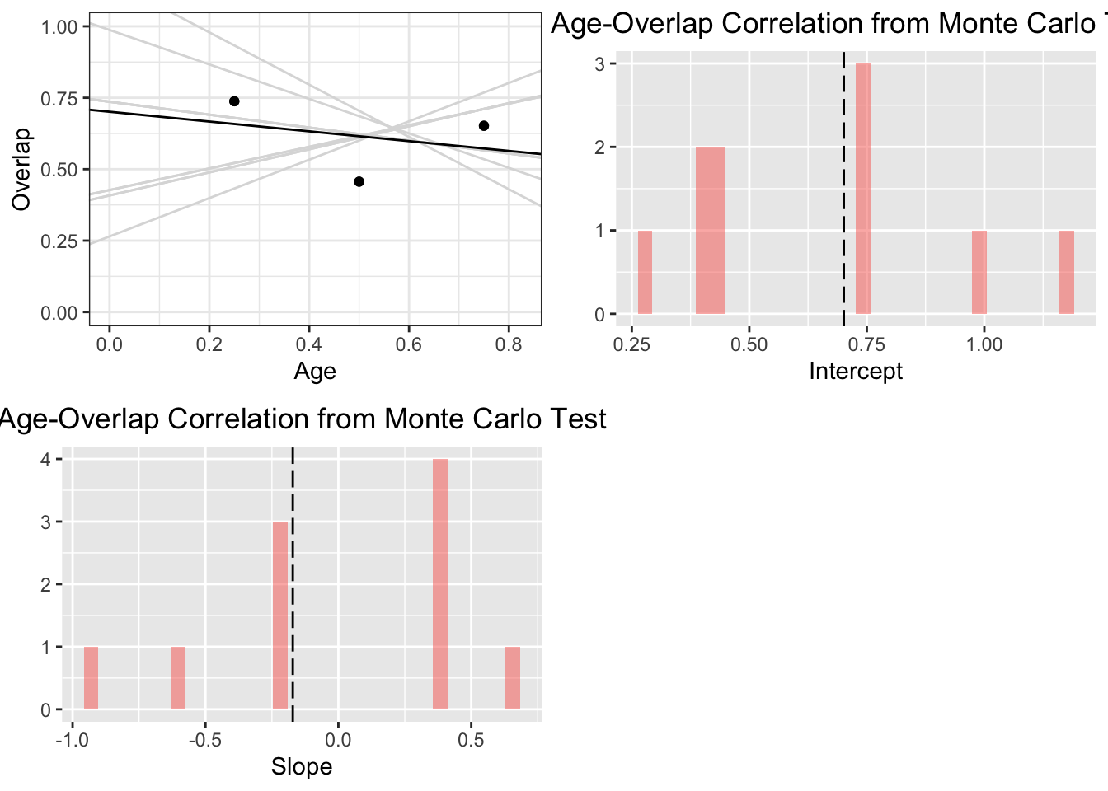
Phylogenetic correlation

Slide 31
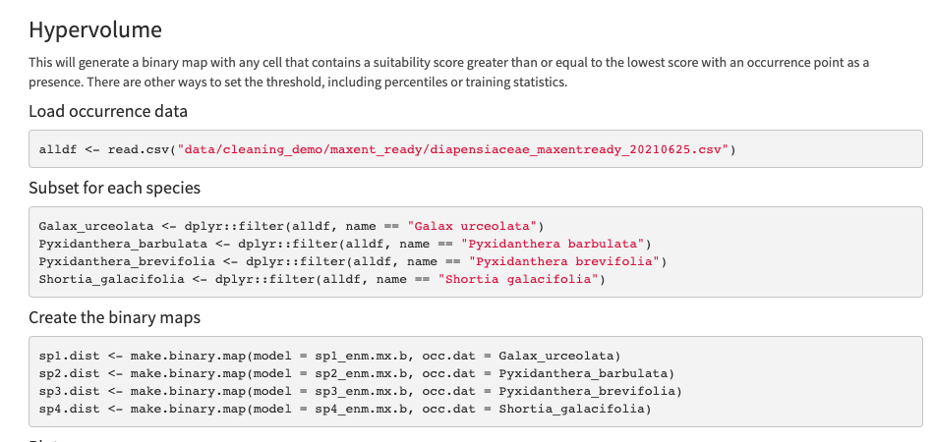
Hypervolume

Slide 32
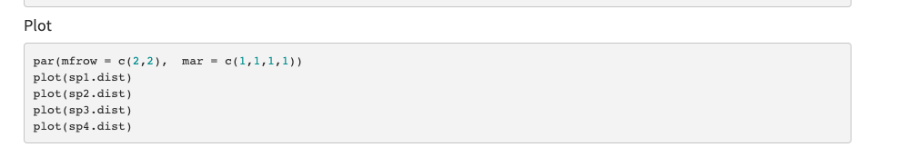
Hypervolume

Slide 33
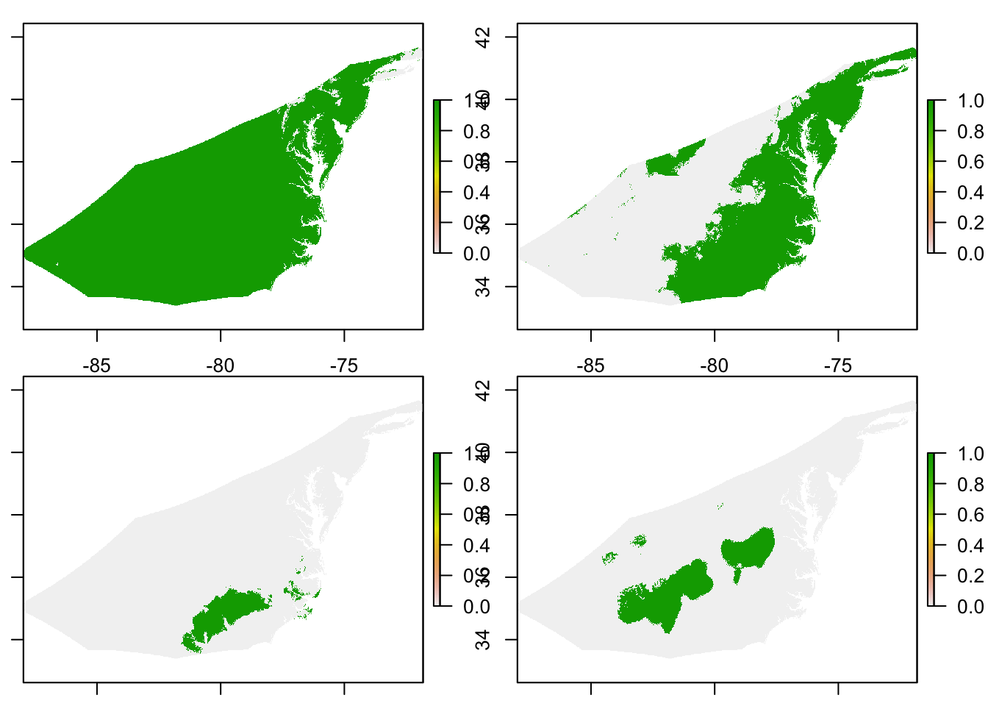

Slide 34
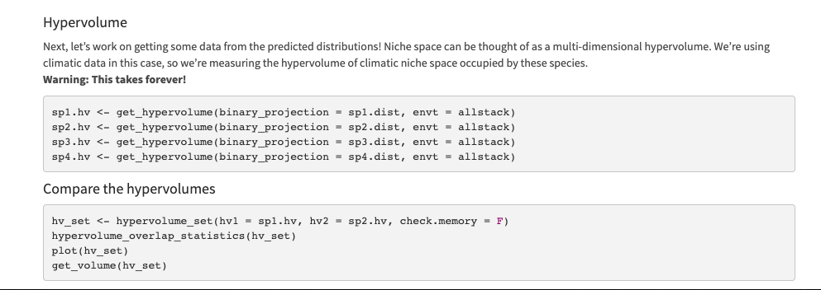
Hypervolume

