Slide 1

DATA
TOP WORDS
TOPIC MODELING
CLUSTERING

Slide 2
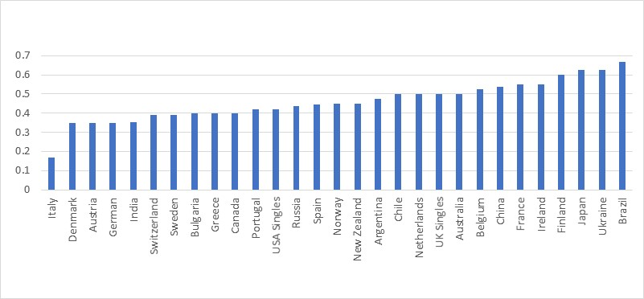

Slide 3
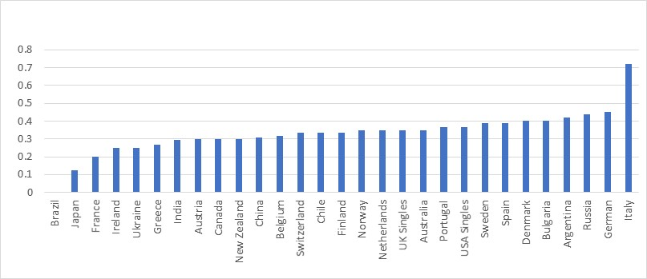

Slide 4
