Slide 1
Announcements
Course TA: Danny Kumar (ndkumar@cs.unc.edu)
Guest lectures next week
Assignment 1 out, due Tuesday, September 14
Course discussion board
You should be able to find the discussion thread “AI in the news/on the Web” on Blackboard
For participation points: at least two posts during the semester

Slide 2
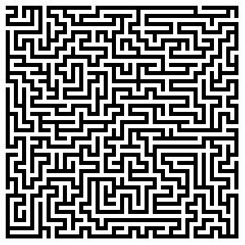
Solving problems by searching
Chapter 3

Slide 3

Search
We will consider the problem of designing goal-based agents in observable, deterministic, discrete, known environments
Example:
Start state
Goal state

Slide 4
Search
We will consider the problem of designing goal-based agents in observable, deterministic, discrete, known environments
The solution is a fixed sequence of actions
Search is the process of looking for the sequence of actions that reaches the goal
Once the agent begins executing the search solution, it can ignore its percepts (open-loop system)

Slide 5
Search problem components
Initial state
Actions
Transition model
What is the result of performing a given action in a given state?
Goal state
Path cost
Assume that it is a sum of nonnegative step costs
The optimal solution is the sequence of actions that gives the lowest path cost for reaching the goal
Initial
state
Goal state

Slide 6
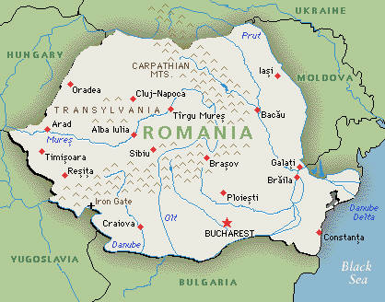
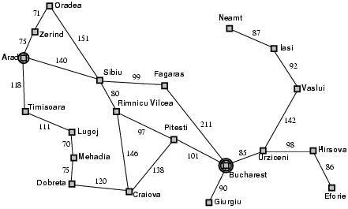
Example: Romania
On vacation in Romania; currently in Arad
Flight leaves tomorrow from Bucharest
Initial state
Arad
Actions
Go from one city to another
Transition model
If you go from city A to city B, you end up in city B
Goal state
Bucharest
Path cost
Sum of edge costs

Slide 7
State space
The initial state, actions, and transition model define the state space of the problem
The set of all states reachable from initial state by any sequence of actions
Can be represented as a directed graph where the nodes are states and links between nodes are actions
What is the state space for the Romania problem?

Slide 8
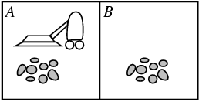
Example: Vacuum world
States
Agent location and dirt location
How many possible states?
What if there are n possible locations?
Actions
Left, right, suck
Transition model

Slide 9
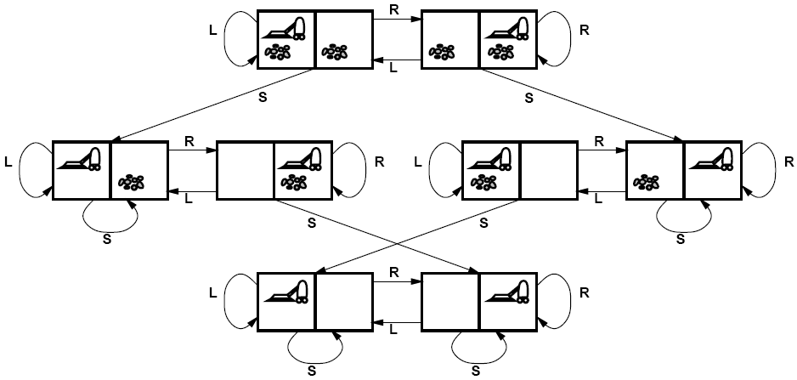
Vacuum world state space graph

Slide 10
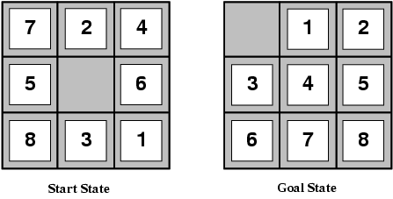
Example: The 8-puzzle
States
Locations of tiles
8-puzzle: 181,440 states
15-puzzle: 1.3 trillion states
24-puzzle: 10²⁵ states
Actions
Move blank left, right, up, down
Path cost
1 per move
Optimal solution of n-Puzzle is NP-hard

Slide 11
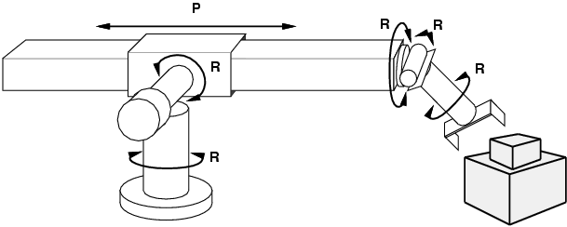
Example: Robot motion planning
States
Real-valued coordinates of robot joint angles
Actions
Continuous motions of robot joints
Goal state
Desired final configuration (e.g., object is grasped)
Path cost
Time to execute, smoothness of path, etc.

Slide 12
Other Real-World Examples
Routing
Touring
VLSI layout
Assembly sequencing
Protein design

Slide 13
Search
Given:
Initial state
Actions
Transition model
Goal state
Path cost
How do we find the optimal solution?
How about building the state space and then using Dijkstra’s shortest path algorithm?
The state space is huge!
Complexity of Dijkstra’s is O(E + V log V), where V is the size of the state space

Slide 14
Tree Search
Let’s begin at the start node and expand it by making a list of all possible successor states
Maintain a fringe or a list of unexpanded states
At each step, pick a state from the fringe to expand
Keep going until you reach the goal state
Try to expand as few states as possible

Slide 15
Search tree
Starting state
“What if” tree of possible actions and outcomes
The root node corresponds to the starting state
The children of a node correspond to the successor states of that node’s state
A path through the tree corresponds to a sequence of actions
A solution is a path ending in the goal state
Nodes vs. states
A state is a representation of a physical configuration, while a node is a data structure that is part of the search tree
Action
Successor state
…
…
…
…
Goal state

Slide 16
Tree Search Algorithm Outline
Initialize the fringe using the starting state
While the fringe is not empty
Choose a fringe node to expand according to search strategy
If the node contains the goal state, return solution
Else expand the node and add its children to the fringe

Slide 17
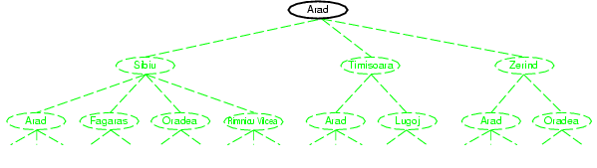
Tree search example

Slide 18
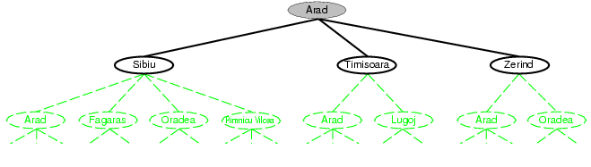
Tree search example

Slide 19
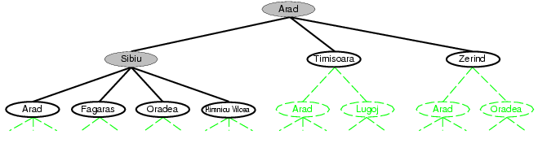
Tree search example
Fringe

Slide 20
Search strategies
A search strategy is defined by picking the order of node expansion
Strategies are evaluated along the following dimensions:
Completeness: does it always find a solution if one exists?
Optimality: does it always find a least-cost solution?
Time complexity: number of nodes generated
Space complexity: maximum number of nodes in memory
Time and space complexity are measured in terms of
b: maximum branching factor of the search tree
d: depth of the least-cost solution
m: maximum length of any path in the state space (may be infinite)

Slide 21
Uninformed search strategies
Uninformed search strategies use only the information available in the problem definition
Breadth-first search
Uniform-cost search
Depth-first search
Iterative deepening search

