Slide 1
Decision-making Study
Consent Form

Slide 2
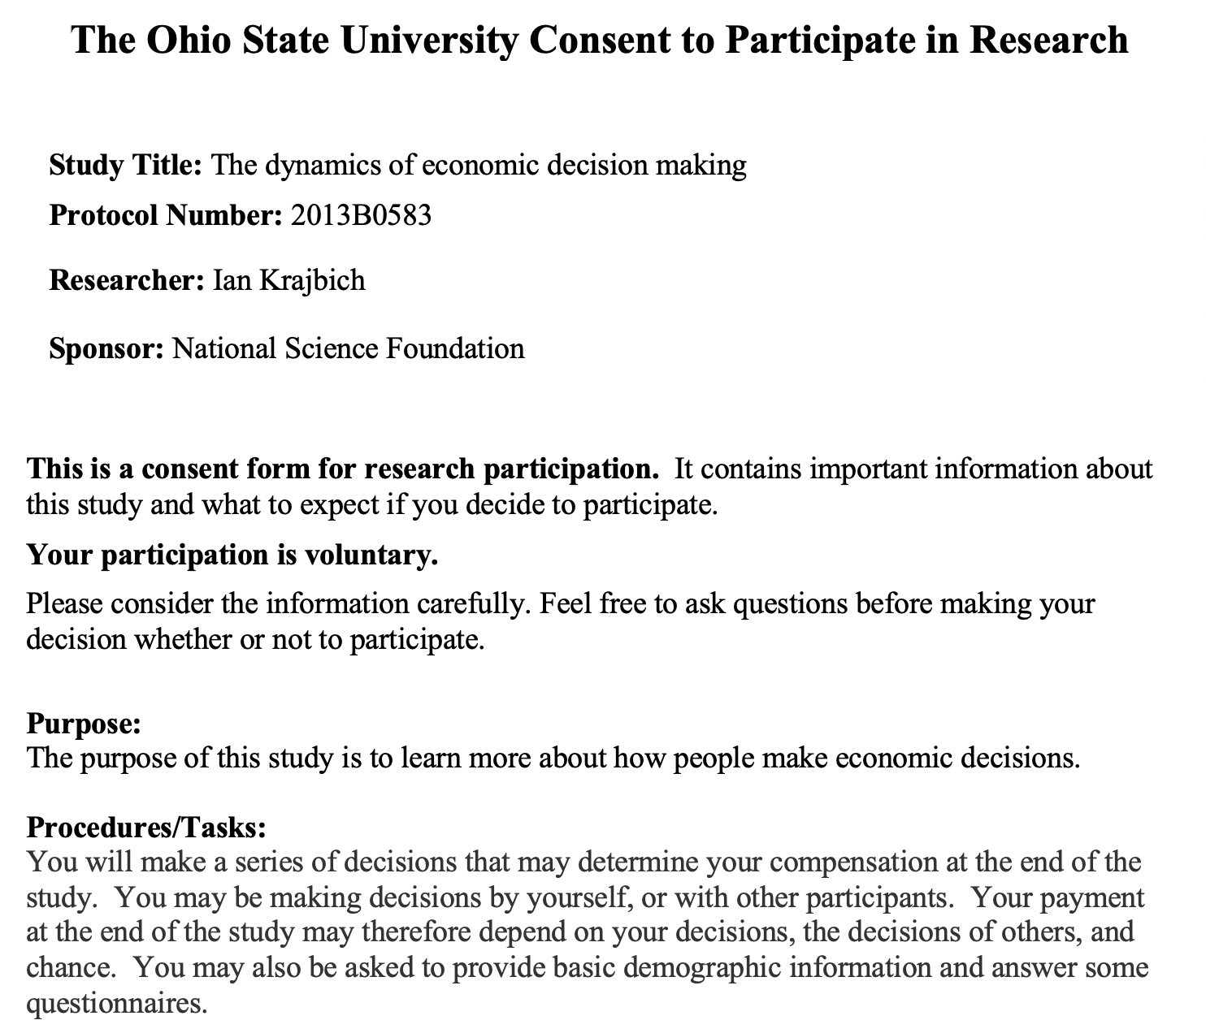

Slide 3
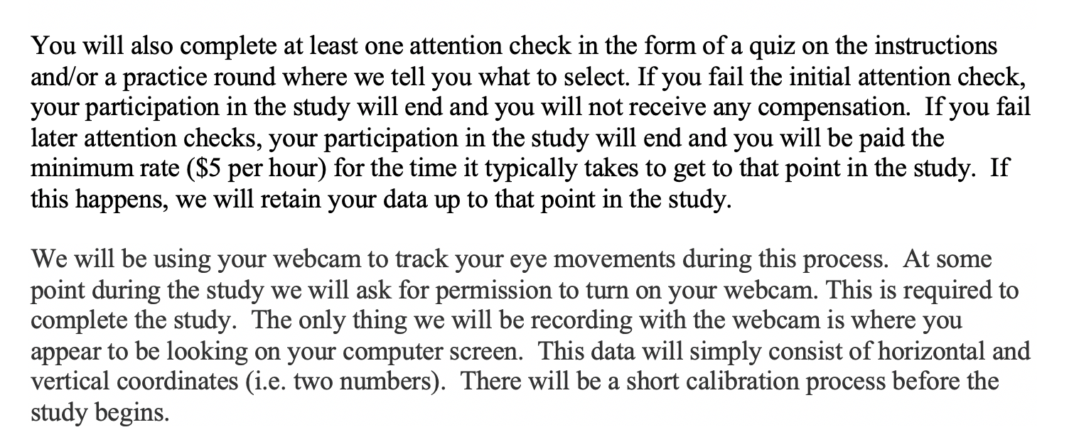


Slide 4
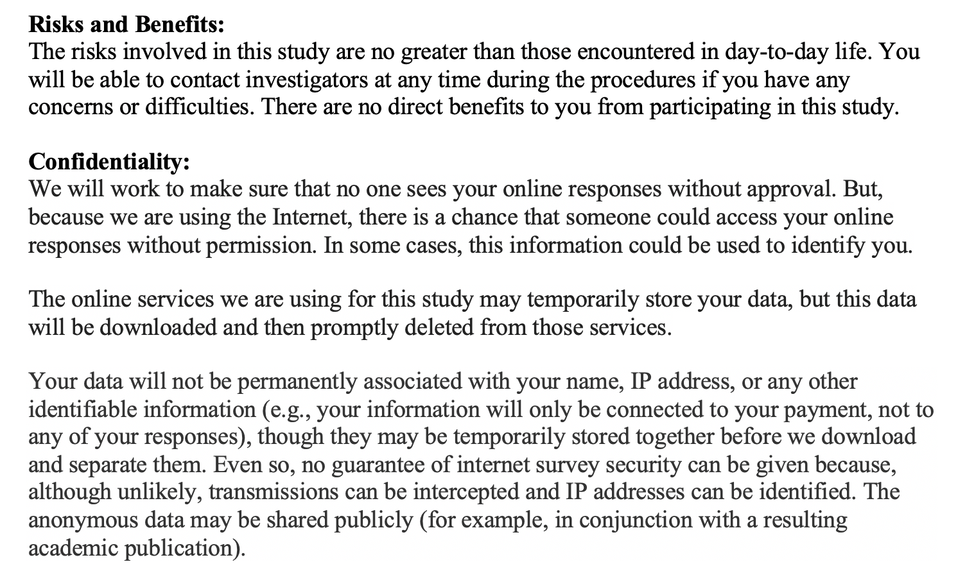

Slide 5
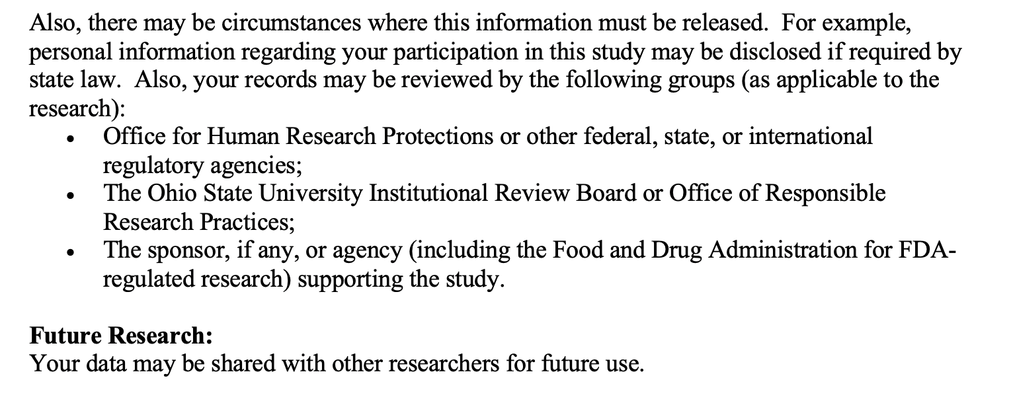



Slide 6
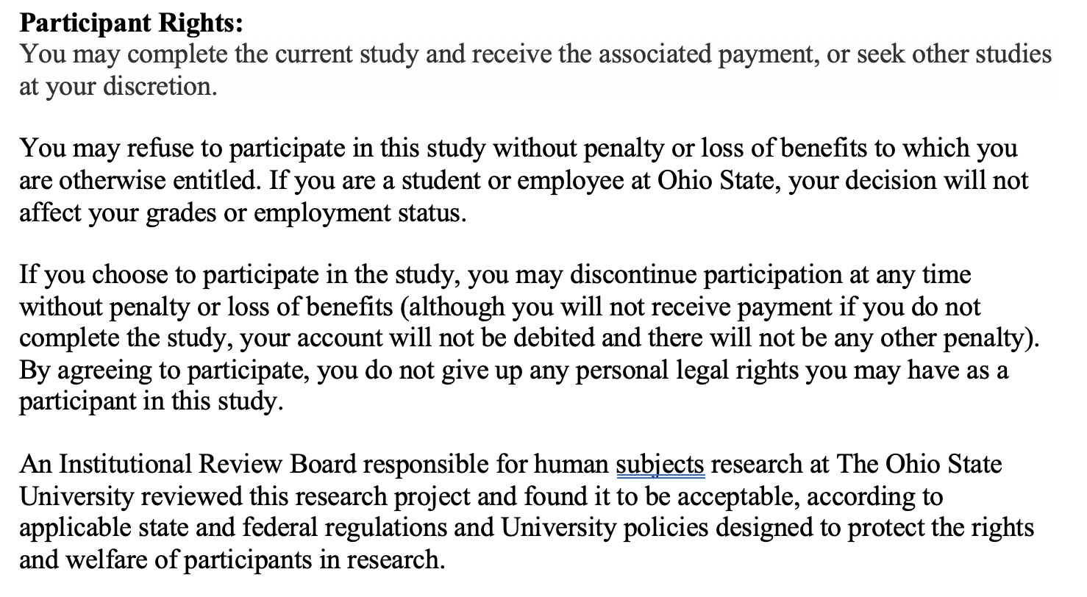

Slide 7
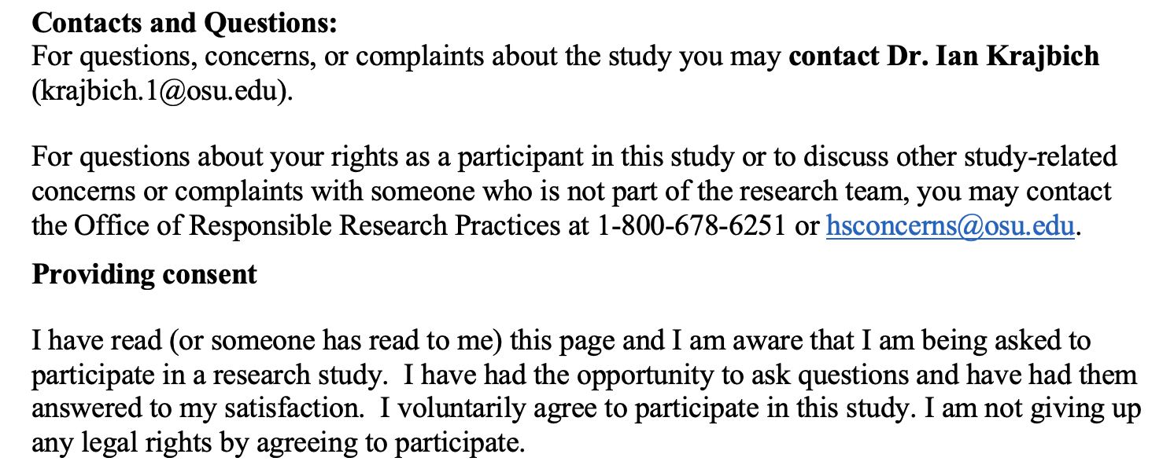

Slide 8
If you have questions, let the experimenter know.
Please press the KEY ‘C’ to proceed and participate in this study.
If you do not wish to participate, please let the experimenter know.

