Slide 1
Decision-making study
Instructions

Slide 2
Your choices in this study will determine how much money you earn at the end.

Slide 3
Instructions
After you read the following instructions, there will be a short quiz to make sure you understood them. You need to do well on the quiz to continue with the study, so read the the instructions carefully.

Slide 4
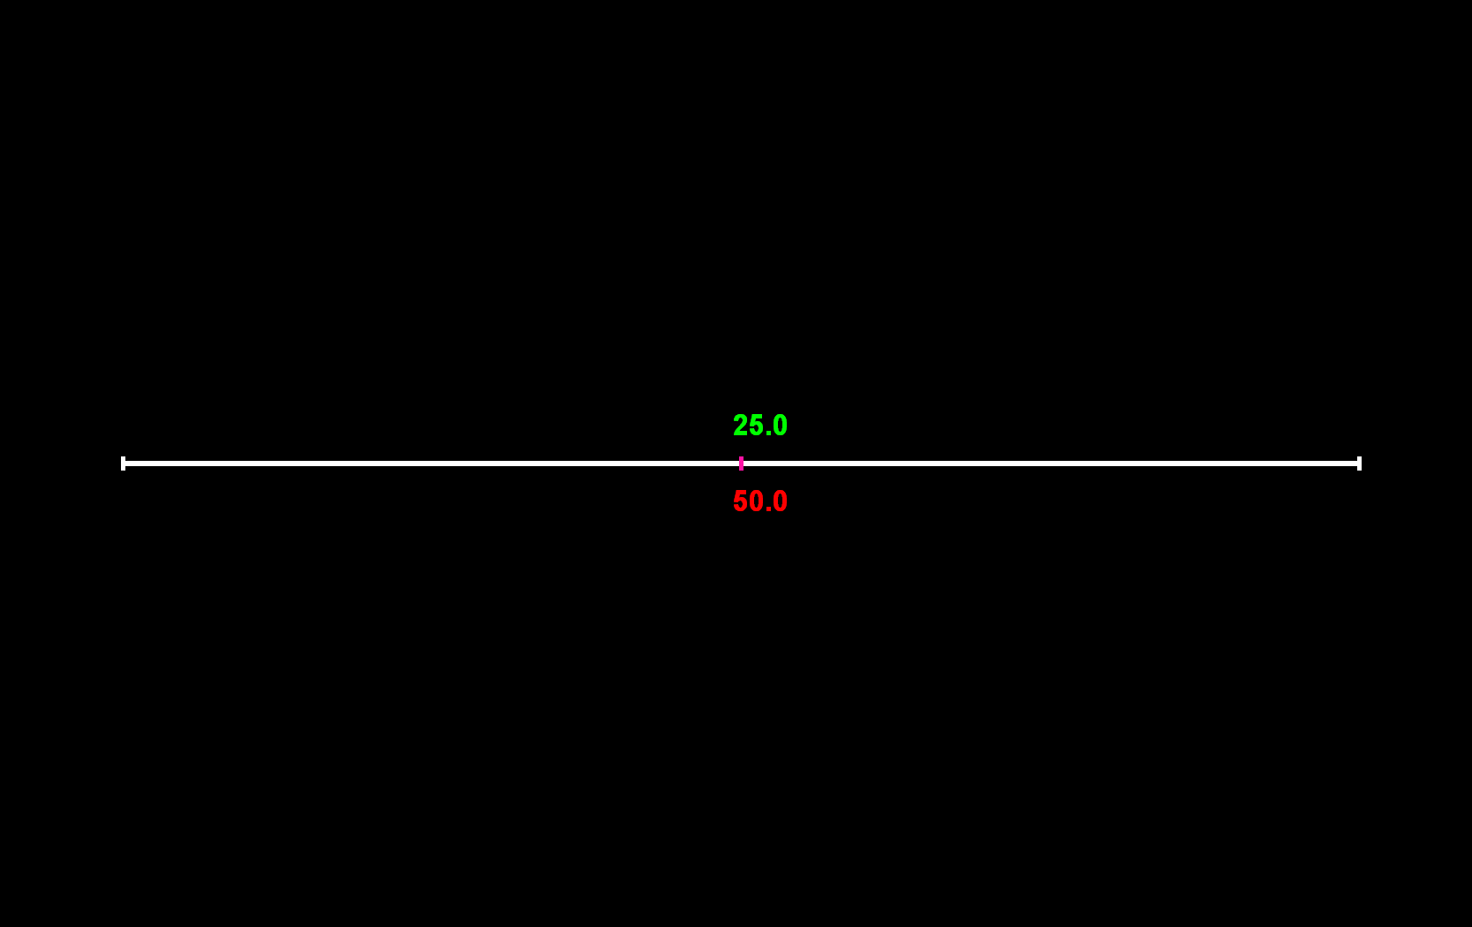
Instructions
In each round, you will be paired with another participant in the study.
You will never know the identity of the person you are paired with and this person will never know your identity.
In each round, you must choose how many of your 100 tokens to give to the other participant.
At the end of the study, both you and the other person’s tokens will be converted into cash.
The other participant is like you. They are making their own decisions. At the end they will receive money from one of their own decisions and from one of someone else’s decisions. That decision could be yours.

Slide 5
Instructions
An example decision screen is presented on the right.
During the study, you will respond by moving the slider with your mouse, and then CLICKING to finalize your decision.

Slide 6
Instructions
The number of tokens you would give is shown under the slider. You can select any amount from 0 to 100.
In each decision, the number of tokens you give is converted into tokens for the other person at a specific exchange rate.
In this example, each token you give is converted into 0.5 tokens for the other person.
Above the slider, you can see how many tokens the other participant would get depending on how much you decide to give.
In this example, if you give 50 tokens (and hence keep 100-50 = 50 tokens), the other participant gets 25 tokens.

Slide 7
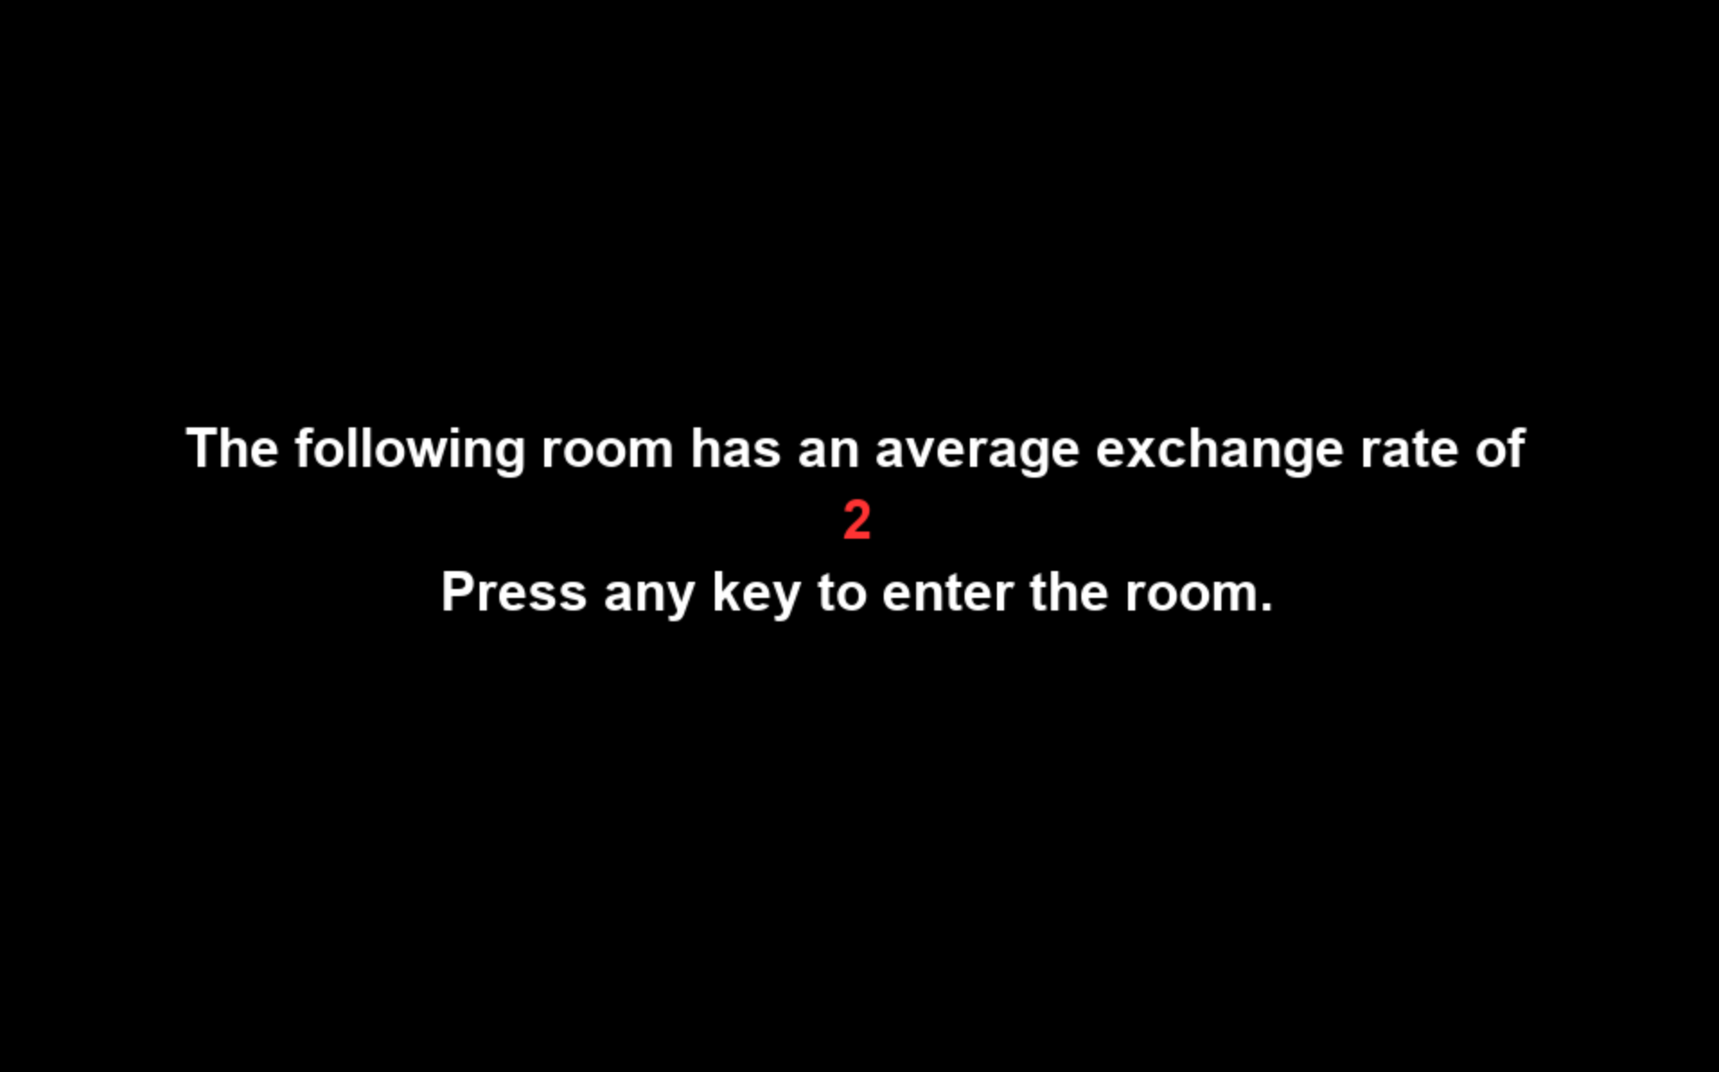
Instructions
The experiment consists of decisions in 7 different “rooms”. Each room has 20 decisions. Each decision resembles the one we just described.
In each room, the exchange rate will be roughly the same, but will vary a little from one decision to another.
For example, in this room, for each 1 token you give, the other participant gets about 2 tokens.

Slide 8
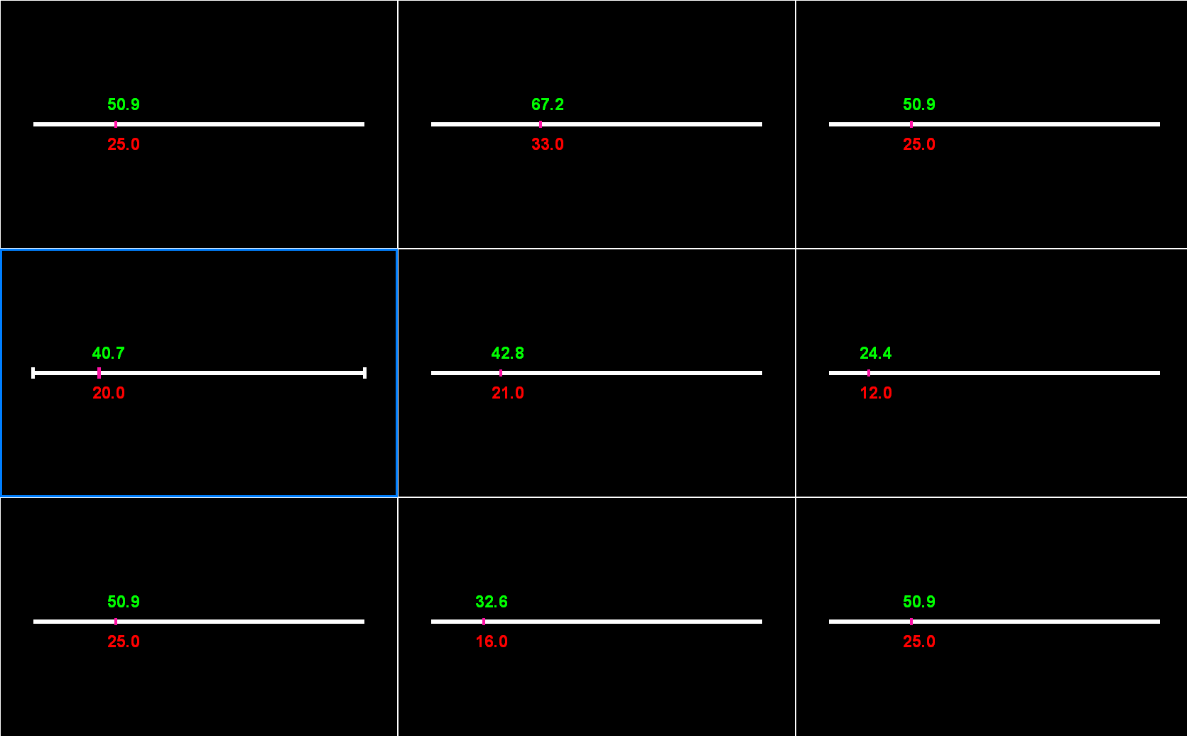
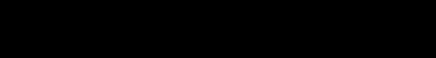
Instructions
In each room, you will first make one decision alone.
In subsequent rounds, you will be able to see what 8 randomly selected participants from a previous version of the study decided to give (alone) for the same exchange rate.
Each square on the screen represents one of the participants from the previous study and the pink bar on the slider indicates what they chose to give for that exchange rate.

Slide 9
Instructions
As you progress through the rounds, each square will continue to show decisions from the same past participant.
For example, decisions in the TOP LEFT square will always show decisions from the same past participant. Decisions in the TOP RIGHT square will always show decisions from another past participant.
But, these 8 randomly selected participants will be different in each room.
For example, the participant in the TOP LEFT square will be different from one room to the next.

Slide 10
Instructions
One square is allocated to your decision. This square will be highlighted in blue.
In this example screen it is the MIDDLE LEFT square.
Once you have decided how many tokens to give to the other participant, CLICK on the slider bar to make your selection.
Note: You will be told the exchange rate before each round.

Slide 11
Instruction summary
The main part of the study consists of 147 rounds, split into 7 rooms.
There is an exchange rate between your tokens and the tokens for the other participant. The average exchange rate will vary a lot between rooms. The exact exchange rate will vary a little between rounds within a room.
For each decision, you are paired with a different participant.
There is no time limit.
Before the main part of the study, you will make 7 decisions alone.

Slide 12
Instructions
At the end of the study your earnings from this part will be determined as follows:
We will randomly select one of your decisions.
The money that YOU and THE OTHER PARTICIPANT earn will be determined by YOUR choice.
1 token will be worth 5 cents.
You will also earn money from another random participant’s decision.

Slide 13
Instructions
Before you start, there will be a short quiz to make sure you understand the instructions.
Please make sure you understand the instructions before advancing to the quiz.

