Slide 1
Shadow Mapping with Today’s OpenGL Hardware
SIGGRAPH 2002 Course 31: Interactive Geometric Computations Using Graphics Hardware
Mark J. Kilgard
NVIDIA Corporation

Slide 2
Problems with Common
Shadow Techniques
Various limitations
  Projected planar shadows
      Well works only on flat surfaces
  Stenciled shadow volumes
      Determining the shadow volume is hard work
  Light maps
      Totally unsuited for dynamic shadows
  In general, hard to get everything shadowing everything

Slide 3
Another Technique:
Shadow Mapping
Image-space shadow determination
  Lance Williams published the basic idea in 1978
      By coincidence, same year Jim Blinn invented bump mapping (a great vintage year for graphics)
  Completely image-space algorithm
      Means no knowledge of scene’s geometry is required
      Must deal with aliasing artifacts
  Well known software rendering technique
      Pixar’s RenderMan uses the algorithm
      Basic shadowing technique for toy story, etc.

Slide 4
Shadow Mapping
References
Important SIGGRAPH papers
  Lance Williams, “Casting Curved Shadows on Curved Surfaces,” SIGGRAPH 78
  William Reeves, David Salesin, and Robert Cook (Pixar), “Rendering antialiased shadows with depth maps,” SIGGRAPH 87
  Mark Segal, et. al. (SGI), “Fast Shadows and Lighting Effects Using Texture Mapping,” SIGGRAPH 92

Slide 5
The Shadow Mapping
Concept (1)
Depth testing from the light’s
point-of-view
  Two pass algorithm
  First, render depth buffer from the light’s point-of-view
      The result is a “depth map” or “shadow map”
      Essentially a 2D function indicating the depth of the closest pixels to the light
  This depth map is used in the second pass

Slide 6
The Shadow Mapping
Concept (2)
Shadow determination with the
depth map
  Second, render scene from the eye’s point-of-view
  For each rasterized fragment
      Determine fragment’s XYZ position relative to the light
      This light position should be setup to match the frustum used to create the depth map
      Compare the depth value at light position XY in the depth map to fragment’s light position Z

Slide 7
The Shadow Mapping
Concept (3)
The Shadow Map Comparison
  Two values
      A = Z value from depth map at fragment’s light XY position
      B = Z value of fragment’s XYZ light position
  If B is greater than A, then there must be something closer to the light than the fragment
      Then the fragment is shadowed
  If A and B are approximately equal,
  the fragment is lit

Slide 8
Shadow Mapping with a Picture in 2D (1)
The A < B shadowed fragment case
depth map image plane
depth map Z = A
light
source
eye
position
eye view image plane,
a.k.a. the frame buffer
fragment’s
light Z = B

Slide 9
Shadow Mapping with a Picture in 2D (2)
The A ≅ B unshadowed fragment case
depth map image plane
depth map Z = A
light
source
eye
position
eye view image plane,
a.k.a. the frame buffer
fragment’s
light Z = B

Slide 10
Shadow Mapping
with a Picture in 2D (3)
Note image precision mismatch!
The depth map
could be at a
different resolution
from the framebuffer
This mismatch can
lead to artifacts

Slide 11
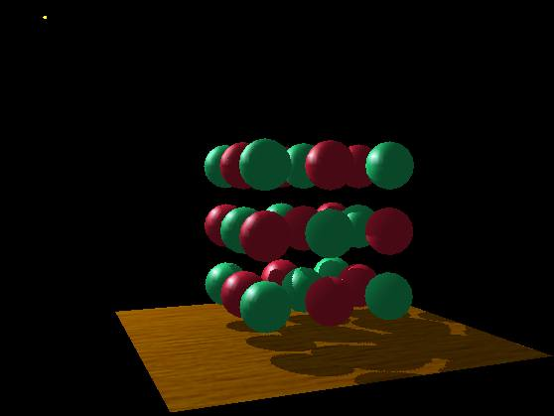
Visualizing the Shadow
Mapping Technique (1)
A fairly complex scene with shadows
the point
light source

Slide 12
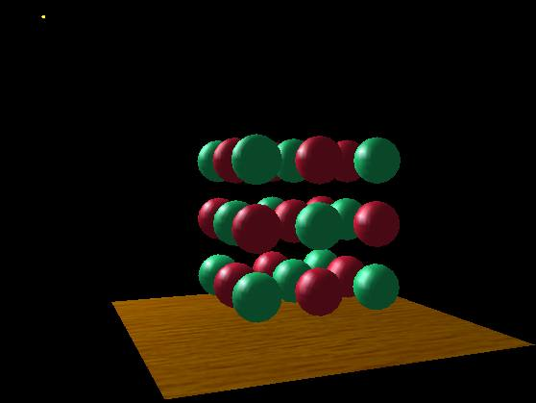
Visualizing the Shadow
Mapping Technique (2)
Compare with and without shadows
with shadows
without shadows

Slide 13
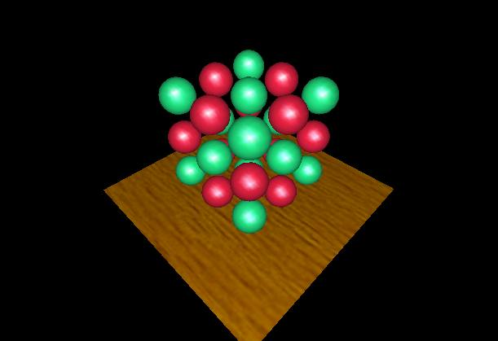
Visualizing the Shadow
Mapping Technique (3)
The scene from the light’s point-of-view
FYI: from the
eye’s point-of-view
again

Slide 14

Visualizing the Shadow
Mapping Technique (4)
The depth buffer from the light’s point-of-view
FYI: from the
light’s point-of-view
again

Slide 15
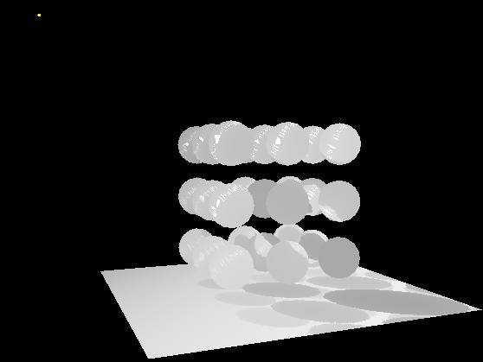
Visualizing the Shadow
Mapping Technique (5)
Projecting the depth map onto the eye’s view
FYI: depth map for
light’s point-of-view
again

Slide 16

Visualizing the Shadow
Mapping Technique (6)
Projecting light’s planar distance onto eye’s view

Slide 17
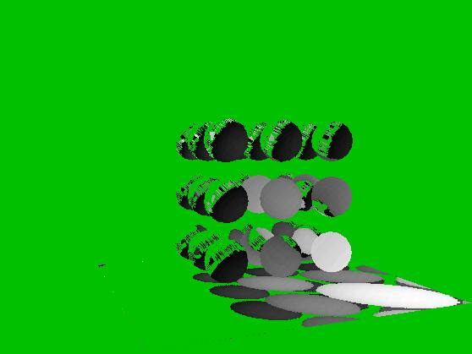
Visualizing the Shadow
Mapping Technique (6)
Comparing light distance to light depth map
Green is where the light planar distance and the light depth map are approximately equal
Non-green is where shadows should be

Slide 18
Visualizing the Shadow
Mapping Technique (7)
Complete scene with shadows
Notice how specular highlights never appear in shadows
Notice how curved surfaces cast shadows on each other

Slide 19
Construct
Light View Depth Map
Realizing the theory in practice
  Constructing the depth map
      Use existing hardware depth buffer
      Use glPolygonOffset to offset depth value back
      Read back the depth buffer contents
  Depth map can be copied to a 2D texture
      Unfortunately, depth values tend to require more precision than 8-bit typical for textures
      Depth precision typically 16-bit or 24-bit

Slide 20
Why glPolygonOffset When Making Shadow Maps?
Depth buffer contains “window space” depth values
  Post-perspective divide means non-linear distribution
  glPolygonOffset is guaranteed to be a window space offset
Doing a “clip space” glTranslatef is not sufficient
  Common shadow mapping implementation mistake
  Actual bias in depth buffer units will vary over the frustum
  No way to account for slope of polygon

Slide 21
Sampling a Polygon’s Depth at Pixel Centers (1)
Consider a polygon covering pixels in 2D
Polygon
X
Z
Pixel centers

Slide 22
Sampling a Polygon’s Depth at Pixel Centers (2)
Consider a 2nd grid for the polygon covering pixels in 2D
X
Z
X
Z

Slide 23
Sampling a Polygon’s Depth at Pixel Centers (3)
How Z changes with respect to X
X
Z
∂z/∂x

Slide 24
Why You Need glPolygonOffset’s Slope
Consider pixel center on another grid
  For example, the shadow map texture’s grid!
The re-sampled depth could be off by
+/-0.5 ∂z/∂x and +/-0.5 ∂z/∂y
The maximum absolute error would be
| 0.5 ∂z/∂x | + | 0.5 ∂z/∂y | ≈
max( | ∂z/∂x | , | ∂z/∂y | )
  This assumes the two grids have pixel footprint area ratios of 1.0
  Otherwise, we might need to scale by the ratio
Same as polygon offset’s “slope” bias

Slide 25
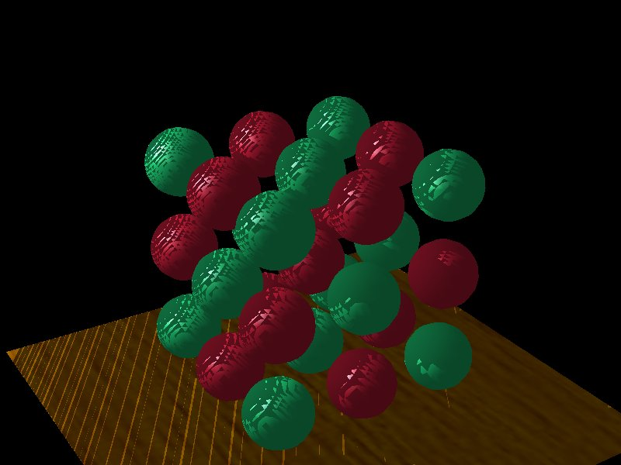
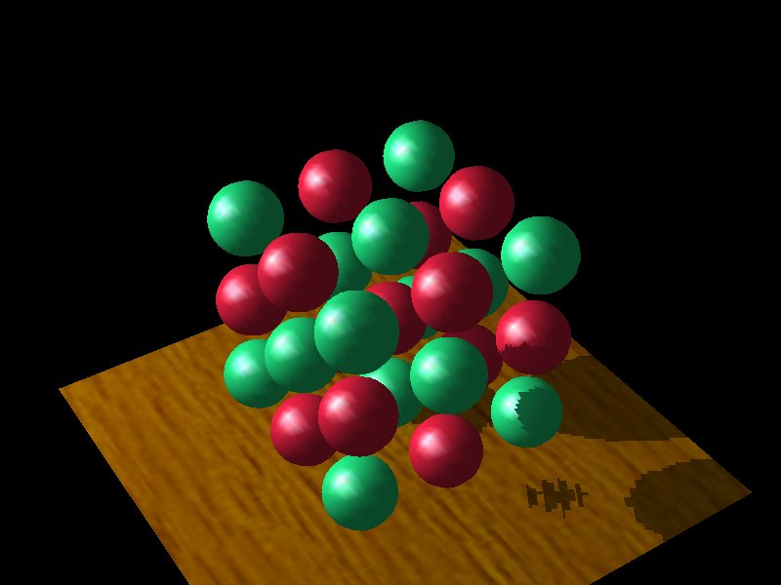
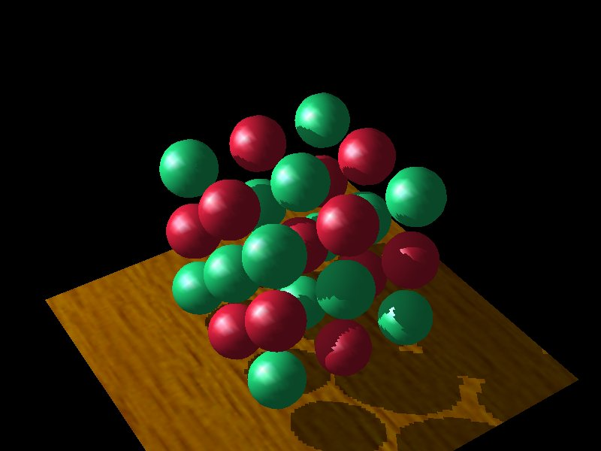
Depth Map Bias
Issues
How much polygon offset bias depends
Too little bias,
everything begins to
shadow
Too much bias, shadow
starts too far back
Just right

Slide 26
Selecting the
Depth Map Bias
Not that hard
  Usually the following works well
      glPolygonOffset(scale = 1.1, bias = 4.0)
  Usually better to error on the side of too
  much bias
      adjust to suit the shadow issues in your scene
  Depends somewhat on shadow map precision
      more precision requires less of a bias
  When the shadow map is being magnified, a larger scale is often required

Slide 27
Render Scene and
Access the Depth Texture
Realizing the theory in practice
  Fragment’s light position can be generated using eye-linear texture coordinate generation
      specifically OpenGL’s GL_EYE_LINEAR texgen
      generate homogenous (s, t, r, q) texture coordinates as light-space (x, y, z, w)
      T&L engines such as GeForce accelerate texgen!
      relies on projective texturing

Slide 28
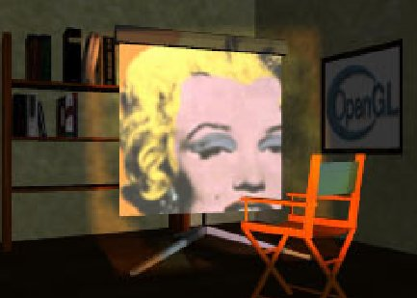
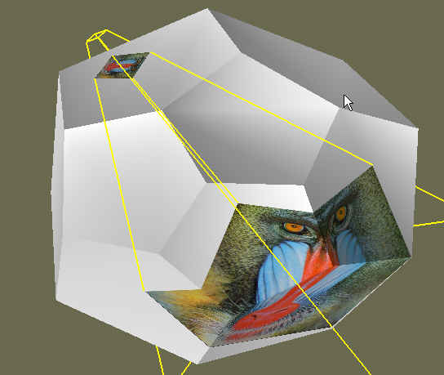
What is
Projective Texturing?
An intuition for projective texturing
  The slide projector analogy
Source: Wolfgang Heidrich [99]

Slide 29
About
Projective Texturing (1)
First, what is perspective-correct texturing?
  Normal 2D texture mapping uses (s, t) coordinates
  2D perspective-correct texture mapping
      Means (s, t) should be interpolated linearly in eye-space
      So compute per-vertex s/w, t/w, and 1/w
      Linearly interpolated these three parameters over polygon
      Per-fragment compute s’ = (s/w) / (1/w) and
      t’ = (t/w) / (1/w)
      Results in per-fragment perspective correct (s’, t’)

Slide 30
About
Projective Texturing (2)
So what is projective texturing?
  Now consider homogeneous texture coordinates
      (s, t, r, q) --> (s/q, t/q, r/q)
      Similar to homogeneous clip coordinates where
      (x, y, z, w) = (x/w, y/w, z/w)
  Idea is to have (s/q, t/q, r/q) be projected per-fragment
  This requires a per-fragment divider
      Yikes, dividers in hardware are fairly expensive

Slide 31
About
Projective Texturing (3)
Hardware designer’s view of texturing
  Perspective-correct texturing is a practical requirement
      Otherwise, textures “swim”
      Perspective-correct texturing already requires the hardware expense of a per-fragment divider
  Clever idea [Segal, et.al. ‘92]
      Interpolate q/w instead of simply 1/w
      So projective texturing is practically free if you already do perspective-correct texturing!

Slide 32
About
Projective Texturing (4)
Tricking hardware into doing projective textures
  By interpolating q/w, hardware computes per-fragment
      (s/w) / (q/w) = s/q
      (t/w) / (q/w) = t/q
  Net result: projective texturing
      OpenGL specifies projective texturing
      Only overhead is multiplying 1/w by q
      But this is per-vertex

Slide 33
Back to the Shadow
Mapping Discussion . . .
Assign light-space texture coordinates via texgen
  Transform eye-space (x, y, z, w) coordinates to the light’s view frustum (match how the light’s depth map is generated)
  Further transform these coordinates to map directly into the light view’s depth map
  Expressible as a projective transform
      Load this transform into the 4 eye linear plane equations for S, T, and Q coordinates
  (s/q, t/q) will map to light’s depth map texture

Slide 34
OpenGL’s Standard
Vertex Coordinate Transform
From object coordinates to window coordinates
object
coordinates
(x, y, z, w)
modelview
matrix
eye
coordinates
(x, y, z, w)
projection
matrix
clip
coordinates
(x, y, z, w)
divide
by w
normalized
device
coordinates
(x, y, z)
viewport &
depth range
window
coordinates
(x, y, z)

Slide 35
Eye Linear Texture
Coordinate Generation
Generating texture coordinates from eye-space
eye-linear
plane
equations
(s, t, r, q)
object
coordinates
modelview
matrix
eye
coordinates
projection
matrix
clip
coordinates
divide
by w
normalized
device
coordinates
viewport &
depth range
window
coordinates
(x, y, z)

Slide 36
Setting Up
Eye Linear Texgen
With OpenGL
  GLfloat Splane[4], Tplane[4], Rplane[4], Qplane[4];
  glTexGenfv(GL_S, GL_EYE_PLANE, Splane);
  glTexGenfv(GL_T, GL_EYE_PLANE, Tplane);
  glTexGenfv(GL_R, GL_EYE_PLANE, Rplane);
  glTexGenfv(GL_Q, GL_EYE_PLANE, Qplane);
  glEnable(GL_TEXTURE_GEN_S);
  glEnable(GL_TEXTURE_GEN_T);
  glEnable(GL_TEXTURE_GEN_R);
  glEnable(GL_TEXTURE_GEN_Q);
Each eye plane equation is transformed by current inverse modelview matrix
  Very handy thing for us; otherwise, a pitfall
  Note: texgen object planes are not transformed
  by the inverse modelview

Slide 37
Eye Linear
Texgen Transform
Plane equations form a projective transform
The 4 eye linear plane equations form a 4x4 matrix
  No need for the texture matrix!
s
t
r
q
x_{e}
y_{e}
z_{e}
w_{e}
Splane[0] Splane[1] Splane[2] Splane[3]
=
Tplane[0] Tplane[1] Tplane[2] Tplane[3]
Rplane[0] Rplane[1] Rplane[2] Rplane[3]
Qplane[0] Qplane[1] Qplane[2] Qplane[3]

Slide 38
Shadow Map Eye Linear
Texgen Transform
glTexGen automatically applies this when modelview matrix contains just the eye view transform
x_{e}
y_{e}
z_{e}
w_{e}
x_{o}
y_{o}
z_{o}
w_{o}
Eye
view
(look at)
matrix
=
Modeling
matrix
s
t
r
q
1/2
1/2
x_{e}
y_{e}
z_{e}
w_{e}
Light
frustum
(projection)
matrix
Light
view
(look at)
matrix
Inverse
eye
view
(look at)
matrix
=
1/2
1/2
1/2
1/2
1
Supply this combined transform to glTexGen

Slide 39
Shadow Map
Operation
Automatic depth map lookups
  After the eye linear texgen with the proper transform loaded
      (s/q, t/q) is the fragment’s corresponding location within the light’s depth texture
      r/q is the Z planar distance of the fragment relative to the light’s frustum, scaled and biased to [0,1] range
  Next compare texture value at (s/q, t/q) to
  value r/q
      If texture[s/q, t/q] ≅ r/q then not shadowed
      If texture[s/q, t/q] < r/q then shadowed

Slide 40
Shadow Mapping Hardware Support (1)
OpenGL now has official ARB-standard shadow mapping extensions
  Approved February 2002!
  ARB_depth_texture – adds depth texture formats
  ARB_shadow – adds “percentage closer” filtering for depth textures
  The two extensions are used together
Based on prior proven SGI proprietary extensions
  SGIX_depth_texture
  SGIX_shadow

Slide 41
Shadow Mapping Hardware Support (2)
SGIX_depth_texture & SGIX_shadow support
  SGI’s RealityEngine & InfiniteReality
  Brian Paul’s Mesa3D OpenGL work-alike
  NVIDIA’s GeForce3, GeForce4 Ti, and
  Quadro 4 XGL
      Software emulation for GeForce1 & 2
ARB extensions now implemented
  Latest NVIDIA drivers and Mesa 4.0

Slide 42
ARB_shadow Filtering Mode
Performs the shadow test as a texture filtering operation
  Looks up texel at (s/q, t/q) in a 2D texture
  Compares lookup value to r/q
  If texel is greater than or equal to r/q, then generate 1.0
  If texel is less than r/q, then generate 0.0
Modulate color with result
  Zero if fragment is shadowed or unchanged color if not

Slide 43
ARB_shadow API Usage
Request shadow map filtering with glTexParameter calls
  glTexParameteri(GL_TEXTURE_2D,
  GL_TEXTURE_COMPARE_MODE_ARB,
  GL_COMPARE_R_TO_TEXTURE);
  Default is GL_NONE for normal filtering
  Only applies to depth textures
Also select the comparison function
  Either GL_LEQUAL (default) or GL_GEQUAL
  glTexParameteri(GL_TEXTURE_2D, GL_TEXTURE_COMPARE_FUNC_ARB, GL_LEQUAL);

Slide 44
New Depth Texture
Internal Texture Formats
ARB_depth_texture supports textures containing depth values for shadow mapping
Three new internal formats
  GL_DEPTH_COMPONENT16_ARB
  GL_DEPTH_COMPONENT24_ARB
  GL_DEPTH_COMPONENT32_ARB
  (same as 24-bit on GeForce3/4/Xbox)
Use GL_DEPTH_COMPONENT for your external format
Work with glCopySubTexImage2D for fast copies from depth buffer to texture
  NVIDIA optimizes these copy texture paths

Slide 45
Depth Texture Details
Usage example:
glCopyTexImage2D(GL_TEXTURE_2D, level=0,
internalfmt=GL_DEPTH_COMPONENT24_ARB,
x=0, y=0, w=256, h=256, border=0);
Then use glCopySubTexImage2D for faster updates once texture internal format initially defined
Hint: use GL_DEPTH_COMPONENT for your texture internal format
  Leaving off the “n_ARB” precision specifier tells the driver to match your depth buffer’s precision
  Copy texture performance is optimum when depth buffer precision matches the depth texture precision

Slide 46
Depth Texture Copy Performance
The more depth values you copy, the slower the performance
  512x512 takes 4 times longer to copy than 256x256
  Tradeoff: better defined shadows require higher resolution shadow maps, but slows copying
16-bit depth values copy twice as fast as 24-bit depth values (which are contained in 32-bit words)
  Requesting a 16-bit depth buffer (even with 32-bit color buffer) and copying to a 16-bit depth texture is faster than using a 24-bit depth buffer
  Note that using 16-bit depth buffer usually
  requires giving up stencil

Slide 47
Hardware Shadow
Map Filtering
“Percentage Closer” filtering
  Normal texture filtering just averages color components
  Averaging depth values does NOT work
  Solution [Reeves, SIGGARPH 87]
      Hardware performs comparison for each sample
      Then, averages results of comparisons
  Provides anti-aliasing at shadow map edges
      Not soft shadows in the umbra/penumbra sense

Slide 48
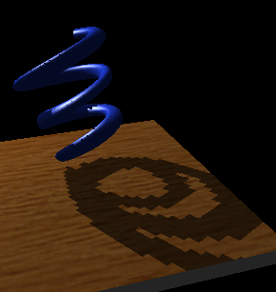
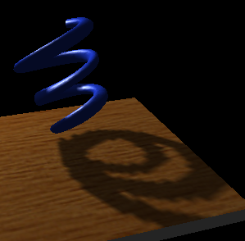
Hardware Shadow Map
Filtering Example
GL_NEAREST: blocky
GL_LINEAR: antialiased edges
Low shadow map resolution
used to heightens filtering artifacts

Slide 49
Depth Values are not Blend-able
Traditional filtering is inappropriate
What pixel covers in
shadow map texture
Pixel depth = 0.57
eye
position
Texel sample
depth = 0.25
Texel sample
depth = 0.63
0.25
0.25
Average(0.25, 0.25, 0.63, 0.63) = 0.44
0.57 > 0.44 so pixel is wrongly “in shadow”
Truth: nothing is at 0.44, just 0.25 and 0.57
0.63
0.63

Slide 50
Percentage Closer Filtering
Average comparison results, not depth values
What pixel covers in
shadow map texture
Pixel depth = 0.57
eye
position
Texel sample
depth = 0.25
Texel sample
depth = 0.63
Shadowed
Average(0.57>0.25, 0.57>0.25, 0.57<0.63, 0.57<0.63) = 50%
so pixel is reasonably 50% shadowed
(actually hardware does weighted average)
Unshadowed

Slide 51
Mipmapping for Depth Textures with Percentage Closer Filtering (1)
Mipmap filtering works
  Averages the results of comparisons form the one or two mipmap levels sampled
You cannot use gluBuild2DMipmaps to construct depth texture mipmaps
  Again, because you cannot blend depth values!
If you do want mipmaps, the best approach is re-rendering the scene at each required resolution
  Usually too expensive to be practical for all mipmap levels
  OpenGL 1.2 LOD clamping can help avoid rendering all the way down to the 1x1 level

Slide 52
Mipmapping for Depth Textures with Percentage Closer Filtering (2)
Mipmaps can make it harder to find an appropriate polygon offset scale & bias that guarantee avoidance of self-shadowing
You can get “8-tap” filtering by using (for example) two mipmap levels, 512x512 and 256x256, and setting your min and max LOD clamp to 0.5
  Uses OpenGL 1.2 LOD clamping

Slide 53
Advice for Shadowed
Illumination Model (1)
Typical illumination model with decal texture:
( ambient + diffuse ) * decal + specular
The shadow map supplies a shadowing term
Assume shadow map supplies a shadowing term, shade
  Percentage shadowed
  100% = fully visible, 0% = fully shadowed
Obvious updated illumination model for shadowing:
( ambient + shade * diffuse ) * decal + shade * specular
Problem is real-world lights don’t 100% block diffuse shading on shadowed surfaces
  Light scatters; real-world lights are not ideal points

Slide 54
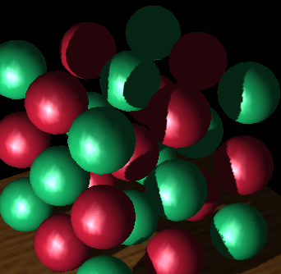
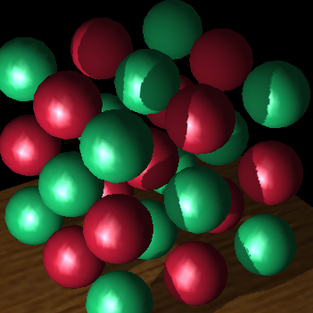
The Need for
Dimming Diffuse
No dimming; shadowed
regions have 0% diffuse
and 0% specular
With dimming; shadowed
regions have 40% diffuse
and 0% specular
No specular
in shadowed
regions in
both versions.
Front facing shadowed
regions appear unnaturally flat.
Still evidence of curvature
in shadowed regions.

Slide 55
Advice for Shadowed
Illumination Model (2)
Illumination model with dimming:
( ambient + diffuseShade * diffuse ) * decal + specular * shade
where diffuseShade is
diffuseShade = dimming + ( 1.0 – dimming ) * shade
Easy to implement with NV_register_combiners & OpenGL 1.2 “separate specular color” support
Separate specular keeps the diffuse & specular per-vertex lighting results distinct
NV_register_combiners can combine the primary
(diffuse) and secondary (specular) colors per-pixel
with the above math

Slide 56
Careful about Back Projecting Shadow Maps (1)
Just like standard projective textures, shadow maps can back-project
Pentagon would be incorrectly
lit by back-projection
if not specially handled
Spotlight casting shadows
(a hooded light source)
Back-projection of
spotlight’s cone of illumination
Spotlight’s of cone of illumination
where “true” shadows can form

Slide 57
Careful about Back Projecting Shadow Maps (2)
Techniques to eliminate back-projection:
  Modulate shadow map result with lighting result from a single per-vertex spotlight with the proper cut off (ensures is light “off” behind the spotlight)
  Use a small 1D texture where “s” is planar distance from the light (generated “s” with a planar texgen mode), then 1D texture is 0.0 for negative distances and 1.0 for positive distances.
  Use a clip plane positioned at the plane defined by the light position and spotlight direction
  Simply avoid drawing geometry “behind” the light when applying the shadow map (better than a clip plane)
  NV_texture_shader’s GL_PASS_THROUGH_NV mode

Slide 58
Other OpenGL Extensions for Improving Shadow Mapping
ARB_pbuffer – create off-screen rendering surfaces for rendering shadow map depth buffers
  Normally, you can construct shadow maps in your back buffer and copy them to texture
  But if the shadow map resolution is larger than your window resolution, use pbuffers.
NV_texture_rectangle – new 2D texture target that does not require texture width and height to be powers of two
  Limitations
      No mipmaps or mipmap filtering supported
      No wrap clamp mode
      Texture coords in [0..w]x[0..h] rather than [0..1]x[0..1] range.
  Quite acceptable for for shadow mapping

Slide 59
Combining Shadow Mapping with other Techniques
Good in combination with techniques
  Use stencil to tag pixels as inside or outside of shadow
  Use other rendering techniques in extra passes
      bump mapping
      texture decals, etc.
  Shadow mapping can be integrated into more complex multi-pass rendering algorithms
Shadow mapping algorithm does not require access to vertex-level data
  Easy to mix with vertex programs and such

Slide 60
An Alternative to Dedicated
Shadow Mapping Hardware
Consumer 3D hardware solution
  Proposed by Wolfgang Heidrich in his 1999 Ph.D. thesis
  Leverages today’s consumer multi-texture hardware
      1st texture unit accesses 2D depth map texture
      2nd texture unit accesses 1D Z range texture
  Extended texture environment subtracts 2nd texture from 1st
      shadowed if greater than zero, unshadowed otherwise
      use alpha test to discard shadowed fragments

Slide 61
Issues with Shadow
Mapping (1)
Not without its problems
  Prone to aliasing artifacts
      “percentage closer” filtering helps this
      normal color filtering does not work well
  Depth bias is not completely foolproof
  Requires extra shadow map rendering pass and texture loading
  Higher resolution shadow map reduces blockiness
      but also increase texture copying expense

Slide 62
Issues with Shadow
Mapping (2)
Not without its problems
  Shadows are limited to view frustums
      could use six view frustums for omni-directional light
  Objects outside or crossing the near and far clip planes are not properly accounted for by shadowing
      move near plane in as close as possible
      but too close throws away valuable depth map precision when using a projective frustum

Slide 63
Some Theory for Determining Shadow Map Resolution (1)
Requires knowing how pixels (samples) in the light’s view compare to the size of pixels (samples) in the eye’s view
  A re-sampling problem
When light source frustum is reasonably well aligned with the eye’s view frustum, the ratio of sample sizes is close to 1.0
  Great match if eye and light frustum’s are nearly identical
  But that implies very few viewable shadows
  Consider a miner’s lamp (i.e., a light attached to your helmet)
  The chief reason for such a lamp is you don’t see shadows from the lamp while wearing it

Slide 64
Some Theory for Determining Shadow Map Resolution (2)
So best case is miner’s lamp
Worst case is shadows from light shining at the viewer
  “that deer in the headlights” problem – definitely worst case for the deer
  Also known as the “dueling frusta” problem
  (frusta, plural of frustum)
Let’s attempt to visualize what’s happens…

Slide 65
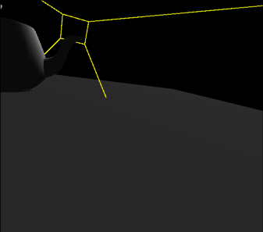
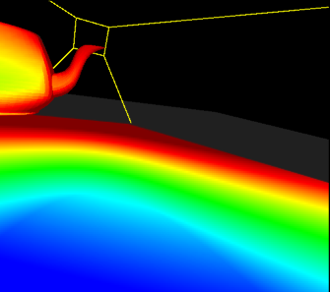
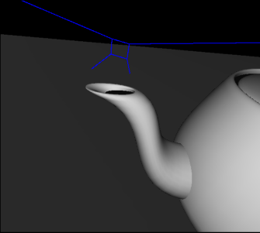
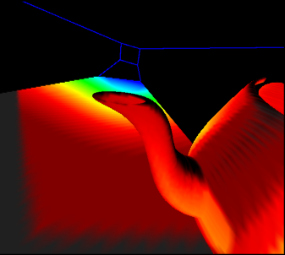
Four Images of Dueling Frusta Case
Eye’s View with projection
of color-coded
mipmap levels
from light:
Red = minification
Blue = magnification
Eye’s
View
Light’s
View
Light’s View with
re-projection
of above image
from the eye

Slide 66
Interpretation of the Images of the Dueling Frusta Case
Region that is smallest in the light’s view is a region that is very large in the eye’s view. This implies that it would require a very high-resolution shadow map to avoid obvious blocky shadow edge artifacts.
Eye’s
View
Light’s
View

Slide 67
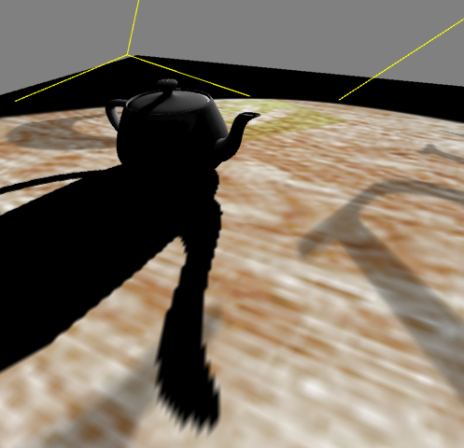
Dueling Frusta Blocky Shadow Edge Artifacts
Notice that shadow edge is well defined in the distance.
Light position out here pointing towards the viewer.
Blocky shadow edge artifacts.

Slide 68
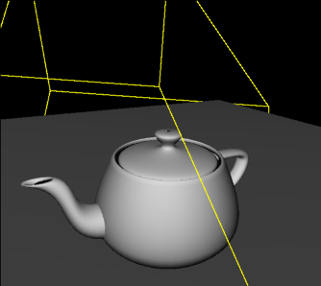
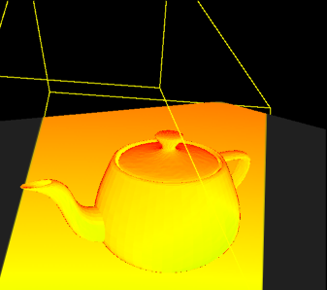
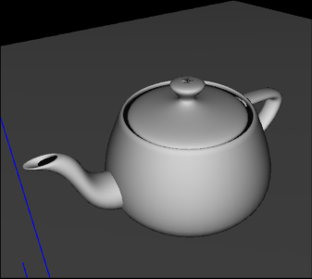
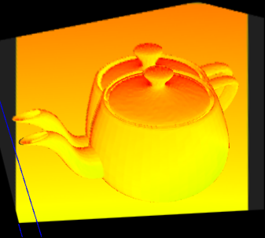
Good Situation, Close to the Miner’s Lamp
Note how the color-coded images share similar pattern and the coloration is uniform. Implies single depth map resolution would work well for most of the scene.
Eye’s
View
Very similar views
Light’s
View
Ghosting is where projection would be in shadow.

Slide 69
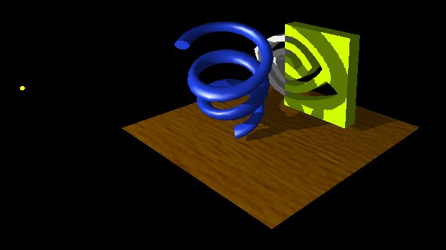
More Examples
Smooth surfaces with object self-shadowing
Note object self-shadowing

Slide 70
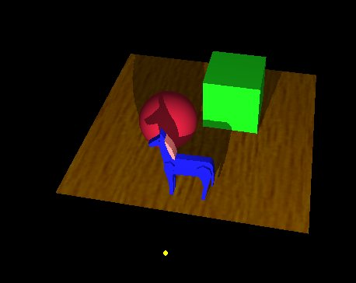
More Examples
Complex objects all shadow

Slide 71
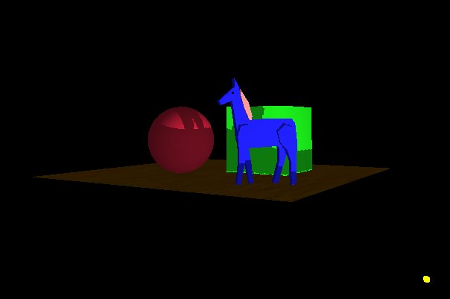
More Examples
Even the floor casts shadow
Note shadow leakage due to
infinitely thin floor
Could be fixed by giving floor thickness

Slide 72
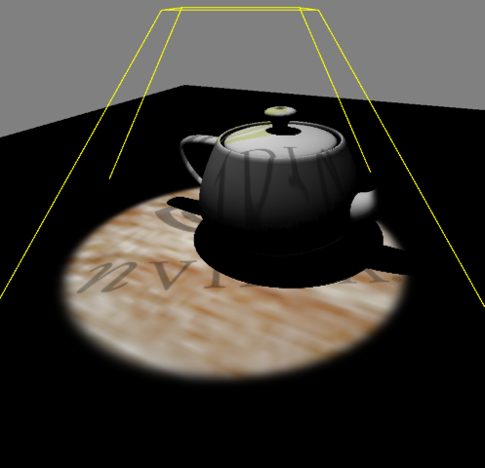

Combining Projective Texturing for Spotlights
Use a spotlight-style projected texture to give shadow maps a spotlight falloff

Slide 73
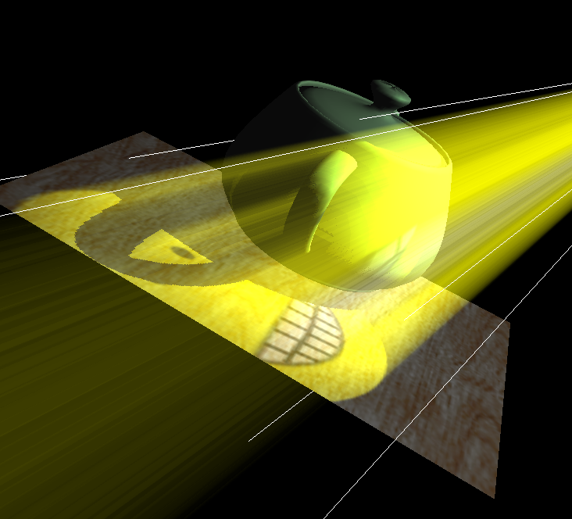
Combining Shadows with
Atmospherics
Shadows in a dusty room
Simulate atmospheric effects such
as suspended dust
1) Construct shadow map
Draw scene with shadow map
Modulate projected texture image
with projected shadow map
Blend back-to-front shadowed
slicing planes also modulated
by projected texture image
Credit: Cass Everitt

Slide 74
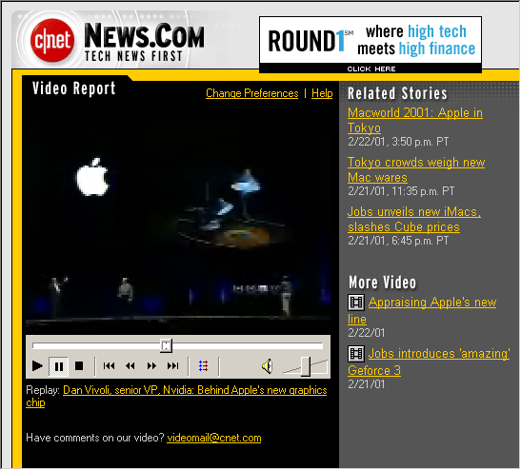
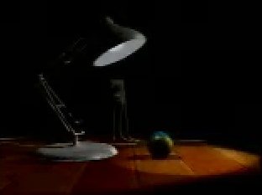
Luxo Jr. in Real-time using
Shadow Mapping
Steve Jobs at 2001 MacWorld Japan shows this on a Mac with OpenGL using hardware shadow mapping

Slide 75
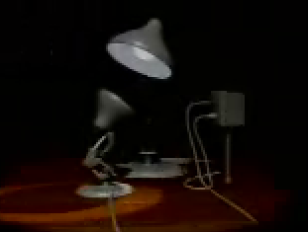
Luxo Jr. Demo Details
Luxo Jr. has two animated lights and one overhead light
  Three shadow maps dynamically generated per frame
Complex geometry (cords and lamp arms) all correctly shadowed
User controls the view,
shadowing just works
Real-time Luxo Jr.
is technical triumph
for OpenGL
Only available in OpenGL.
(Sorry, no demo. Images are from web cast video
of Apple’s MacWorld Japan 2001 announcement.)

Slide 76
Shadow Mapping
Source Code
Find it on the NVIDIA web site
  The source code
      “shadowcast” in OpenGL example code
      Works on TNT, GeForce, Quadro, & GeForce3 using best available shadow mapping support
      And vendors that support EXT_texture_env_combine
  NVIDIA OpenGL Extension Specifications
      documents EXT_texture_env_combine, NV_register_combiners, SGIX_depth_texture, & SGIX_shadow
  http://www.nvidia.com

Slide 77
Credits
The inspiration for these ideas
  Wolfgang Heidrich, Max-Planck Institute for Computer Science
      original dual-texture shadow mapping idea
      read his thesis High-quality Shading and Lighting for Hardware-accelerated Rendering
  Michael McCool, University of Waterloo
      suggested idea for multi-digit shadow comparisons

Slide 78
Conclusions
Shadow mapping offers real-time shadowing effects
  Independent of scene complexity
  Very compatible with multi-texturing
      Does not mandate multi-pass as stenciled shadow volumes do
  Ideal for shadows from spotlights
Consumer hardware shadow map support here today
  GeForce3, GeForce4 Ti, Xbox
  Dual-texturing technique supports legacy hardware
Same basic technique used by Pixar to generate shadows in their computer-generated movies

Slide 79
Appendix
Simulating Shadow Mapping For Legacy Graphics Hardware With Dual-Texturing

Slide 80
An Alternative to Dedicated
Shadow Mapping Hardware
Consumer 3D hardware solution
  Proposed by Wolfgang Heidrich in his 1999 ph.D. Thesis
  Leverages today’s consumer multi-texture hardware
      1st texture unit accesses 2D depth map texture
      2nd texture unit accesses 1D Z range texture
  Extended texture environment subtracts 2nd texture from 1st
      Shadowed if greater than zero, un-shadowed otherwise
      Use alpha test to discard shadowed fragments

Slide 81
Dual-texture Shadow
Mapping Approach
Constructing the depth map texture
  Render scene from the light view (can disable color writes)
      Use glPolygonOffset to bias depth values to avoid surfaces shadowing themselves in subsequent shadow test pass
      Perform bias during depth map construct instead of during shadow testing pass so bias will be in depth buffer space
  Read back depth buffer with glReadPixels as unsigned bytes
  Load same bytes into GL_INTENSITY8 texture via glTexImage2D

Slide 82
Dual-texture Shadow
Mapping Approach
Depth map texture issues
  Limited to 8-bit precision
      Not a lot of precision of depth
      More about this issue later
  Un-extended OpenGL provides no direct depth copy
      Cannot copy depth buffer to a texture directly
      Must glReadPixels, then glTexImage2D

Slide 83
Dual-texture Shadow
Mapping Approach
Two-pass shadow determination
  1st pass: draw everything shadowed
      Render scene with light disabled -or- dimmed substantially and specular light color of zero
      With depth testing enabled
  2nd pass: draw unshadowed, rejecting shadowed fragments
      Use glDepthFunc(GL_equal) to match 1st pass pixels
      Enable the light source, un-rejected pixels = unshadowed
      Use dual-texture as described in subsequent slides

Slide 84
Dual-texture Shadow
Mapping Approach
Dual-texture configuration
  1st texture unit
      Bind to 2D texture containing light’s depth map texture
      Intensity texture format (same value in RGB and alpha)
  2nd texture unit
      Bind to 1D texture containing a linear ramp from 0 to 1
      Maps S texture coordinate in [0, 1] range to intensity value in [0, 1] range

Slide 85
Dual-texture Shadow
Mapping Approach
Texgen Configuration
  1st texture unit using 2D texture
      Generate (s/q, t/q) to access depth map texture, ignore R
s
t
q
1/2
1/2
x_{e}
y_{e}
z_{e}
w_{e}
Light
frustum
(projection)
matrix
Light
view
(look at)
matrix
Inverse
eye
view
(look at)
matrix
=
1/2
1/2
1
Supply this combined transform to glTexGen
glTexGen
automatically
applies this

Slide 86
Dual-texture Shadow
Mapping Approach
Texgen Configuration
  2nd texture unit using 1D texture
      generate Z planar distance in S, flips what R is into S
1/2
1/2
x_{e}
y_{e}
z_{e}
w_{e}
s
q
0 0 1 0
Inverse
eye
view
(look at)
matrix
Light
frustum
(projection)
matrix
Light
view
(look at)
matrix
=
1/2
1/2
1/2
1/2
1
1
Supply this combined transform to glTexGen
glTexGen
automatically
applies this

Slide 87
Dual-texture Shadow
Mapping Approach
Texture environment (texenv) configuration
  Compute the difference between Tex0 from Tex1
      un-extended OpenGL texenv cannot subtract
  But can use standard EXT_texture_env_combine extension
      add signed operation
      compute fragment alpha as
      alpha(Tex0) + (1 - alpha(Tex1)) - 0.5
      result is greater or equal to 0.5 when Tex0 >= Tex1
      result is less than 0.5 when Tex0 < Tex1

Slide 88
Dual-texture Shadow
Mapping Approach
Texture environment (texenv) specifics
  glActiveTextureARB(GL_TEXTURE0_ARB);
  glTexEnvi(GL_TEXTURE_ENV, GL_TEXTURE_ENV_MODE, GL_COMBINE_EXT);
  glTexEnvi(GL_TEXTURE_ENV, GL_COMBINE_RGB_EXT, GL_REPLACE);
  glTexEnvi(GL_TEXTURE_ENV, GL_SOURCE0_RGB_EXT, GL_PRIMARY_COLOR_EXT);
  glTexEnvi(GL_TEXTURE_ENV, GL_OPERAND0_RGB_EXT, GL_SRC_COLOR);
  glTexEnvi(GL_TEXTURE_ENV, GL_COMBINE_ALPHA_EXT, GL_REPLACE);
  glTexEnvi(GL_TEXTURE_ENV, GL_SOURCE0_ALPHA_EXT, GL_TEXTURE);
  glTexEnvi(GL_TEXTURE_ENV, GL_OPERAND0_ALPHA_EXT, GL_SRC_ALPHA);
  glActiveTextureARB(GL_TEXTURE1_ARB);
  glTexEnvi(GL_TEXTURE_ENV, GL_TEXTURE_ENV_MODE, GL_COMBINE_EXT);
  glTexEnvi(GL_TEXTURE_ENV, GL_COMBINE_RGB_EXT, GL_REPLACE);
  glTexEnvi(GL_TEXTURE_ENV, GL_SOURCE0_RGB_EXT, GL_PREVIOUS_EXT);
  glTexEnvi(GL_TEXTURE_ENV, GL_OPERAND0_RGB_EXT, GL_SRC_COLOR);
  glTexEnvi(GL_TEXTURE_ENV, GL_COMBINE_ALPHA_EXT, GL_ADD_SIGNED_EXT);
  glTexEnvi(GL_TEXTURE_ENV, GL_SOURCE0_ALPHA_EXT, GL_PREVIOUS_EXT);
  glTexEnvi(GL_TEXTURE_ENV, GL_OPERAND0_ALPHA_EXT, GL_SRC_ALPHA);
  glTexEnvi(GL_TEXTURE_ENV, GL_SOURCE1_ALPHA_EXT, GL_TEXTURE);
  glTexEnvi(GL_TEXTURE_ENV, GL_OPERAND1_ALPHA_EXT, GL_ONE_MINUS_SRC_ALPHA);

Slide 89
Dual-texture Shadow
Mapping Approach
Post-texture environment result
  RGB is lit color (lighting is enabled during second pass)
  Alpha is the biased difference of Tex0 and Tex1
      Unshadowed fragments have alpha >= 0.5
      Shadowed fragments have an alpha of < 0.5

Slide 90
Dual-texture Shadow
Mapping Approach
Next, reject shadowed fragments
  Shadowed or unshadowed depends on alpha value
      Less than 0.5 means shadowed
  Use the alpha test to rejected shadowed fragments
      glEnable(GL_alpha_test)
      glAlphaFunc(GL_greater, 0.5)

Slide 91
Dual-texture Shadow
Mapping Approach
Careful about self-shadowing
  Fragments are likely to shadow themselves
      Surface casting shadow
      must not shadow itself
      “Near equality” common
      when comparing Tex0
      and Tex1

Slide 92
Dual-texture Shadow
Mapping Approach
Biasing values in depth map helps
  recall glPolygonOffset suggestion during the depth map construction pass
  this bias should be done during depth map construction
      biases in the texgen transform do not work
      problem is depth map has non-linear distribution due to projective frustum
  polygon offset scale keeps edge-on polygons from self-shadowing

Slide 93
Dual-texture Shadow
Mapping Precision
Is 8-bit precision enough?
  Yes, for some simple scenes
      When the objects are relatively distant from the light, but still relatively close together
  No, in general
      An 8-bit depth buffer is not enough depth discrimination
      And the precision is badly distributed because of perspective

Slide 94
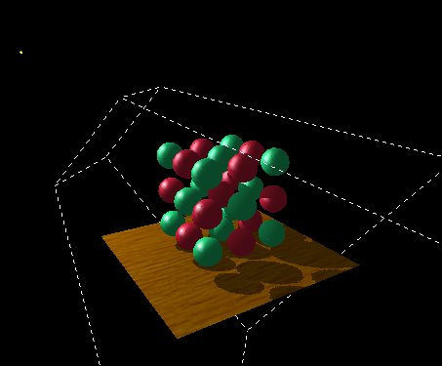
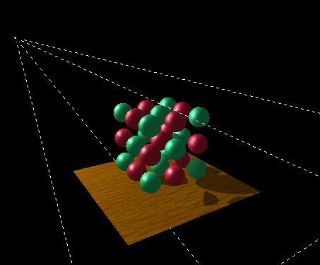
Dual-texture Shadow
Mapping Precision
Conserving your 8-bit depth map precision
Frustum confined to
objects of interest
Frustum expanded out considerably
breaks down the shadows

Slide 95
Improving Depth Map
Precision
Use linear depth precision [Wolfgang 99]
  During depth map construction
      Generate S texture coordinate as eye planar Z distance scaled to [0, 1] range
      Lookup S in identity 1D intensity texture
      Write texture result into color frame buffer
      Still using standard depth testing
      Read alpha (instead of depth) and load it in depth map texture
      Alpha will have linear depth distribution (better!)

Slide 96
Improving Depth Map
Precision
More hardware color component precision
  High-end workstations support more color precision
      SGI’s InfiniteReality, RealityEngine, and Octane workstations support 12-bit color component precision
  But no high precision color buffers in consumer 3D space
      Consumer 3D designs too tied to 32-bit memory word size of commodity RAM
      And overkill for most consumer applications anyway

Slide 97
Improving Depth Map
Precision
Use multi-digit comparison
  Fundamental shadow determination operation is a comparison
      Comparisons (unlike multiplies or other operations) are easy to extend to higher precision
  Think about comparing two 2-digit numbers: 54 and 82
      54 is less than 82 simply based on the first digit (5 < 8)
      Only when most-significant digits are equal do you need to look at subsequent digits

Slide 98
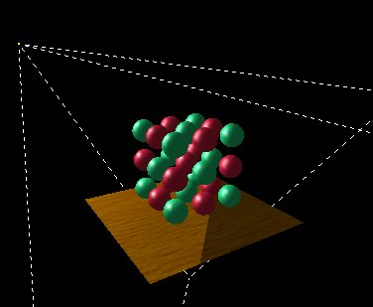
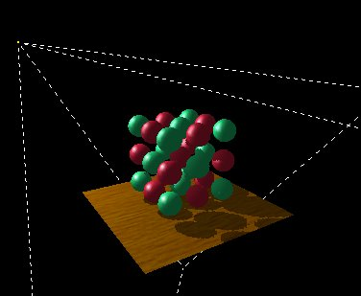
More Precision Allows
Larger Lights Frustums
Compare 8-bit to 16-bit precision for large frustum
8-bit: Large frustum breaks down the shadows, not enough precision
16-bit: Shadow looks just fine

Slide 99

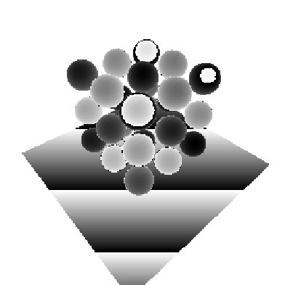
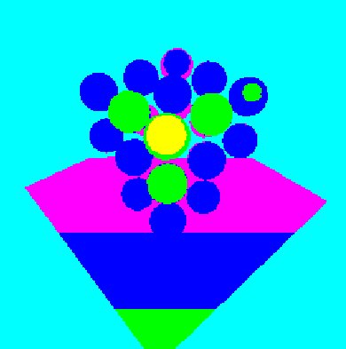
Why Extra Precision
Helps
Where the precision is for previous images
Most significant 8 bits of the depth map, pseudo-color inset magnifies variations
Least significant 8 bits of the depth map, here is where the information is!

Slide 100
GeForce1 & 2
Precision Extension
Application of multi-digit comparison idea
  Read back depth buffer as 16-bit unsigned short values
  Load these values into GL_LUMINANCE8_ALPHA8 texture
      Think of depth map as two 8-bit digits
  Two comparison passes
  Uses NV_register_combiners extension
      Signed math and mux’ing helps
      Enough operations to test equality and greater/less than

Slide 101
GeForce1 & 2
Precision Extension
Multi-digit comparison passes
  during clear, clear stencil buffer to 0
  1st pass draws unshadowed scene as before
  2nd pass draws unshadowed
      alpha = bigDigit(Tex0) < bigDigit(Tex1)
      alpha test with glAlphaFunc(GL_GREATER, 0.0)
      and write 1 into stencil buffer when alpha test passes
  needs 3rd pass for when
  bigDigit(Tex0) = bigDigit(Tex1)

Slide 102
GeForce/Quadro
Precision Extension
Third pass picks up the extra 8 bits of precision
  Use NV_register_combiners to assign alpha as follows
      if bigDigit(Tex1) > bigDigit(Tex0) then
      alpha = 0
      else
      alpha = littleDigit(Tex0) - littleDigit(Tex1)
  Use alpha test with glAlphaFunc(GL_GREATER, 0.0)
  Also reject fragment if the stencil value is 1
      Meaning the 2nd pass already updated the pixel

Slide 103
GeForce/Quadro
Precision Extension
Third pass needs 2 digits of light Z range
  2nd pass just requires a linear 1D texture
      Only needs 8 bits for bigDigit(Tex1)
  3rd pass
      Needs full 16-bit precision
      Needs both bigDigit(Tex1) and littleDigit(Tex1)
      Use a 2D texture, linear along both axis
      Setup texgen for S as before but texgen T = S*256

Slide 104
What’s The Point of This Appendix?
Existing hardware can often be coaxed to do surprising things
  Shadow mapping without explicit hardware support is one example
The NVIDIA shadowcast example
  Demonstrates shadow mapping for
      TNT and other EXT_texture_env_combine capable GPUs
      The just described technique for GeForce1 & 2 GPUs
      And finally ARB_shadow & ARB_depth_texture support for GeForce3, GeForce4 Ti, and Quadro4 XGL GPUs

