Slide 1

Introducing YOGA: Your OSINT Graphical Analyzer
Micah Hoffman
https://webbreacher.com
©2018 Spotlight Infosec LLC

Slide 2



Who am I?
OSINTer / Pentester
Mentor / Advisor
Author and Instructor SANS SEC487 OSINT Course
Open Source Fan

Slide 3
Let's talk about cooking

Slide 4
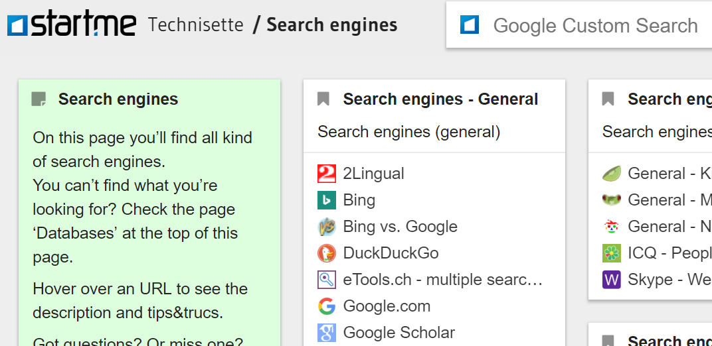
https://technisette.com

Slide 5
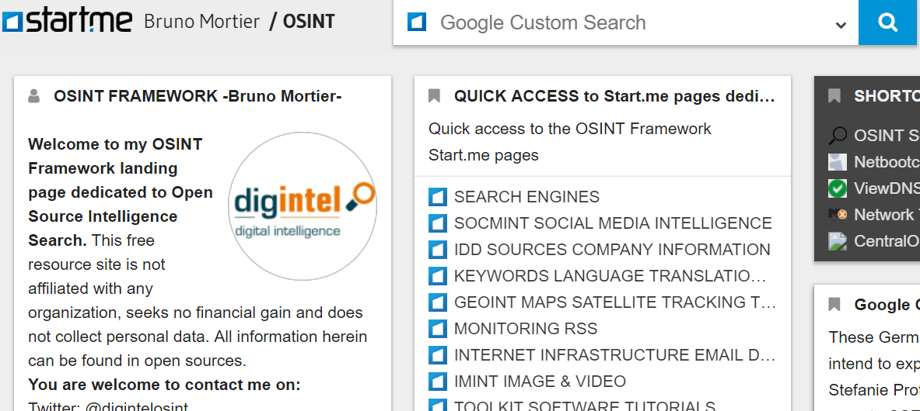
https://start.me/p/ZME8nR/osint

Slide 6
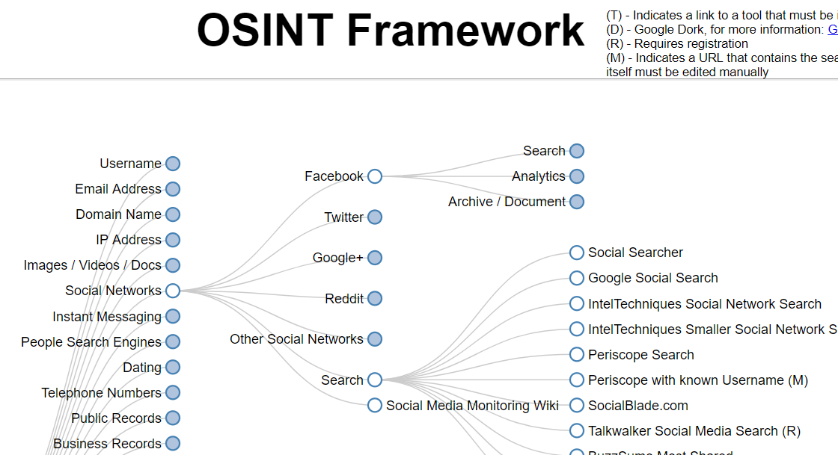
http://osintframework.com

Slide 7
OSINTers,
we have a problem

Slide 8
Unique URLs per Resource

Slide 9
6,187
OSINT Links

Slide 10
We need to understand how things fit together

Slide 11
If I have this data,
then I can do that

Slide 12
At a "recipe" level

Slide 13
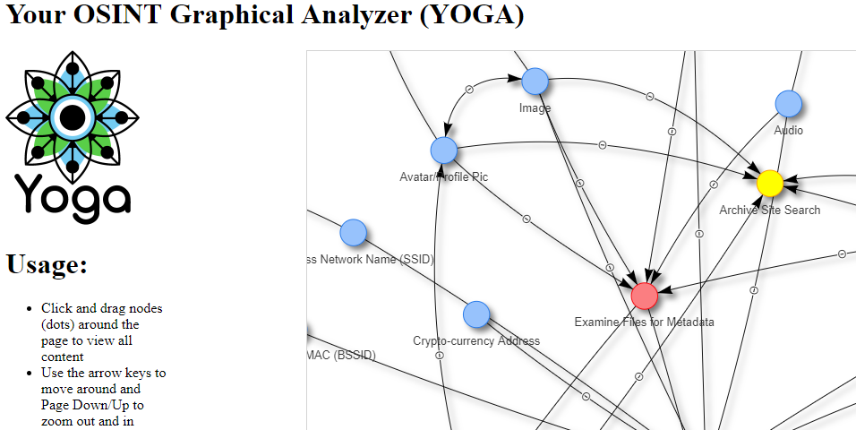
https://yoga.osint.ninja

Slide 14
Yoga Details
https://github.com/WebBreacher/yoga
Javascript (vis.js) and HTML
Self-contained (download and run)

Slide 15
Demo

Slide 16
Unique URLs per Resource

Slide 17
How many are duplicate resources?

Slide 18
Why are we making this OSINT Tower of Babel?

Slide 19
We need an
OSINT-wide taxonomy

Slide 20

https://orcs.osint.ninja
Being created now by the community
https://osint.team
Tagging of resources

Slide 21

https://www.sans.org/sec487
Micah Hoffman
@WebBreacher
https://webbreacher.com

